Slide 1
Crypto

Slide 2
Thanks!
Over 95% of these slides provided by Kuruwa

Slide 3
ToC
RSA
Public-Key Cryptography
Discrete Log
Elliptic Curve
Digital Signature
Lattices

Slide 4
RSA (cont.)

Slide 5


Continued Fraction

Slide 6
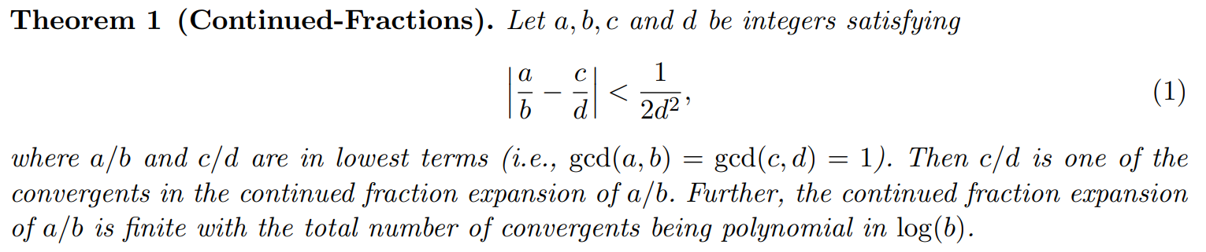



Wiener’s Attack
⇒
⇒

Slide 7
Wiener’s Attack (cont.)
k/d will be one of the convergents in the continued fraction expansion of e/n
φ = (ed - 1)/k = (p - 1)(q - 1) = n - p - q + 1
Solve x² - (n-φ+1)x + n = 0
x = p or q

Slide 8
Chosen Ciphertext Attack
Homomorphism
f(x ∘ y) = f(x) * f(y)
RSA encryption is homomorphic
e(m₁m₂) = (m₁m₂)^{e} = e(m₁)e(m₂)
Server can decrypt anything except c = m^{e}
d(2ec) = 2m
2⁻¹∙2m = m (mod n)

Slide 9
LSB Oracle
Server can decrypt any c, but only return the least significant bit of m

Slide 10
LSB Oracle
To get first bit (LSB), oracle
c → m
Inference
m = 2y₁ + x₀
r = 2y₁ + x₀ = x₀ (mod 2)
⇒ x₀ = r
y₁
x₀

Slide 11
LSB Oracle (cont.)
Oracle
(2⁻¹)^{e}c → 2⁻¹m
Inference
2⁻¹m = 2y₂ + x₁ + 2⁻¹x₀
r = [2y₂ + x₁ + 2⁻¹x₀]_{modn} (mod 2)
= [2⁻¹x₀]_{modn} + x₁ (mod 2)
⇒ x₁ = r - [2⁻¹x₀]_{modn} (mod 2)
y₂
x₁
x₀

Slide 12
LSB Oracle (cont.)
Oracle
(2⁻²)^{e}c → 2⁻²m
Inference
2⁻²m = 2y₃ + x₂ + 2⁻¹x₁ + 2⁻²x₀
r = [2y₃ + x₂ + 2⁻¹x₁ + 2⁻²x₀]_{modn} (mod 2)
= [2⁻²x₀ + 2⁻¹x₁]_{modn} + x₂ (mod 2)
⇒ x₂ = r - [2⁻²x₀ + 2⁻¹x₁]_{modn} (mod 2)
y₃
x₂
x₁
x₀

Slide 13
LSB Oracle (cont.)
Can recover one bit every oracle
Need log(n) oracles totally

Slide 14
Lab:
LSB Oracle

Slide 15
Discrete Logarithm

Slide 16
Diffie-Hellman Key Exchange
Set-up
Choose a large prime p
Choose an integer 𝛼 ∊ {2, 3, … , p – 2}
Publish p and 𝛼

Slide 17


Diffie-Hellman Key Exchange
Choose random private key K_{prA} = a ∊ {1, 2, … , p–1}
Choose random private key K_{prB} = b ∊ {1, 2, … , p–1}
A
Compute
A = αª (mod p)
Compute
B = α^{b} (mod p)
B
Caluculate common secret
K = Bª = (α^{b})ª (mod p)
Caluculate common secret
K = A^{b} = (αª)^{b} (mod p)
y
y = AES_{K}(x)
x = AES⁻¹_{K}(y)

Slide 18
The Discrete Logarithm Problem
Given a finite cyclic group ℤ_{p}* of order p – 1 and a primitive element 𝛼 ∊ ℤ_{p}* and another element 𝛽 ∊ ℤ_{p}*
The DLP is the problem of determining the integer 1 ≤ x ≤ p – 1 such that
𝛼^{x} = 𝛽 (mod p)

Slide 19
The ElGamal Encryption Scheme
Choose d = K_{prB} ∊ {2, … , p–2}
(p,𝛼,𝛽)
Compute 𝛽 = K_{pubB} = 𝛼^{d} (mod p)
Choose i = K_{prA} ∊ {2, … , p–2}
Compute the ephemeral key
K_{E} = K_{pubA} = 𝛼^{i} (mod p)
Compute the masking key
K_{M} = 𝛽^{i} (mod p)
Encrypt the message x
y = x × K_{M} (mod p)
Compute the masking key
K_{M} = K_{E}^{d} (mod p)
(K_{E}, y)
Decrypt the message
x = y × K_{M}⁻¹ (mod p)

Slide 20
Computational Aspects
Key generation
Generation of prime p
p has size of at least 1024 bits
Encryption
Requires two modular exponentiations and a modular multiplictation
All operands have the bitlength of log₂ p
Efficient execution requires methods such as the square-and-multiply algorithm
Decryption
Requires one modular exponentiation and one modular inversion
The inversion can be computed from the ephemeral key

Slide 21
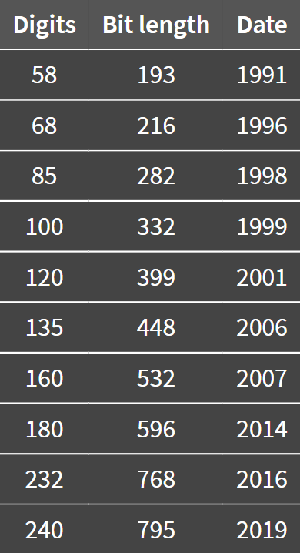
Security
Summary of records for computing discrete logarithms

Slide 22
Generalized DLP
Generalized DLP
Let (G, ∘) be an abelian group
Given g, h ∊ G, find x (if it exists) such that g^{x} = h
The difficulty of this problem depends on the group G
Very easy: polynomial time algorithm
e.g. (ℤ_{N} , +)
Rather hard: sub-exponential time algorithm
e.g. (𝔽_{p} , ×)
Very hard: exponential time algorithm
e.g. Elliptic Curve groups

Slide 23
Attacks against the DLP
Generic algorithms: Work in any cyclic group
Brute-Force Search
Baby-Step-Giant-Step
Pollard’s Rho Method
Pohlig-Hellman Method
Non-generic Algorithms: Work only in specific groups, in particular in ℤ_{p}*
The Index Calculus Method

Slide 24
Baby-Step-Giant-Step
Input: A cyclic group G of order n, having a generator α and an element β.
Output: A value x satisfying α^{x} = β
m ← Ceiling(√n)
For all j where 0 ≤ j < m:
Compute α^{j} and store the pair (j, α^{j}) in a table.
Compute α^{−m}.
γ ← β.
For all i where 0 ≤ i < m:
Check to see if γ is the second component (α^{j}) of any pair in the table.
If so, return im + j.
If not, γ ← γ • α^{−m}.

Slide 25

Pohlig-Hellman
If p-1 = p₁p₂…p_{k}
(g^{(p-1)/pi})^{pi} = 1
g_{i} = g^{(p-1)/pi} has order p_{i}
(g_{i})^{x} = (g_{i})^{(x mod pi)} = y^{(p-1)/pi} = h_{i}
Find x_{i} such that (g_{i})^{x} = h_{i}
e.x. BSGS
x_{i} = x (mod p_{i})
Use CRT to recover x
Runtime: O(∑_{i}(logn+√p_{i}))

Slide 26
Pohlig-Hellman
Input: A cyclic group G of order n = p₁...p_{r} , having a generator g and an element h.
Output: A value x satisfying g^{x} = h
For all i where 1 ≤ i ≤ r:
Compute g_{i} = g^{n/pi}
Compute h_{i} = h^{n/pi}
Use BSGS to compute x_{i} such that g_{i}^{xi} = h_{i}
Solve the CRT
Return x

Slide 27
Lab:
dlog

Slide 28
Elliptic Curve

Slide 29
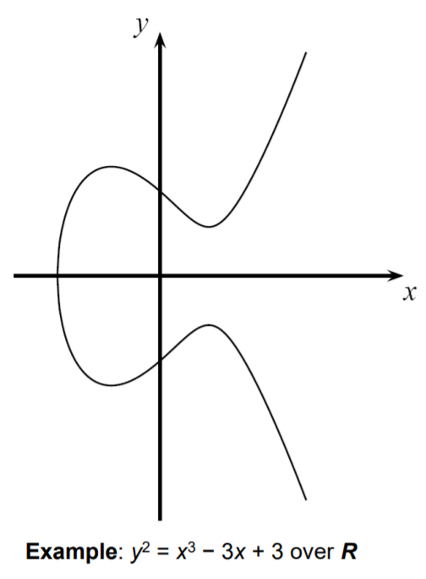
Elliptic Curve
Elliptic curves are polynomials that define points based on the (simplified) Weierstraß equation:
y² = x³ + ax + b
for parameters a, b that specify the exact shape of the curve
On the real numbers and with parameters a, b ∊ ℝ, an elliptic curve looks like this

Slide 30
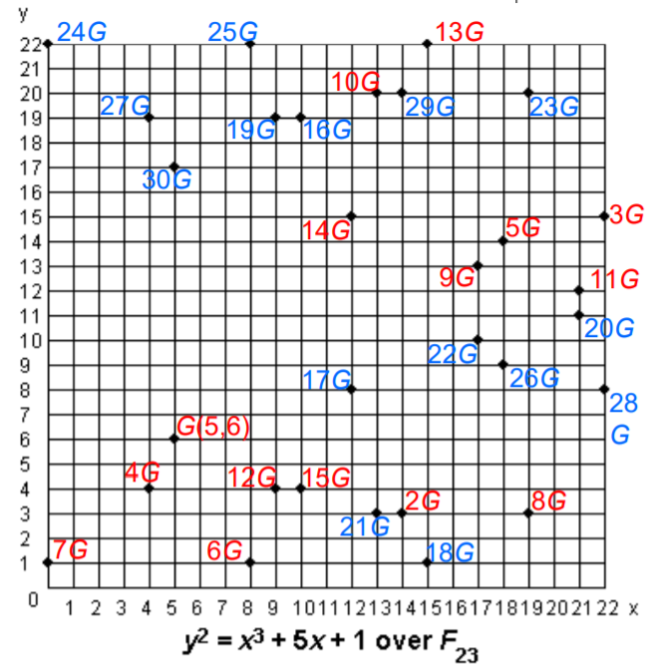
Elliptic Curve
In cryptography, we are interested in elliptic curves modulo a prime p
The elliptic curve over ℤ_{p}, p > 3 is the set of all pairs (x,y) ∊ ℤ_{p} which fulfill
y² = x³ + ax + b (mod p)
together with an imaginary point at infinity θ, where
4a³ + 27b² ≠ 0 (mod p)

Slide 31
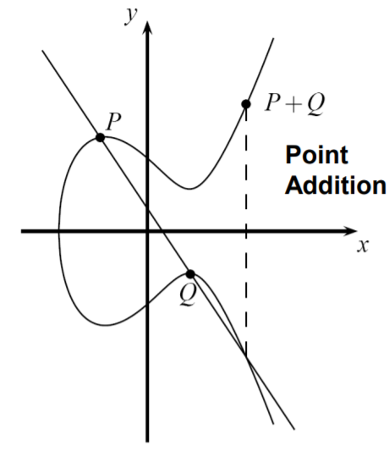
Elliptic Curve
Generating a group of points on elliptic curves based on point addition operation P + Q = R, i.e., (x_{P}, y_{P}) + (x_{Q}, y_{Q}) = (x_{R}, y_{R})
Geometric Interpretation of point addition operation
Draw straight line through P and Q; if P = Q use tangent line instead
Mirror third intersection point of drawn line with the elliptic curve along the x-axis

Slide 32

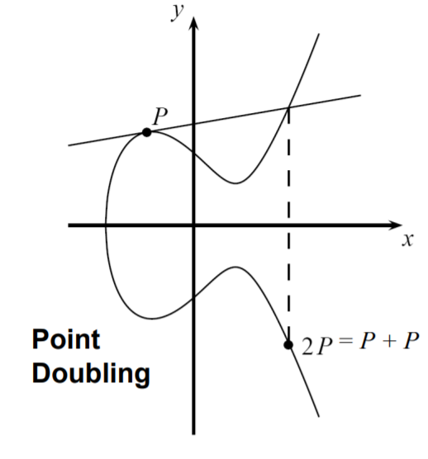


Elliptic Curve
Elliptic Curve Point Addition and Doubling Formulas

Slide 33

Elliptic Curve
Example: Compute 2G = G + G = (5, 6) + (5, 6) = (x₃ , y₃)
The points on an elliptic curve and the point at infinity θ form cyclic groups
This elliptic curve has order #E = |E| = 31

Slide 34
Number of Points on an Elliptic Curve
Hasse’s Theorem:
Given an elliptic curve modulo p, the number of points on the curve is denoted by #E and is bounded by
The number of points is “close to” the prime p
To generate a curve with about 2¹⁶⁰ points, a prime with a length of about 160 bits is required

Slide 35
ECDLP
Cryptosystems rely on the hardness of the Elliptic Curve Discrete Logarithm Problem (ECDLP)
Given an element P and another element Q on an elliptic curve E. The ECDLP problem is finding the integer d, where 1 ≤ d ≤ #E such that
P + P + … + P = dP = Q
Cryptosystems are based on the idea that d is large and kept secret, and attackers cannot compute it easily
If d is known, an efficient method to compute the point multiplication dP is required to create a reasonable cryptosystem

Slide 36
Double-and-Add Algorithm
Example 25P = (11001₂)P
θ + θ = θ #DOUBLE
θ + P = P #ADD
P + P = 2P
2P + P = 3P
3P + 3P = 6P
#NO ADD
6P + 6P = 12P
#NO ADD
12P + 12P = 24P
24P + P = 25P
def Double_and_Add(d, P):
bits = bin(d)[2:]
Q = θ
for bit in bits:
Q = Q + Q
if bit == “1”:
Q = Q + P
return Q

Slide 37
Elliptic Curve Diffie-Hellman Key Exchange
ECDH
Given a prime p, a suitable elliptic curve E and a point P = (x_{P}, y_{P})
Choose random private key K_{prA} = a ∊ {1, 2, … , #E-1}
Choose random private key K_{prB} = b ∊ {1, 2, … , #E–1}
A
Compute
A = aP = (x_{A}, y_{A})
Compute
B = bP = (x_{B}, y_{B})
B
Caluculate common secret
K = aB = a(bP)
Caluculate common secret
K = bA = b(aP)

Slide 38
Parameter Choice
E has smooth order
Pohlig-Hellman
E has order equal to p (anomalous curve)
Transform the DLP to (𝔽_{p}, +)
Smart’s Attack
E is singular
Node: Transform the DLP to (𝔽_{p}, ×)
Cusp: Transform the DLP to (𝔽_{p}, +)

Slide 39
Pohlig-Hellman (on ECC)
Input: Elliptic Curve E of order n = p₁...p_{r} , having a generator G and an element P.
Output: A value d satisfying dG = P
For all i where 1 ≤ i ≤ r:
Compute G_{i} = (n/p_{i})G
Compute P_{i} = (n/p_{i})P
Use BSGS to compute d_{i} such that d_{i}G_{i} = P_{i}
Solve the CRT
Return d

Slide 40
Singular Curve
A curve is singular if 4a³ + 27b² = 0 (mod p)
ECDLP becomes much easier if curve is singular
There are two types of singular point
Node: y² = (x - α)²(x - β)
Cusp: y² = x³

Slide 41

Node
y² = (x - α)²(x - β)
Define φ(P(x, y)) =
If we have homomorphism φ(P + Q) = φ(P) × φ(Q)
φ(dP) = φ(P)^{d}
Reduce to DLP on (𝔽_{p}, ×)

Slide 42

Proof (provided by utaha)
${let x}^{′}=x − α, we have y^{2}={x^{′}}^{2}\left(x^{′}+α−β\right)$
$let t=\frac{y}{x′}, we have t^{2}=\left(x^{′}+α−β\right), so x^{′}=t^{2}−\left(α−β\right), y=t^{3}−\left(α− β\right)t$
If P, Q, R is the intersections of $y^{2}={\left(x−α\right)}^{2}(x−β)$ and $y=px+q$
Then t of P, Q, R is the roots of $t^{3}−\left(α− β\right)t=p\left(t^{2}−\left(α−β\right)\right)+q$
Let the roots are u, v, w We have $uv+vw+wu=(α−β)$ which is equivalent to $\prod{(u+\sqrt{(α−β)}}=\prod{(u−\sqrt{(α−β)}}$

Slide 43
Cusp
y² = x³
Define φ(P(x, y)) = x/y
If we have homomorphism φ(P + Q) = φ(P) + φ(Q)
φ(dP) = dφ(P)
Reduce to DLP on (𝔽_{p}, +)
Q = dP ⇒ d = φ(Q)φ(P)⁻¹

Slide 44
Digital Signature

Slide 45
Motivation
Bob orders an RTX-3090 from Alice
After seeing the RTX-3090, Bob states that he has never ordered it
How can Alice prove towards a judge that Bob has ordered an RTX-3090? (And that she did not fabricate the order herself)
Symmetric cryptography fails because both Alice and Bob can be malicious
Can be achieved with public-key cryptography

Slide 46
Digital Siganture
k_{pub}
x
sign
k_{pr}
s
x, s
(x, s)
k_{pub}
verify
true/false

Slide 47
Main Idea
For a given message x, a digital signature is appended to the message (just like a conventional signature)
Only the person with the private key should be able to generate the signature
The signature must change for every document
The signature is realized as a function with the message x and the private key as input
The public key and the message x are the inputs to the verification function

Slide 48
Objectives
Integrity
Ensures that a message has not been modified in transit.
Message Authentication
Ensures that the sender of a message is authentic. An alternative term is data origin authentication.
Non-repudiation
Ensures that the sender of a message can not deny the creation of the message. (e.x. order of a GPU)

Slide 49
RSA Signature
To generate the signature
Sign (encrypt) the message x with the private key
s = sig_{Kpr}(x) = x^{d} mod n
Append s to message x
To verify the signature
Verify (decrypt) the signature with the public key
x' = ver_{Kpub}(s) = s^{e} mod n
If x = x', the signature is valid

Slide 50
RSA Signature Protocol
k_{pub} = (n, e)
k_{pr} = d
k_{pub}
(x, s)
s = x^{d} mod n
x’ = s^{e} mod n
if x’ = x ⟶ valid
if x’ ≠ x ⟶ invalid

Slide 51

Existential Forgery
k_{pub} = (n, e)
k_{pr} = d
(n, e)
(n, e)
Choose signature
s ∊ ℤ_{n}
Compute message
x = s^{e} mod n
(x, s)
Verification:
x’ = s^{e} = x mod n
⟶ Signature is valid

Slide 52
Existential Forgery
An attacker can generate valid message-signature pairs (x, s)
But an attack can only choose the signature s and NOT the message x
Formatting the message x according to a padding scheme can be used to make sure that an attacker cannot generate valid (x, s) pairs

Slide 53
Digital Signature Algorithm (DSA)
Key generation of DSA:
Generate a prime p with 2¹⁰²³ < p < 2¹⁰²⁴
Find a prime divisor q of p – 1 with 2¹⁵⁹ < q < 2¹⁶⁰
Find an integer α with ord(α) = q
α = g^{(p-1)/q} ≠ 1 mod p
Choose a random integer d with 0 < d < q
Compute β = α^{d} mod p
The keys are: k_{pub} = (p, q, α, β) and k_{pr} = (d)

Slide 54
Digital Signature Algorithm (DSA)
Signature (message: H < q)
Choose an integer k_{E} as a random ephemeral key with 0 < k_{E} < q
Compute r = (α^{kE} mod p) mod q
Compute s = k_{E}^{–1}(H + d × r) mod q
In practice, H is hash of the message
Verification
Compute auxiliary value u₁ = s^{–1} × H mod q
Compute auxiliary value u₂ = s^{–1} × r mod q
Compute v = (α^{u1} × β^{u2} mod p) mod q
if v = r ⟶ siganature is valid
if v ≠ r ⟶ siganature is invalid

Slide 55
Correctness
s = (H + d × r)k_{E}^{–1} mod q
⇔ k_{E} = s⁻¹ × H + d(s⁻¹ × r) mod q
⇔ k_{E} = u₁ + du₂ mod q
⇔ α^{kE} mod p = α^{u1+du2} mod p
⇔ (α^{kE} mod p) mod q = (α^{u1} × β^{u2} mod p) mod q
⇔ r = v

Slide 56
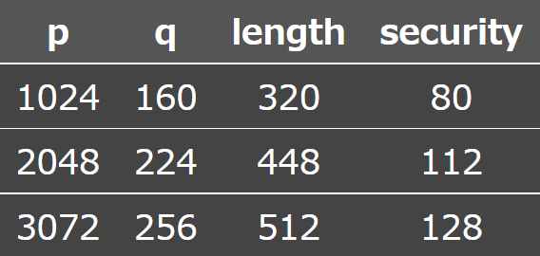
Security
DSA can achieve same security level as RSA scheme with less siganture length

Slide 57
ECDSA
Key generation of ECDSA:
Find a generator G on an elliptic curve E with prime order n
Choose a random integer d with 0 < d < n
Compute P = dG
The keys are: k_{pub} = (E, G, n, P) and k_{pr} = (d)
Shorter private key and higher speed than DSA

Slide 58
ECDSA
Signature (message: H < n)
Choose an integer k_{E} as a random ephemeral key with 0 < k_{E} < n
Calculate the curve point (x₁, y₁) = k_{E} × G
Compute r = x₁ mod n
Compute s = k_{E}^{–1}(H + d × r) mod n
Verification
Compute auxiliary value u₁ = s^{–1} × H mod n
Compute auxiliary value u₂ = s^{–1} × r mod n
Compute (x₁, y₁) = u₁G + u₂P
if x₁ = r mod n ⟶ siganature is valid
if x₁ ≠ r mod n ⟶ siganature is invalid

Slide 59
Sensitivity
The entropy of the random value k_{E} are critical
Example: sign two different messages, k₁ = k₂
k₁ = s₁⁻¹H₁ + d(s₁⁻¹r₁) mod q
k₂ = s₂⁻¹H₂ + d(s₂⁻¹r₂) mod q
d = (s₁⁻¹H₁ - s₂⁻¹H₂) / (s₂⁻¹r₂ - s₁⁻¹r₁)

Slide 60
Hash - Motivation
Naive signing of long messages generates a signature of same length.
Solution
Instead of signing the whole message, sign only a digest (hash)
x₁
x₂
x₃
...
x_{n}
k_{pr}
sig
k_{pr}
sig
k_{pr}
sig
k_{pr}
sig
s₁
s₂
s₃
...
s_{n}

Slide 61
Digital Signature with Hash Function
x₁
x₂
x₃
...
x_{n}
h
k_{pr}
sig
s

Slide 62
Lattices

Slide 63
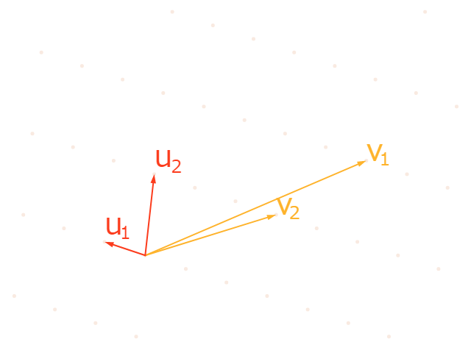
Lattices
Let v₁, v₂, …, v_{n} ∈ ℝ^{m} be a set of linearly independent vectors
The lattice L generated by v₁, v₂, … , v_{n} is the set of linear combinations with coefficients in ℤ,
L = {a₁v₁ + a₂v₂ + … + a_{n}v_{n} | a₁, a₂, … , a_{n} ∈ ℤ}

Slide 64
Shortest Vector Problem (SVP)
The basis of lattice is not unique
Given a basis of L, find the shortest vector in L
SVP is NP-hard

Slide 65
A Congruential PKC
A toy model of a real public key cryptosystem is described
It turns out to have an unexpected connection with lattices of dimension 2
An example of how lattices may appear in cryptanalysis even when the underlying hard problem appears to have nothing to do with lattices

Slide 66


Key Creation
Alice chooses a large positive integer q as public parameter, and two other secret positive integers f and g, satisfying
f < , < g < , and gcd(f , qg) = 1
Then Alice compute h ≡ f⁻¹g (mod q), with 0 < h < q
Public key: (q, h)
Secret key: (f, g)

Slide 67
Encryption
To send a message m, Bob chooses a random integer r, with
0 < m <
0 < r <
The ciphertext is e ≡ rh + m (mod q), with 0 < e < q

Slide 68
Decryption
Alice decrypts ciphertext e by computing
a ≡ fe (mod q)
b ≡ f⁻¹a (mod g)
Then b is the plaintext m

Slide 69

Correctness
a ≡ fe ≡ f(rh + m) ≡ frf⁻¹g + fm ≡ rg + fm (mod q)
The size restrictions on f, g, r, m imply that
So Alice can get the exact value a = rg + fm
Then Alice computes
b ≡ f⁻¹a ≡ f⁻¹(rg + fm) ≡ f⁻¹fm ≡ m (mod g)
Since m < < g, it follows that b = m

Slide 70
Overall Process
Choose a modulus q
Choose f, g with restrictions
Compute h ≡ f⁻¹g (mod q)
(q, h)
Choose m <
Choose r <
Compute e ≡ rh + m(modq)
e
Compute a ≡ fe (mod q)
Compute b ≡ f⁻¹a (mod g)
Then b is the plaintext m

Slide 71
Example
Alice chooses
q = 122430513841
f = 231231 ≈ 0.66√q
g = 195698 ≈ 0.56√q
Alice computes
f⁻¹ ≡ 49194372303 (mod q)
h ≡ f⁻¹g ≡ 39245579300 (mod q)
Public key: (q, h) = (122430513841, 39245579300)
Bob chooses
message m = 123456
random value r = 101010
Bob computes ciphertext e ≡ rh + m ≡ 18357558717 (mod q)
To decrypt, Alice computes
a ≡ fe ≡ 48314309316 (mod q)
b ≡ f⁻¹a ≡ 193495 × 48314309316 ≡ 123456 ≡ m (mod g)

Slide 72
Cryptanalysis
Brute-force search: O(q) operations
If attacker can find any pair of positive integers F and G s.t.
Fh ≡ G (mod q)
F, G = O(√q)
then (F, G) is likely to serve as a decryption key
Rewriting Fh = G + qR, we reformulate Eve’s task as that of finding a pair of comparatively small integers (F, G) with
unknown integers
known vectors
unknown small vector

Slide 73
Cryptanalysis (cont.)
Thus attacker knows two vectors v₁ = (1, h) and v₂ = (0, q), both of length O(q)
Attacker wants to find a linear combination w = a₁v₁ + a₂v₂ such that w has length O(√q)
This corresponds to find a short nonzero vector in the set
L = {a₁v₁ + a₂v₂ : a₁, a₂ ∈ ℤ}
This set L is an example of a two-dimensional lattice
Unfortunately for Bob and Alice, there is an extremely rapid method for finding short vectors in two-dimensional lattices

Slide 74
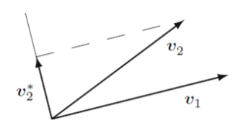


Gaussian Lattice Reduction
Suppose that L ⊂ ℝ² is a 2-dimensional lattice with basis vectors v₁, v₂
May assume ⃦ v₁ ⃦ < ⃦ v₂ ⃦
If allowed to subtract any multiple of v₁, then replace v₂ with the vector
v₂* is orthogonal to v₁
But v₂* is unlikely to be in L
So the best is to replace v₂ with the vector v₂ − mv₁ with

Slide 75
Gaussian Lattice Reduction (cont.)
If ⃦ v₁ ⃦ < ⃦ v₂ ⃦ , then stop
Otherwise, swap v₁ and v₂ and repeat the process
When the algorithm terminates
The vector v₁ is a shortest nonzero vector in L
The algorithm solves SVP
Loop
If ⃦ v₂ ⃦ < ⃦ v₁ ⃦ , swap v₁ and v₂.
Compute m = ⌈ v₁ · v₂ / ⃦ v₁ ⃦ ² ⌋.
If m = 0, return the basis vectors v₁ and v₂.
Replace v₂ with v₂ − mv₁.
Continue Loop

Slide 76
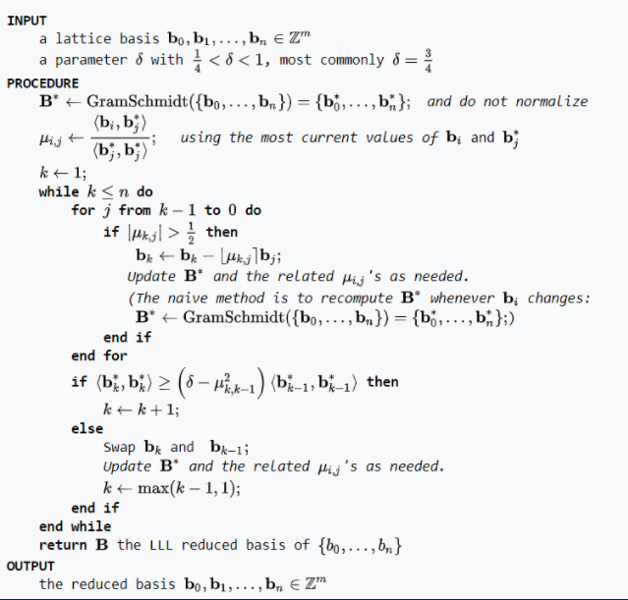
Lenstra–Lenstra–Lovász Algorithm (LLL)
Given a lattice L, LLL solves approximated SVP in polynomial time
The shortest vector v it found satisfies
⃦ v ⃦ ≤ 2^{(n-1)/4}|det L|^{1/n}
On average, LLL achieves
⃦ v ⃦ ≤ 1.02^{n}|det L|^{1/n}

Slide 77
Coppersmith’s Method
Input: f(x) ∈ ℤ[x], N ∈ ℤ
Output: r s.t. f(r) ≡ 0 mod N
Intermediate output: Q(x) such that Q(r) = 0 over ℤ
Q(x) = s(x)f(x) + t(x)N
Q(r) ≡ 0 mod N by construction
If |r| ≤ R, then we can bound
|Q(r)| = |Q₃r³ + Q₂r² + Q₁r + Q₀|
≤ |Q₃|R³ + |Q₂|R² + |Q₁|R + |Q₀|
If |Q(r)| < N and Q(r) ≡ 0 mod N, then Q(r) = 0
We want a Q in our lattice with short coefficient vector!

Slide 78
Coppersmith’s Method
Construct a matrix of coefficient vectors of elements of <f(x), N>
Run LLL algorithm on this matrix
Construct a polynomial Q from the shortest vector output
Factor Q to find its roots
Theorem (Coppersmith)
Given a polynomial f of degree d and N, we can efficiently find all roots r satisfying f(r) ≡ 0 mod N when |r| < N^{1/d}.

Slide 79
RSA - Stereotyped Messages
Known most of the message, ex: padding
m = a + x₀, x₀ ≤ R
c = m³ = (a + x₀)³ mod n
x₀ is a small root of f(x) = (a + x)³ - c (mod n)
Let the biggest degree of Q be 3
Q(x) = c₃(x³ + 3ax² + 3a²x + (a³ - c)) + c₂Nx² + c₁Nx + c₀N
Q(x₀) ≤ c₃(R³ + 3aR² + 3a²R + (a³ - c)) + c₂NR² + c₁NR + c₀N

Slide 80

RSA - Stereotyped Messages (cont.)
Construct lattice basis
dim L = 4, det L = N³R⁶
Ignoring approximation factor, we can solve when
|Q(x₀)| ≤ |v| ≤ |det L|^{1/4} < N
⇒ (N³R⁶)^{1/4} < N
⇒ R < N^{1/6}

Slide 81

Achieving the Coppersmith Bound
Generate lattice from subset of <f(x), N>^{k}
Allow higher degree polynomials
(R²¹N⁹)^{1/7} < N² ⇒ R < N^{5/21}

Slide 82
RSA - Known High Bits of p
Known large portion of MSBs of one factor
n = pq, p = a + x₀, known a, x₀ ≤ R
x₀ is a small roots of f(x) = a + x (mod p)
Construct Q(x) = 0 (mod p)
Q(x) = c₁x(a + x) + c₂(a + x) + N
Q(x₀) ≤ c₁(R² + aR) + c₂(R + a) + N
Theorem (Howgrave-Graham)
Given degree d polynomial f, integer N, we can find roots r modulo divisors B of N satisfying f(r) ≡ 0 mod B for |B| > N^{β} , when |r| < N^{β2/d}

Slide 83

RSA - Known High Bits of p
Construct lattice basis
dim L = 3, det L = NR³
Can find the root when
(NR³)^{1/3} < p = N^{1/2}
⇒ R < N^{1/6}

Slide 84
RSA - Partial Key Recovery
Can factor given 1/2 bits of p [Coppersmith 96]
Can factor given 1/4 bits of d [Boneh Durfee Frankel 98]
Can factor given 1/2 bits of d mod (p−1) [Blömer May 03]

Slide 85
(EC)DSA - Known High Bits of k
Two singature (r₁, s₁), (r₂, s₂), both use small nonces k
s₁ ≡ k₁⁻¹(h₁ + dr₁) mod n
s₂ ≡ k₂⁻¹(h₂ + dr₂) mod n
Eliminate the variable d
k₁ − s₁⁻¹s₂r₁r₂⁻¹k₂ + s₁⁻¹r₁h₂r₂⁻¹ − s₁⁻¹h₁ ≡ 0 mod n
Let t = -s₁⁻¹s₂r₁r₂⁻¹, u = s₁⁻¹r₁h₂r₂⁻¹ − s₁⁻¹h₁
k₁ + tk₂ + u ≡ 0 mod n
We wish to solve k₁ and k₂, both small.
Let |k₁|, |k₂| < K

Slide 86
Lab: Signature

Slide 87

(EC)DSA - Known High Bits of k
Construct lattice basis
The vector v = (-k₁, k₂, K) is in this lattice
(-q, k₂, 1)B = (-k₁, k₂, K)
Can find v when
K < (nK)^{1/3}
⇒ K < n^{1/2}

