Slide 1
COMP42015
Learning from data
Group 2 (lfd_2023_group2.csv)
Chan Ho Yin 001117192 vpzk95
Chen Jun Xi 001130058 lcwh98
Chiu Hao Chen 001074244 xjgw25

Slide 2
Outline(Training Process)
Data Processing
Model Training (Feature Scaling & Without Feature Scaling)
Baseline Model Training
Hyperparameter Tuning with Grid Search
Model Refinement
Training Time Recording
Final Model Evaluation

Slide 3
Data Processing

Slide 4
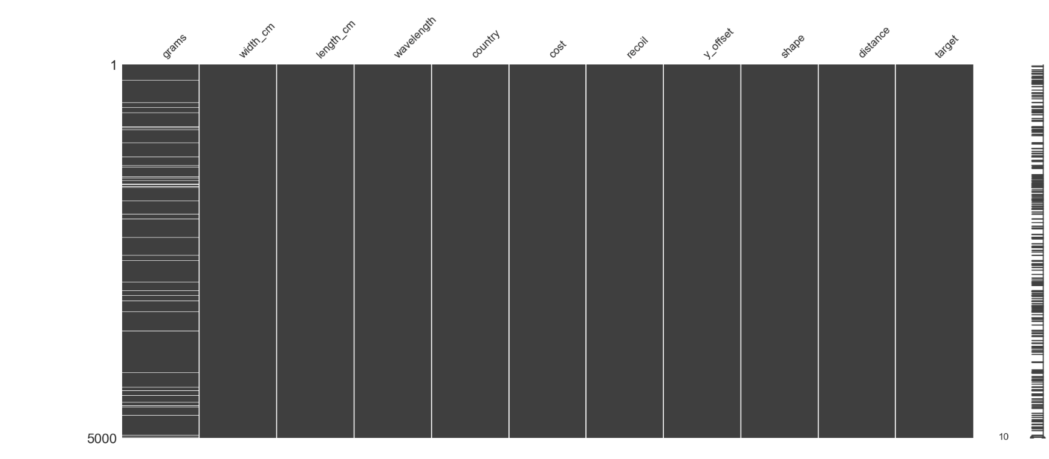

Missing data
Notes:
visualized missing data matrix from our dataset,we can identify the missing data

Slide 5
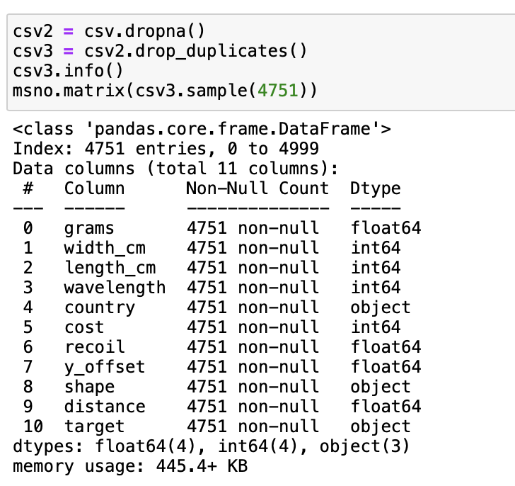
Why drop it (Jakobsen et al., 2017)
5% - General Rule
5000 x 5% = 250
249 missing data(less then 5%)

Slide 6
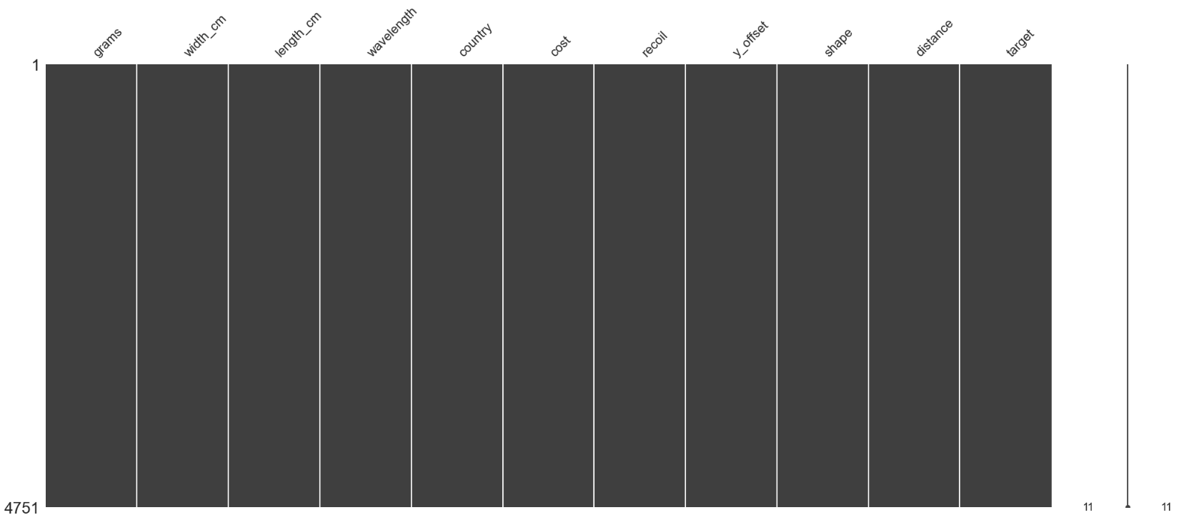
Notes:
missing data matrix

Slide 7
OneHotEncoder:
OneHotEncoder:
LabelEncoder:
Notes:
in the next step

Slide 8
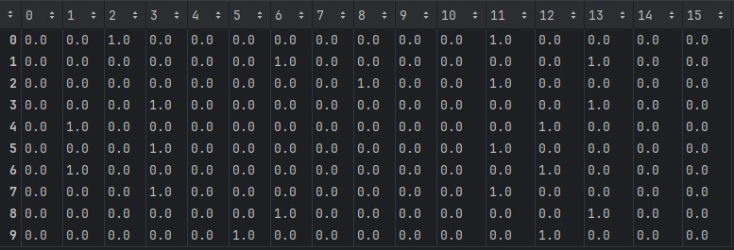
Country
Shape

Slide 9
100% Data set (group 2)
20% (Test set)
80% (Train set)

Slide 10
Model Training

Slide 11
Training Time Recording
Re-run each training model process five times
Mean as the matric

Slide 12
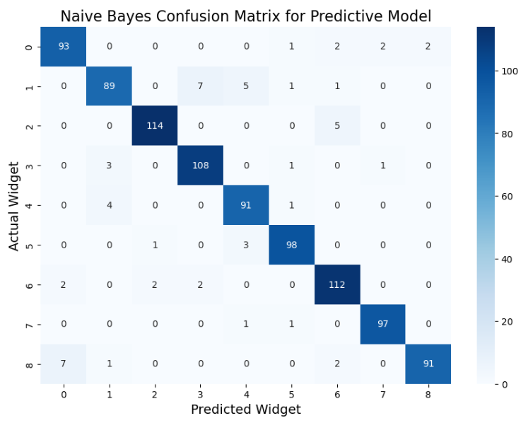
Naive Bayes
Accuracy: 93.9%
Training Time: 0.00632s

Slide 13
Random Forests (RandomForestClassifier)
n_estimators (Be tuned)
criterion = 'entropy'
random_state=1

Slide 14
Without Feature Scaling

Slide 15
Limitation: Why choose Entropy as a criterion?
Limitation: Lack of diverse criteria testing
Sensitivity to Changes in Class Distribution
Less Bias for Multi-Class Problems
Using Information Gain

Slide 16
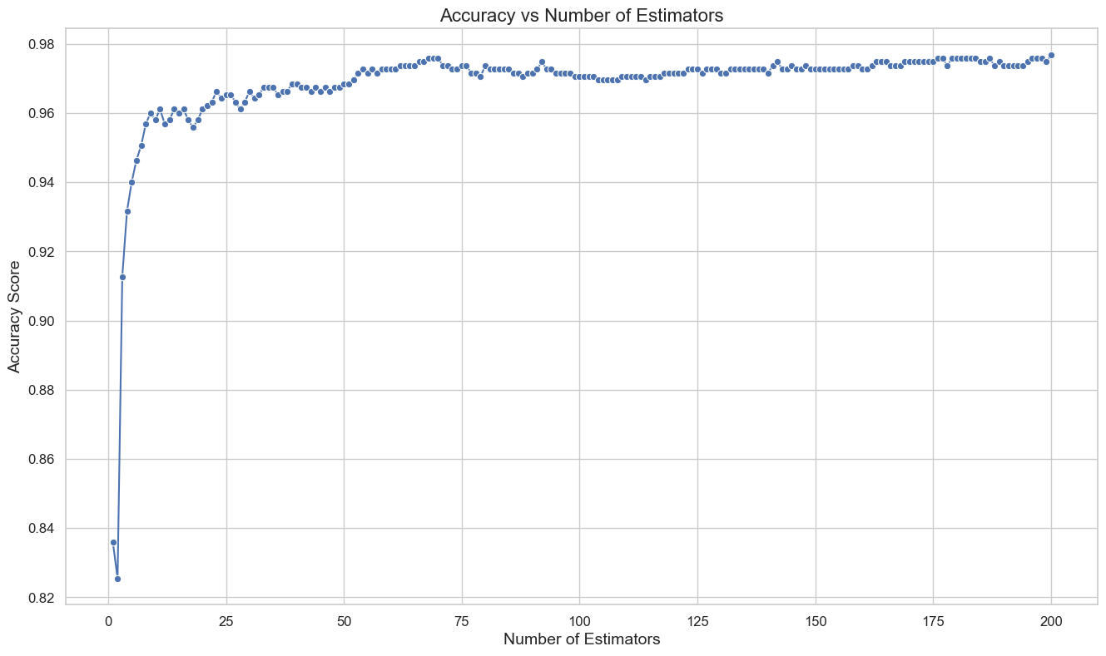
Random Forests (RandomForestClassifier)
n_estimators = range(0-200)

Slide 17
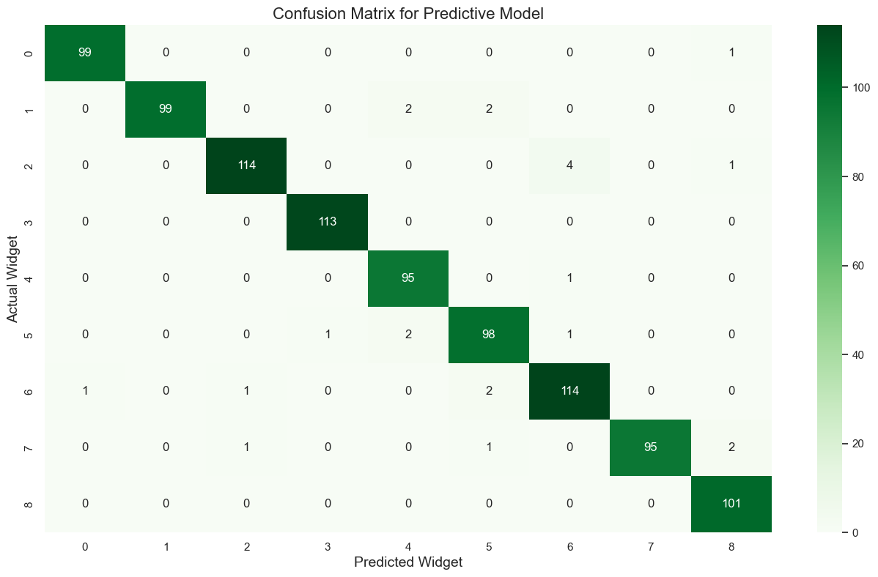
After Grid Search (RandomForestClassifier)
n_estimators = 184
Accuracy = 97.58%
Training Time = 1.7112s

Slide 18
Random Forest (BaggingClassifier)
decisiontree = DecisionTreeClassifier()
n_estimators (Be tuned)
max_samples = 0.8
random_state = 1

Slide 19
Limitation: Why use 0.8 in max_samples?
Limitation: Exploration of the model's performance
Common practice & effective starting point

Slide 20
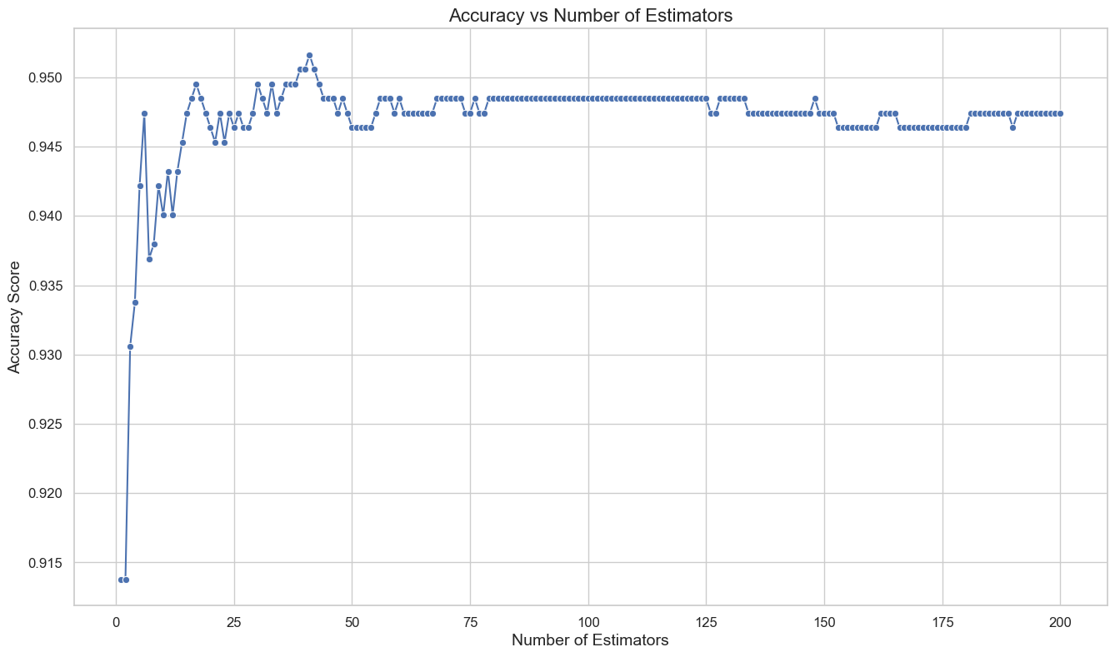
Random Forest (BaggingClassifier)
n_estimators = range(0-200)

Slide 21
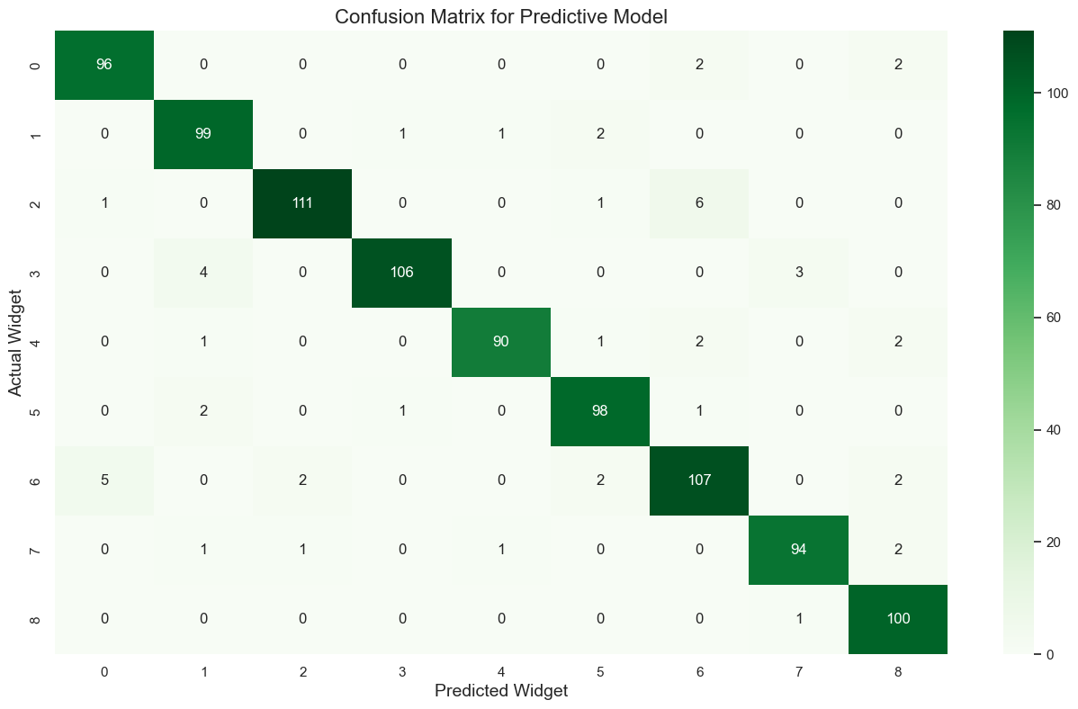
After Grid Search (BaggingClassifier)
n_estimators = 198
Accuracy = 94.74%
Training Time = 6.0758s

Slide 22
Kernel SVM (RBF)
kernel = 'rbf'
random_state = 1
C (Be tuned)
gamma (Be tuned)

Slide 23
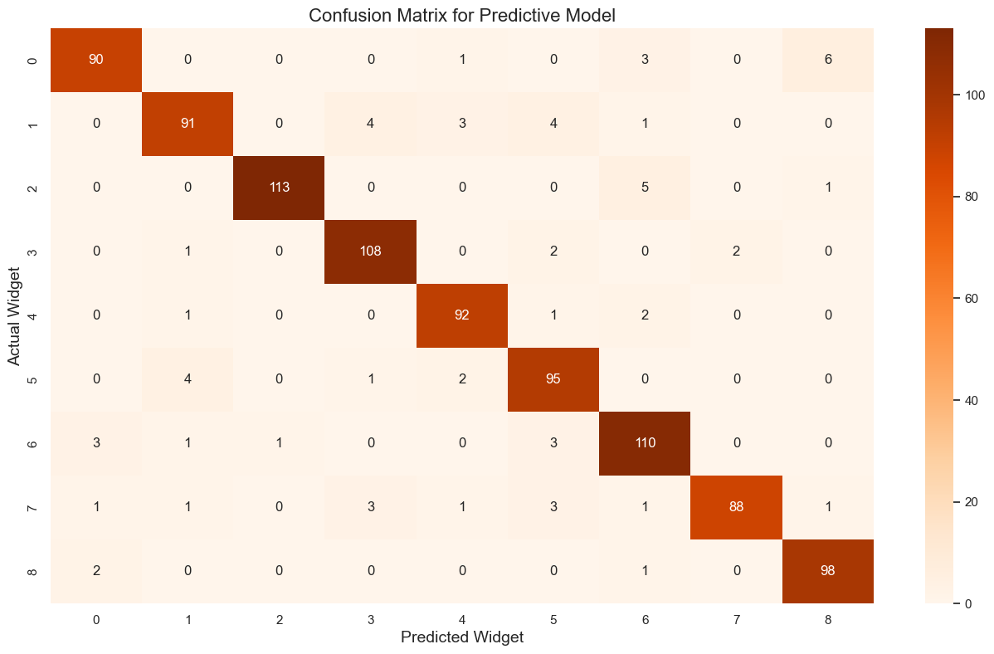
After Grid Search (RBF)
C = 1
gamma = 0.0001
Accuracy = 93.05%
Training Time = 0.2989s

Slide 24
Kernel SVM (poly)
kernel='poly'
C (Be tuned)
random_state = 1

Slide 25

After Grid Search (poly)
C = 100
Accuracy = 94.95%
Training Time = 0.1788s

Slide 26
SVM (linear)
C (Be tuned)
kernel='linear'
random_state = 1

Slide 27
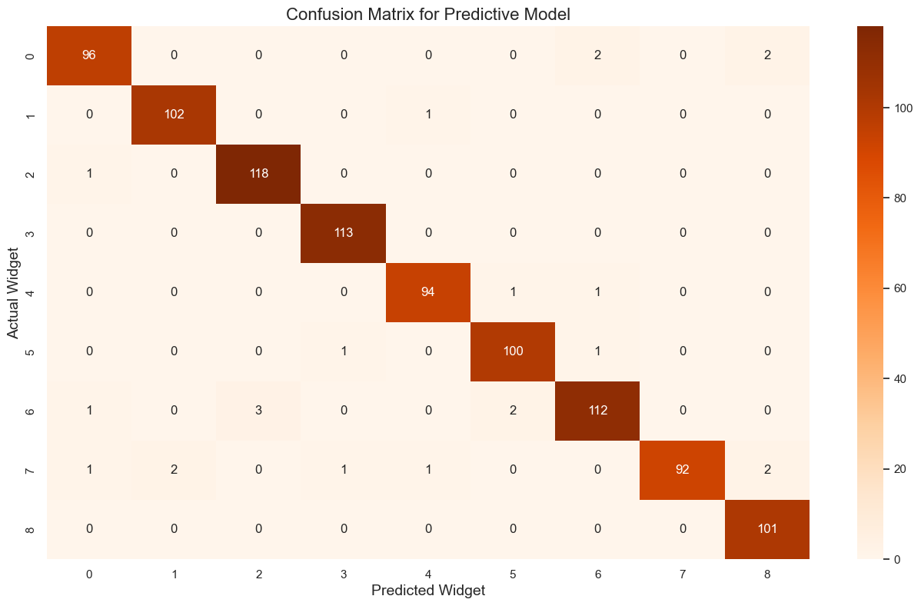
After Grid Search (linear)
C = 1
Accuracy = 97.58%
Training Time = 2.9642s

Slide 28
With Feature Scaling

Slide 29
What does it mean for feature scaling?
Adjusting the scale of the data
Normalization: for non-normal distribution data
Standardization : for normal distribution data

Slide 30

What does it mean for feature scaling?
Adjusting the scale of the data.
Normalization: for non-normal distribution data
Standardization : for normal distribution data

Slide 31
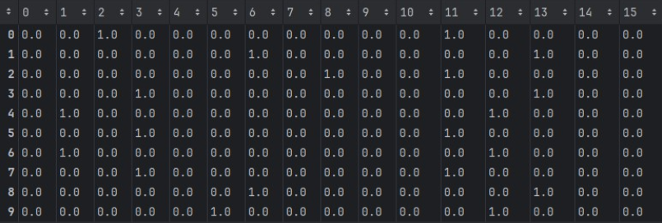
What it mean for feature scaling
Standardization : for normal distribution data
Train vs test, do it separately
Skip categorical data
Notes:
We have to make sure the test data is unique enough to test our model.
By doing so, we can avoid data information lost, and it’s actually quite meaningless to standardize 0 and 1.

Slide 32
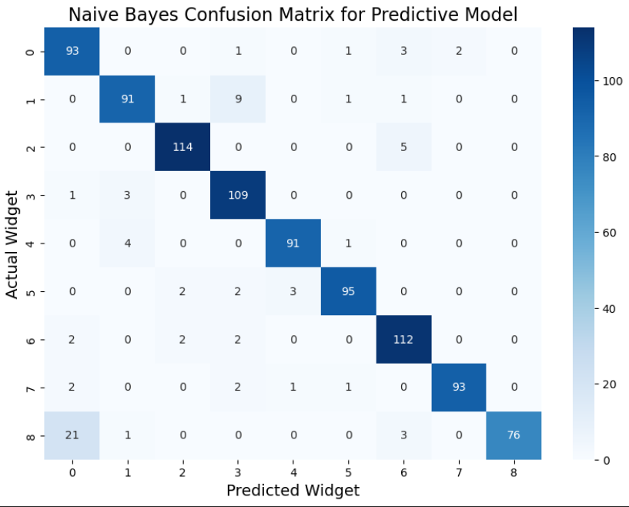
Results of Naive Bayes
Accuracy: 91.9% (drop)
Having trouble predicting widget 8
Mean of training time: 0.00492s

Slide 33
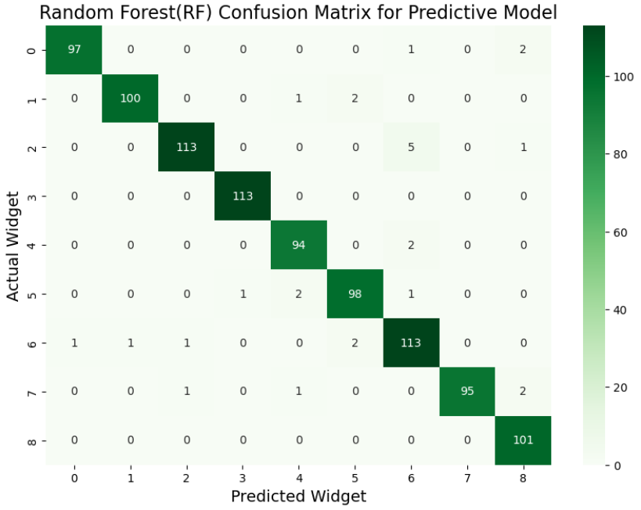
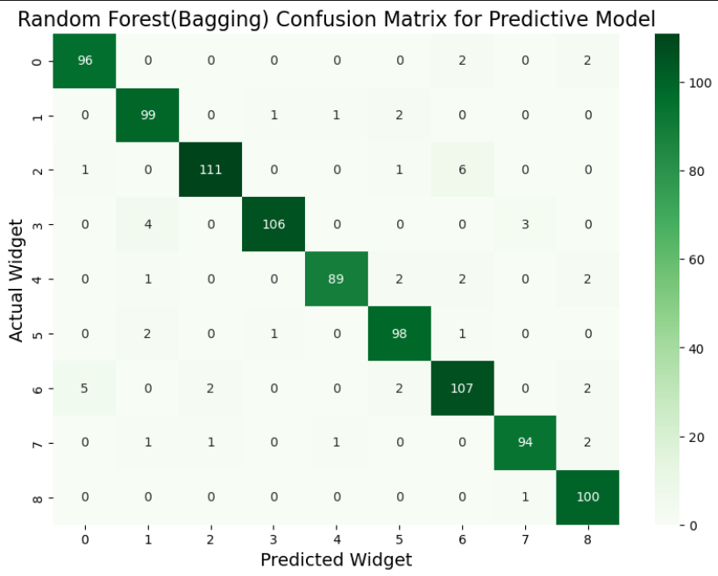
Result of Random Forest
Random Forest Classifier
Accuracy: 97.6%
Training time: 0.89554s
n_estimators = 98
Bagging Classifier
Accuracy: 94.6%
Training time: 5.4044s
n_estimators = 177
Same
Same

Slide 34
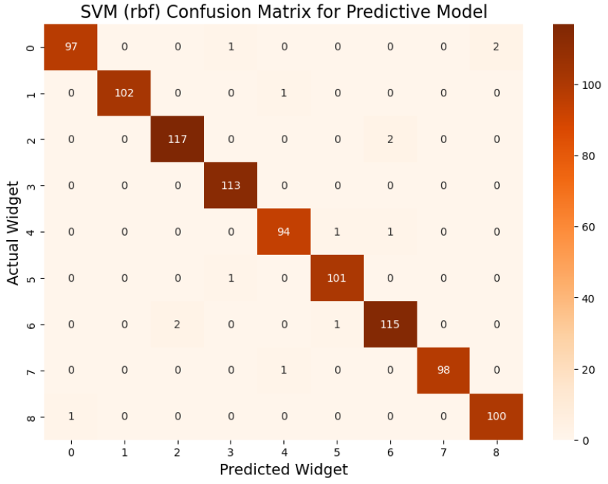
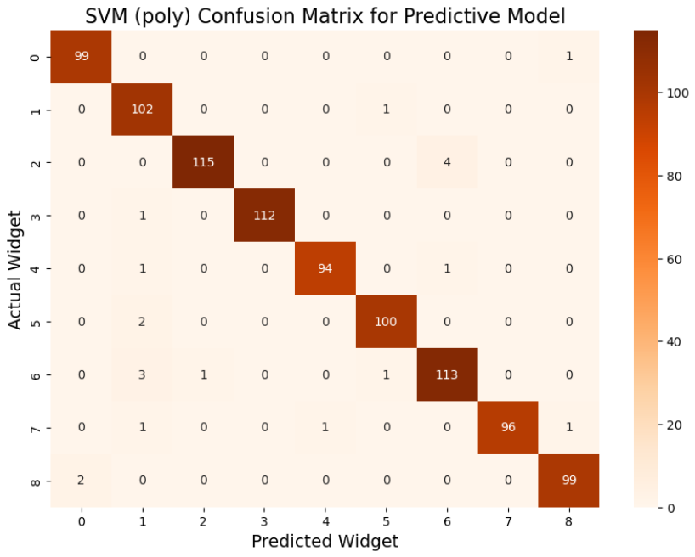

Result of SVM
RBF
Accuracy: 98.5%
Training time: 0.075s
C = 100, gamma = 0.0001
Poly
Accuracy: 97.8%
Training time: 0.0693s
C = 1
Linear
Accuracy: 98.6%
Training time: 0.0292s
C = 0.1

Slide 35
Final Model Evaluation

Slide 36
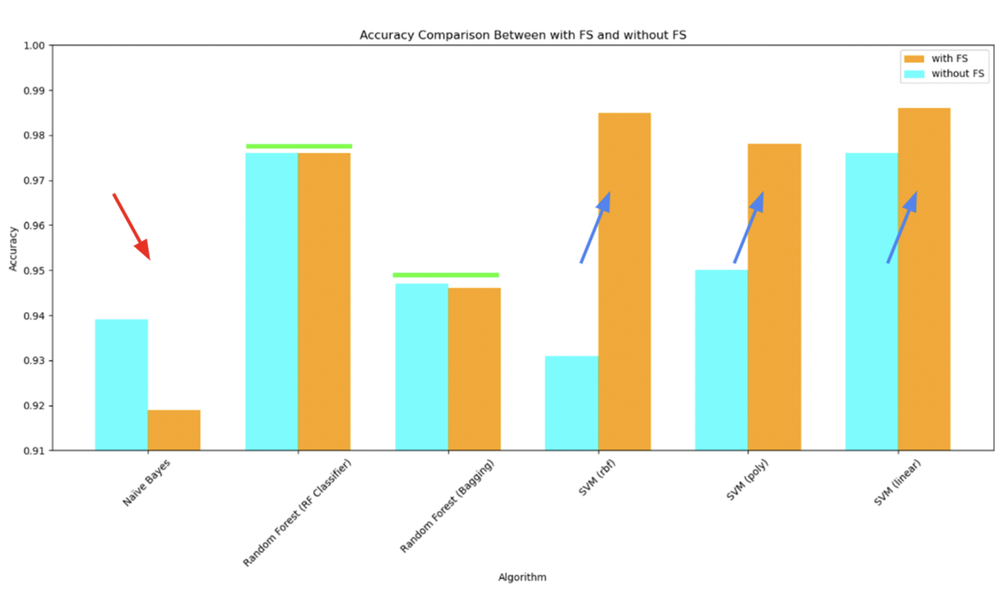
Notes:
After feature scaling, the Naive Bayes algorithm saw a drop in accuracy, whereas the Random Forest algorithm's accuracy remained stable. In contrast, all SVM kernels—rbf, poly, and linear—showed a significant improvement in accuracy with feature scaling,

Slide 37
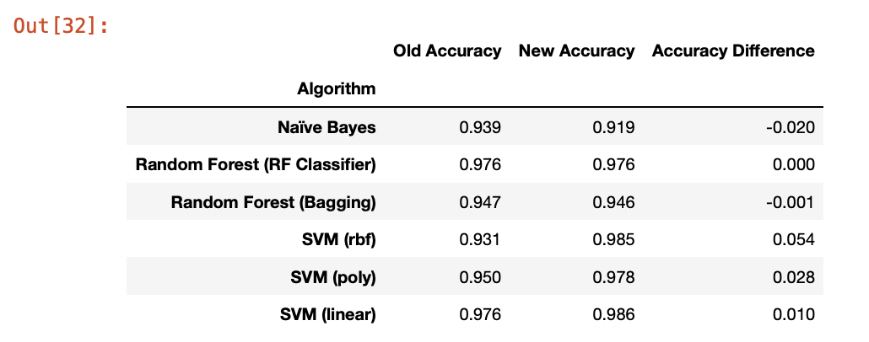

Slide 38
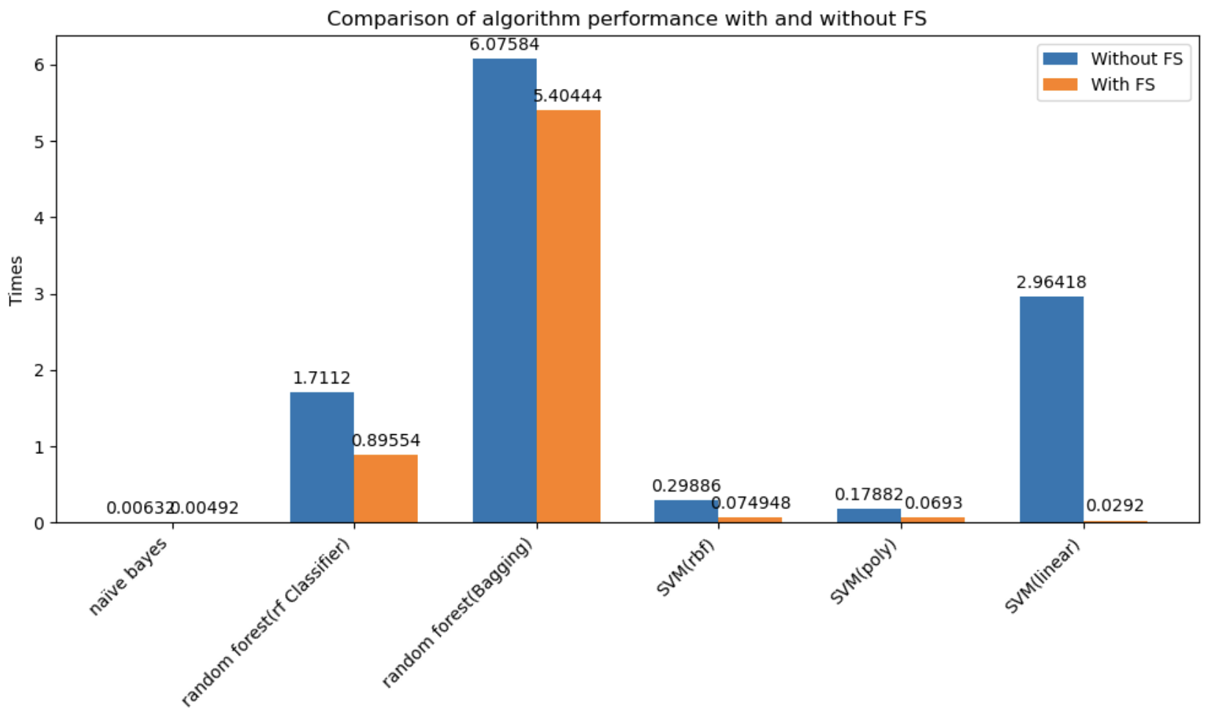
Notes:
Upon examining the influence of feature scaling on training times, we observed a reduction across all algorithms. Notably, the training time for the SVM with a linear kernel decreased substantially after applying feature scaling, indicating that feature scaling can lead to more efficient model training

Slide 39
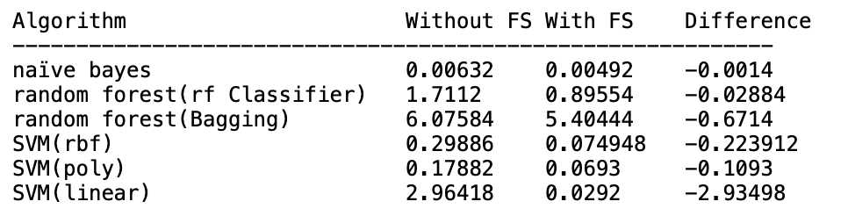

Slide 40
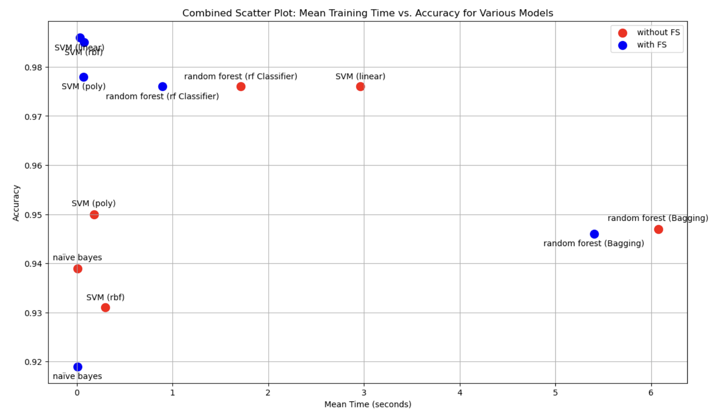
Notes:
in conclusion
1.svm with fs can increase accruacy
2.random forest with fs can decrease training time
3.but naive bayes with fs will decrease its accruacy

Slide 41
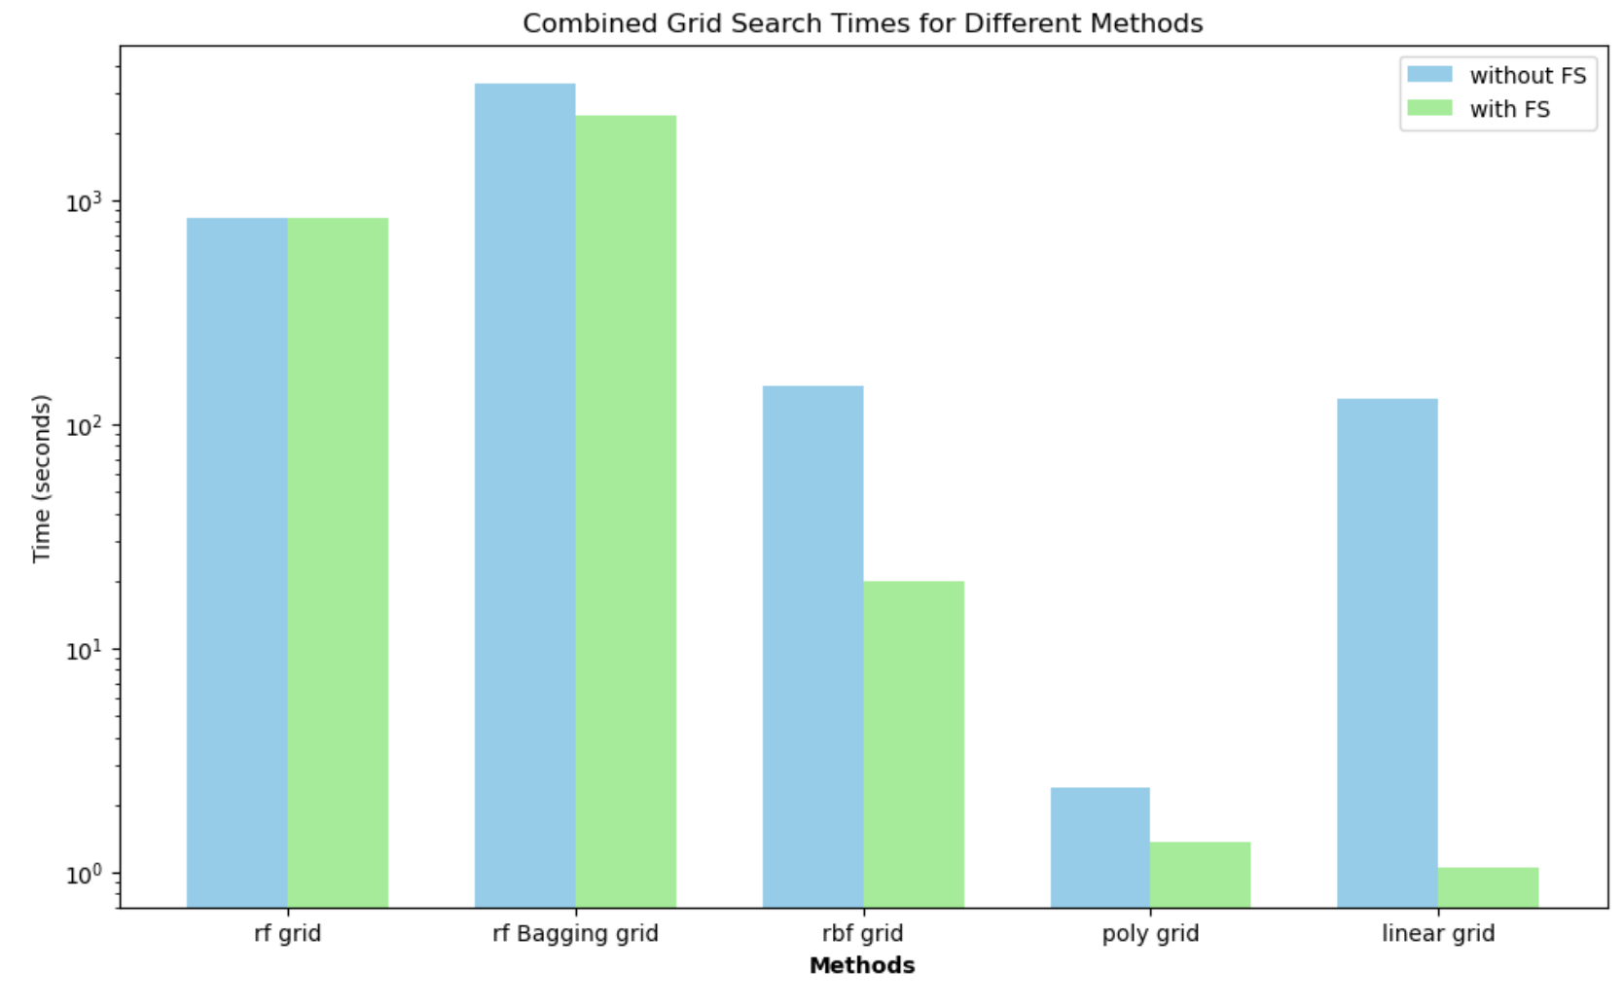
Notes:
we observed that after applying feature scaling, the search times for Random Forest, RBF, Poly,
and Linear Grid methods were reduced.
This suggests that feature scaling is an effective preprocessing step prior to conducting grid searches.

Slide 42
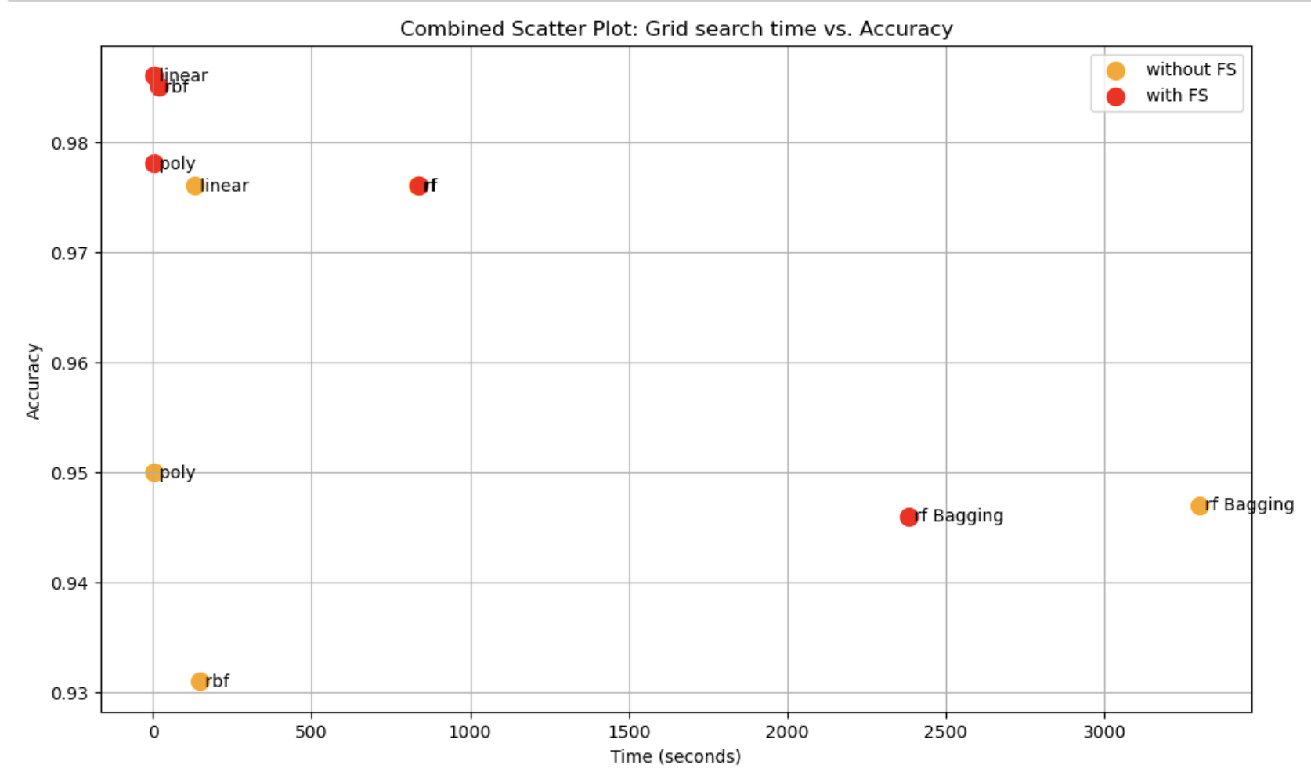
Notes:
However, we found no difference in accuracy and grid search time for Random Forest with or without feature scaling.

Slide 43
Conclusion
Feature Scaling vs Without Feature Scaling
SVM (Linear) Model
Best Training Time & Grid Search Time
Best Accuracy

Slide 44
Reference
Jakobsen, J.C., Gluud, C., Wetterslev, J. et al., 2017. When and how should multiple imputation be used for handling missing data in randomised clinical trials – a practical guide with flowcharts. BMC Medical Research Methodology, 17(1), p.162. Available at: https://doi.org/10.1186/s12874-017-0442-1 [Accessed 1 December 2023].

