Slide 1

Bayesian Epistemic Uncertainty for LLM Trajectory Selection
Can epistemic uncertainty choose better reasoning trajectories for fine-tuning than standard entropy?
CS 677 Final Project
James Chen
Better post-training data curation may help small language models learn reasoning more efficiently.

Slide 2


Why Standard Entropy Is Not Enough
Not all uncertainty is equally useful for data selection.
ALEATORIC
EPISTEMIC
Data Uncertainty
Inherent ambiguity or noise in the response itself.
Manifests as variable wording, formatting, or phrasing.
Choosing this leads to training on random noise.
Model Uncertainty
The model truly does not know the concept or reasoning step.
Reflects a genuine lack of mathematical knowledge.
Hypothesis: This is the critical signal for trajectory selection.
High entropy is not always useful if it mostly reflects noise instead of missing knowledge.

Slide 3
Estimate Epistemic Uncertainty
STEP 1
STEP 2
STEP 3
Re-run the same trajectory
Compare the predictions
Score the trajectory
• Feed one candidate reasoning trajectory into Qwen2.5-3B multiple times
• Keep dropout active so each pass is slightly different
• Each pass produces a slightly different prediction pattern
• Agreement suggests confidence
• Disagreement suggests uncertainty from missing knowledge
• Trajectories with meaningful disagreement get higher scores
• Higher score means the example is more useful for fine-tuning
High disagreement across dropout passes means the student model probably does not fully understand that reasoning pattern yet.

Slide 4




How the Score Is Computed
From multiple dropout passes to an epistemic uncertainty score
Average the token probabilities across the dropout passes.
STEP 1
[ Equation Placeholder ]
Average the predictions
Measure the uncertainty of the averaged prediction.
STEP 2
[ Equation Placeholder ]
Compute total entropy
Average the uncertainty inside each individual dropout pass.
STEP 3
[ Equation Placeholder ]
Compute expected entropy
Subtract expected entropy from total entropy to isolate disagreement.
STEP 4
[ Equation Placeholder ]
Get epistemic uncertainty
K = 10 dropout passes • t = token position • v = vocabulary token

Slide 5
Experimental Pipeline
Generate Candidate Data
Score and Select Trajectories
Fine-Tune and Compare
Teacher model: Qwen2.5-72B-Instruct
12,000 math problems
5 reasoning trajectories per problem
60,000 total candidate trajectories
Student model: Qwen2.5-3B
Each trajectory scored with 10 MC-dropout passes
Baseline: total entropy
Proposed: epistemic uncertainty via mutual info
One winner selected per scoring rule
Train two separate LoRA student models
One model uses baseline-selected data
One model uses epistemic-selected data
Evaluate on downstream reasoning benchmarks
The scoring rule materially changed the training data: the two methods selected different winning trajectories for 67.54% of problems.

Slide 6
Evaluation
Evaluation Setup
Benchmarks: MATH-500 and GSM8K
Compare baseline vs. epistemic selection
Primary Metric: ACC@1
Extract first boxed final answer
Grade by exact string match
The only experimental difference between the two models is the trajectory selection rule.

Slide 7
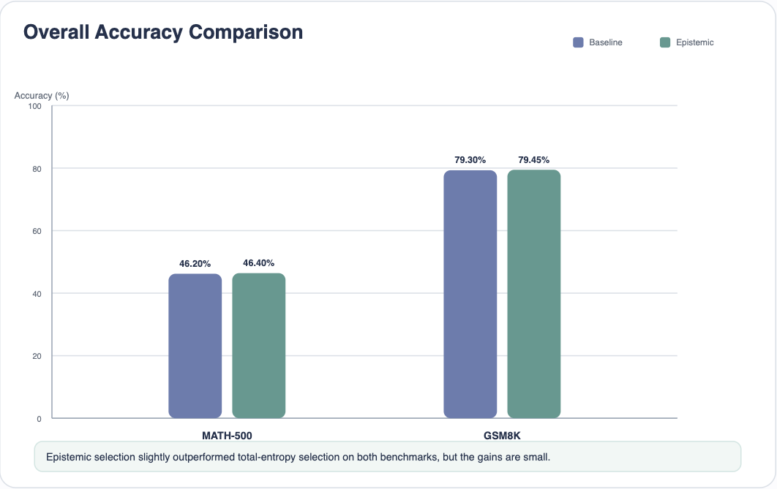

Slide 8
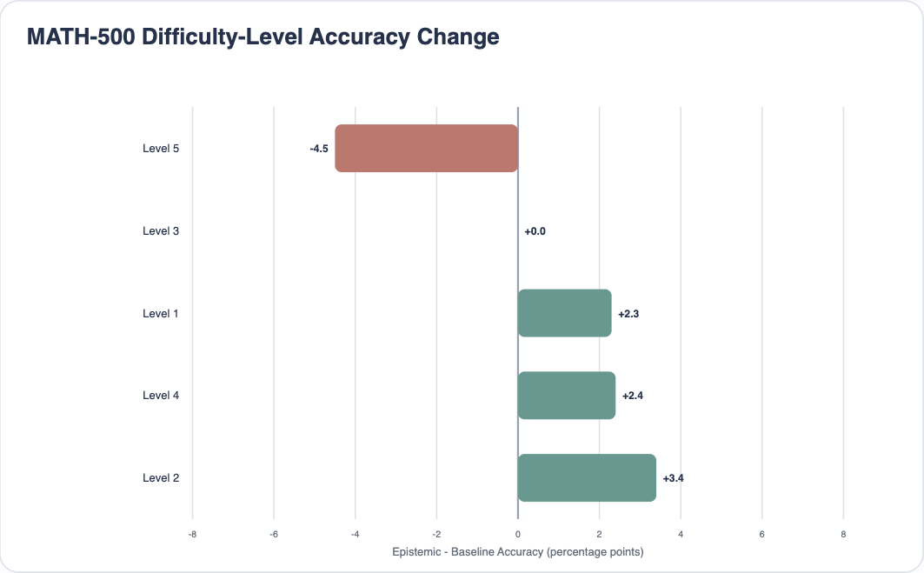

Slide 9
Conclusion and Future Work
Main Takeaway
What This Means
Next Steps
Epistemic uncertainty slightly outperformed total-entropy selection
The improvement was positive on both MATH-500 and GSM8K
The effect size was small
Bayesian uncertainty is a promising direction for trajectory selection
Useful for identifying informative reasoning data
Result is not yet strong enough to be considered definitive
Stronger answer normalization and equivalence checking
Combine with diversity-aware selection
Test larger ablations and selection budgets
Improve uncertainty preservation during distillation
This project should be viewed as a promising proof of concept rather than a final conclusive result.

