Slide 1

Laravel Lifesavers
Spatie Packages you may need

Slide 2
LARAVEL BACKUP | LARAVEL ACTIVITY LOG
LARAVEL MEDIALIBRARY | LARAVEL QUERY BUILDER
LARAVEL TRANSLATABLE | IMAGE OPTIMIZER
LARAVEL TAGS | LARAVEL HONEYPOT
OPENING HOURS | LARAVEL SCHEMALESS ATTRIBUTES
REGEX | LARAVEL PDF
LARAVEL HEALTH | LARAVEL SCHEDULE MONITOR
LARAVEL CSP | LARAVEL WEB TINKER
LARAVEL RESPONSECACHE | LARAVEL QUICK LOGIN
LARAVEL SIGNAL AWARE COMMAND

Slide 3


Slide 4


Slide 5
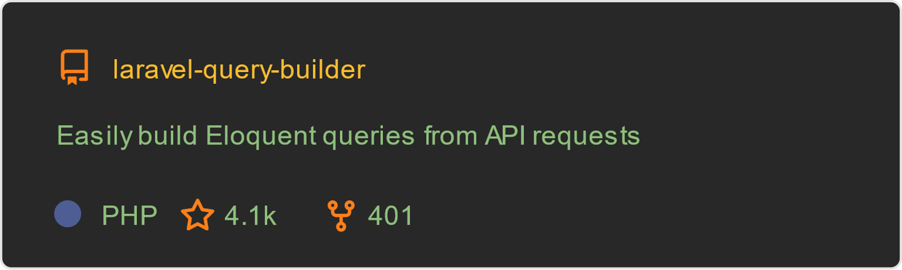

Slide 6


Slide 7


Slide 8
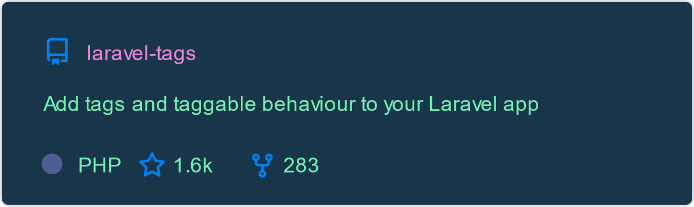

Slide 9


Slide 10


Slide 11


Slide 12
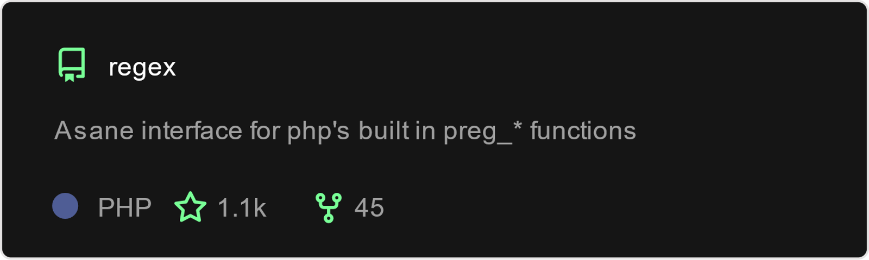

Slide 13


Slide 14


Slide 15


Slide 16
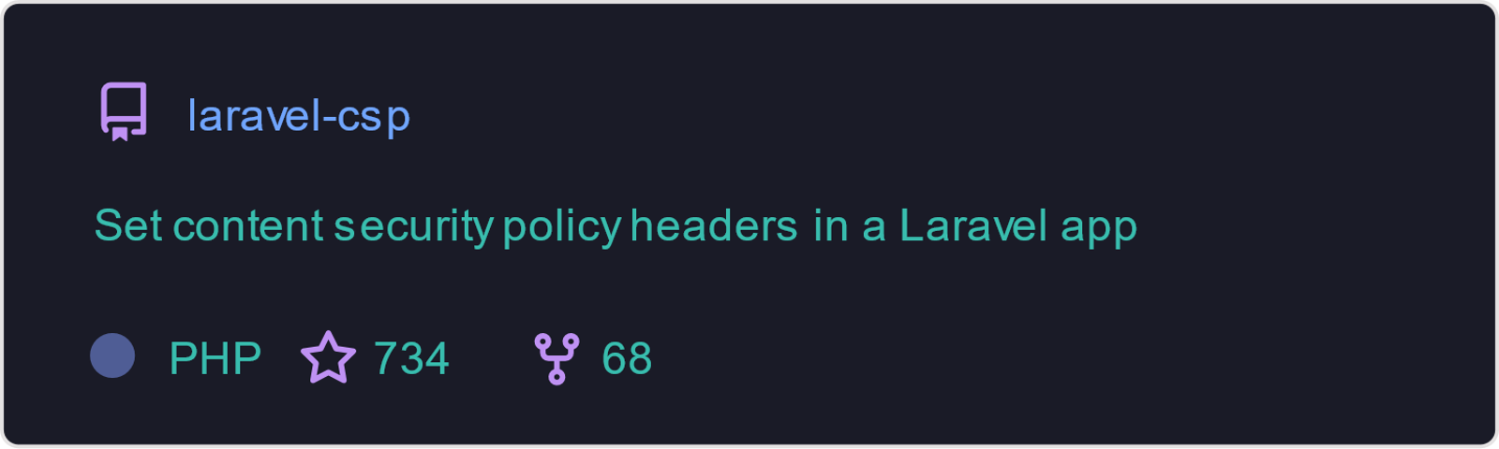

Slide 17
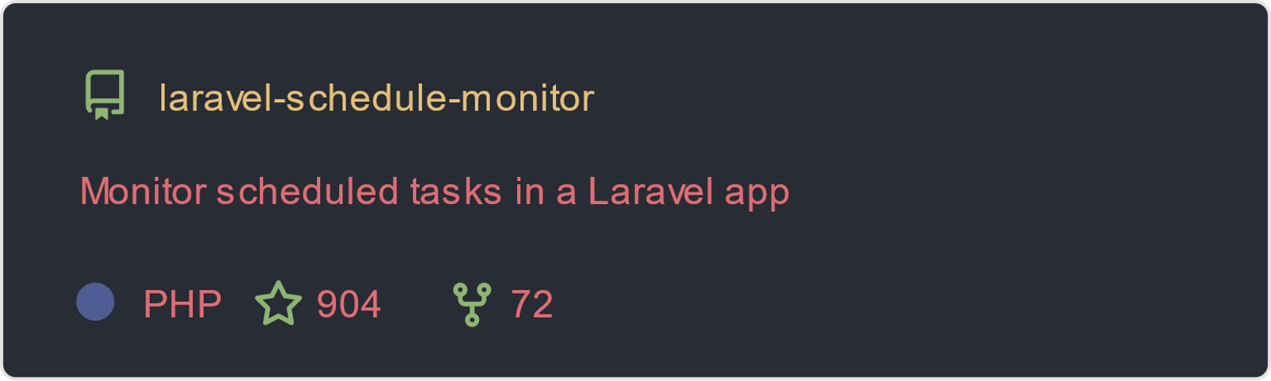

Slide 18
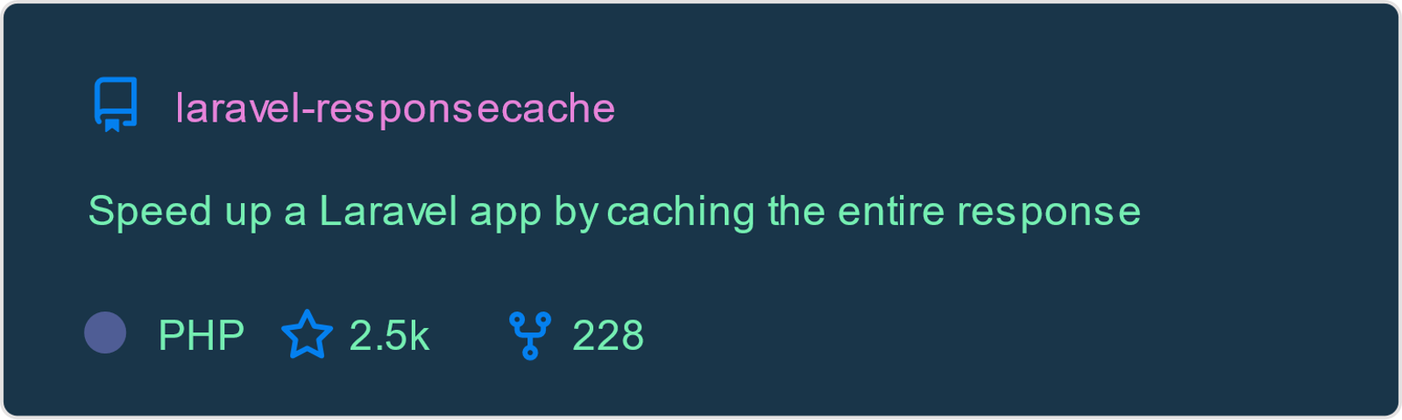

Slide 19


Slide 20


Slide 21
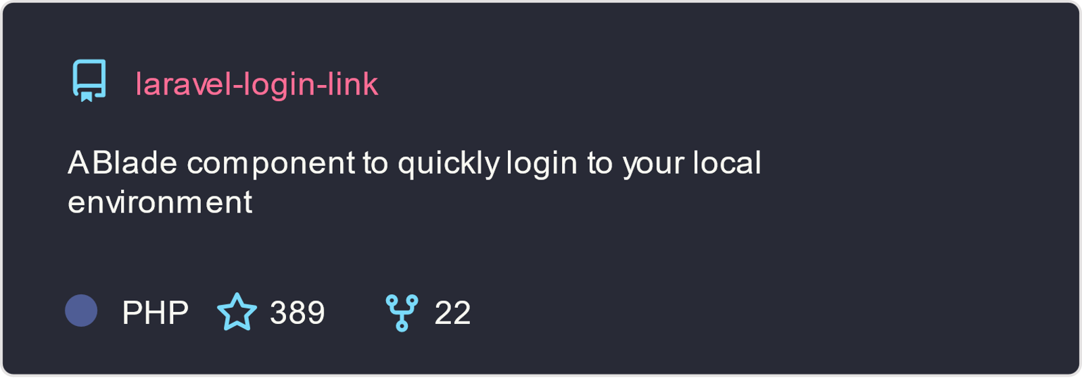

Slide 22

W

