Slide 1

Laravel Lifesavers
Spatie Packages you may need

Slide 2
LARAVEL BACKUP | LARAVEL ACTIVITY LOG
SIMPLE EXCEL | LARAVEL QUERY BUILDER
LARAVEL TRANSLATABLE | LARAVEL MEDIALIBRARY
LARAVEL TAGS | IMAGE OPTIMIZER
OPENING HOURS | LARAVEL HONEYPOT
REGEX | LARAVEL SCHEMALESS ATTRIBUTES
LARAVEL HEALTH | LARAVEL PDF
LARAVEL CSP | LARAVEL SCHEDULE MONITOR
LARAVEL RESPONSECACHE | LARAVEL WEB TINKER
LARAVEL SIGNAL AWARE COMMAND | LARAVEL QUICK LOGIN

Slide 3


Slide 4


Slide 5


Slide 6
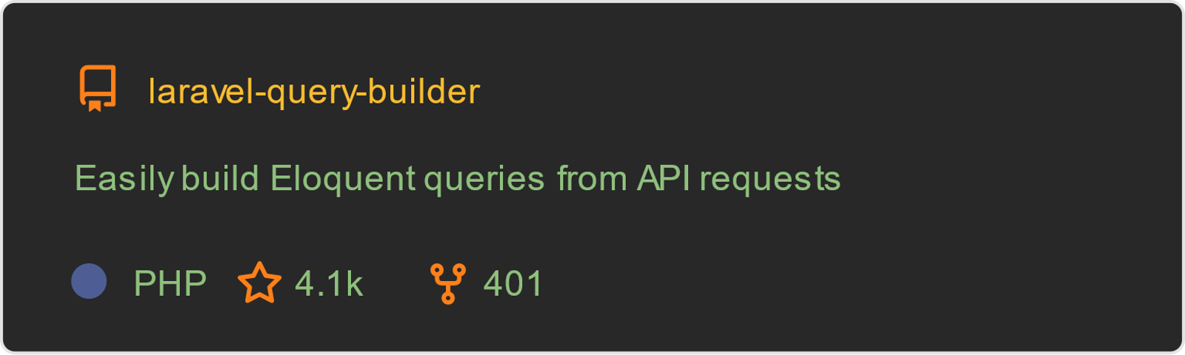

Slide 8


Slide 9


Slide 10
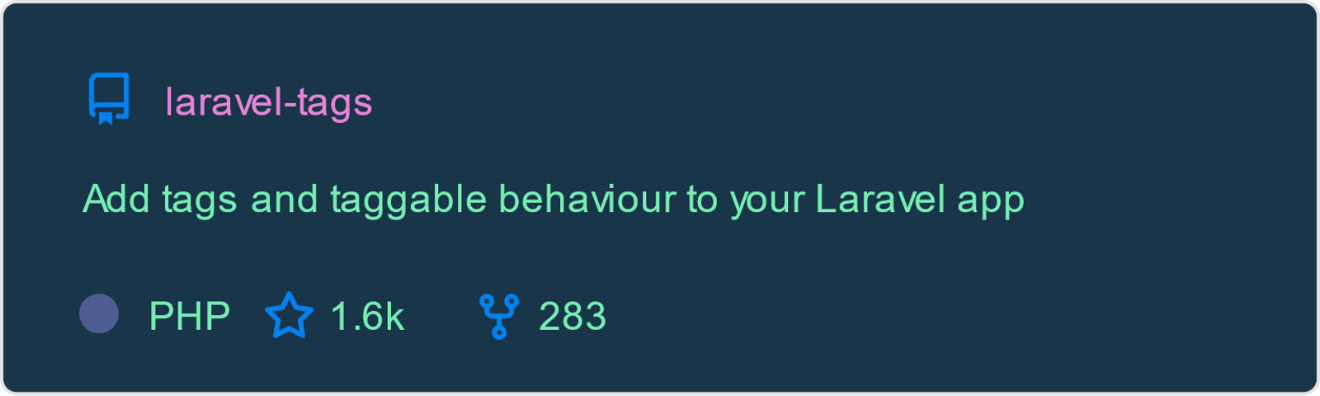

Slide 11


Slide 12


Slide 13


Slide 14
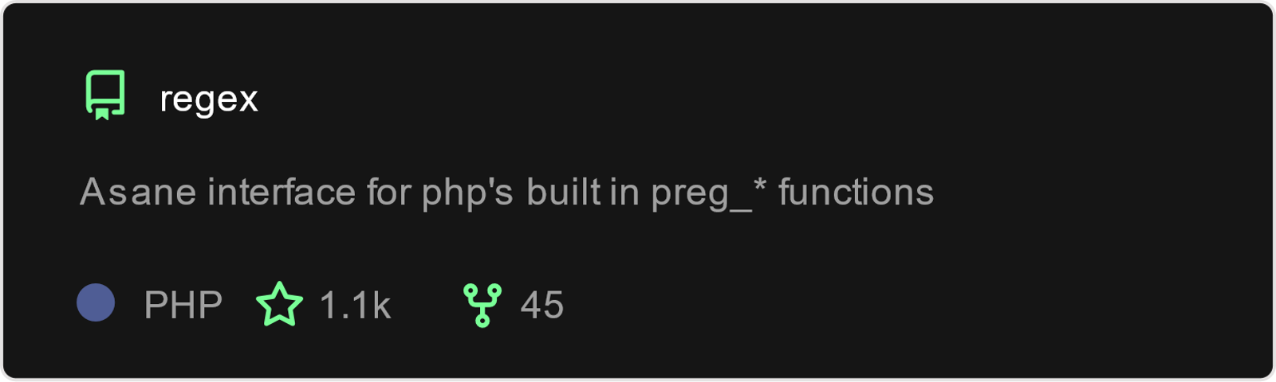

Slide 15


Slide 16


Slide 17


Slide 18
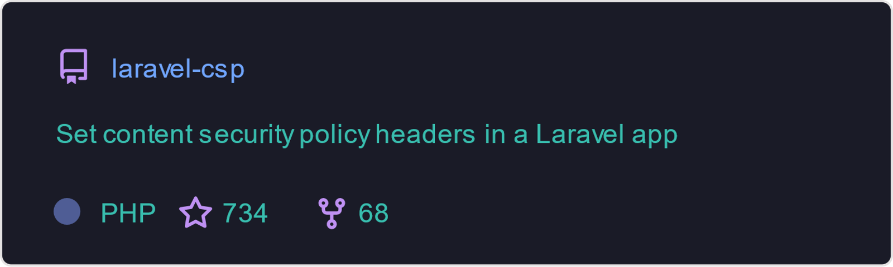

Slide 19
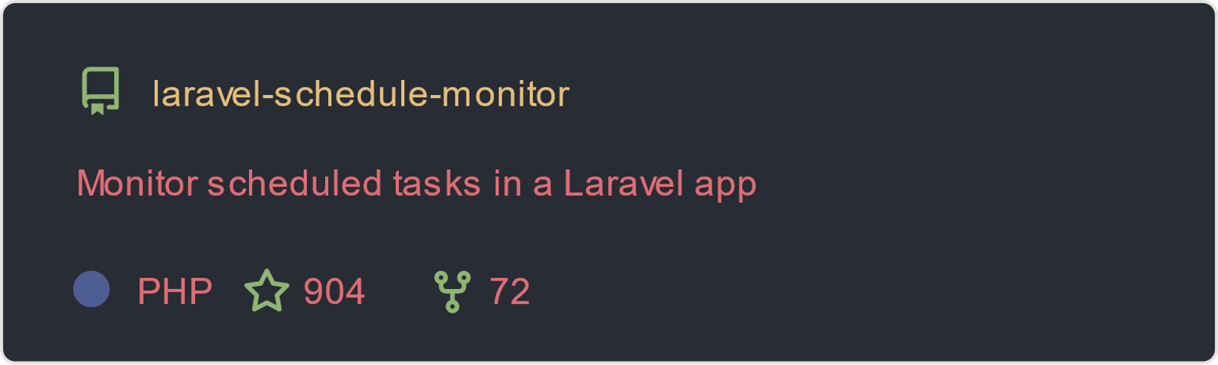

Slide 20
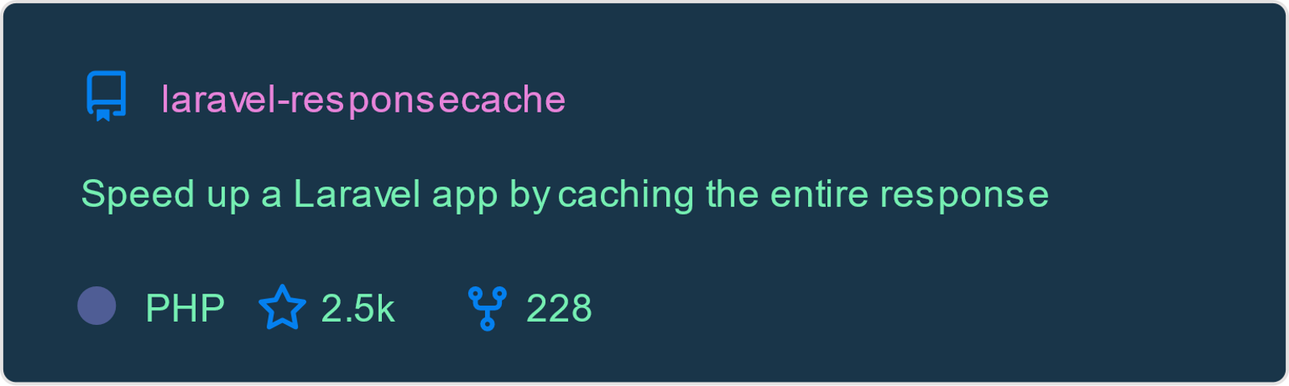

Slide 21


Slide 22
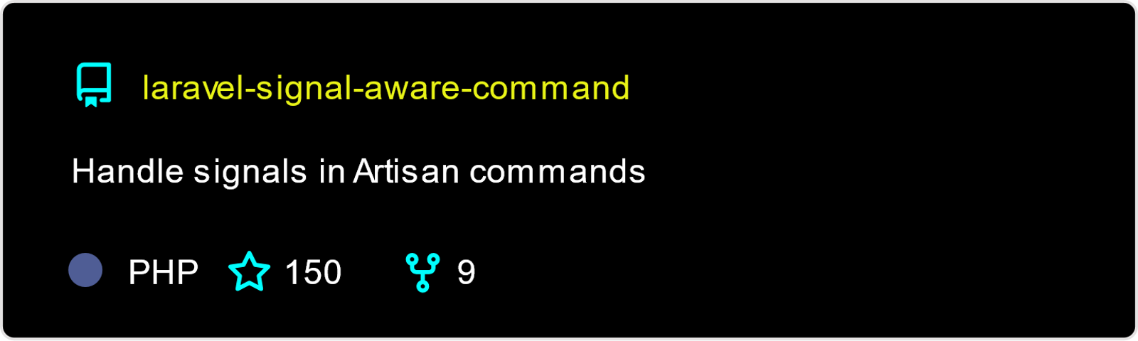

Slide 23
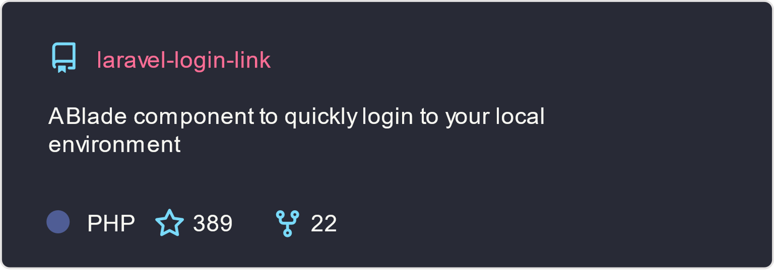

Slide 24

W

