Slide 1
The Chore Manager
Managing chores never been easier…

Slide 2
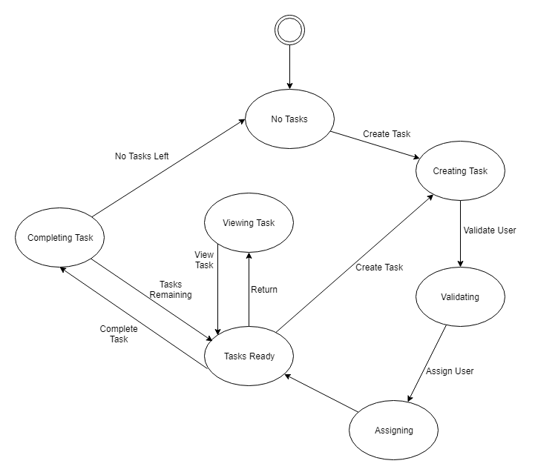

Slide 3
Objectives
Functional:
Create different profiles for each family member
Switch between profiles while the app is open
Add and delete tasks
View their personal task lists
Mark tasks as completed
Reward user for completed tasks
Drop (release) an incomplete task if needed
Pick up dropped (released) tasks again
And many more…

Slide 4
Objectives
Non-Functional
Android Nexus 5
Android API 15(Ice Cream Sandwich)
Google Firebase Database

Slide 5
Demo Use Cases
Creation of User Profile Actors
User Goals: The addition of a new user profile for a member of the family.
Preconditions: Any number of profiles already exist in the app database.
Summary: User creates new profile for a member of the family.
Related Use Cases: Deletion of a user profile
Post Conditions: System database has a profile with no reminders/schedule set in addition to any pre-existing profiles.

Slide 6
Demo Use Case
Setting up a schedule
User Goals: Creation of a schedule for selected profile
Preconditions: Profile for a user has been created.
Summary: User enters information of repeating tasks into system which will generate a schedule for a profile.
Related Use Cases: Modification of an existing schedule
Post Conditions: System Database has a new schedule tied to a user profile

Slide 7
Demo Use Case
Creating a shopping list
User Goals: Creation of a shopping list
Preconditions: Profile for a user has been created
Summary: User enters items that need to be purchased, creating a shopping list
Related Use Cases: Deleting items for shopping list
Post conditions: System Database has a new shopping list tied to a user profile

Slide 8
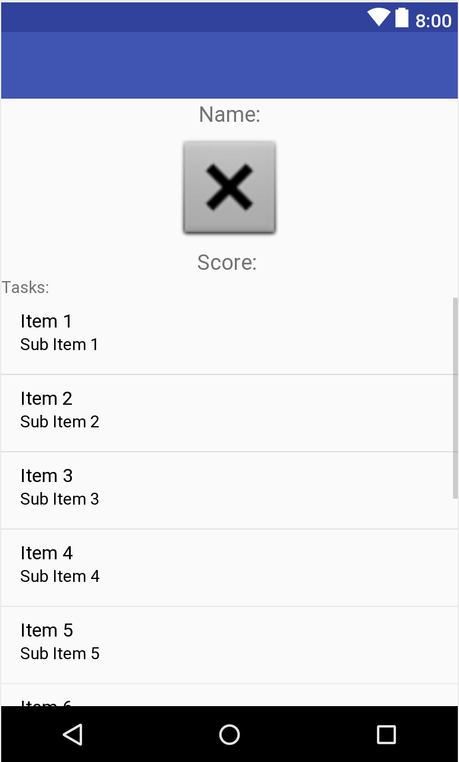
Child Profile
Displays the profile and the tasks assigned to user

Slide 9
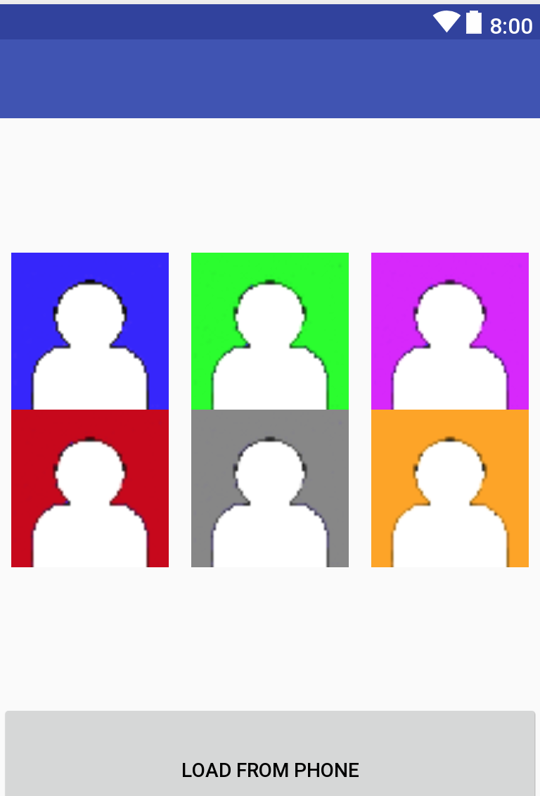
Choose Photo
Allows user to choose a personal profile photo

Slide 10
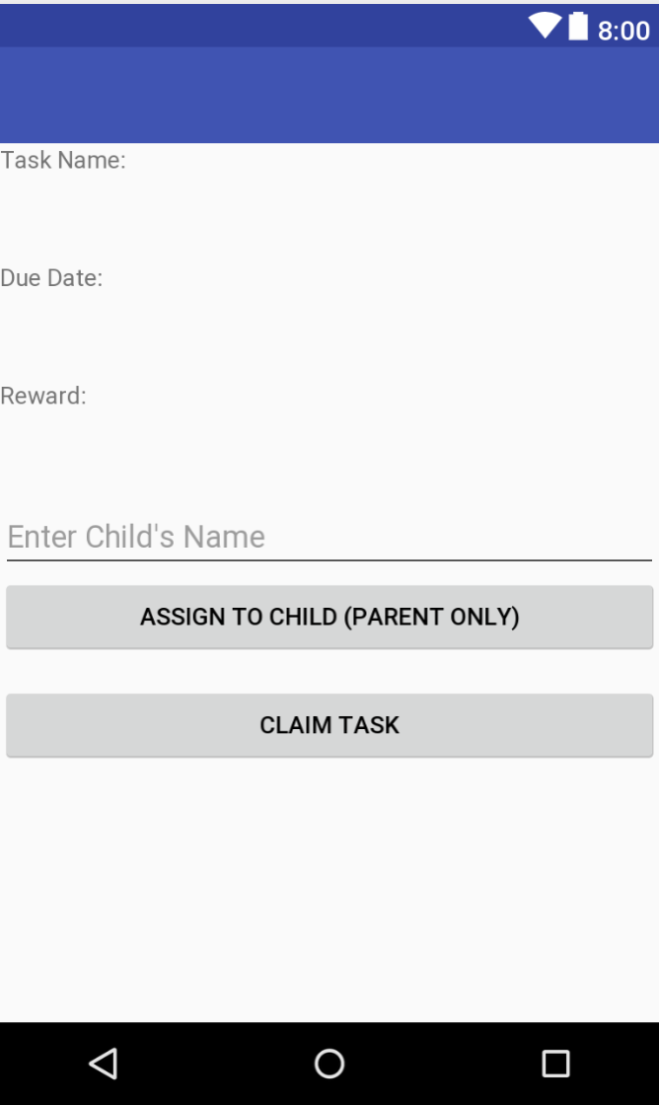
Claim Task
Allows user to claim an unclaimed task

Slide 11
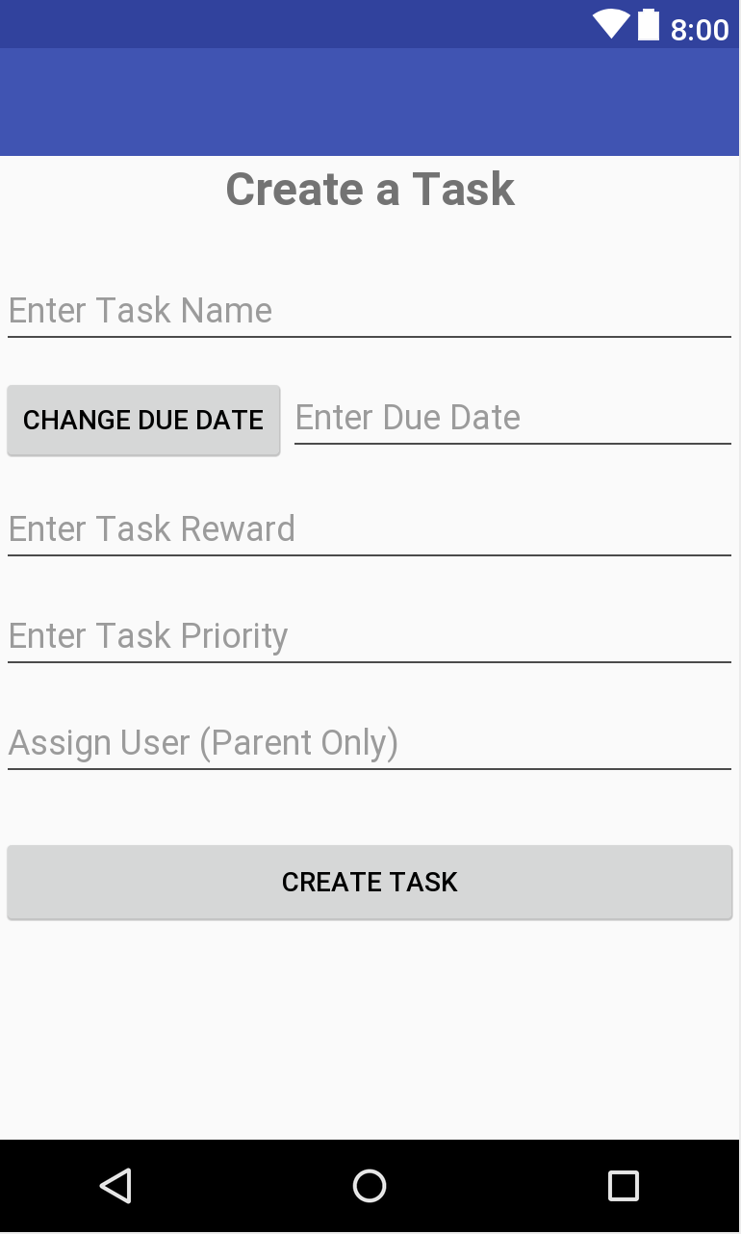
Create Task
Allows user to create a task

Slide 12
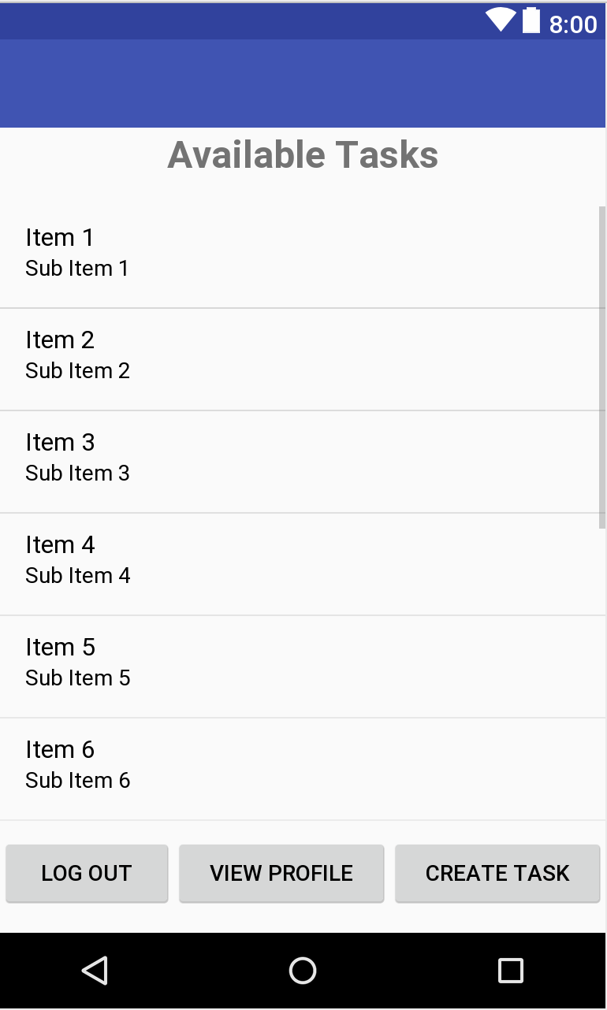
Home Page
Displays available tasks

Slide 13
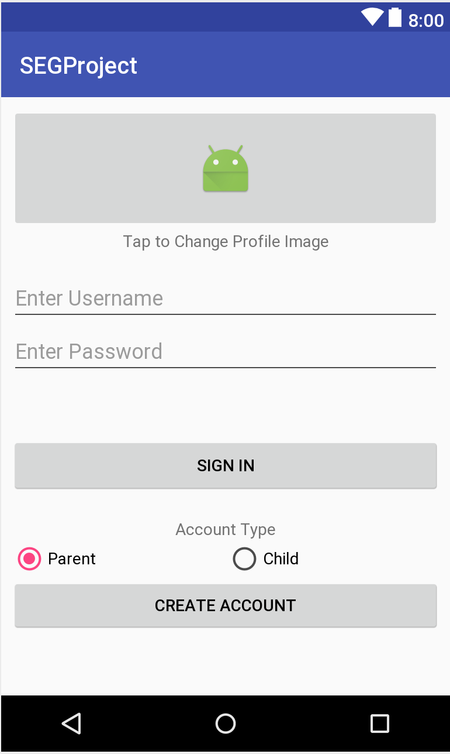
Sign in / Create Account
Create a new account or sign in with an existing account

Slide 14
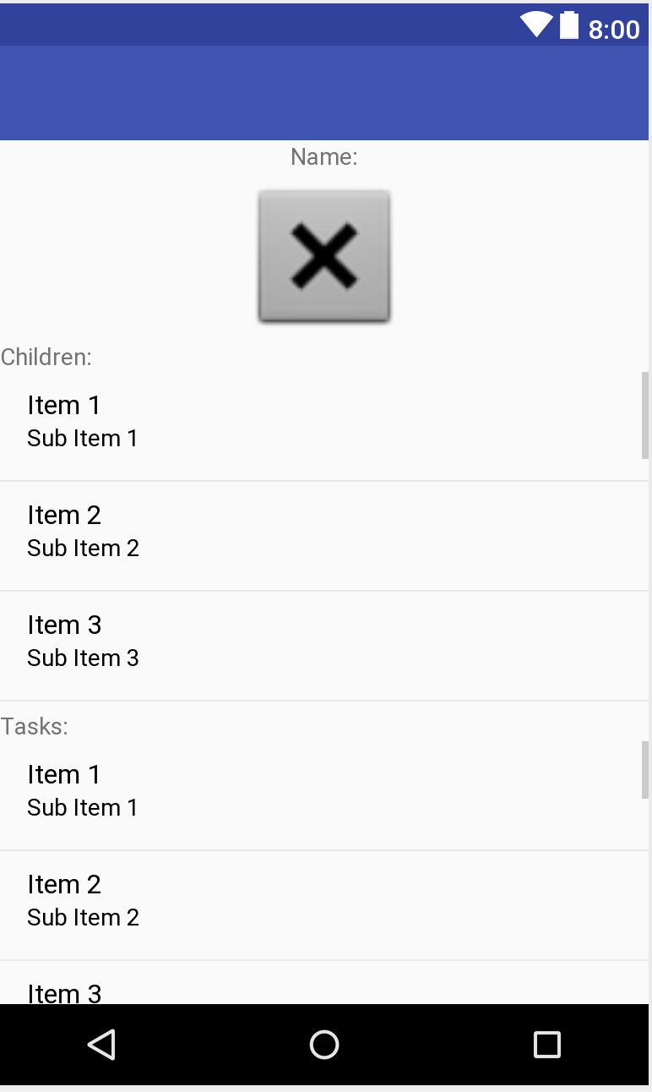
Parent Profile
Displays the child accounts and the tasks that are assigned to the parent

Slide 15
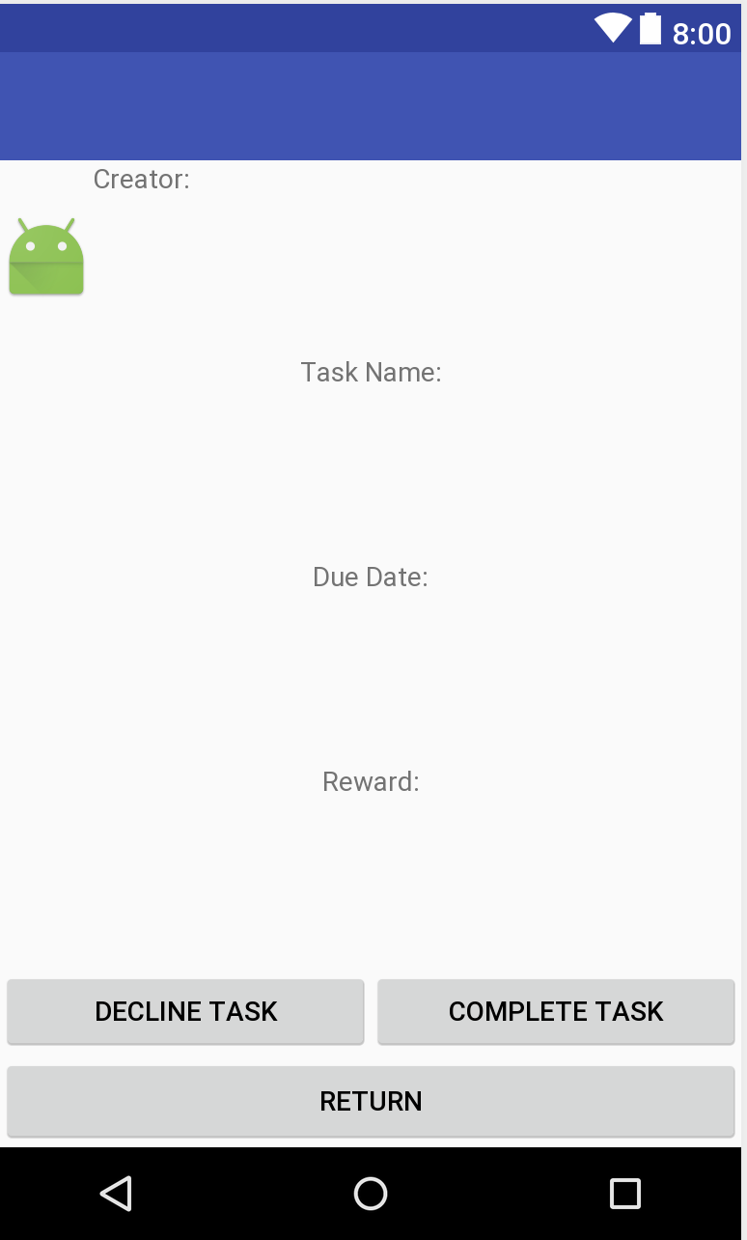
View Task
Displays the task details

Slide 16
Challenges
Notification System
Notify parent users if a task is completed.
Notify parent users if an urgent task is due soon and incomplete.
Notify users for schedule conflicts.
Messaging System
Send/Receive messages

