Slide 1

Superstore Presentation BA 205
Group 6: Hope Holland, Jimmy Dao, Hailey Hendrick, Bryce Pennock

Slide 2
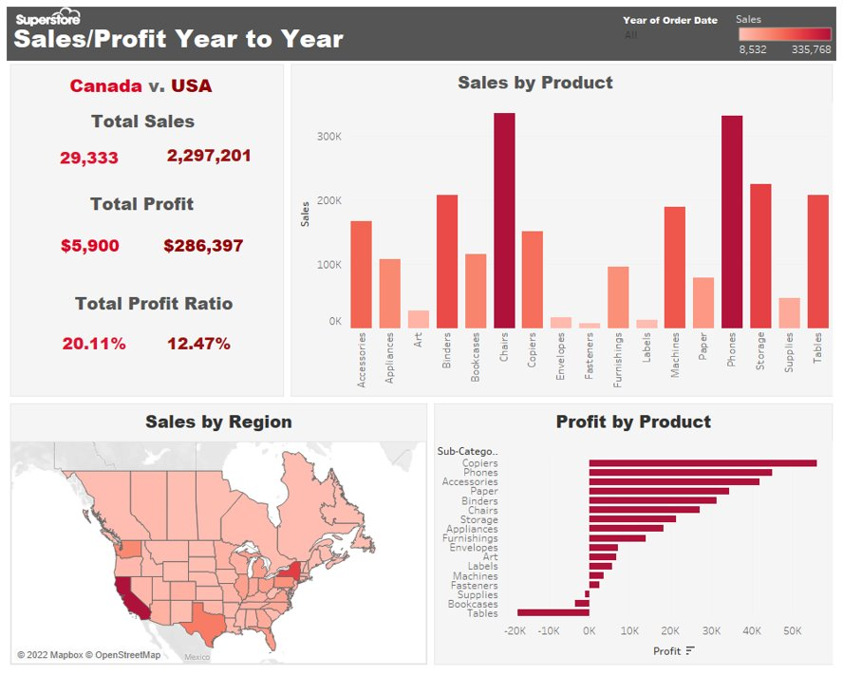
Overview
The Director of Superstore has heard stories that the business has higher revenues, but profitability is declining
Assigned to create a dashboard supporting our findings on whether these stories are true or not
Utilized given data from Superstore including sales, profit, category of products, regions, etc.

Slide 3
Research Findings – Part 1
Yes, the anecdotes/stories are true, Superstore has increased in revenue but has hit a decline/stagnant profitability in 2022
Profit ratio (2021) = 13.46%, Profit ratio (2022) = 12.87%
Due to these factors and their relations:
Product category
Region
The expenses that come from product and region

Slide 4
Research Findings – Part 2
Sales = Revenues before expenses, Profit = Revenues after expenses
Higher profit ratio in Canada than USA (20.11% CAN v. 12.47% USA)
Despite revenue increases, region (USA) and certain products (chairs, tables) halted profitability
Product manufacturing costs, shipping costs to the USA, and offshore production can be major factors in the expense cost
In total Superstore did $335,768 in sales but only made $27,224 in profit.

Slide 5

Recommendations
Expand
Expand the market into Canada and create more sales.
Reduce
Reduce expenses to produce certain products (I.e., tables, chairs, bookcases)
Reduce
Overall reduce expenses

Slide 6

Concluding Remarks
Superstore has indeed increased in revenues, but profitability has started to hit a decline
Due to products, regions, and their relationships
There's still room to recover
Cut expenses
Expand the market's region
Lessen the gap between sales and profit

