Slide 1
The price of wine
BY:JIMMY HERNANDEZ
BELLEVUE UNIVERSITY
DATA EXPLORATION AND ANALYSIS
PROFESSOR:BECKY DEITENBECK
07/28/2019

Slide 2
Hypothesis & Variables
Hypothesis- Is the price of wine determined by reviewer points?
Data set Variables
Country- The country of the wines origin
Points- The number of points assigned by a wine taster. Scale is from 80-100. Higher is better.
Price- The price for a bottle of wine(retail).
Province- The location of the winery.
Variety- The variety of wine. I.E. Pinot, Cabernet Sauvignon, Merlot…ECT

Slide 3
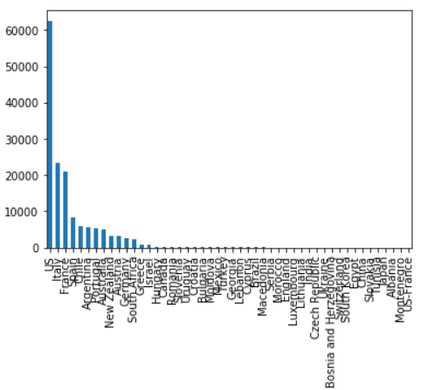
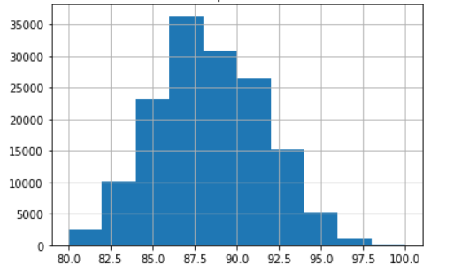
Histograms
Below are the histograms with unscrubbed data. Please see next slides to see scrubbed histograms.
Country
Points

Slide 4
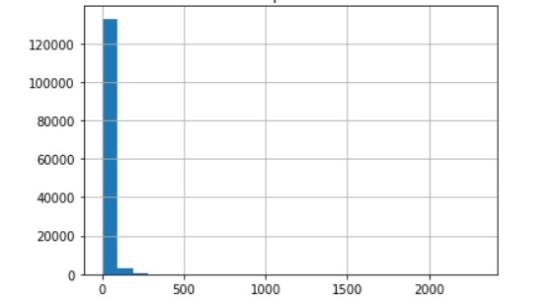
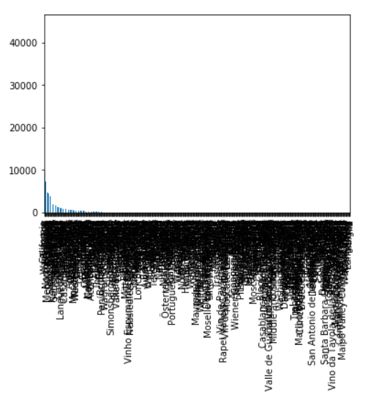
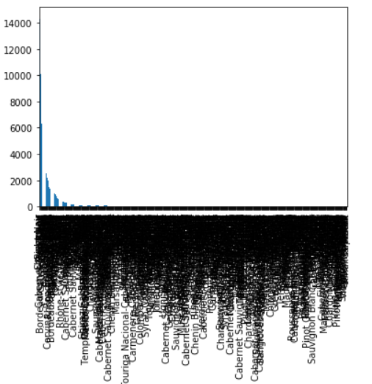
Histograms
Unscrubbed variables. See next slides for scrubbed histograms and explanation.
Price
Province
Variety

Slide 5
Histograms
As seen in the previous slides there are numerous amounts of variations for the histograms. Upon further investigation for frequency counts I have decided to reduce the list down to the top 10 counts by country. This removes the outliers while also adjusting the counts for highest granularity view which is the country variable. I’m removing all rows of data across all variables which are not in the top 10 by count for the country variable. See next slides for scrubbed data and histograms.

Slide 6
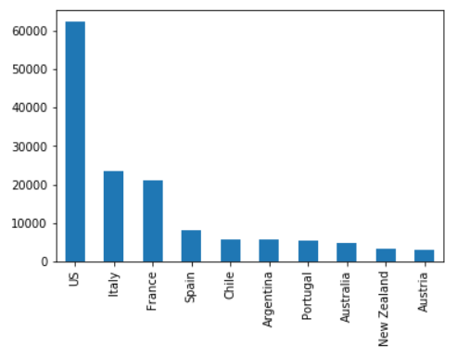
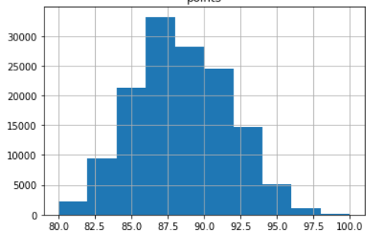
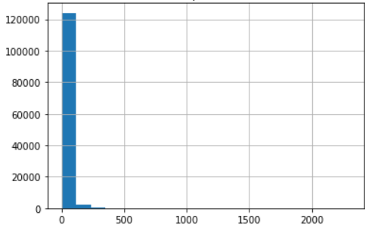
Histograms
Country
Points
Price
Mean:87.91
Median: 88
Mode:87
Spread:80-100
Mean:33.38
Median: 25
Mode:20
Spread:4-2300

Slide 7
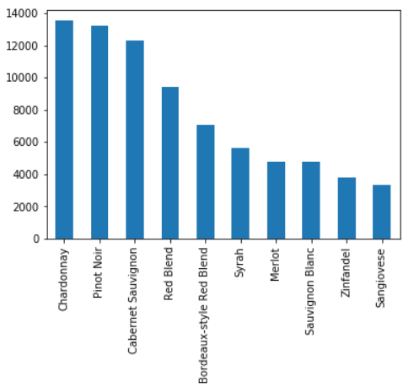
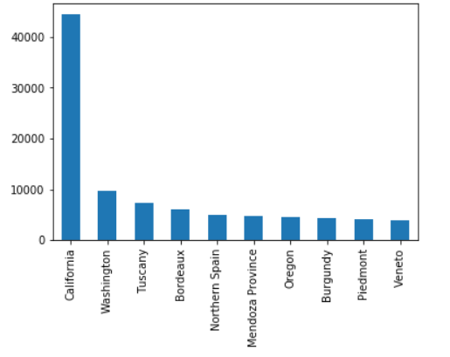
Histograms
Variety
Province

Slide 8
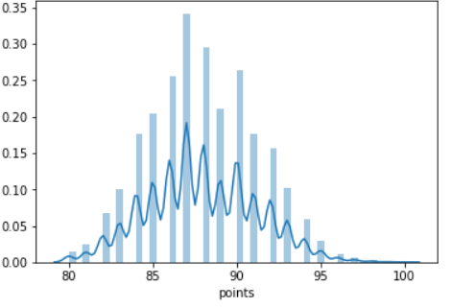
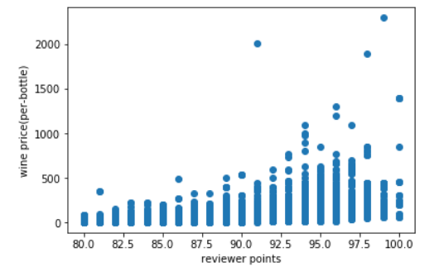
Distribution &Scatterplot
Below is a scatter plot of price compared to reviewer points. I only have 2 numeric columns in my data set. This is the only scatter plot possible. As points increase so does the price of the wine. The normal distribution of price shows many outliers.
The normal distribution of price
Correlation of .4523

