Slide 1
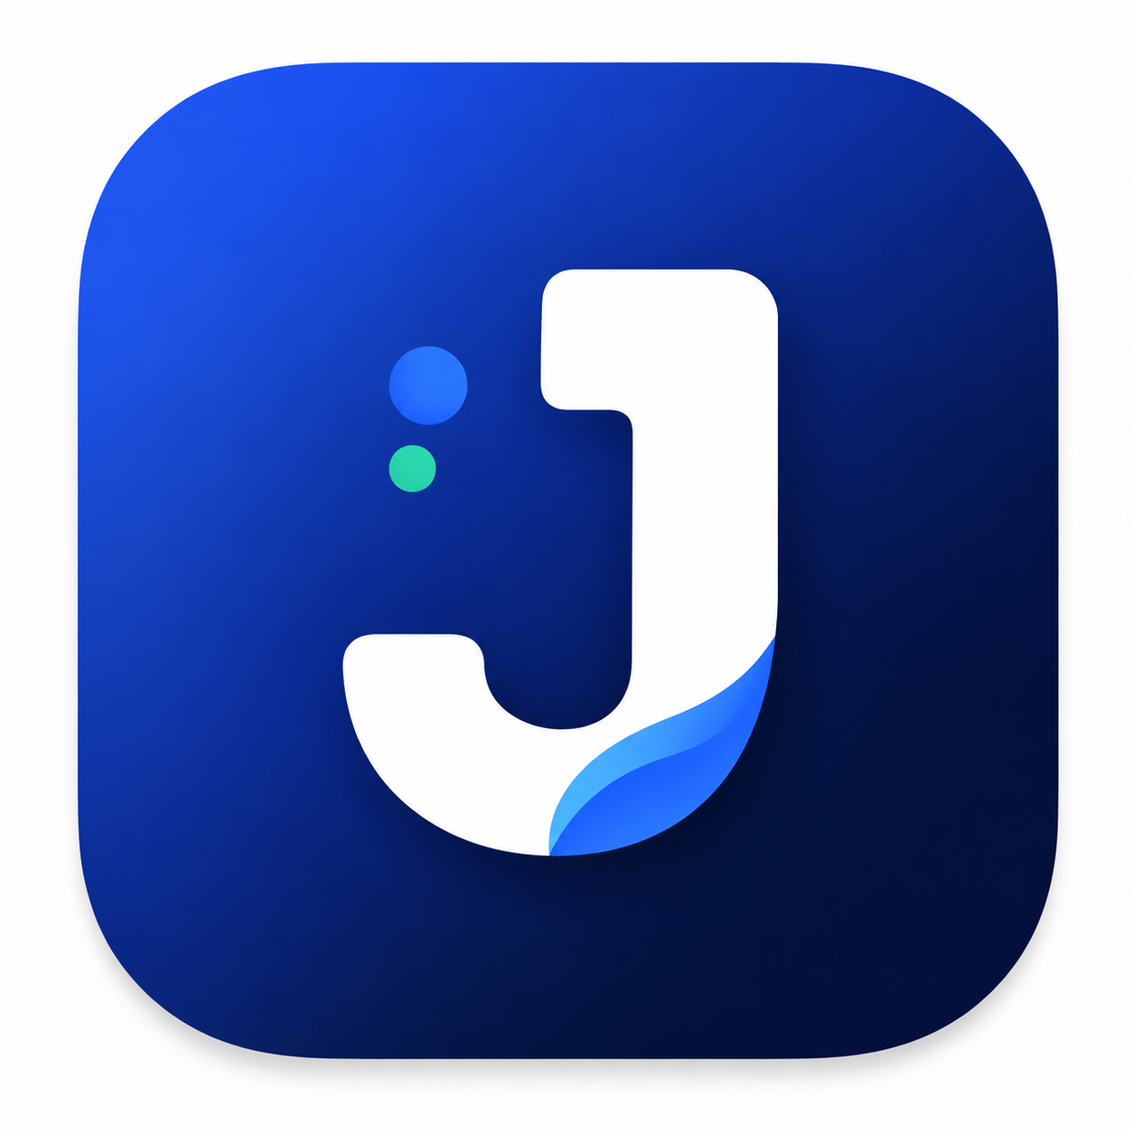
TalentLens
AI-powered resume analytics and job recommendation platform
Resume-to-Job Fit
Semantic analysis beyond keyword matching
Career Role Match
Strong, alternative, and missing-skill recommendations
Portfolio + Job Discovery
Editable portfolio preview and relevant India-focused opportunities
Final-year major project | Smart career guidance for job seekers

Slide 2
Problem Statement
Traditional resume screening often relies on keyword matching.
This fails to capture:
• Skill context and usage
• Career-role suitability
• Missing skills and gaps
• Project depth and achievements
• Semantic alignment between resume and job requirement
Why TalentLens?
To help job seekers understand their profile more realistically,
identify useful career directions,
discover suitable opportunities, and improve employability with explainable insights.

Slide 3
Project Objectives
•
1. Resume Analytics
•
2. Career Matching
•
3. Skill Gap Detection
Extract structured resume information and understand skills, experience, education, projects, and strengths.
Recommend the best-fit and alternative job roles using contextual reasoning rather than simple keyword overlap.
Highlight important missing skills and suggest useful resume improvements for better employability.
•
4. Portfolio Transformation
•
5. Domain-Aware Scoring
•
6. Evolving Skill Catalogue
Turn extracted profile data into an editable, professional portfolio preview that can be printed or saved as PDF.
Apply domain-based skill weighting with bounded, explainable score components for transparent job matching.
Allow users to review and accept new skills, which are normalized and saved for future recommendation accuracy.

Slide 4
Key Features
✓
Resume upload
✓
AI-powered analysis
✓
Career role suggestions
✓
Skill gap analysis
Supports PDF and DOCX resume processing.
Uses Google Gemini for contextual resume reasoning.
Best match and alternative roles are identified dynamically.
Detects missing skills and resume improvement opportunities.
✓
Job discovery
✓
Resume-to-job matching
✓
Portfolio preview
✓
Secure authentication
Searches and normalizes relevant jobs, primarily India-oriented.
Combines baseline scoring with semantic validation.
Editable professional portfolio with browser export options.
JWT-based access and MongoDB-backed user data.

Slide 5
System Architecture
Client / Frontend (React + Vite)
↓
Backend API (Express.js + Node.js)
↓
Services: Resume parsing, Gemini analysis, skill matching, job discovery
↓
Database: MongoDB for users, skills, and persisted catalogue data
↓
External integration: Google Gemini API + Jobicy public jobs API

Slide 6
Technology Stack
Frontend
Backend
Data & Intelligence
React
Vite
JavaScript
Responsive UI
Portfolio export
Node.js
Express.js
REST APIs
JWT auth
Multer uploads
MongoDB
Google Gemini API
Jobicy API
Resume parsing (PDF/DOCX)
AI embeddings / scoring

Slide 7
Resume Analysis Pipeline
1
1. Upload
2
2. Extract text
3
3. Normalize
User uploads PDF or DOCX resume.
Backend reads and parses resume content.
Resume information is structured into skills, education, experience, projects, and certifications.
4
4. AI reasoning
5
5. Validate
6
6. Recommend
Gemini interprets context, strengths, role fit, and improvement opportunities.
Results are checked and normalized before the frontend renders them.
Best-fit role, skill gaps, and job opportunities are generated.

Slide 8
Job Recommendation & Matching
Discovery
Matching Logic
Collects role, location, and resume context
Queries external job provider data
Filters and ranks India-relevant opportunities
Displays job title, company, source, and URL
Uses baseline keyword match as a foundation
Adds semantic evaluation with Gemini embeddings when available
Applies deterministic fallback if embeddings are unavailable
Explains matched vs missing skills and score components

Slide 9
Current Status & Future Roadmap
Implemented
Planned Enhancements
User login/register
Resume parsing and AI analysis
Career role recommendation
Skill gap and improvement suggestions
Portfolio preview and PDF export
India-oriented job discovery
Recruiter-side functionality
Broader job provider coverage
Candidate ranking and employer dashboards
Portfolio publishing and sharing
Improved semantic retrieval and ranking
Expanded product maturity and deployment

Slide 10
Project Summary
TalentLens is an AI-powered career assistance platform designed to help job seekers analyze their resumes, identify suitable job roles, discover relevant opportunities, and improve their employability with transparent, explainable insights.
Team: Final-year major project team
Focus: Smart, AI-assisted career guidance for students and job seekers
Thank You

