Slide 1


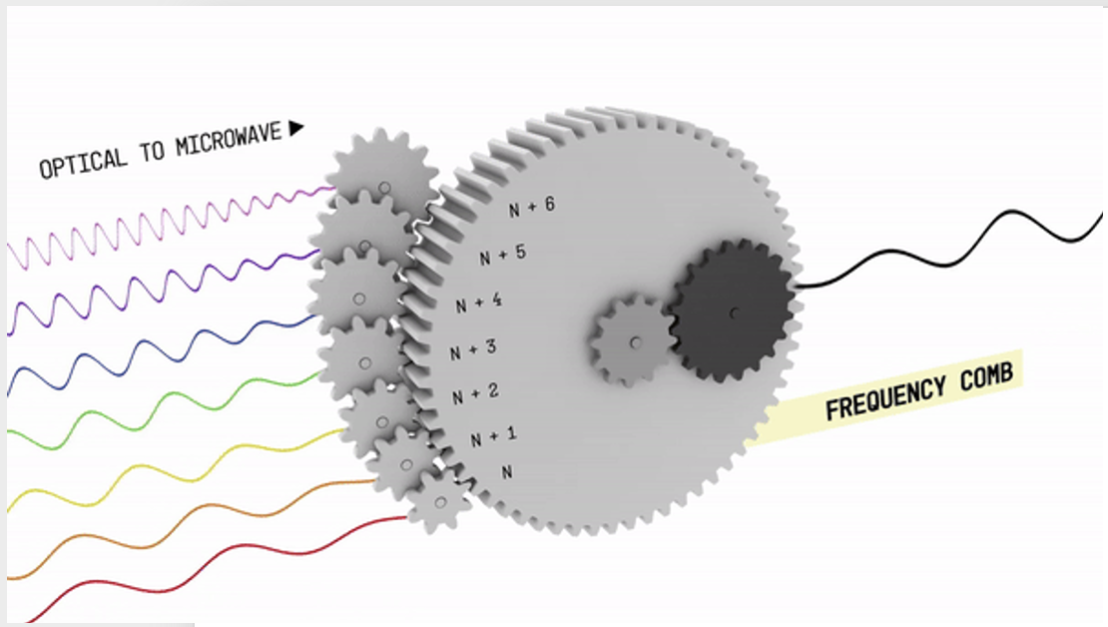
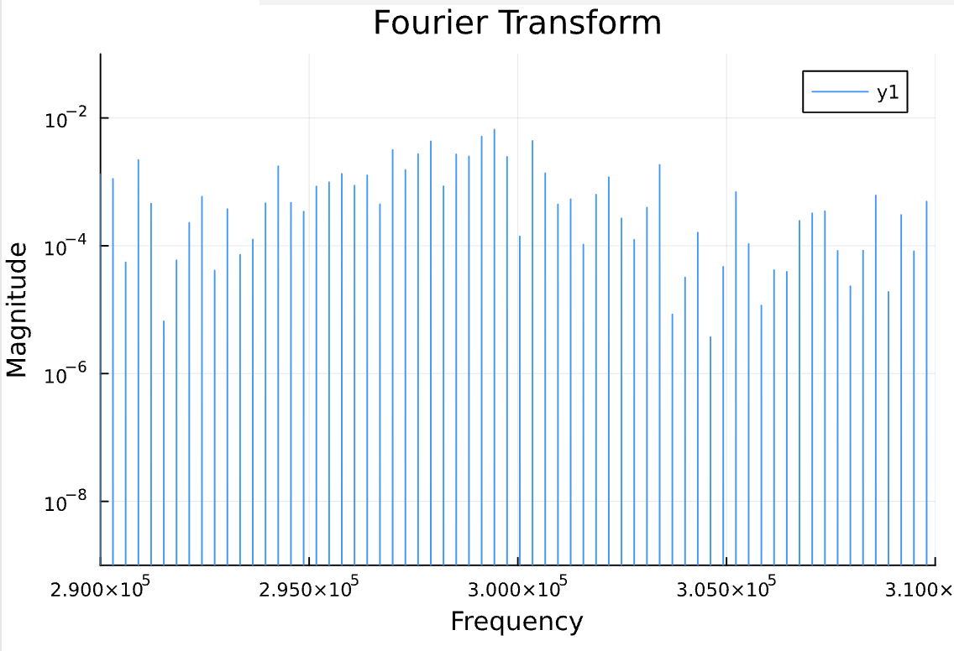
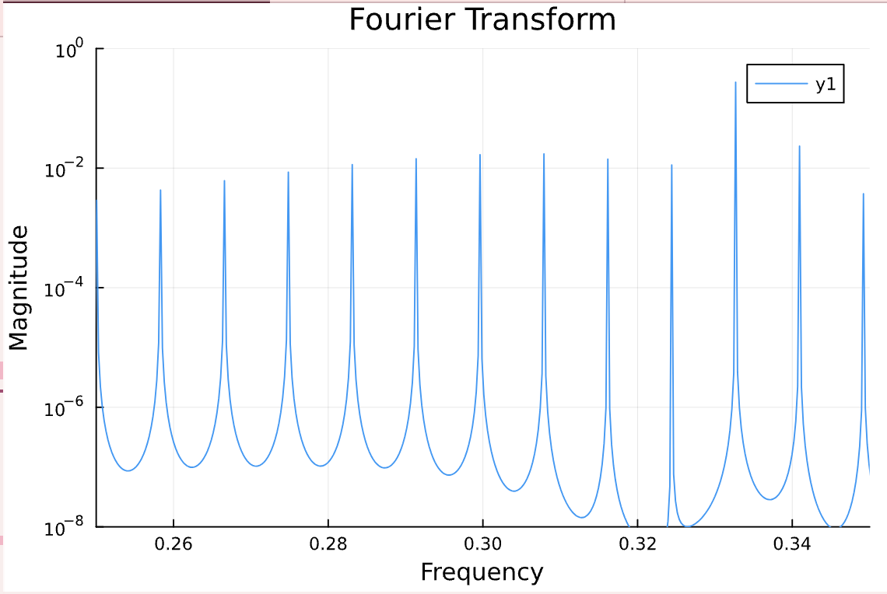
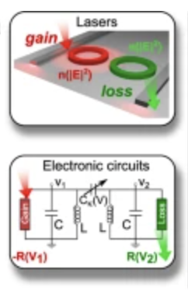
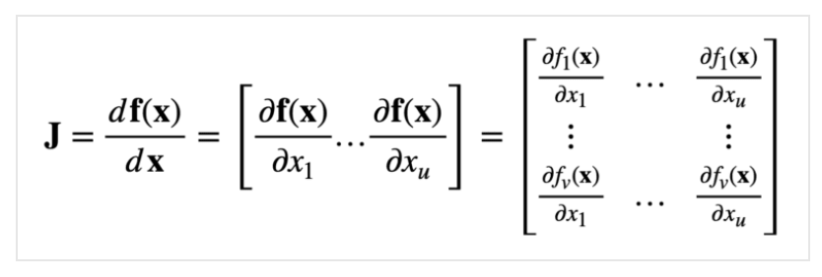
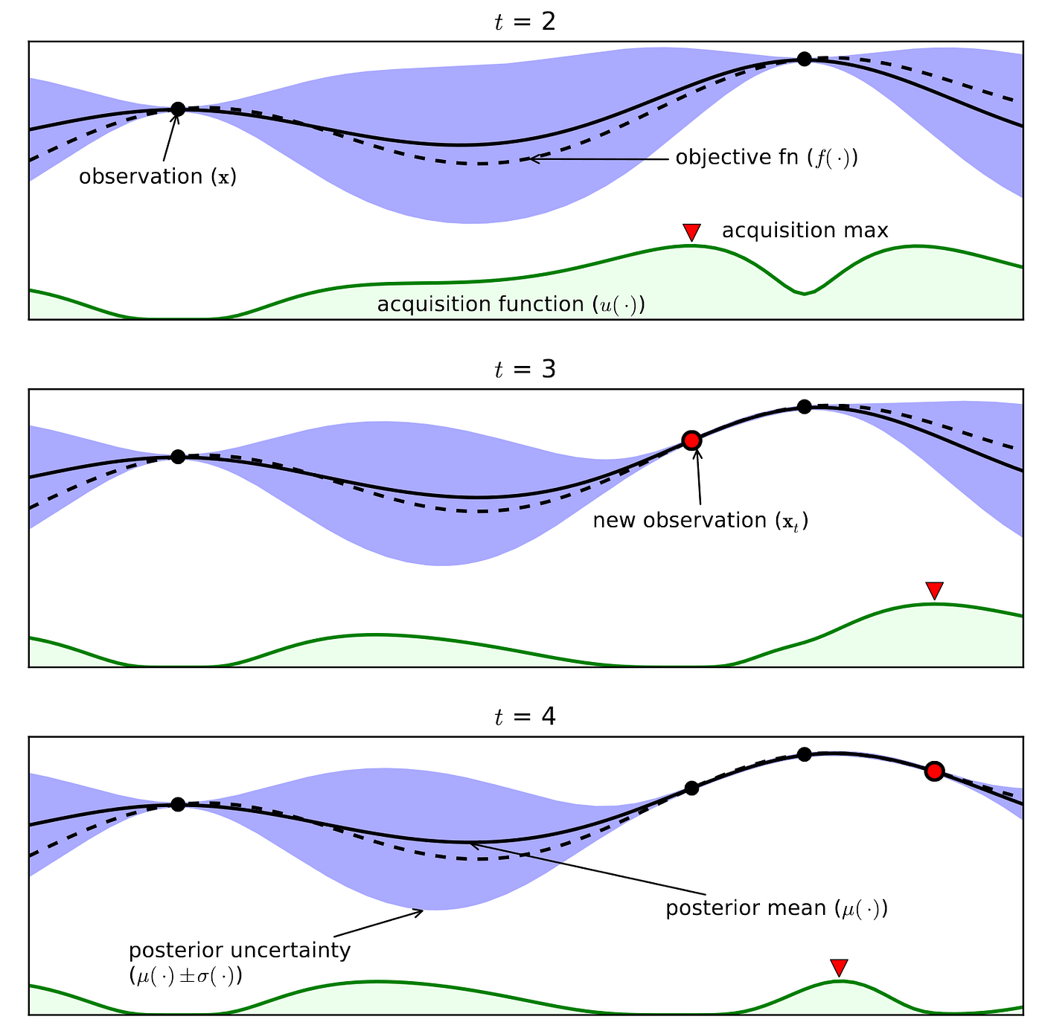
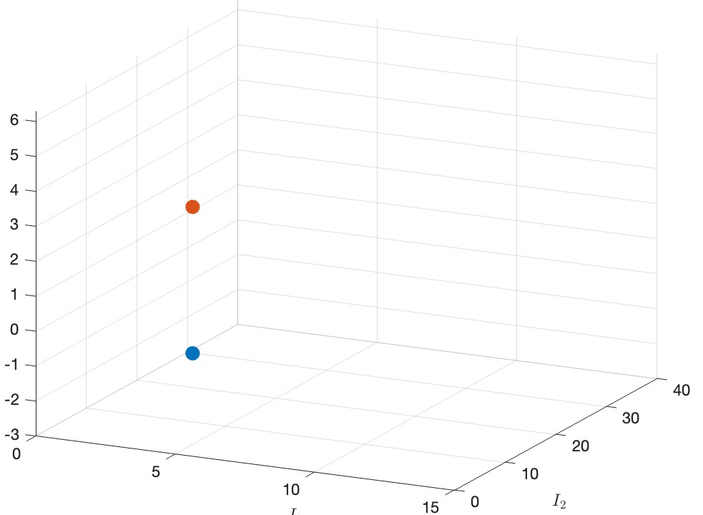
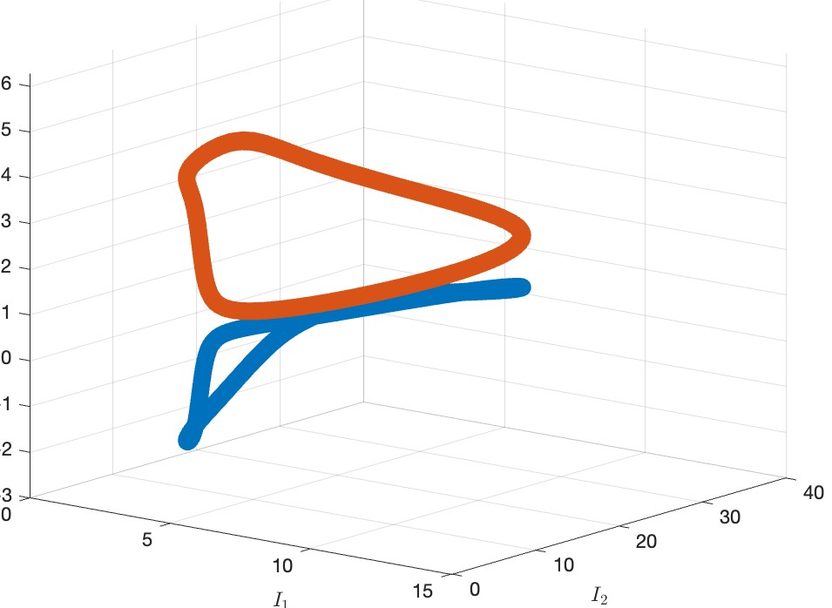
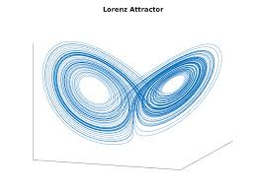
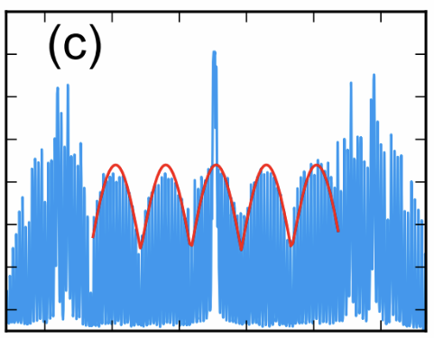
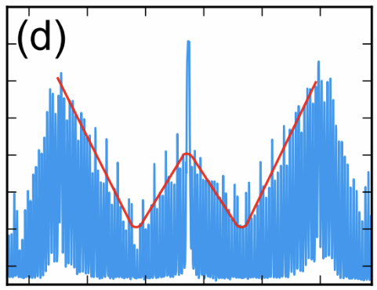
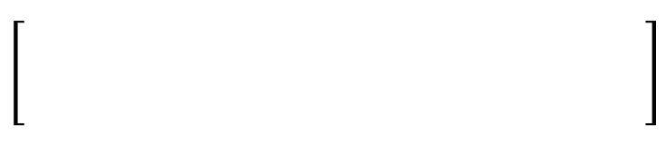
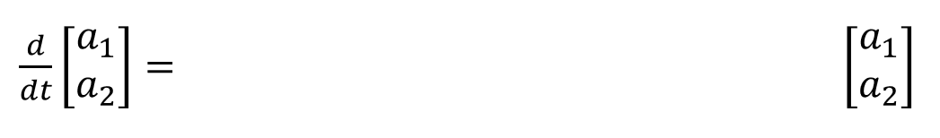

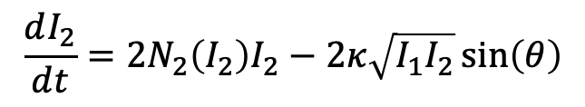










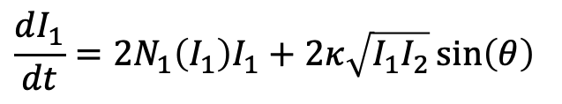


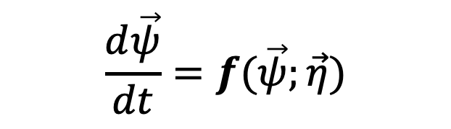

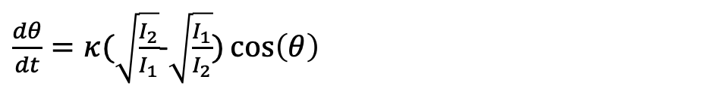


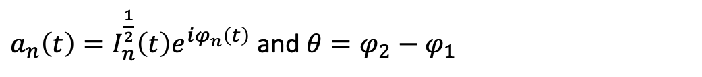


Generation of Frequency Combs via
Physics-Informed Bayesian Optimization
Z. Li, L. Fernandez, Z. Lin, T. Kottos
WTICS Lab, Wesleyan University
Applications
Results
Fourier Power Spectrum
Clocking
Data transmission
Optical signal processing
Magnitude
Magnitude
1. Comb Design Protocol
Frequency (Hz)
2. Dynamical Systems
Universal Modeling for Nonlinear
Multi-cavity Systems
Physics-based methodology to exploit limit cycles
Bayesian Optimization
$$\frac{d\vec{ψ}}{dt}=f(\vec{ψ};\vec{η})$$
Complexity
Fixed points
Limit cycles
Chaos
Optimal Parameters for Comb-Shaping
Power Spectrum
Power Spectrum
Power Spectrum
magnitude (a.u)
frequency (a.u)
Frequency
Frequency
Frequency
Inverse Design of Limit Cycles
3. Coupled Mode Theory
4. Physics-Informed Bayesian Optimization
Limit cycle condition
$$a1$$
$$a2$$
Task:$\min_{\vec{η}∈ℝ^{d}}{Loss\left(\vec{η}\right) subject to\max\left({Re[λ}_{J}(\vec{η})]\right)≥0}$
$$ω_{o}$$
$$κ$$
$$ω_{o}$$
Loss=target comb – current comb
Physics-Agnostic
Iteration 0
$$N_{1}({\left|a_{1}\right|}^{2})$$
$$N_{2}({\left|a_{2}\right|}^{2})$$
$$Loss\left(\vec{η}\right)$$
$$+N_{1}({\left|a_{1}\right|}^{2})$$
$$iκ$$
Initialization
$${iω}_{o}$$
$${iω}_{o}$$
Iteration 1
$$iκ$$
$$+N_{2}({\left|a_{2}\right|}^{2})$$
Sample
$$Loss\left(\vec{η}\right)$$
Sample
$$Expected Improvement$$
In polar coordinates,
$$\frac{dI_{1}}{dt}=2N_{1}\left(I_{1}\right)I_{1}+2κ\sqrt{I_{1}I_{2}}\sin\left(θ\right)$$
Sample
Iteration 2
$$\frac{dI_{2}}{dt}=2N_{2}\left(I_{2}\right)I_{2}−2κ\sqrt{I_{1}I_{2}}\sin\left(θ\right)$$
Update
$$Loss\left(\vec{η}\right)$$
$\frac{dθ}{dt}=κ(\sqrt{\frac{I_{2}}{I_{1}}}$-$\sqrt{\frac{I_{1}}{I_{2}}})\cos\left(θ\right)$
$$Parameter η$$
$a_{n}\left(t\right)=I_{n}^{\frac{1}{2}}\left(t\right)e^{iφ_{n}\left(t\right)}$ and $θ=φ_{2}−φ_{1}$
6. References
Mattis Reisner, Do H. Jeon, Carsten Schindler, Henning Schomerus, Fabrice Mortessagne, Ulrich Kuhl, Tsampikos Kottos, Self-Shielded Topological Reciever Protectors Phys. Ref. A 13, 034067 - 2020
William R. Sweeney, Chia Wei Hsu, A. Douglas Stone, Theory of Reflectionless Scattering Modes Phys. Rev. A 102, 063511 – 2020
J. K. Asbóth, L. oroszlány, A. Pályi, A Short Course on Topological Insulators arXiv 1509.02295v1 - 2015

