Slide 1
Outline
Notes:
Self-introduction

Slide 2
Introduction
Frequency Combs
Applications
Recent developments
Dynamical Systems
Increasing complexity: Fixed points, limit cycles, chaos
Tunability through changing parameters
Inverse Design of Limit Cycles

Slide 3










Bayesian Optimization Overview
Task:$\min_{\vec{η}∈ℝ^{d}}{Loss\left(\vec{η}\right) subject to\max\left({Re[λ}_{J}(\vec{η})]\right)≥0}$
Limit cycle condition
Physics-Agnostic
Iteration 0
Physics-Informed
$$Loss\left(\vec{η}\right)$$
Iteration 0
$$Loss\left(\vec{η}\right)$$
Sample
Iteration 1
Jacobian $λ_{J}$
$$Expected Improvement$$
$$Loss\left(\vec{η}\right)$$
$$Expected Improvement$$
Sample
Iteration 1
Iteration 2
$$Loss\left(\vec{η}\right)$$
Sample
$$Loss\left(\vec{η}\right)$$
$$Parameter η$$
$$Parameter η$$

Slide 4
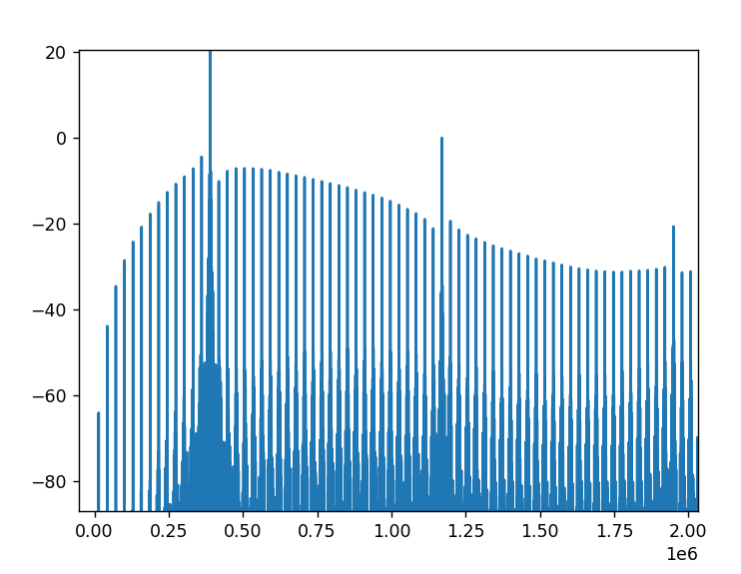
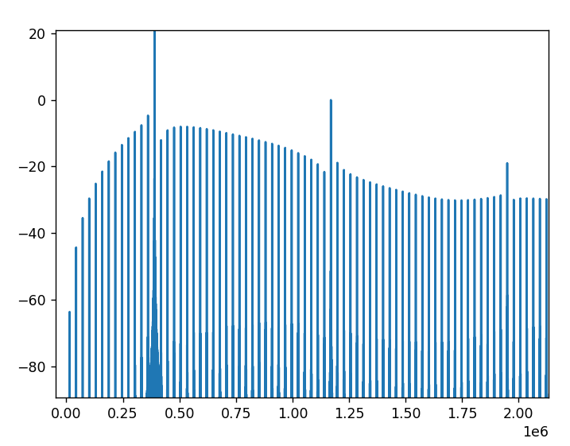
Physical Platform Example 1: Single Dimer LC

Slide 5
Physical Platform Example 2: Two Dimer LC

