Slide 1
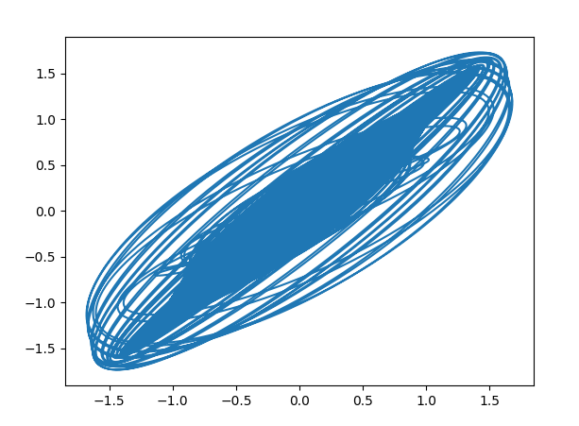
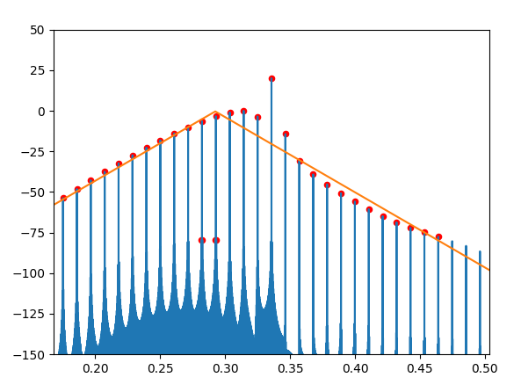
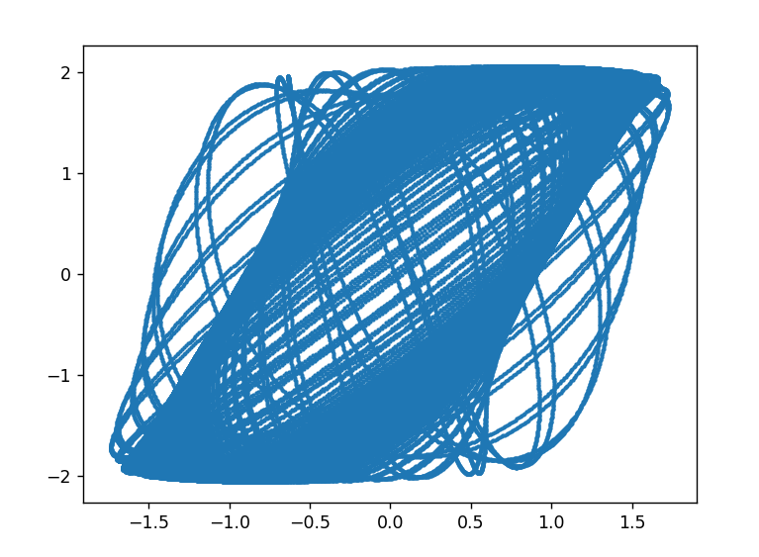
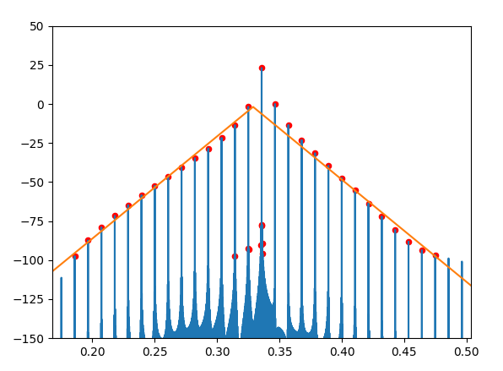




Frequency comb for $V_{1}$
$V_{1}$ vs $V_{2}$
Frequency comb for $V_{3}$
$V_{2}$ vs $V_{3}$

