Slide 1
Outline
Notes:
Self-introduction

Slide 2
Introduction
Frequency Combs
Applications
Recent developments
Dynamical Systems
Increasing complexity: Fixed points, limit cycles, chaos
Tunability through changing parameters
Inverse Design of Limit Cycles

Slide 3










Bayesian Optimization Overview
Task:$\min_{\vec{η}∈ℝ^{d}}{Loss\left(\vec{η}\right) subject to\max\left({Re[λ}_{J}(\vec{η})]\right)≥0}$
Limit cycle condition
Physics-Agnostic
Iteration 0
Physics-Informed
$$Loss\left(\vec{η}\right)$$
Iteration 0
$$Loss\left(\vec{η}\right)$$
Sample
Iteration 1
Jacobian $λ_{J}$
$$Expected Improvement$$
$$Loss\left(\vec{η}\right)$$
$$Expected Improvement$$
Sample
Iteration 1
Iteration 2
$$Loss\left(\vec{η}\right)$$
Sample
$$Loss\left(\vec{η}\right)$$
$$Parameter η$$
$$Parameter η$$

Slide 4
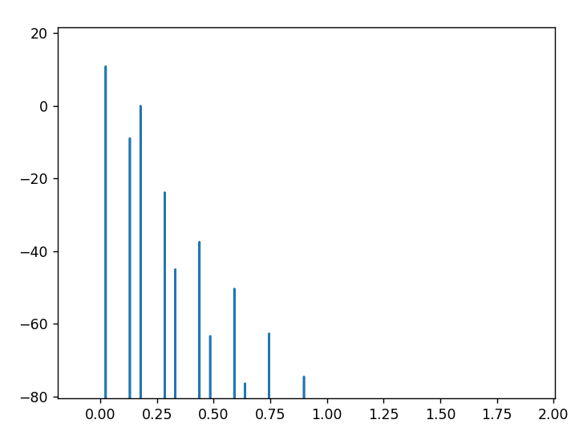
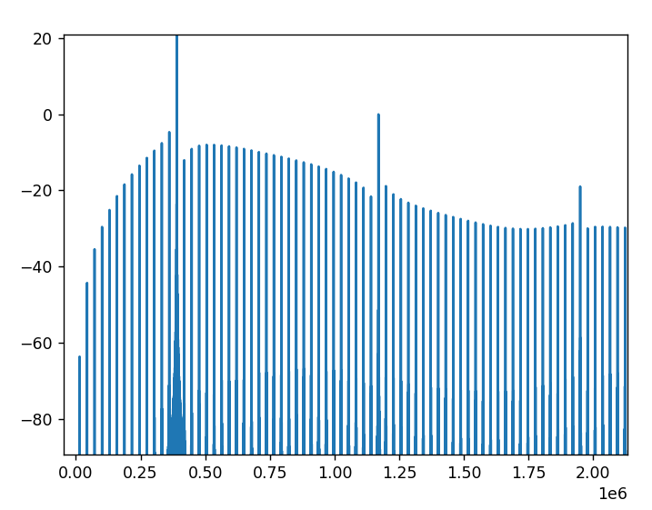
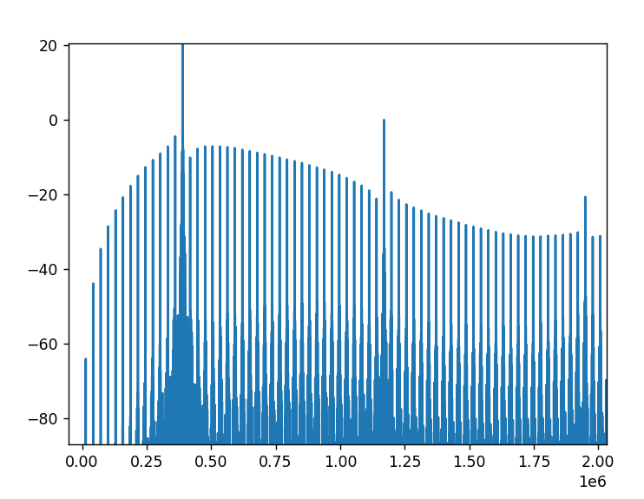
Physical Platform Example 1: Single Dimer LC
CMT
Ngspice without noise
Ngspice with noise

Slide 5
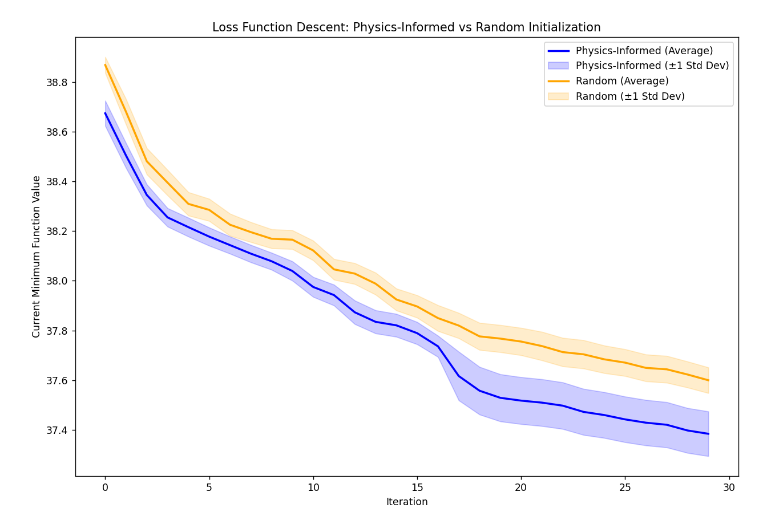
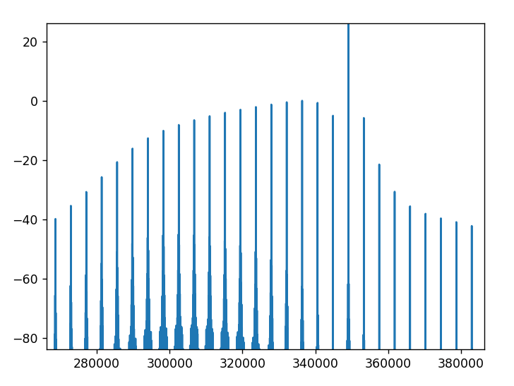
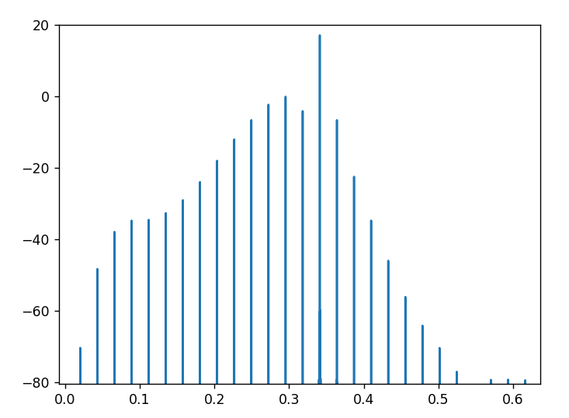
Physical Platform Example 2: Two Dimer LC
Optimization Comparison
Ngspice (Without noise)
CMT

Slide 6
Designing Frequency Combs by Engineered Limit Cycles
Connection between frequency combs and synthetic dimensions/Floquet lattices
The problem with Floquet lattices: exponential decay of harmonic
Traditional alternative methodology for creating frequency combs: utilize nonlinear multimode cavities at steady states (nature photonics paper). Problems with dispersion engineering, excess Q factors, footprint
Here we propose a totally different approach that simultaneously resolves both problems presented above. Our method relies on shaping a limit cycle emerging from few mode cavities and generate frequency combs with equal footing/balanced profile.
Discuss coupled mode theory (including physics-driven improvements) for the two dimers. (Quick discussion) (Comparison between 1, 2, and 3 dimers)
Demonstrate principle for a physical system. a) single dimer b) two dimers. Noise analysis in the appendix.
Experiment?

