Slide 1
Software Engineering

Slide 2
Please Interrupt

Slide 3
Software Engineering

Slide 4
Single Best Option For a Career

Slide 5
First job AI will take over

Slide 6
What if I don't care about programming

Slide 7
Reasons People Are in Software
They have a band and want to be able to tour
They want money for elaborate cosplay
They want to retire early
They want to make art
They want an easy job

Slide 8
Even if you hate programming, tech is an amazing place to be

Slide 9
I Love Programming

Slide 10
I Build Programming Languages

Slide 11
You can do anything

Slide 12
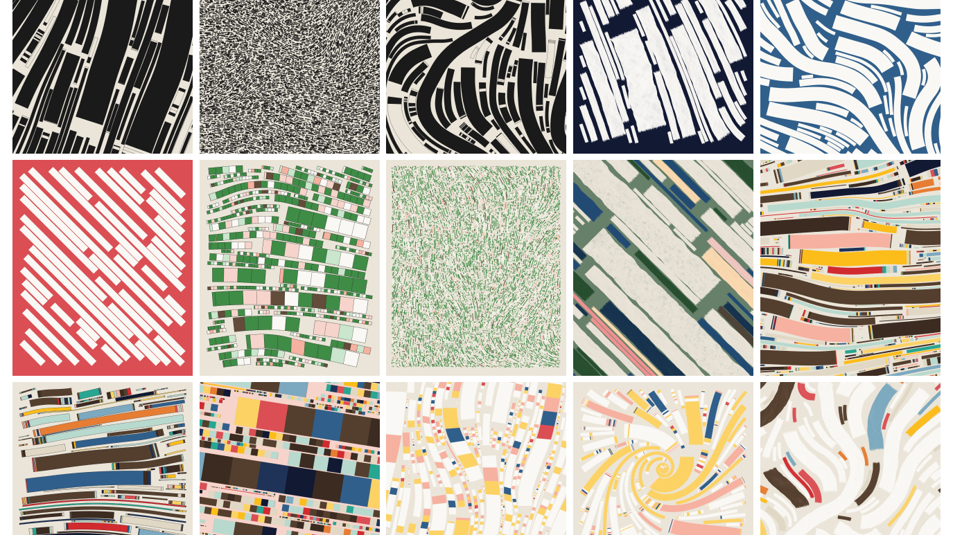

Slide 13
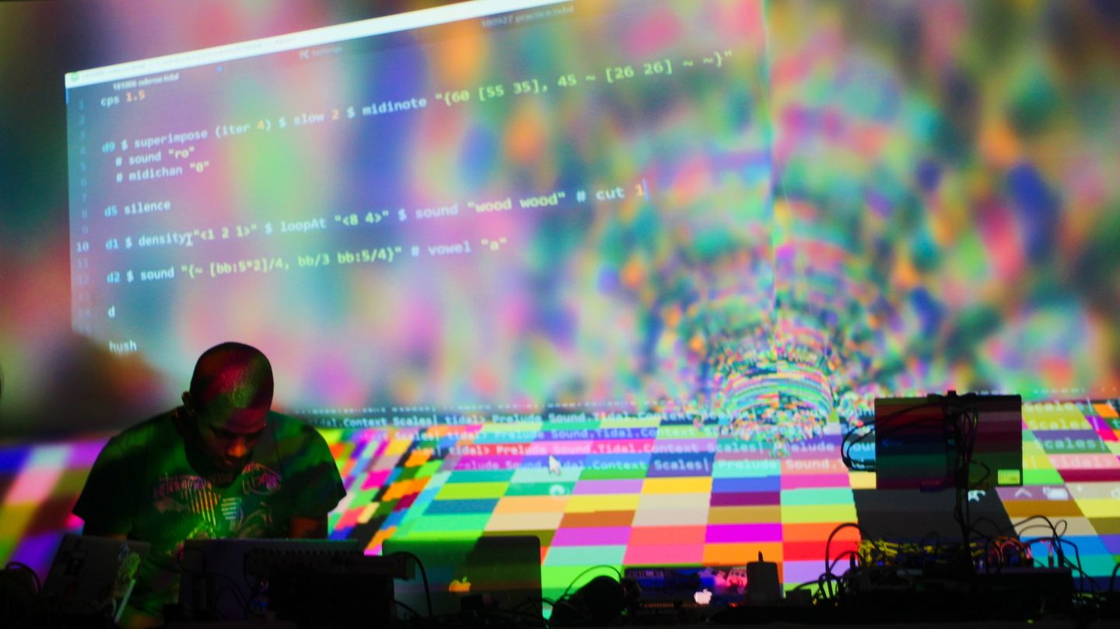

Slide 14
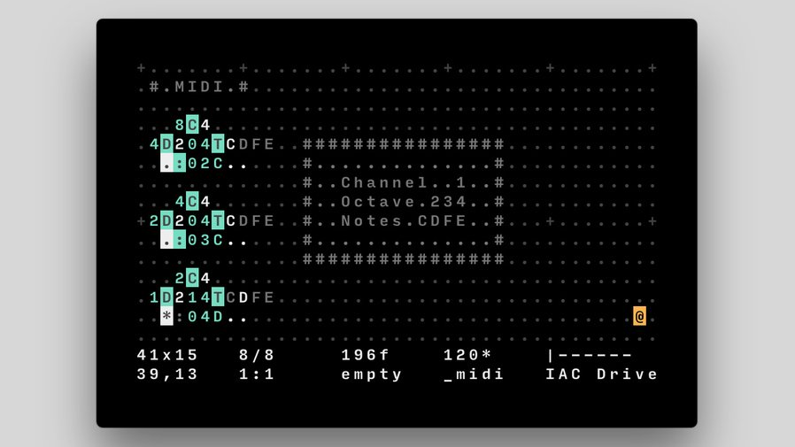

Slide 15
What does a software engineer do?

Slide 16
Code
Clean up old messy code
Make code faster
Debug deep complicated bugs
Design Systems
Argue with "the business" on how things should be done
Talk to customers (occasionally)

Slide 17
Deeply understand the inner workings of a business

Slide 18
How Much Do Software Engineers Make?

Slide 19
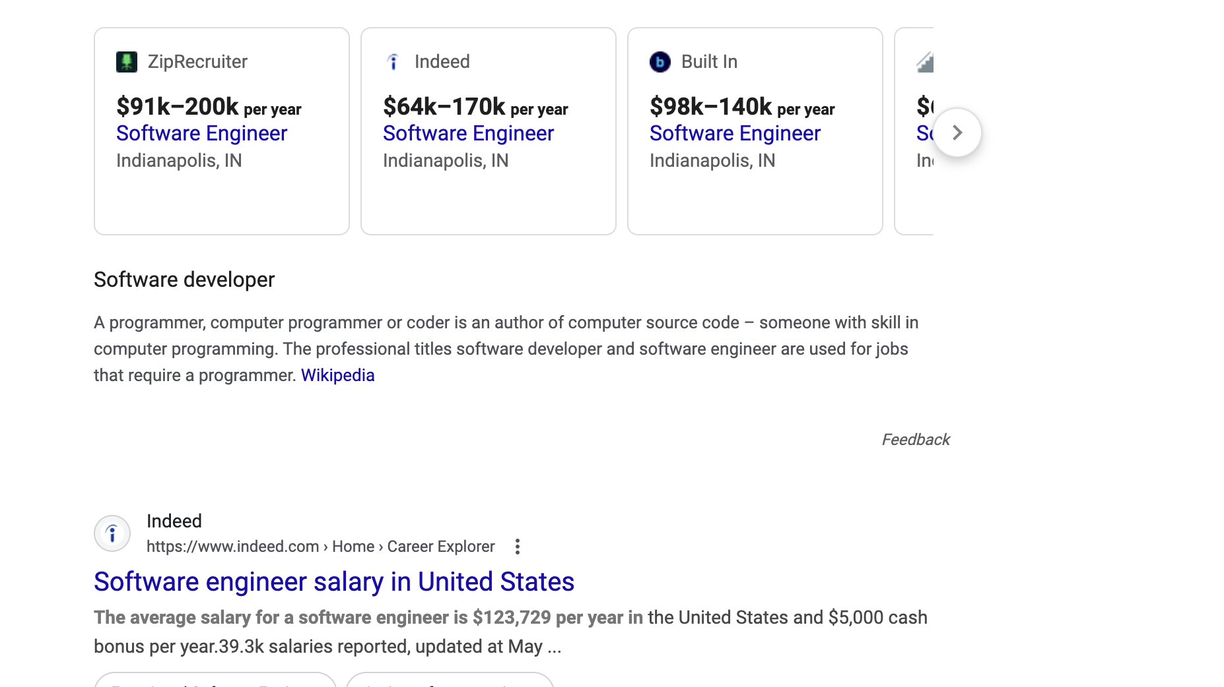

Slide 20
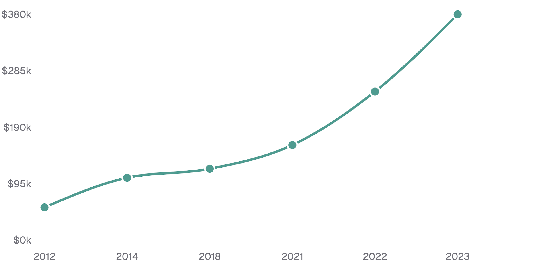
Salary
2012: 55k
2014: 105k
2018: 120k
2021: 160k
2022: 250k
2023: 380k

Slide 21
I'm far from the highest paid

Slide 22
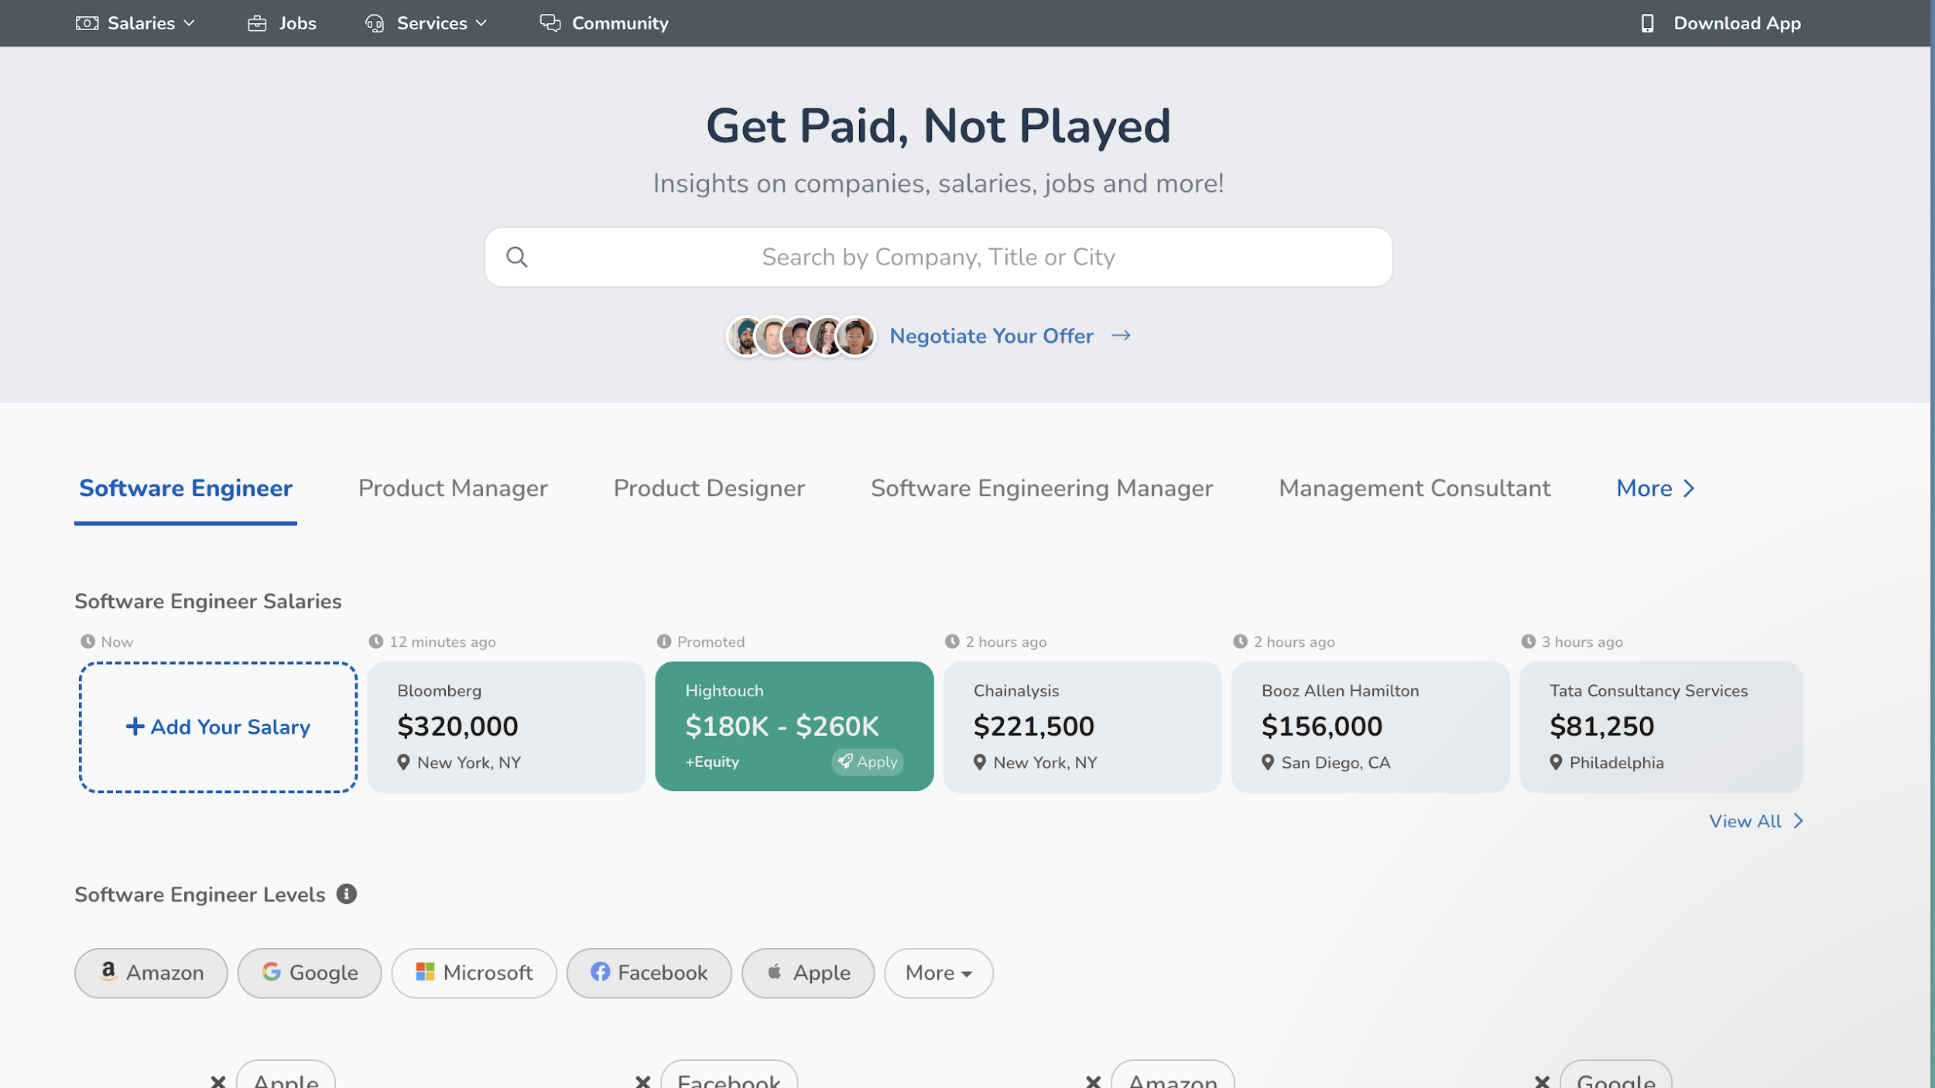

Slide 23
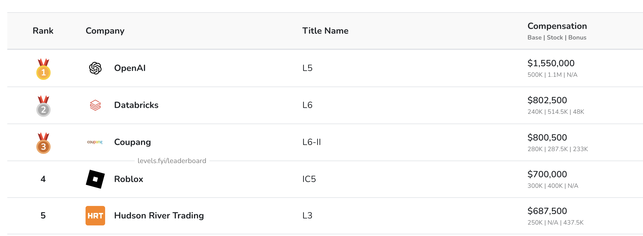

Slide 24
Other Benefits
Remote Work
Unlimited Vacation
Flexibility
No crazy hours

Slide 25
Downsides
Can be boring
Repetitive work
Things move slowly
Some industries have long hours (startups and games)

Slide 26
Questions

Slide 27
What language is most relevant?

Slide 28
It Depends

Slide 29
Python: AI
Javascript/TypeScript: Frontend
Java: Nearly Every Large Company
C/C++/Rust: Games, Operating Systems, Languages
Go: Network Services
SQL: Databases

Slide 30
Unpopular Languages Matter Too

Slide 31
Shopify/Github: Ruby
Whatsapp: Erlang (20B; 35 Engineers)
Largest Bank in Brazil: Clojure
Meta: OCaml, Haskell
NASA: Lisp

Slide 32
Internships?

Slide 33
Advice
Post Code on Github
It can be terrible code!
It can be buggy!
Don't be afraid of "second rate" companies
Show your personality
Don't pretend you know something you don't
Play to your strengths

Slide 34
Starting out
Codebases at companies are messy
There's a lot you don't know
Be ambitious but not stupid
Don't listen to old, grumpy coworkers
Watch talks, read blogs, learn on your own

Slide 35
AI

Slide 36
Or: Aren't all programming jobs going away for ever and no will ever code again??

Slide 37
I use AI tools everyday

Slide 38
They are pretty darn good. And will get better.

Slide 39
They can't convince people to do the RIGHT thing.

Slide 40
Jevon's Paradox

Slide 41
If programmers are more efficient, we can have more of them

Slide 42
Closing Thoughts

Slide 44
Secret Slides

Slide 45
Other things I've worked on
Frontend
Backend
"Big" Data
Fintech
Medical Recommendations
Adtech
Mobile Apps

Slide 46
Languages
Java
Javascript/Typescript
Ruby
Python
Clojure
C#
Rust
SQL/JSON/HTML/YAML etc...

