Slide 1
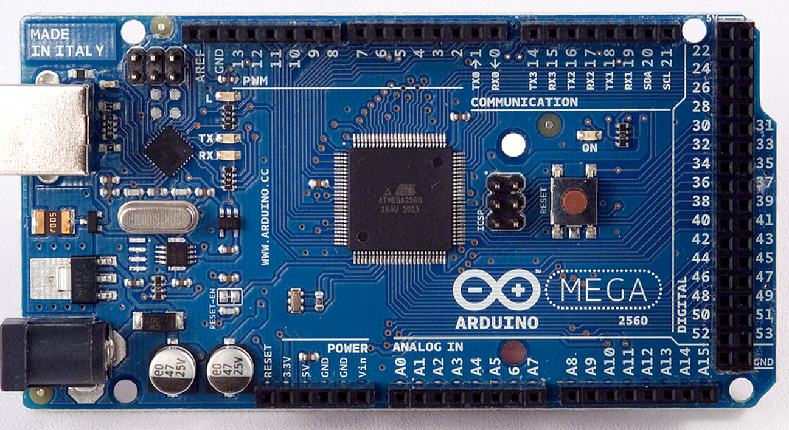
Tutorial – Arduino in C
Tutorial – Arduino in C
James Tappe

Slide 2

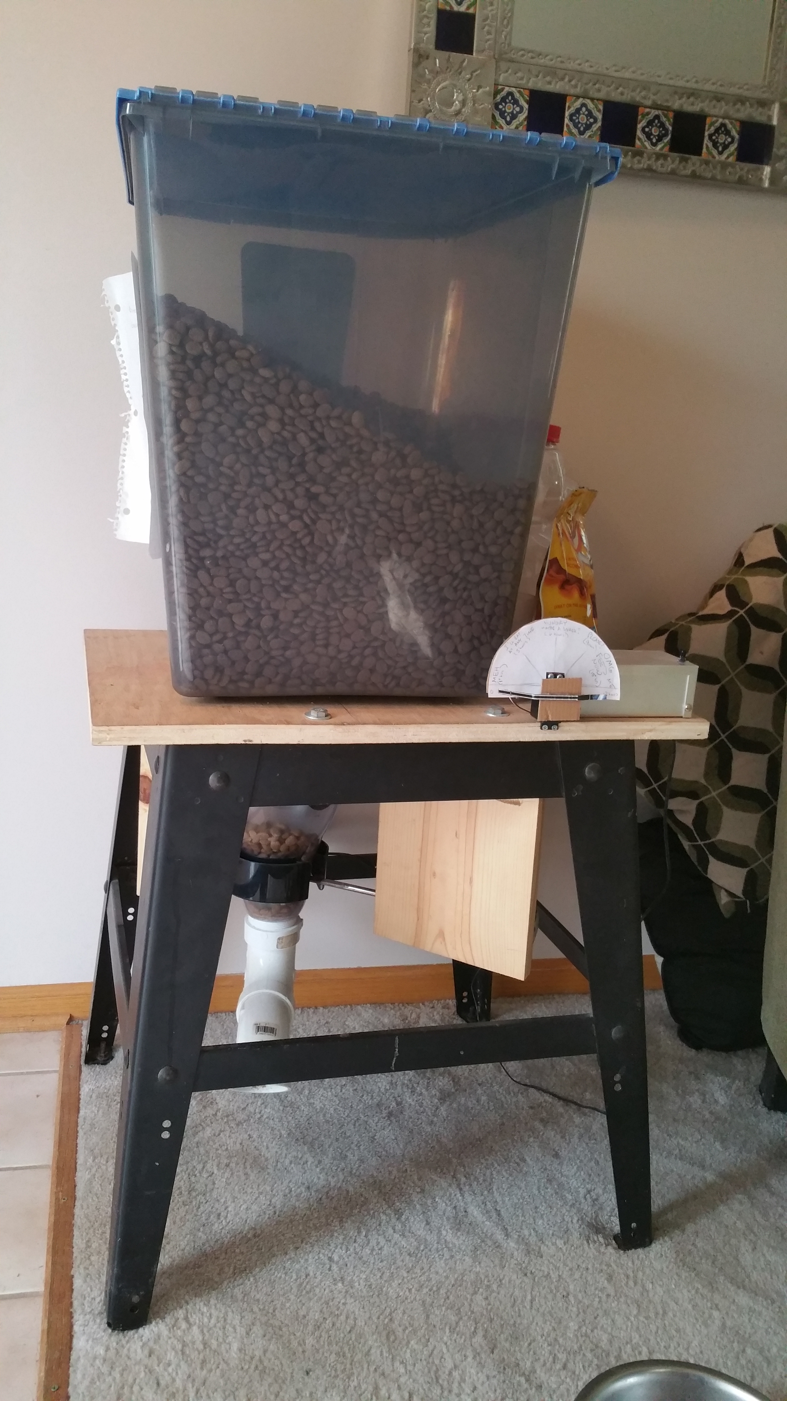
Arduino

Slide 3
Arduino
The Arduino is a an inexpensive open source microcontroller board that makes learning and building electronic circuits fun. It can be used to build electronic projects that can also communicate with electronics and even an Android device. With the free Arduino software, any one can easily change the functionality of the board simply by reprogramming the microcontroller.

Slide 4
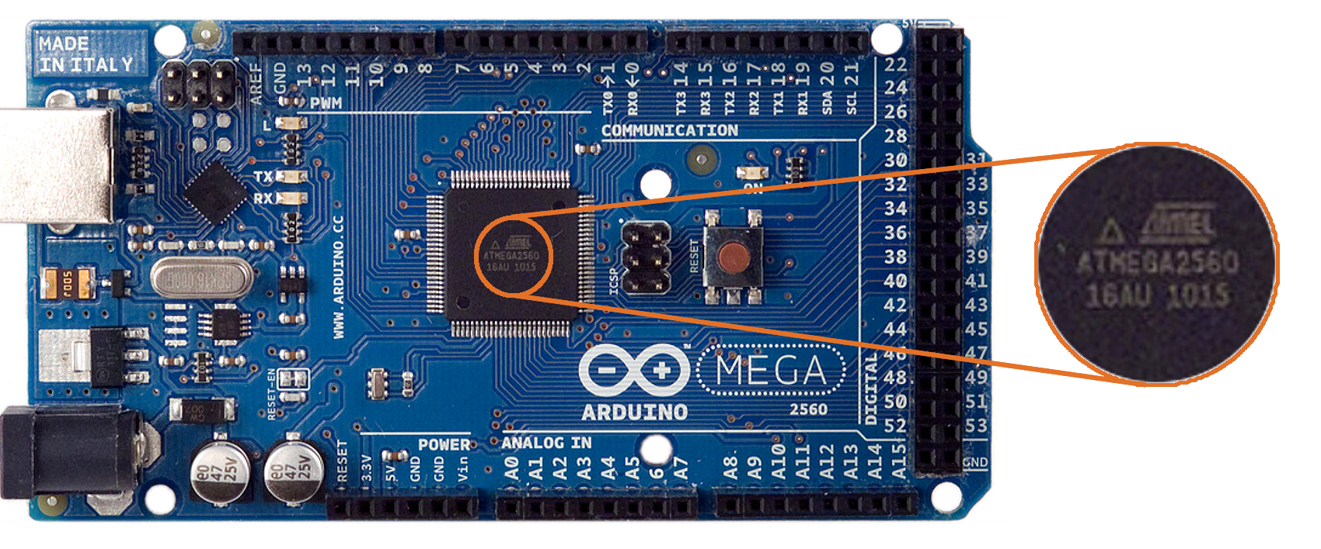
Atmega ADK

Slide 5
Tutorial - Arduino in C
PART 1 - Setting up the Programing Environment
Breaking away from Arduino's IDE, I will describe what (free) tools users will need to download. Since my experience is with Eclipse, avr-gcc, make and linux, this is the environment I will describe. I will show readers how to setup these tools and how to upload programs to the Arduino.
PART 2 - Including the Arduino Libraries
Here I will explain how to use the Arduino libraries in the new environment. This is a great way to test the environment but more importantly I will explain what some of the libraries do. This is a great way to learn what is going on behind the scenes and transition into the next tutorial.
PART 3 - Blink in Pure C
Every new Arduino owner's first program is Blink. It is the Hello World in Arduino. This tutorial will write the Blink program coding the MCU directly utilizing Atmel's data sheets. I will explain why these data sheets are gold as they explain the AVR architecture and contain many examples and tutorials within them. I will then explain line by line what the code is doing.

Slide 6
(Web based) Tutorial - Arduino in C
PART 3 - Blink in Pure C
Every new Arduino owner's first program is Blink. It is the Hello World in Arduino. This tutorial will write the Blink program coding the MCU directly utilizing Atmel's data sheets. I will explain why these data sheets are gold as they explain the AVR architecture and contain many examples and tutorials within them. I will then explain line by line what the code is doing.

Slide 7
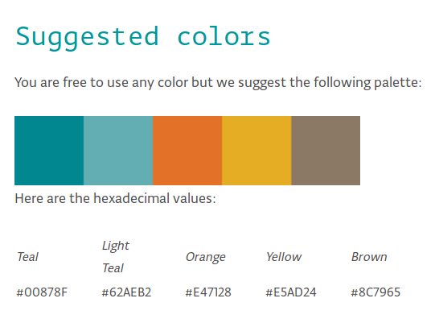
Tutorial - Arduino in C
Content → Layout → HTML → CSS → Finished Product
-Top down vs. Linear Approach
-Audience Centered
-Expandability. Submit to the Arduino Community?
-Time
-Hindsight and knowledge make it difficult
-HTML and Cascading Style Sheets
-Research examples

Slide 8


