Slide 1


Blueno
Match
Made by Jimmy Chen

Slide 2

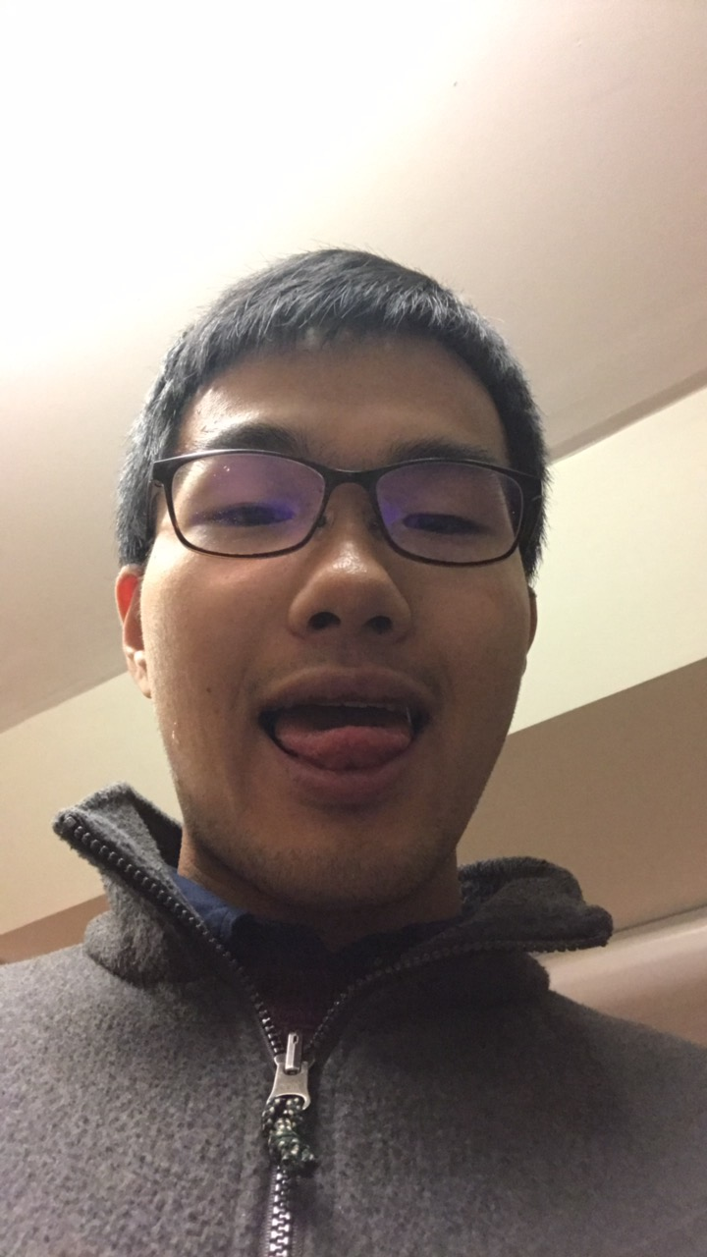
About the “Team”
Hey everyone! I'm Jimmy Chen from Hangzhou, China.
I'm a (rising) Junior studying APMA-CS.
My hobbies are sitcoms and Chinese netfictions, maybe also tiktok memes and combat sports/anime.
In my spare time, you can see me doing RPL works.
You can Email me to jimmy_chen@brown.edu

Slide 3

Lonely on Friday nights?
Can't find a friend?
Want to meet people of similar interests?
Type “Blueno Match” in Facebook

Slide 4

Overview
Link
With COVID happening, a lot of people are being unable to make friends with similar interests because less social events are going on. Our program, Blueno Match, helps deal with this issue by setting up a system to match people with those who are similar for friends.
Basically, you fill a survey answering a bunch of questions before Thursday at 12PM. Then on Friday morning at 8AM you will receive an Email telling you who you are matched with. We will release a new survey every week. The person you are matched with is the person who is the most similar with you based on your answers. Then you can Email that person to meet up.

Slide 5
Overview
People are matched based on questions they answer in the survey, including the classes they take, whether they are substance-free, their native language(s), their hobbies, their political affiliations, and the cultural clubs they are in.
We understand that different factors matter differently for different people. So our program allows you to choose your own weightings for the factors when comparing your matching scores with others. The person with the highest score with you will be matched with you.

Slide 6

TLDR
Fill Survey before Thur. 12PM
Get Match at Fri. 8AM
Happening every week

Slide 7
Have fun folks!
Credit:
Background Music: The Magnificent Seven (Main Theme) by Elmer Bernstein

