Slide 1
Applications
这次应用和上一代的区别
机会和挑战
应用的mapping
4种应用的分类，和趋势
如何选择产品目标用户，目标地域市场方法；避免错配
这些选择

Slide 2
Product Positioning in Agentic AI Era
Technology as Enablement, the Bottom Line
Production， the Top Line
1
2
3
4
5
Embrace Solopreneurship
Target Agentic Workforce, Not Tools
Own the Business, Not Just Enable
Exercise Your Comparative Advantages
Operate Agent-Natively
拥抱独立创业
瞄准劳动力市场
拥有业务,不仅赋能
发挥比较优势
开启原生AI化
公司运营模式
6
7
8
9
10
Master the Agentic Tech Stack
Execute at Lightning Speed
Master Full-Stack Operation
Monetize Fast
Align Strategy and
Execution
掌握Agent技术栈
闪电速度执行
精通全栈经营
快速变现
战略对齐快速迭代

Slide 3
Agentic AI Enterprises
Consumer AI
Power User AI
Vertical AI
Enterprise AI

Slide 4
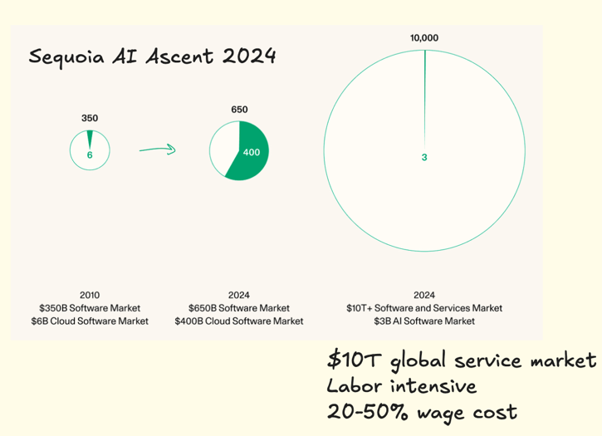
Action 2 -- 瞄准劳动力市场 Target Agentic Workforce, Not Tools
Agentic Tools < Agentic Workforce
Workforce Budget Among Top Three Costs
HR Budgets Exceed IT Budgets
Digital Workforce Becoming Reality
Role-Based Workforce Delivers Higher Value
Stop Hiring Humans for Repetitive Roles
Notes:
workforce market size is much larger than IT market size?
larger market size, agentic tool-> role-based agentic tool

Slide 5



Digital Workforce Cases – Scale With Less Headcount
2
Target Agentic Workforce, Not Tools
Role, Department Function-based
Single to Full Responsibilities
Business Model: Sell by Seats; Cost-based Pricing Model
角色Agent化产品
AI Project Manager
AI SDR
AI Software Engineer
End-to-end coding agent — plans, writes, tests, and deploys software autonomously
Acts as the coordination layer where humans set goals and AI agents execute implementation
Automate full sales funnel—lead qualification

Slide 6
Digital Workforce Challenges in China
Buying Habits
Suppliers’ Competition
Digital Workforce Is Still a Tool, but Powered by LFM
Pure Tools Not Selling Well
Larger Pricing Compression
Commoditization of LFM
Coding Democratizing, Barriers Lowering

Slide 7
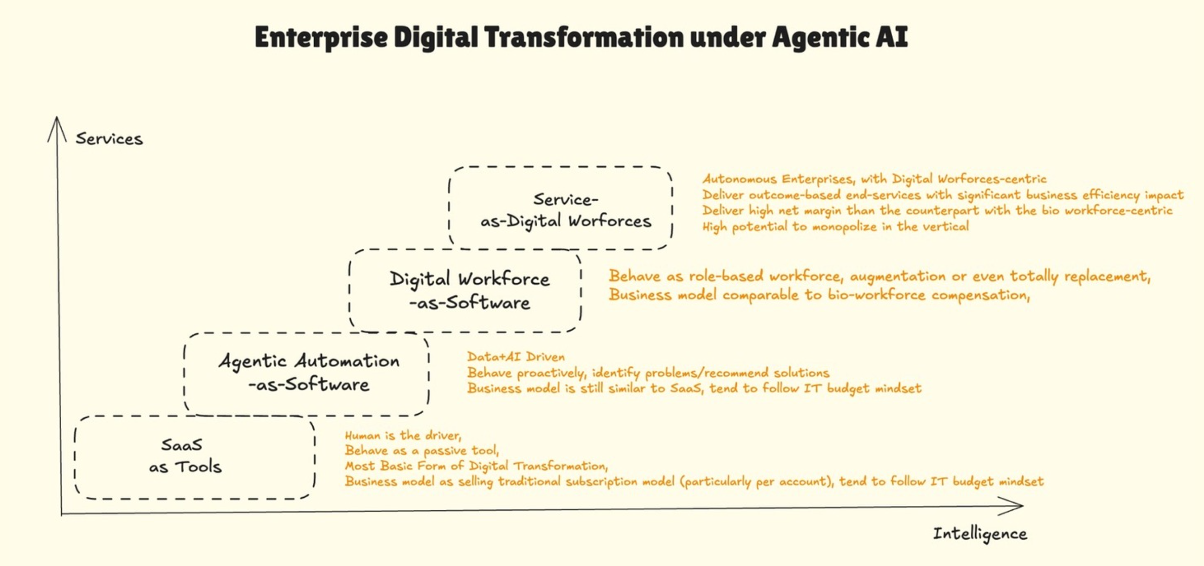
Action 3 -- 拥有业务不要仅赋能 Own the Business, Not Just Enable
Agentic Tools < Agentic Workforce < Agentic Enterprise
Vertical Businesses Usually Capture the Most value, Particular the Agentic AI-powered Verticals in the Future.
Rapid Democratized Technology, So Is the Pricing Power for Agentic Workforce
Outcome-based Models, Business Ownership
Notes:
possible value chain,
in the future digital workforce might like it is cost-based/technology democratization, less likely on value-based.
particular in china (B2B software business);
outcome-based business

Slide 8



Agentic Enterprise Cases
3
Own the Business, Not Just Enable
拥有业务
Call Center
SDR
Supply Chain
Insurance Sales Agency
Marketing Agency
Backoffice GA
Property Management
。。。
AI Recruiting Agency
Robo Taxi Services
Deliver Vetted Talent Faster and More Objectively
Achieve This Through End-to-End Automation
Efficient, scalable, always-on enterprises displacing incumbents.
Autonomous agents running workflows with human oversight.

