Slide 1
Agentic enterprise 运营

Slide 2
Action 4 : 发挥比较优势 Exercise Your Comparative Advantages - Scale Big or Stay Nimble to the Extreme
Exercise the Comparative Advantages to The Fullest: Dominate Through Scale or Win Through Agility
✕
Scale
Leverage resources to dominate market
Last success is inherently the baggage.
Middle Ground
Trapped between paradigms
Nimble
Move fast and disrupt
How to quickly win the category lighting fast.
Notes:
leverage comparative advantage to the extreme

Slide 3





Action 5:开启原生AI公司运营模式 Operate Agent-Natively
Integrate Agentic Mindset/Tools/Services Deeply into Operations
Automate Operational Lifecycles, Gradually, As Much As Possible
Achieve Superior Margins And Scalability
Prepare For Fully Automated Enterprises
Agentic Business Functions
Level of Agency
SaaS
Traditional software model
Research & Development
Marketing & Growth
Sales & Acquisition
80% human + 20% tools
Copilot
Assisted intelligence
50% human + 50% copilot
Product Fulfillment
Customer Support
Supply Chain
Agentic Role
AI-driven processes
20% human + 80% agent
Agentic Enterprise
Full autonomous operation
HR & Recruiting
Finance & Accounting
Operations & Admin
99.9% agents
Notes:
agent-native operation mode;
not just building agentic product,
scalability/super-org productivity and efficiency,
leads to fast scale/higher margin

Slide 4
Action 4 : 发挥比较优势 Exercise Your Comparative Advantages - Scale Big or Stay Nimble to the Extreme
Exercise the Comparative Advantages to The Fullest: Dominate Through Scale or Win Through Agility
✕
Scale
Leverage resources to dominate market
Last success is inherently the baggage.
Middle Ground
Trapped between paradigms
Nimble
Move fast and disrupt
How to quickly win the category lighting fast.
Notes:
leverage comparative advantage to the extreme

Slide 5
Action 5:开启原生AI公司运营模式 Operate Agent-Natively
Integrate Agentic Mindset/Tools/Services Deeply into Operations
Automate Operational Lifecycles, Gradually, As Much As Possible
Achieve Superior Margins And Scalability
Prepare For Fully Automated Enterprises
Agentic Business Functions
Level of Agency
SaaS
Traditional software model
Research & Development
Marketing & Growth
Sales & Acquisition
80% human + 20% tools
Copilot
Assisted intelligence
50% human + 50% copilot
Product Fulfillment
Customer Support
Supply Chain
Agentic Role
AI-driven processes
20% human + 80% agent
Agentic Enterprise
Full autonomous operation
HR & Recruiting
Finance & Accounting
Operations & Admin
99.9% agents
Notes:
agent-native operation mode;
not just building agentic product,
scalability/super-org productivity and efficiency,
leads to fast scale/higher margin

Slide 6

Action 7: 闪电速度执行 Execute at Lightning Speed - Startup’s Only Moat
Speed as the Startup's Only Advantage in The AI Era
Agentic AI Enables Superhuman Productivity
Capture Markets Before Giants Adjust
Embrace Urgency And Continuous Learning
Prioritize Speed to First Milestones
Notes:
fast execution, only moat: too much consensus,
agility (at phase 0-5) is the only comparative advantage facing the imcumbants;
fast decison/just do it
no baggaes from the existing customers/UE/business models
To achieve speed as the Moat: product strategy&direction/brace right tech stack/no mistake, in addition to being 996

Slide 7

Action 8: 精通全栈经营 Master Full-Stack Operation
Technology Enables, Business Execution Wins
Lean, Flat Team Structure Demands Full-stack Operators
Integrated Business Capabilities.
Product-Distribution-Service Feedback Loop
Human-Agent Collaboration Model; Human as the Goal Setters and Reviewers
Notes:
full-stack operator/chief orchestrator, from full-stack developer,
leaner team; human as the goal settings guiding and viewers, agents doing the work.

Slide 8
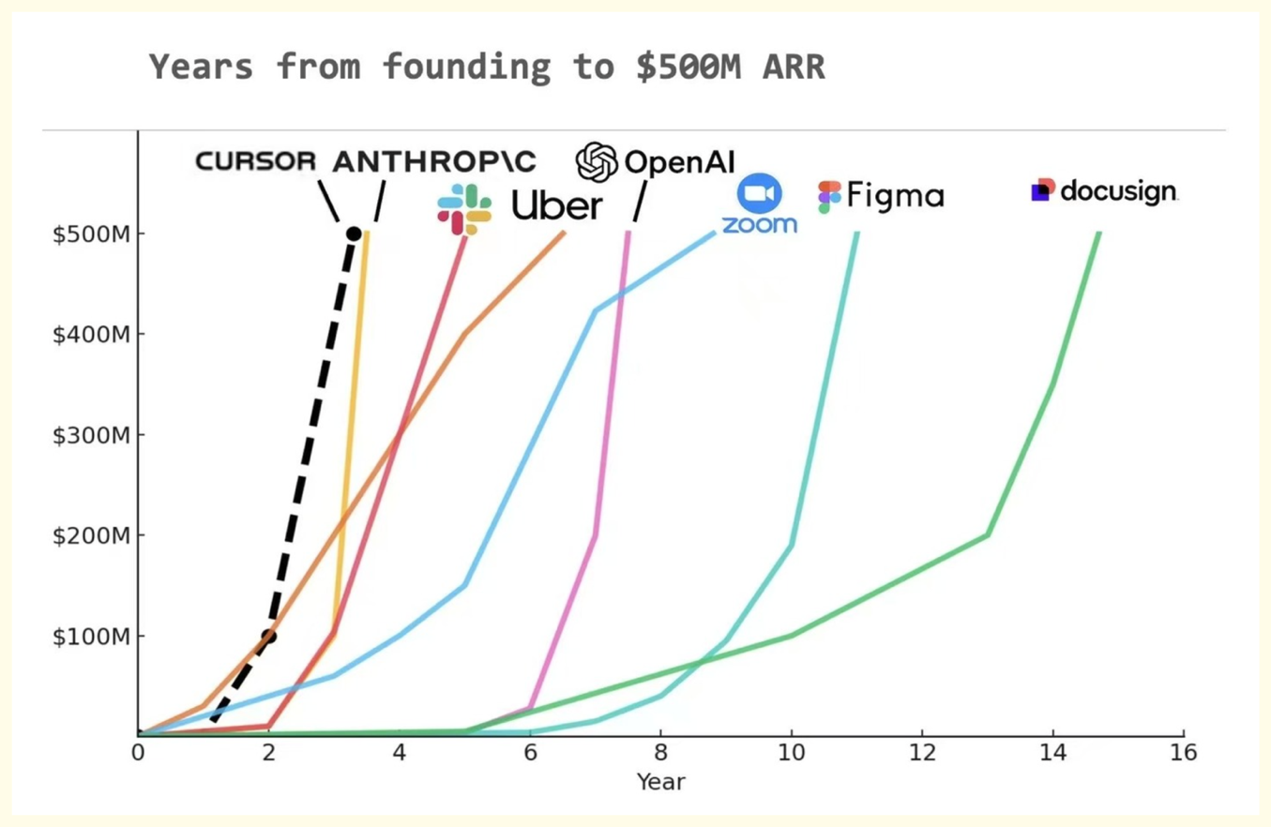
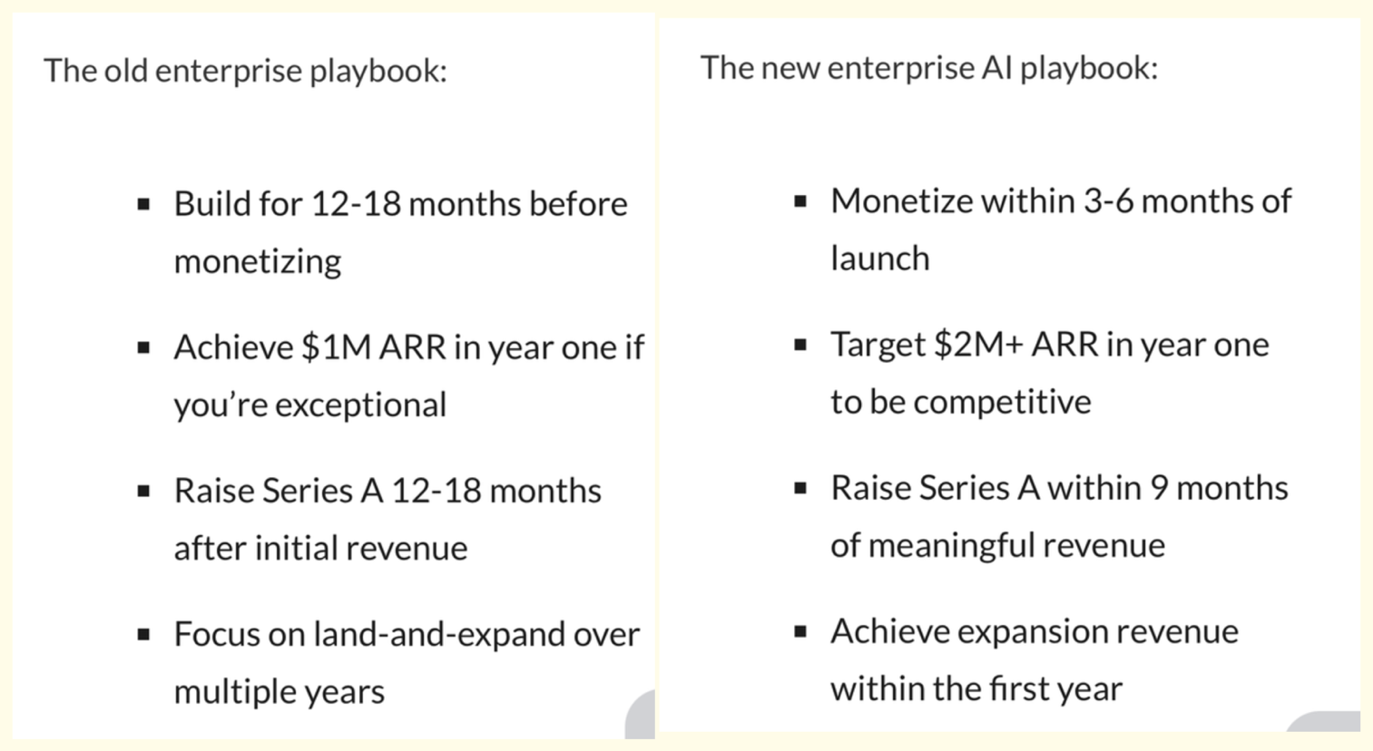
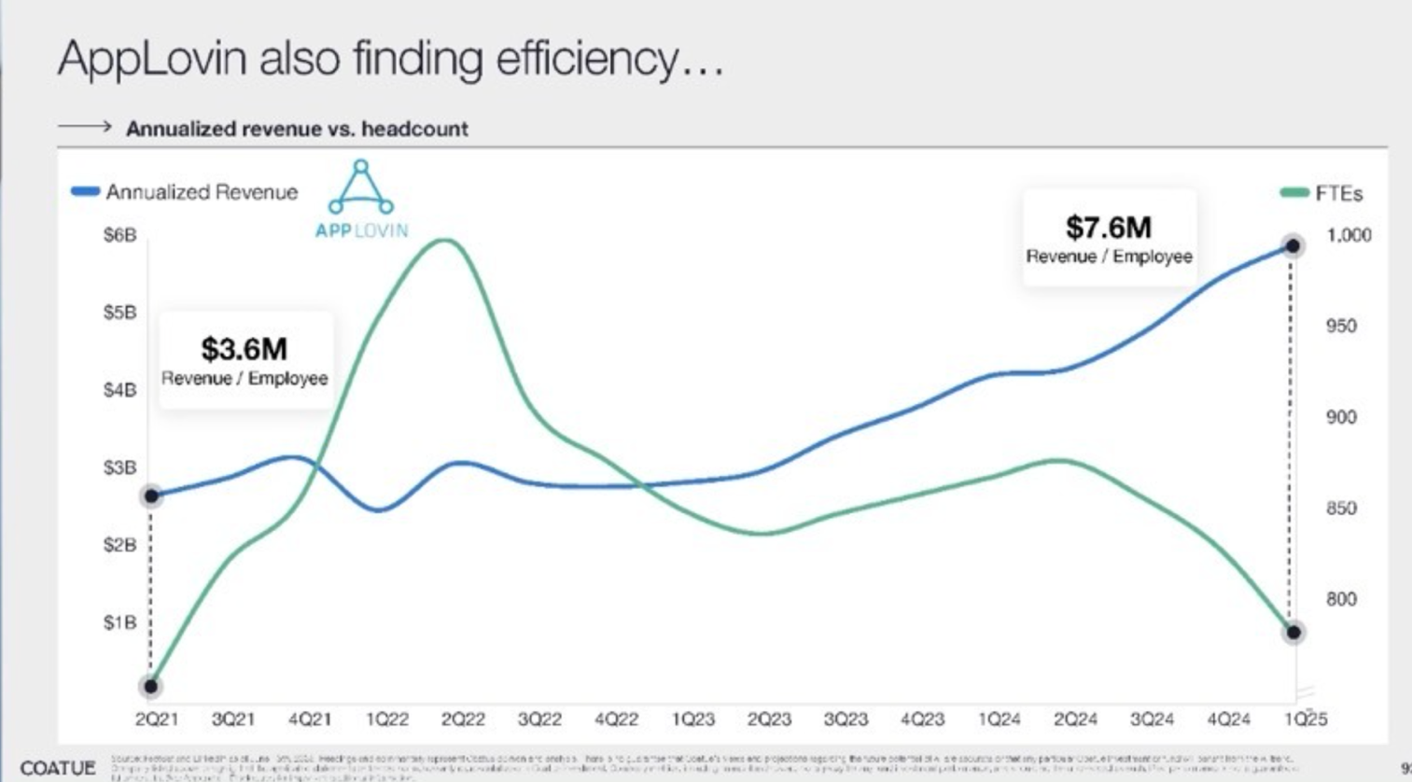
Action 9: 快速变现 Monetize Fast - Revenue is Still the King
Monetize Early and Escape Velocity
Revenue Validates Product-market Fit.
Magical Experiences Drive Monetization.
10 Times More Revenue/Employee
Leverage Technological Generation Gaps
Opportunity Windows Are Shrinking.
Notes:
monetization: magical experience until reaching the plateau,
beyond velocity, anthropic 10times y2y,
old monetization growth matrix does not apply.

Slide 9

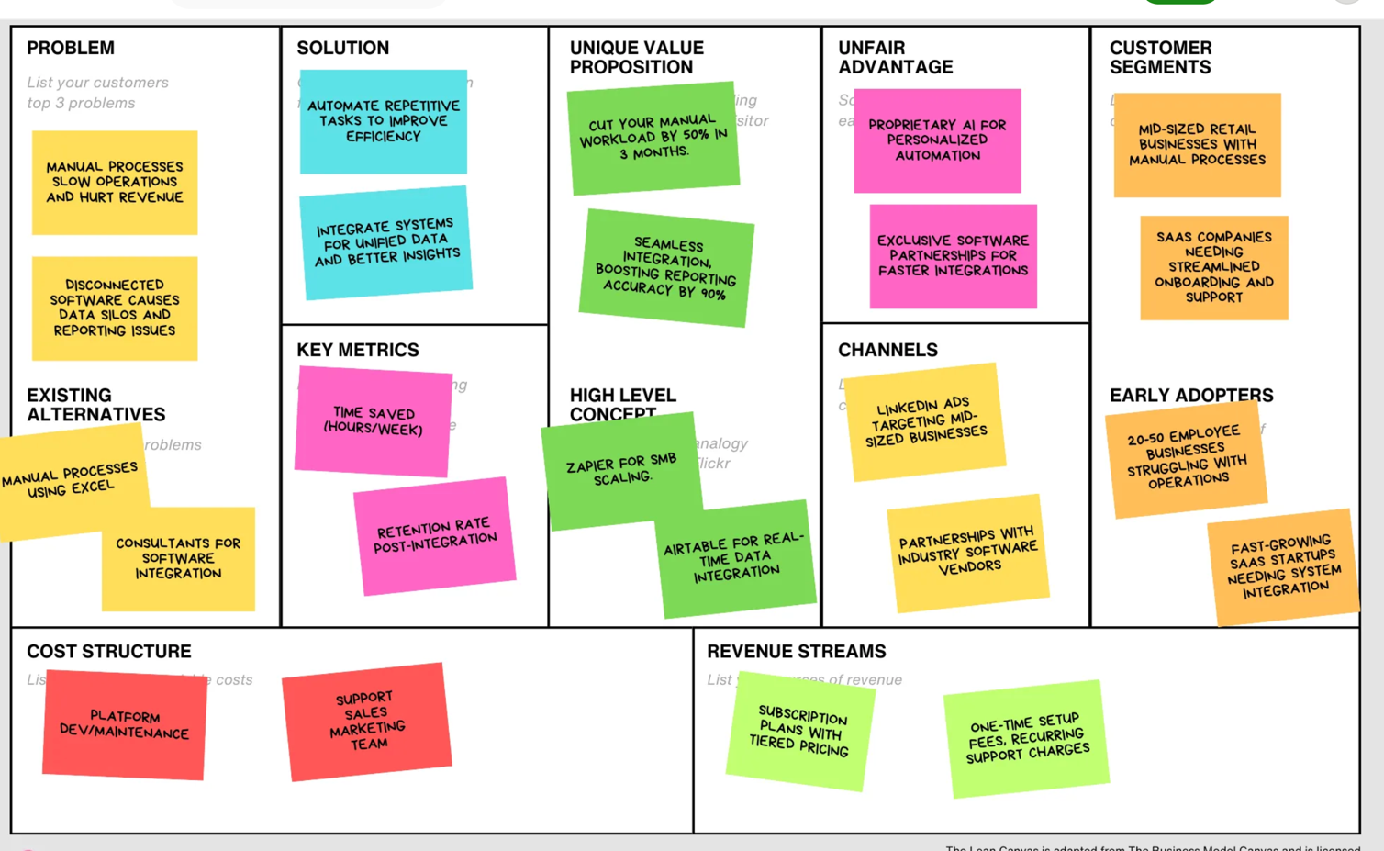




Action 10:战略对齐快速迭代 Align Your Strategy and Execution
Strategic Coherence leads to Execution Velocity
The Company is An Organic System; Need Constant Alignment.
Product-oriented Big Picture Creates Customer Value
Integrated Business and Finance Model to Continuously Evaluate the Trend of Business Performance
Evolve Roadmaps and Integrated Business and Finance Model Continuously
First-time Founders Often Miss Strategic Perspective.
Target Geo Market
Match regulatory environment & cultural context
Product Map
Differentiable Value Proposition
Deliver tangible outcome-based benefits
GTM Strategy
Channel selection based on customer base and ROI
Target Customers
Align personas with acquisition channels & product
AI Technology Choice
Select capabilities that directly enable value delivery
”Running Lean” By Ash Maurya
User Growth Model
Align acquisition with retention mechanisms
Notes:
strategy and execution alignment: (a) critical to large scale success (b) junior founders might not have personal experience in this,
start with this product map, agentize it, with 2 sheets - 1 sheet product map/1 excel of business finance integrated model;
iteratively fill it up and improving it.
you are getting a north star guidance; helps you win big

