Slide 1
Agentic AI Infra
Agentic AI 核心技术创新
Compunding Intelligence
Agentic Composability
Infra Mapping
Agent OS， ADE
Agent Application Model
Agentic Intelligence的特征
开发技术栈 （开源）
Agent OS 项目介绍
工具介绍
未来趋势

Slide 2

Agentic AI: Compounded Intelligence
LLM Intelligence = Compute X Data X Parameters
Agentic Intelligence = ( | LLM | + | Tools | + | Data | + | Persona | ) ! = N!
Context
| LLM |
Foundation Model
| Tools |
Function Calling
| Data |
Public/Private /Contextual Data
| Persona |
Personal Mem/Preference
where N = the Totality of Intelligence Dimensions
Notes:
compounding AI: (a) compounding with tools and application data (b) dynamical composable leads to arbitrary permission of these , IFE composability vs AI’s dynamic agentic composability(b) very high intelligence ceiling N!

Slide 3
Agent Stack and Agentic App Dev Paradigm
1
2
3
4
5
Embrace Solopreneurship
Target Agentic Workforce, Not Tools
Own the Business, Not Just Enable
Exercise Your Comparative Advantages
Operate Agent-Natively
拥抱独立创业
瞄准劳动力市场
拥有业务,不仅赋能
发挥比较优势
开启原生AI化
公司运营模式
6
7
8
9
10
Master the Agentic Tech Stack
Execute at Lightning Speed
Master Full-Stack Operation
Monetize Fast
Align Strategy and
Execution
掌握Agent技术栈
闪电速度执行
精通全栈经营
快速变现
战略对齐快速迭代

Slide 4
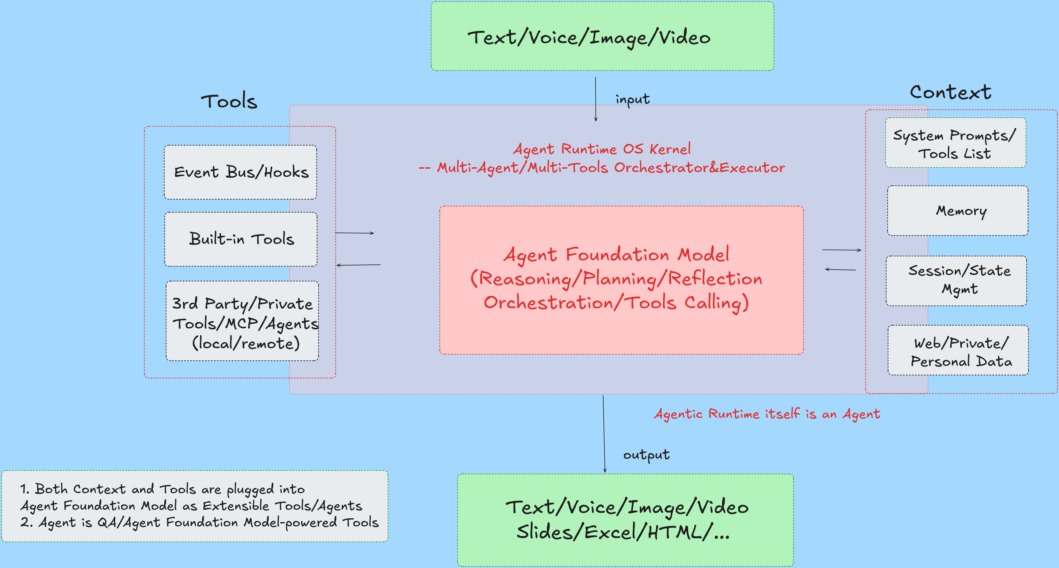
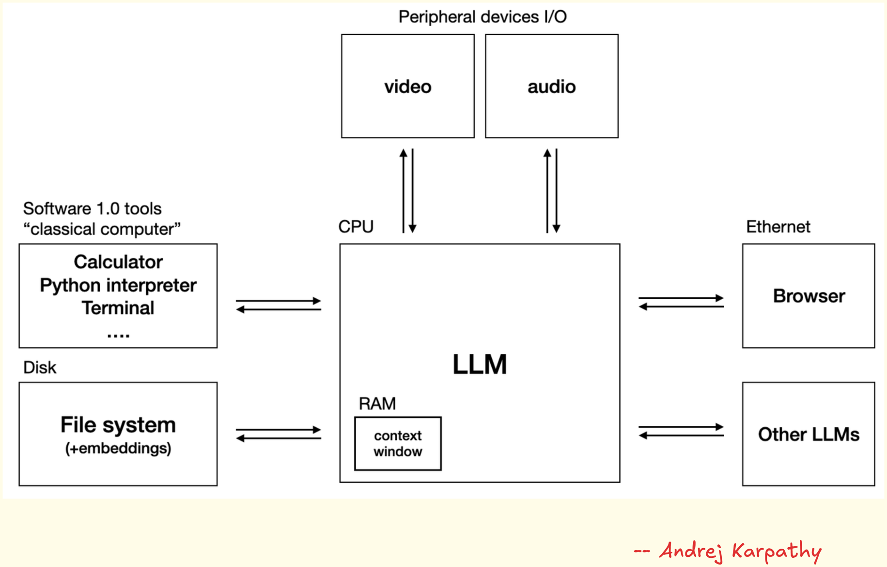
Agent Infra (OS Kernel) — Compounded Intelligence Enabler
Uniform, Recursive, Extensible; Unix/Linux Command-Line–Like
Composability: Tools, Context, Subagents
Powered by LLM / Agentic AI

Slide 5
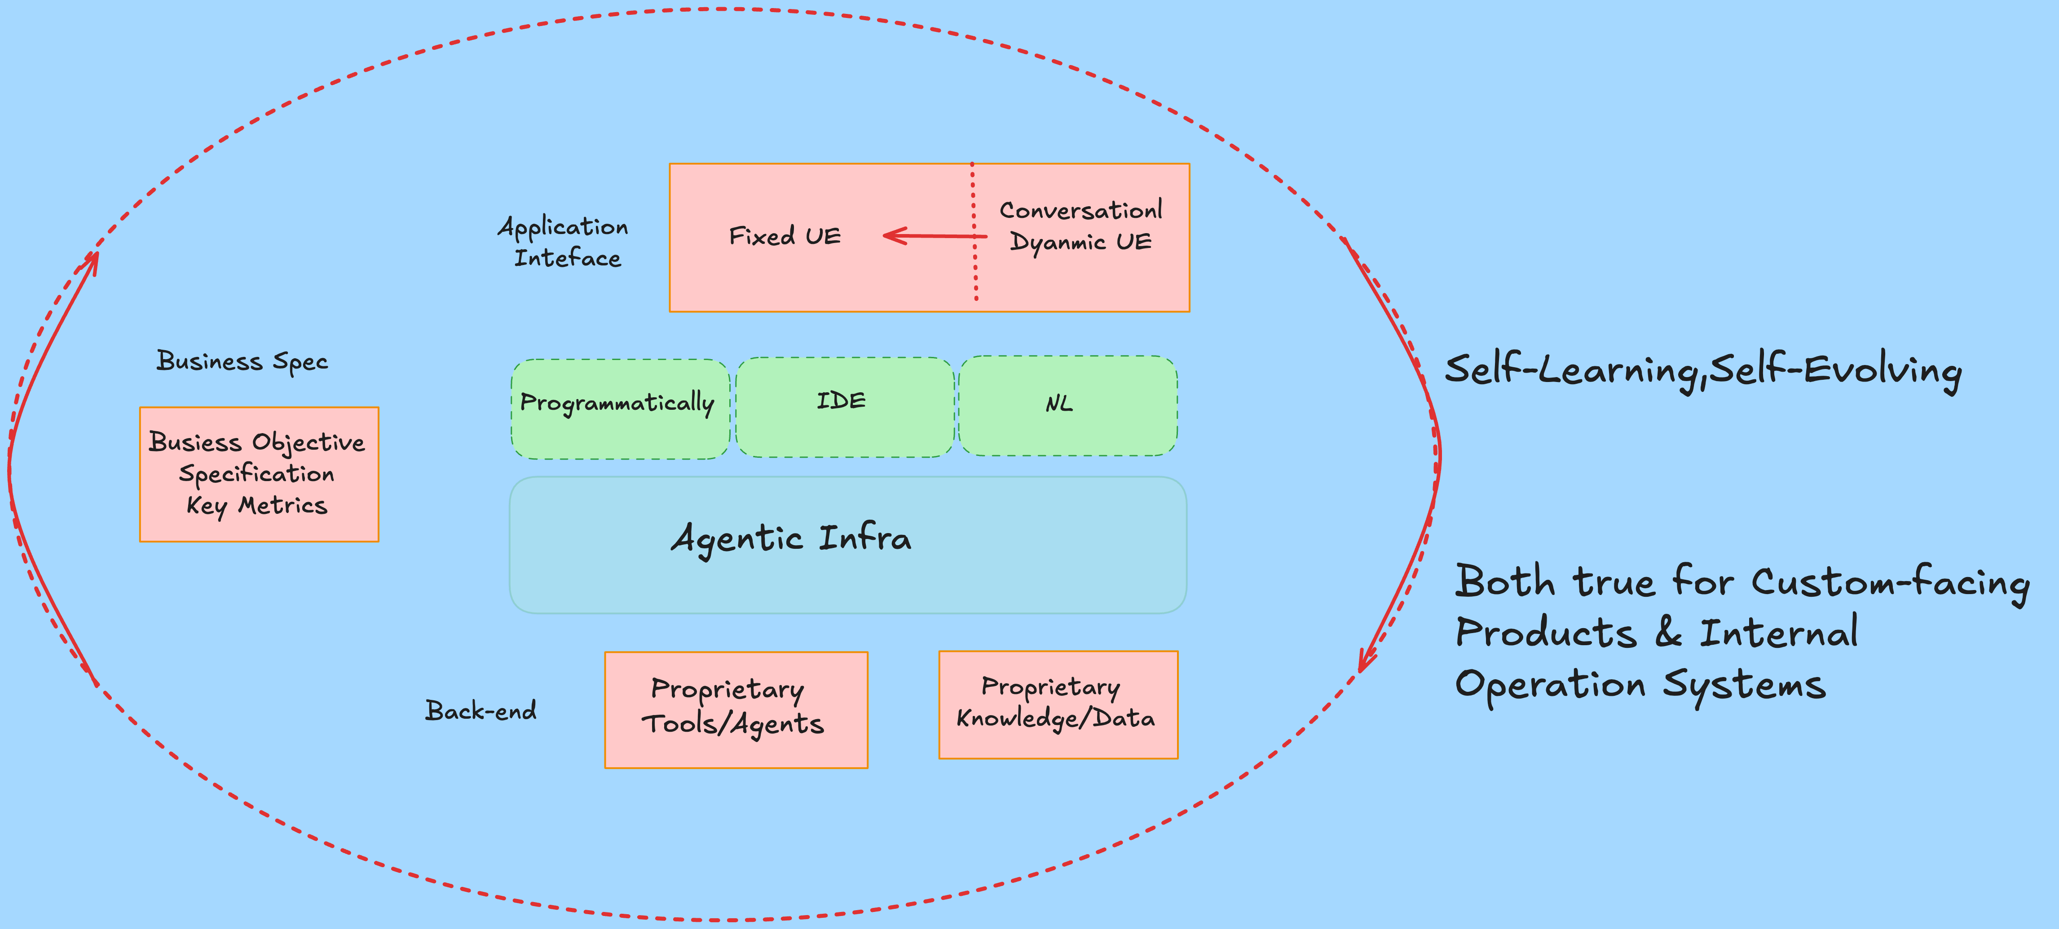
Agentic Application Model: Towards New Paradigm
Spec-Driven (Structured Prompts) Declarative Development
Business Spec and Adaptive UI
Back End: Proprietary and Public Tools/Agents/Context/Data
Continuously Learning and Evolving System through Reinforcement Learning Autopilot

Slide 6
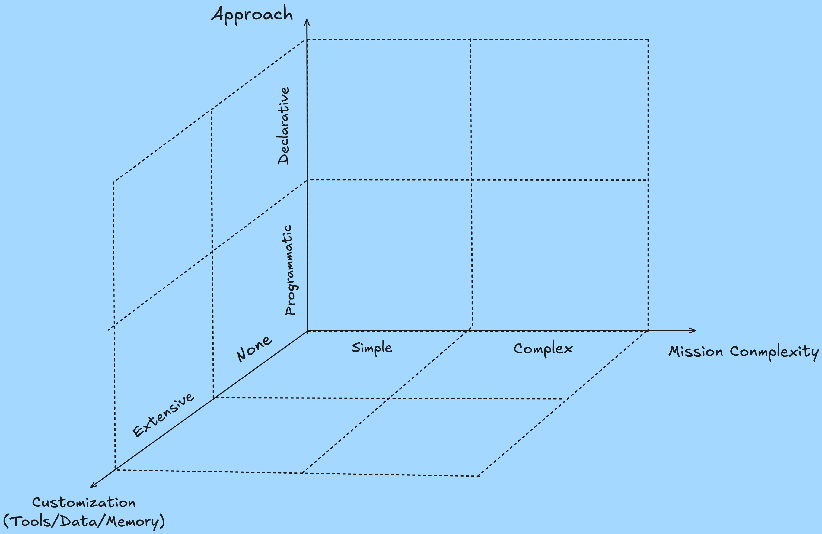
Agentic AI Apps: Categorization and Evolution
Now
Serious Agentic Apps
Programmatic/Complex/Extensive
Light Weight Agent App
Declarative/Simple/None
Static
Future
Serious Agentic Apps
Declarative/Complex/Extensive
Light Weight Agent Apps
Declarative/Simple/Extensive
Dynamic, Disposable

Slide 7
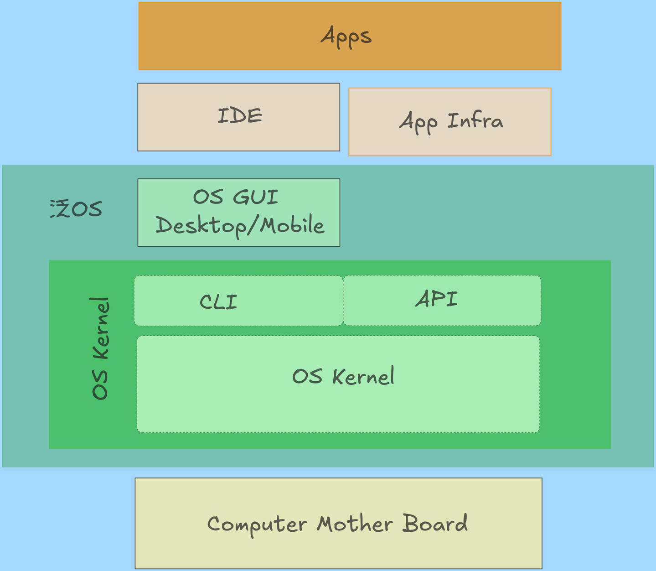
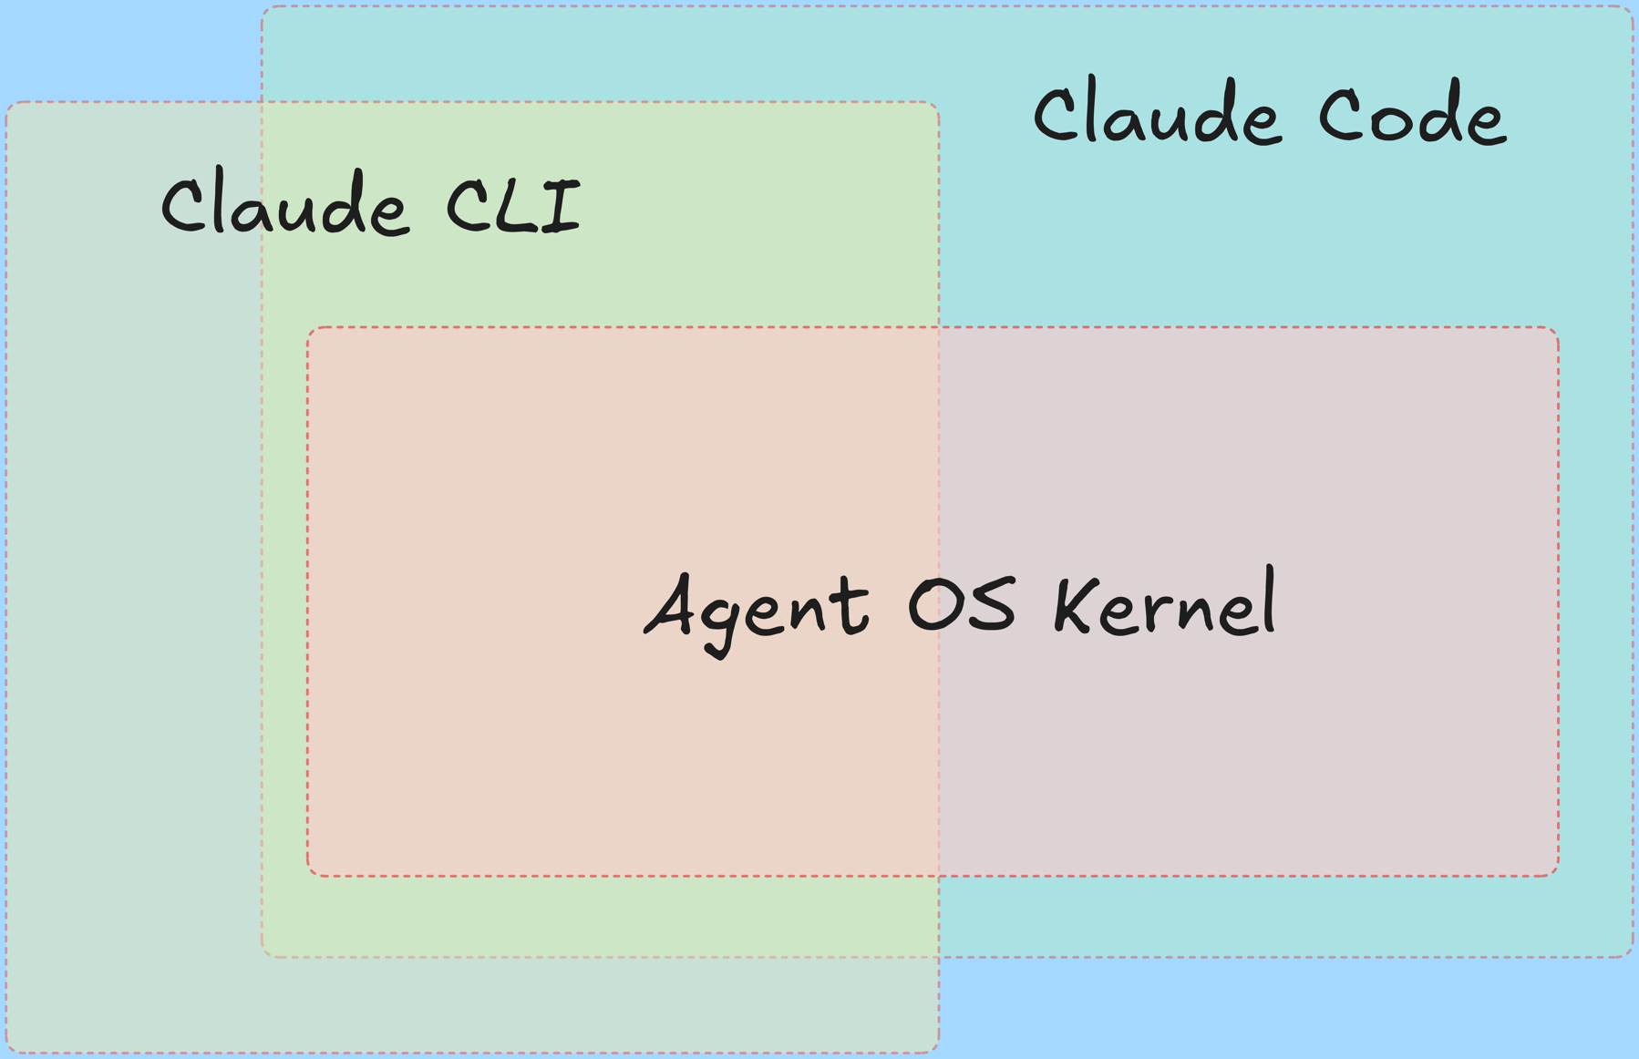
Claude Code — More Than a Coding Agent
Platform for any Agentic Application Runtime
Agentic AI App Framework
Agent OS Kernel
UI Interaction (CLI, Chrome Extension, More to Come)
Runnable Agents Spec, and OS Agnostic(agents.md)

Slide 8
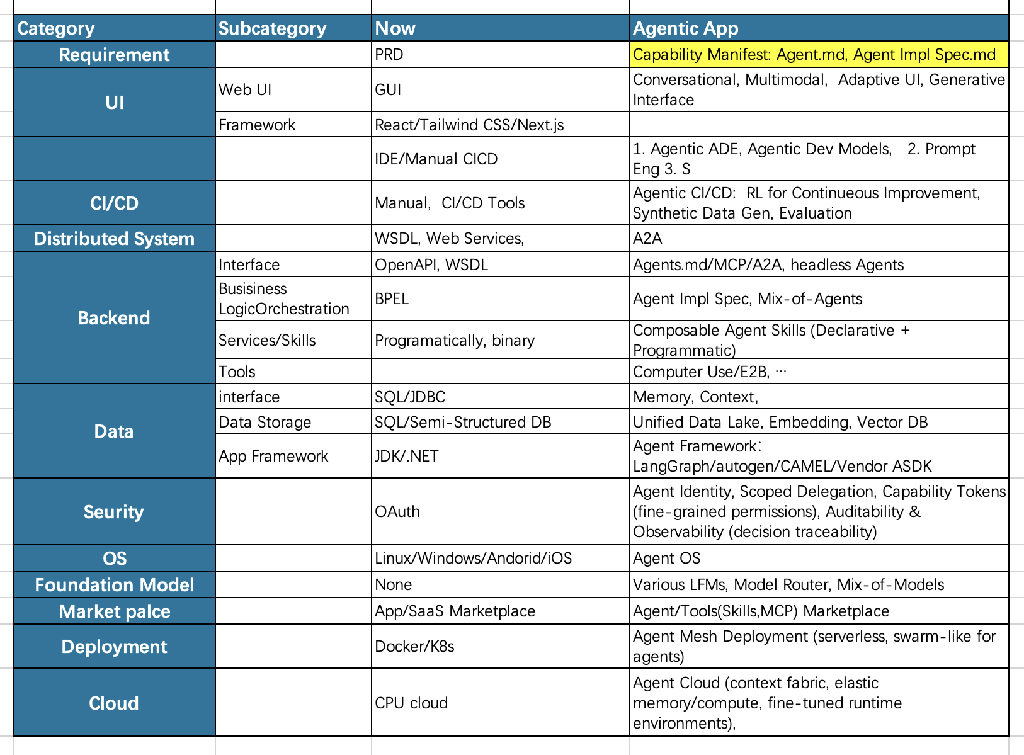
The New Agent Stack – Enabling Compounded Intelligence
Agentic, Generative AI Disruption
Incremental Evolution

Slide 9
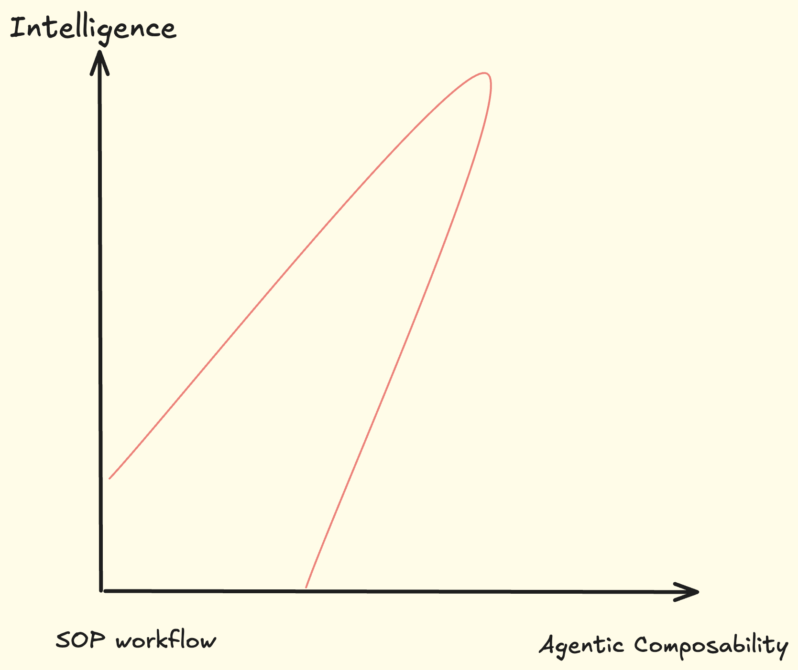
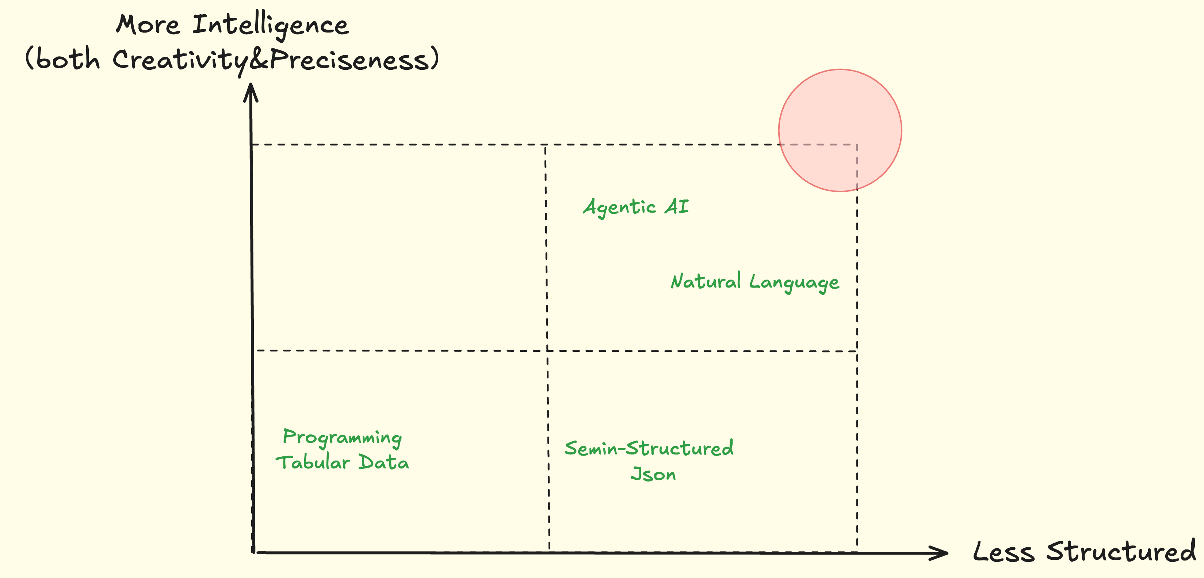
More Intelligence，But Less Structured

Slide 10
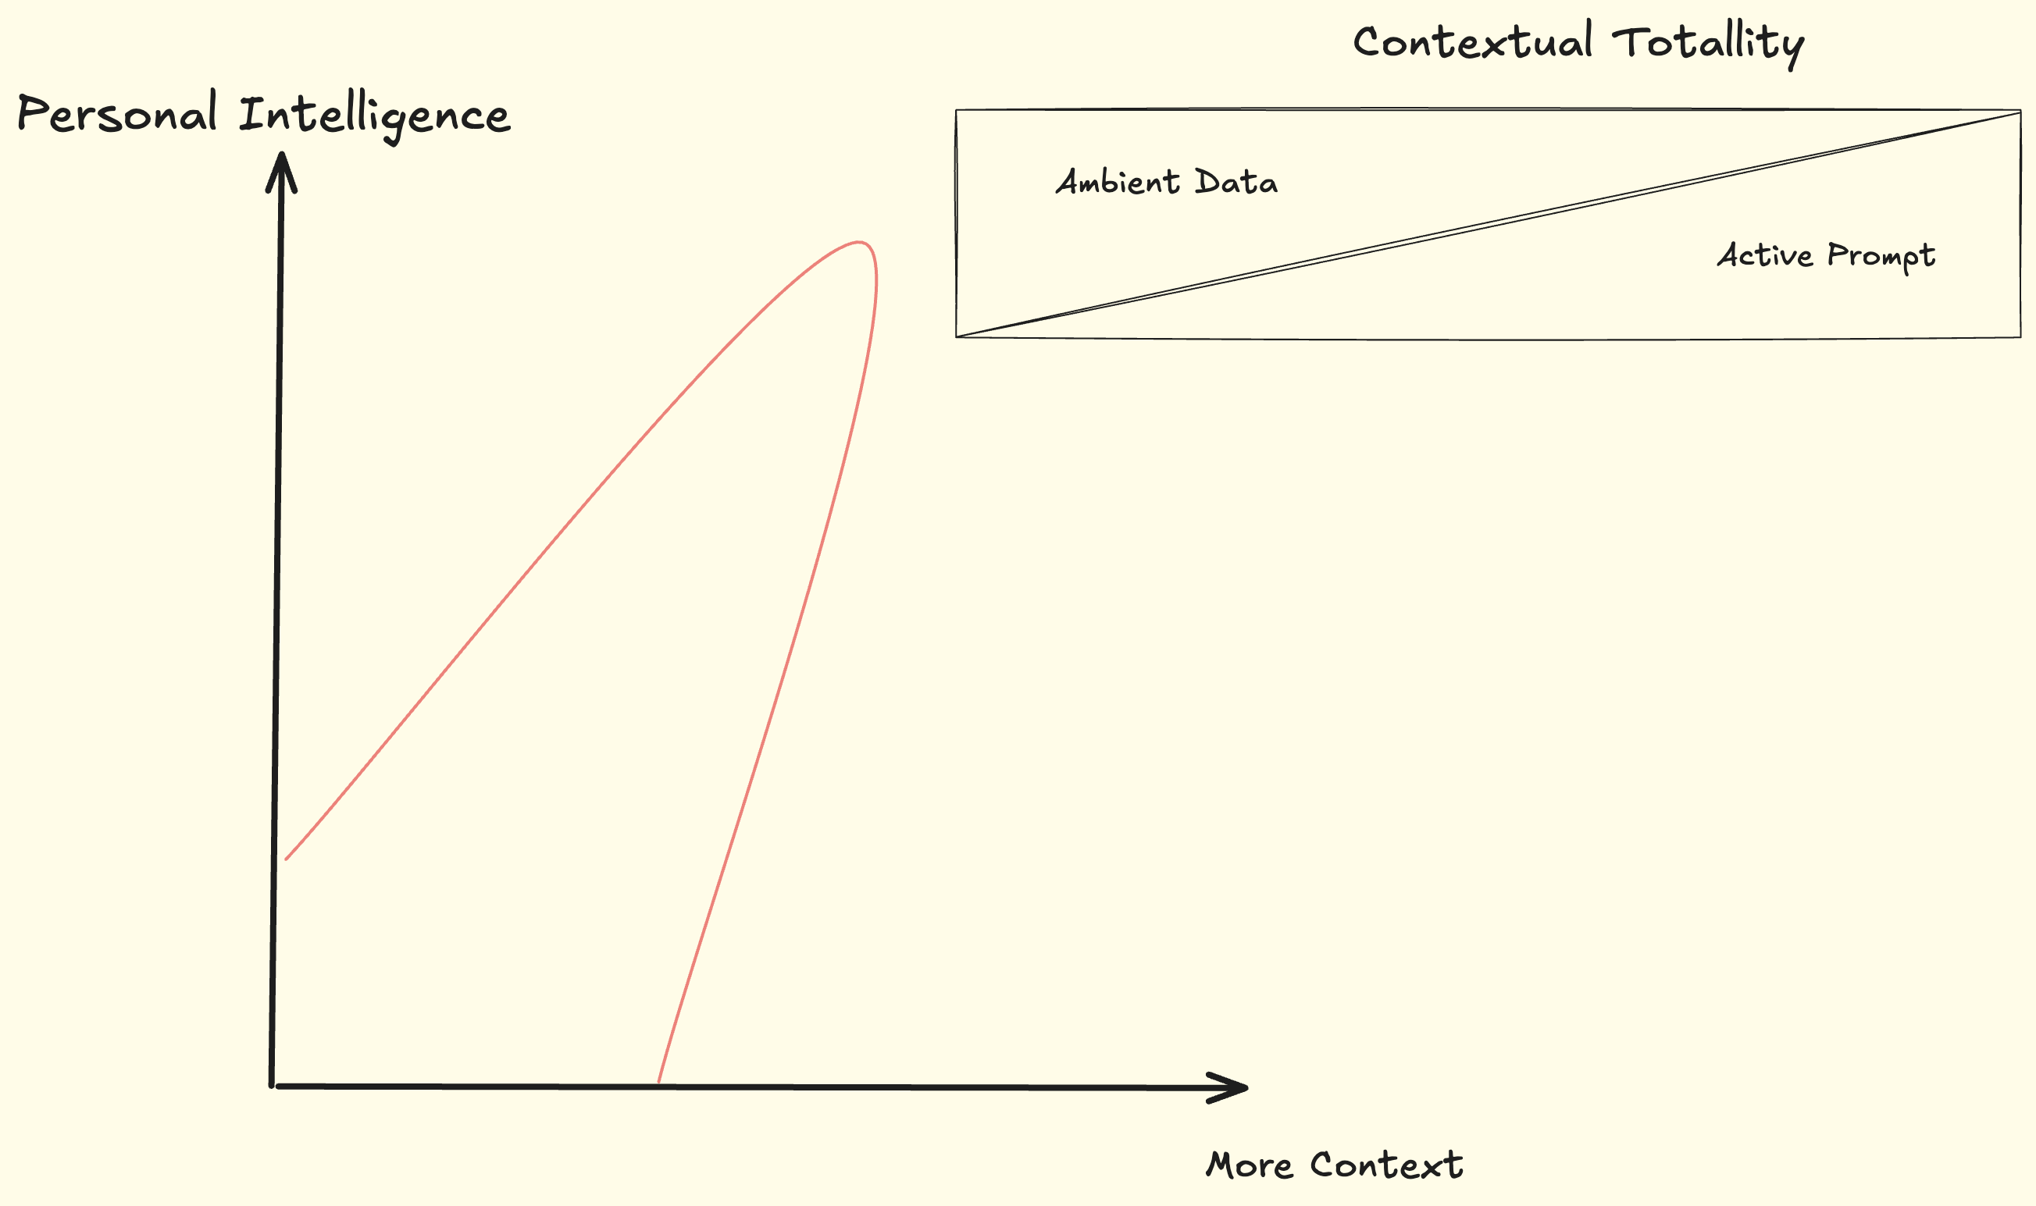
More Intelligence, More Ambient Data&Tools/Less Prompt

Slide 11
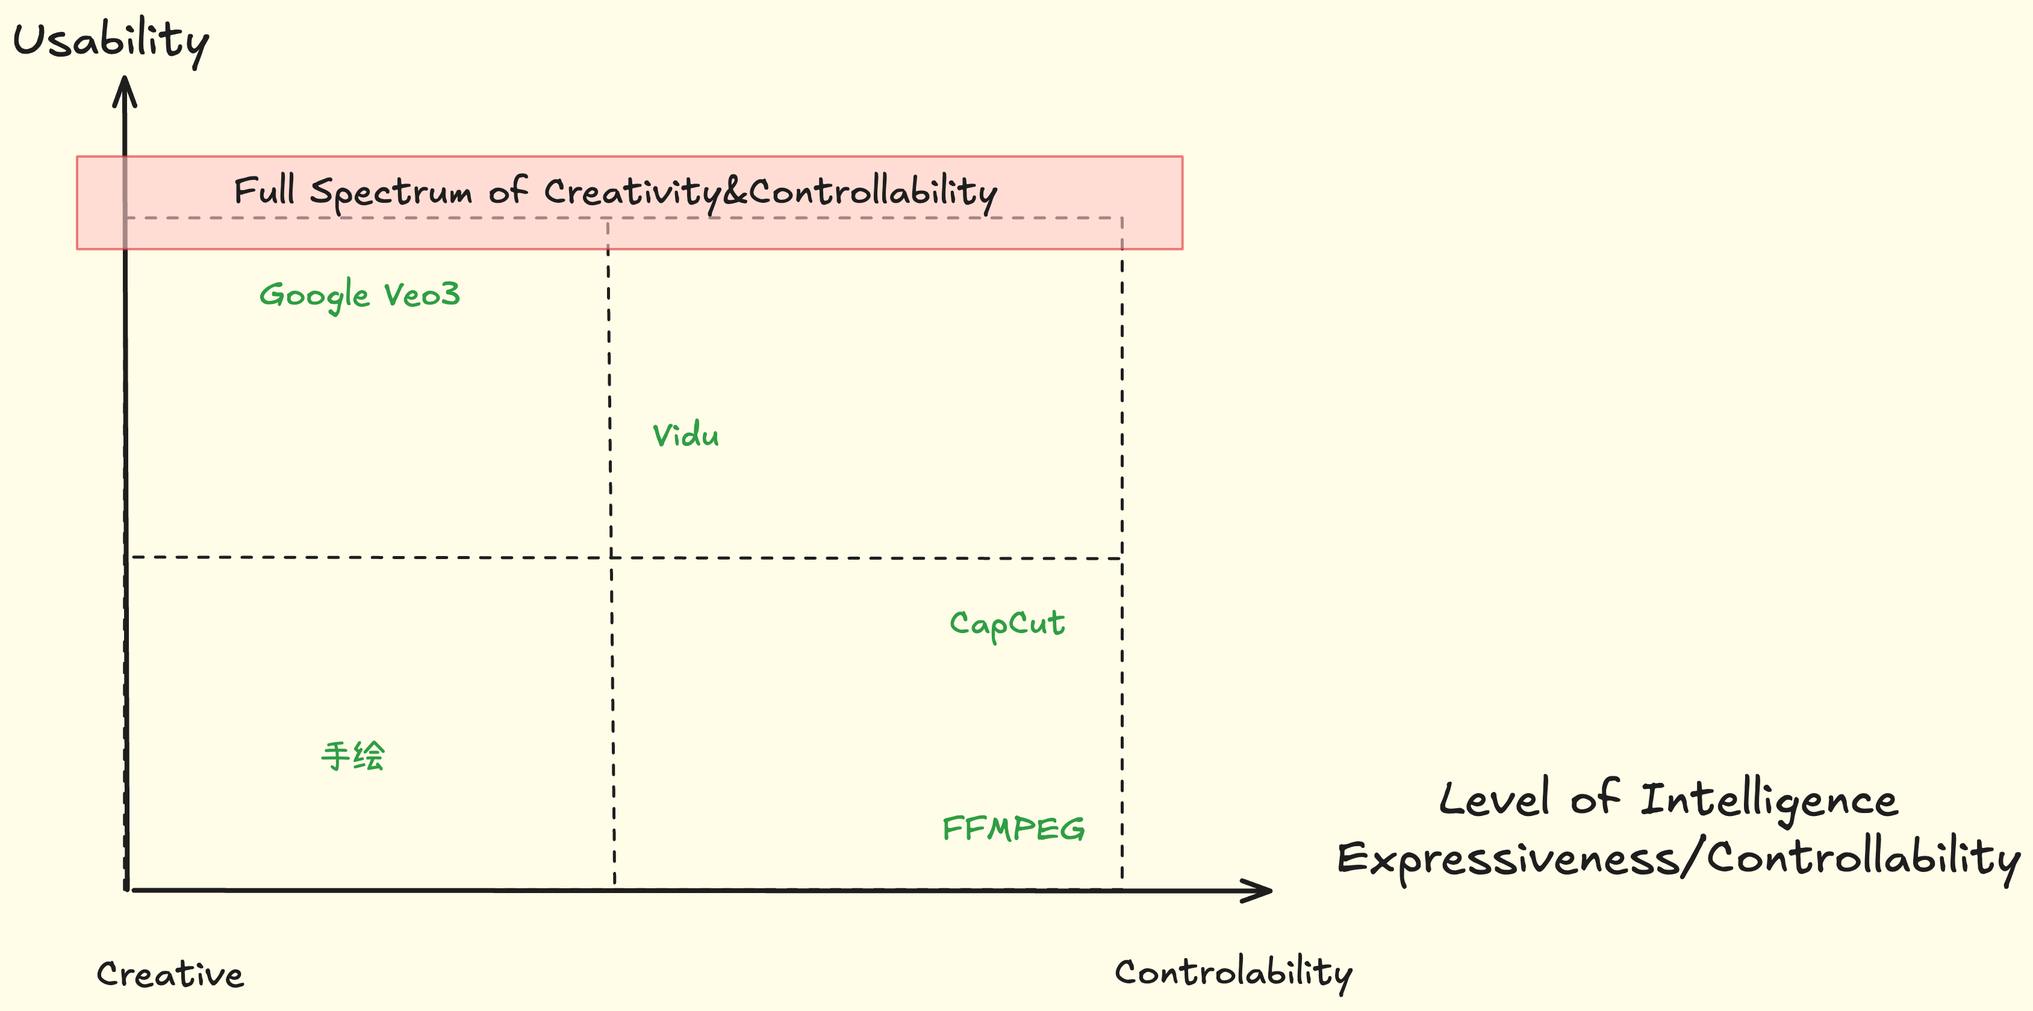
Full Spectrum Intelligence，Democratizing Activation

