Slide 1
Agentic Enterprise
什么是
为啥涌现
为啥是趋势
优势和挑战
进化路径，不同阶段公司的选择路径
案例

Slide 2
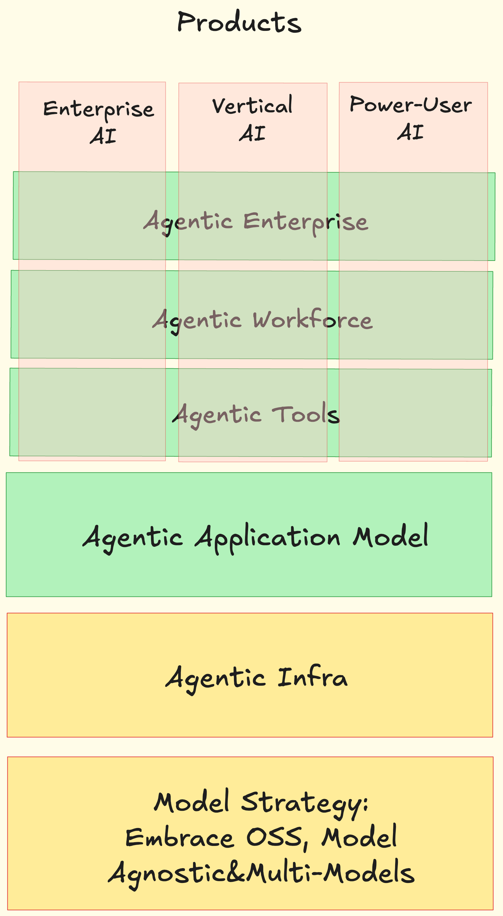
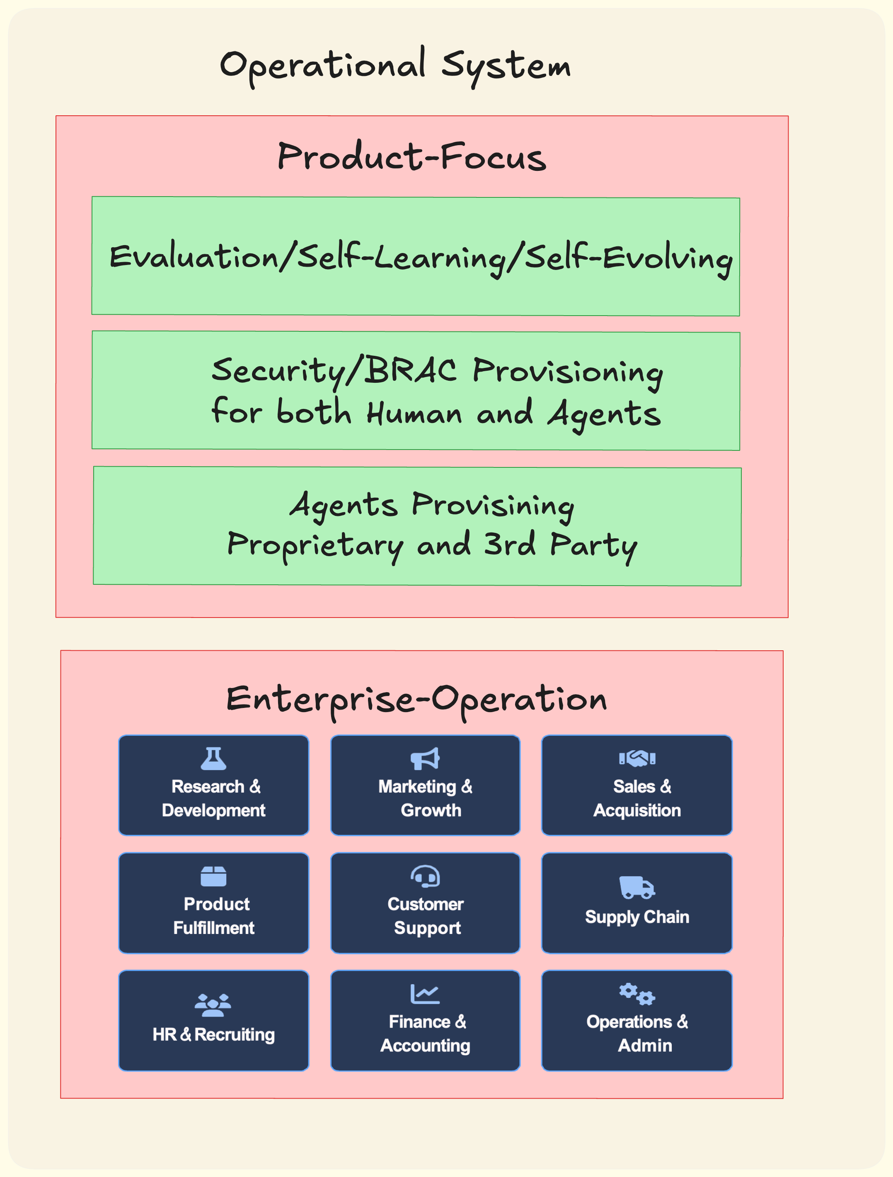
Agentic Enterprise

Slide 3
Agentic Enterprises: Transforming/Replacing Incumbents
Agentic Enterprises
Tool / Workforce Vendors
Traditional Enterprises
AI-native companies in the same verticals, operated by agents instead of people (B2B/B2C model)
Higher Margin, More Scalable, Leads to More Consolidation
Tech companies selling agentic tools or digital workers to enterprises (B2B/B2PowerUser model)
Human-run organizations in vertical industries delivering services or physical products.
(B2B/B2C model)

Slide 4
What Makes Agentic Enterprises Different
Call Center
SDR
Supply Chain
Insurance Sales Agency
Performance Marketing Agency
Backoffice GA
Property Management
。。。
Sell Outcomes, Not Tools — Deliver Products and Services Powered by Agentic AI, Beyond SaaS or Digital Workforce
Capture Value in Existing Verticals — Apply AI to Low-Efficiency Industries, Reduce White-Collar Labor Dependence
Operate on Value-Based Pricing — Align Revenue With Customer Outcomes Instead of Licenses or Seats
Drive Higher Margins and Profits — Achieve Scale Through Agentic AI Efficiency Versus Traditional Labor Models
White-Collar Labor Intensive
Fragmented, Regional
Existing Large TAM
Low Gross Margin

