Slide 1


SUMMER ANALYTICS 2026 · CAPSTONE PROJECT
Sustainability Capstone: Decarbonizing Travel
Turning Scope 3 travel data into an actionable roadmap for Celonis' Net Zero 2030 commitment.
Speaker: Jimmy Khanpara
Institute: Motilal Nehru National Institute of Technology
Branch & Year: Electrical Engineering · 2nd Year
Email: jimmykhanpara265@gmail.com
Decarbonizing Travel · Celonis Summer Analytics 2026

Slide 2






RESULTS AT A GLANCE
Executive Summary
Celonis' global business travel generated 178.09M kg CO₂e last year — and 80% of it came from flights alone. Closing that gap is the single fastest lever Celonis has toward its Net Zero 2030 commitment.
178.09M
$140.48M
65,289
2,727.72
kg CO₂e
annual spend
trips / year
kg CO₂e
Total CO₂ Emissions
Total Travel Cost
Total Trips
Avg CO₂ per Trip
TOP 3 INSIGHTS
TOP 3 RECOMMENDATIONS
Flights (Business + Economy) drive 80% of the entire travel carbon footprint.
Sales & Marketing alone account for ~53% of total emissions across 14 business units.
Customer Visits and Conferences together generate 77% of emissions — but average trip cost barely differs from low-carbon options.
Cabin-downgrade policy (Business → Economy) on eligible routes: –47.5M kg CO₂e/yr.
Electrify the diesel company-car fleet: –10.1M kg CO₂e/yr.
Virtual-first / trip-bundling for Customer Visits & Conferences: –20.6M kg CO₂e/yr.
Business Impact: A combined potential of ~78M kg CO₂e/yr (44% of the footprint) and ~$38M/yr in avoidable cost — directly advancing Net Zero 2030.
Executive Summary

Slide 3
KEY BUSINESS QUESTION 1 & 2
Emissions Profile & Benchmarking
Celonis' current footprint totals 178.09M kg CO₂e across 65,289 trips — dominated by air travel and heavily skewed by departure region.
Carbon Emissions by Transport Mode
Avg CO₂e per Trip by Departure Region (kg)
73.1M kg
Business Class Flight
69.7M kg
Economy Flight
11.1M kg
BMW 3 Diesel
7.2M kg
VW Golf Diesel
BENCHMARK SCORE
55.17%
Europe departures are the most carbon-efficient region (~700 kg/trip) — a benchmark APAC & Americas can adopt via rail and regional routing.
80.2% of the entire footprint comes from flights alone
Emissions Profile & Benchmarking

Slide 4
KEY BUSINESS QUESTION 3
Hotspot Analysis
Emissions are heavily concentrated: a small set of business units, travel purposes, and transport modes drive most of the footprint.
CO₂ Emissions by Business Unit
CO₂ Emissions by Travel Purpose
Sales + Marketing = 53% of total footprint
Customer Visit + Conference = 77% of total footprint
Hotspot Analysis

Slide 5




KEY BUSINESS QUESTION 4
Inefficiencies Identified
Pain points surfaced from the process data explain why emissions and cost remain decoupled from good decision-making.
Air-Travel Dependency
Cost – Carbon Decoupling
Policy Leakage
High-Impact Outliers
80% of the footprint sits in flights, yet the booking flow offers no lower-carbon nudge before confirmation.
Average trip cost is nearly flat ($1.7K–$2.1K) across every business unit and shipping type — cost alone never signals carbon impact.
Out-of-policy trips (e.g. First/Business Class) still clear approval, per the Policy Status flag — governance is manual and inconsistent.
The single highest trip emitted 21,202 kg CO₂e — 7.8× the average — with no automated flag at time of booking.
Opportunity: Celonis Process Intelligence can turn these fragmented, manual signals into automated, carbon-aware guardrails embedded directly in the booking workflow.
Inefficiencies Identified

Slide 6



KEY BUSINESS QUESTION 5
Low-Carbon Strategic Recommendations
Quantified impact modeled from FY dashboard totals using recognized DEFRA / ICCT class-and-fuel conversion factors.
Cabin-Downgrade Policy
Electrify the Company-Car Fleet
Virtual-First & Trip Bundling
Move eligible Business Class routes to Economy (~65% lower CO₂e per DEFRA class factors).
Replace diesel BMW 3 / VW Golf bookings with EV options already in the shipping mix (~55% lower CO₂e).
Target a 15% volume reduction on Customer Visit & Conference travel via virtual check-ins and route bundling.
–47.5M kg CO₂e/yr
–10.1M kg CO₂e/yr
–20.6M kg CO₂e/yr
~$22.1M/yr saved • 27% of footprint
Lower total cost of ownership • 6% of footprint
~$16.2M/yr saved • 12% of footprint
Combined Potential: –78.1M kg CO₂e/yr (44% of footprint) and ~$38.3M/yr in avoidable travel spend.
Low-Carbon Strategic Recommendations

Slide 7





STRATEGIC INTEGRATION ROADMAP
From Visibility to Net Zero by 2030
A phased plan that scales this analysis into Celonis' long-term sustainability strategy.
2026
2027
2028
2029
2030
Visibility
Automation
Optimization
AI-Driven Routing
Net Zero
Deploy live carbon dashboards (this Process App) across all business units.
Embed carbon thresholds into approval workflows; auto-flag out-of-policy, high-CO₂ bookings.
Roll out cabin-downgrade policy and EV fleet transition; bundle Customer Visit travel.
Predictive, AI-recommended low-carbon routes and virtual-first triggers at point of booking.
Scope 3 travel emissions on track for Celonis' Net Zero 2030 commitment.
Projected Outcome: ~44% reduction in Scope 3 travel emissions by 2030 if quick wins launch in 2026.
Strategic Integration Roadmap

Slide 8
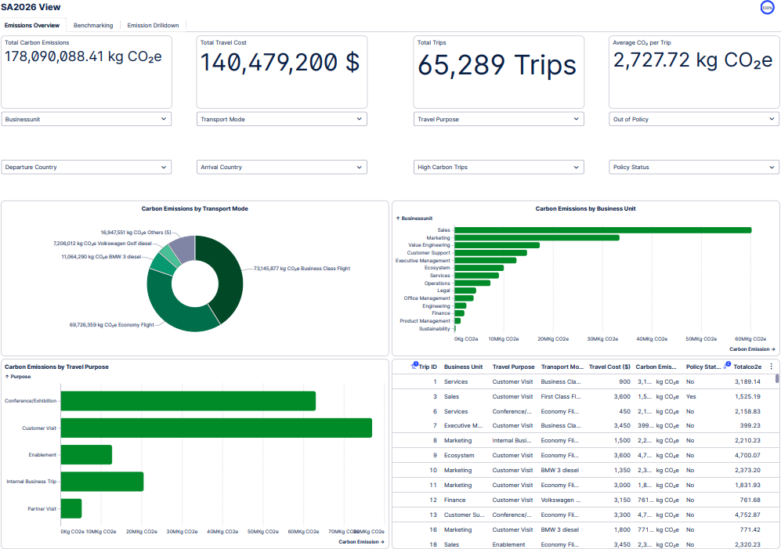


TAB 1 OF 3
Dashboard — Emissions Overview
KEY INSIGHTS
178.09M kg CO₂e total emissions across 65,289 trips ($140.48M spend).
Business & Economy flights: 41% + 39% = 80% of all emissions.
Sales is the single largest emitting business unit.
Filterable by BU, transport mode, purpose, policy status & geography for drill-down.
Dashboard — Emissions Overview

Slide 9
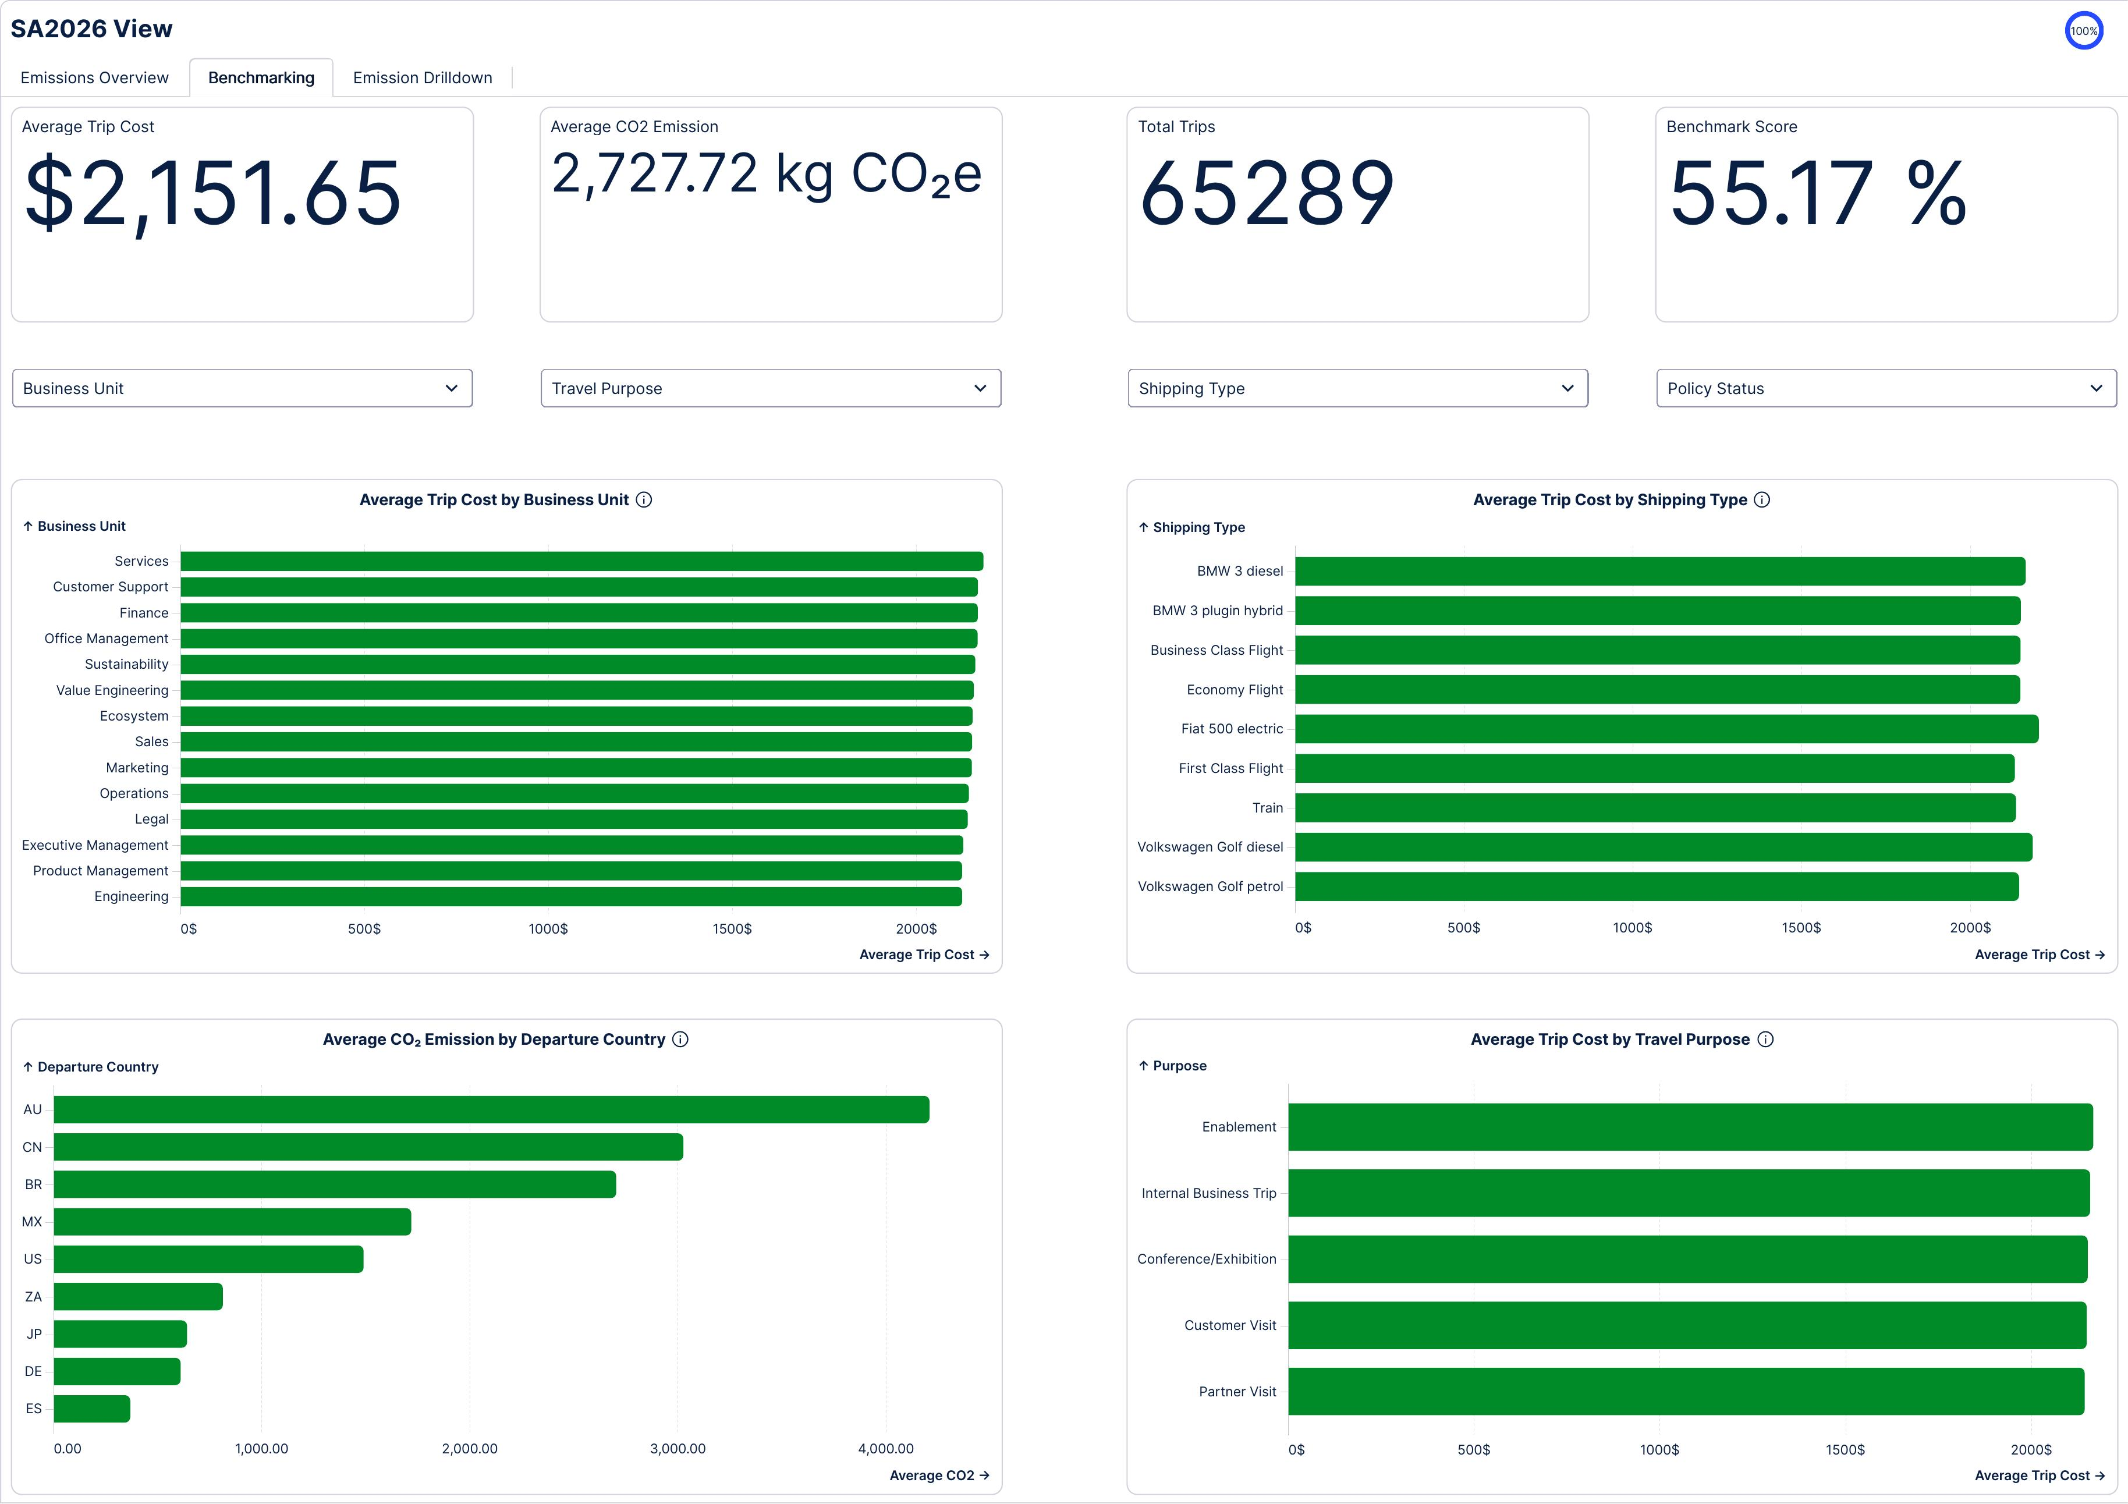


TAB 2 OF 3
Dashboard — Benchmarking
KEY INSIGHTS
Benchmark Score of 55.17% quantifies overall travel efficiency.
Average trip cost is flat (~$1.7K–$2.1K) regardless of business unit or transport mode.
Average CO₂/trip by departure country: AU & CN highest, ES & DE lowest.
Confirms cost is a poor proxy for carbon — policy must optimize for CO₂ directly.
Dashboard — Benchmarking

Slide 10
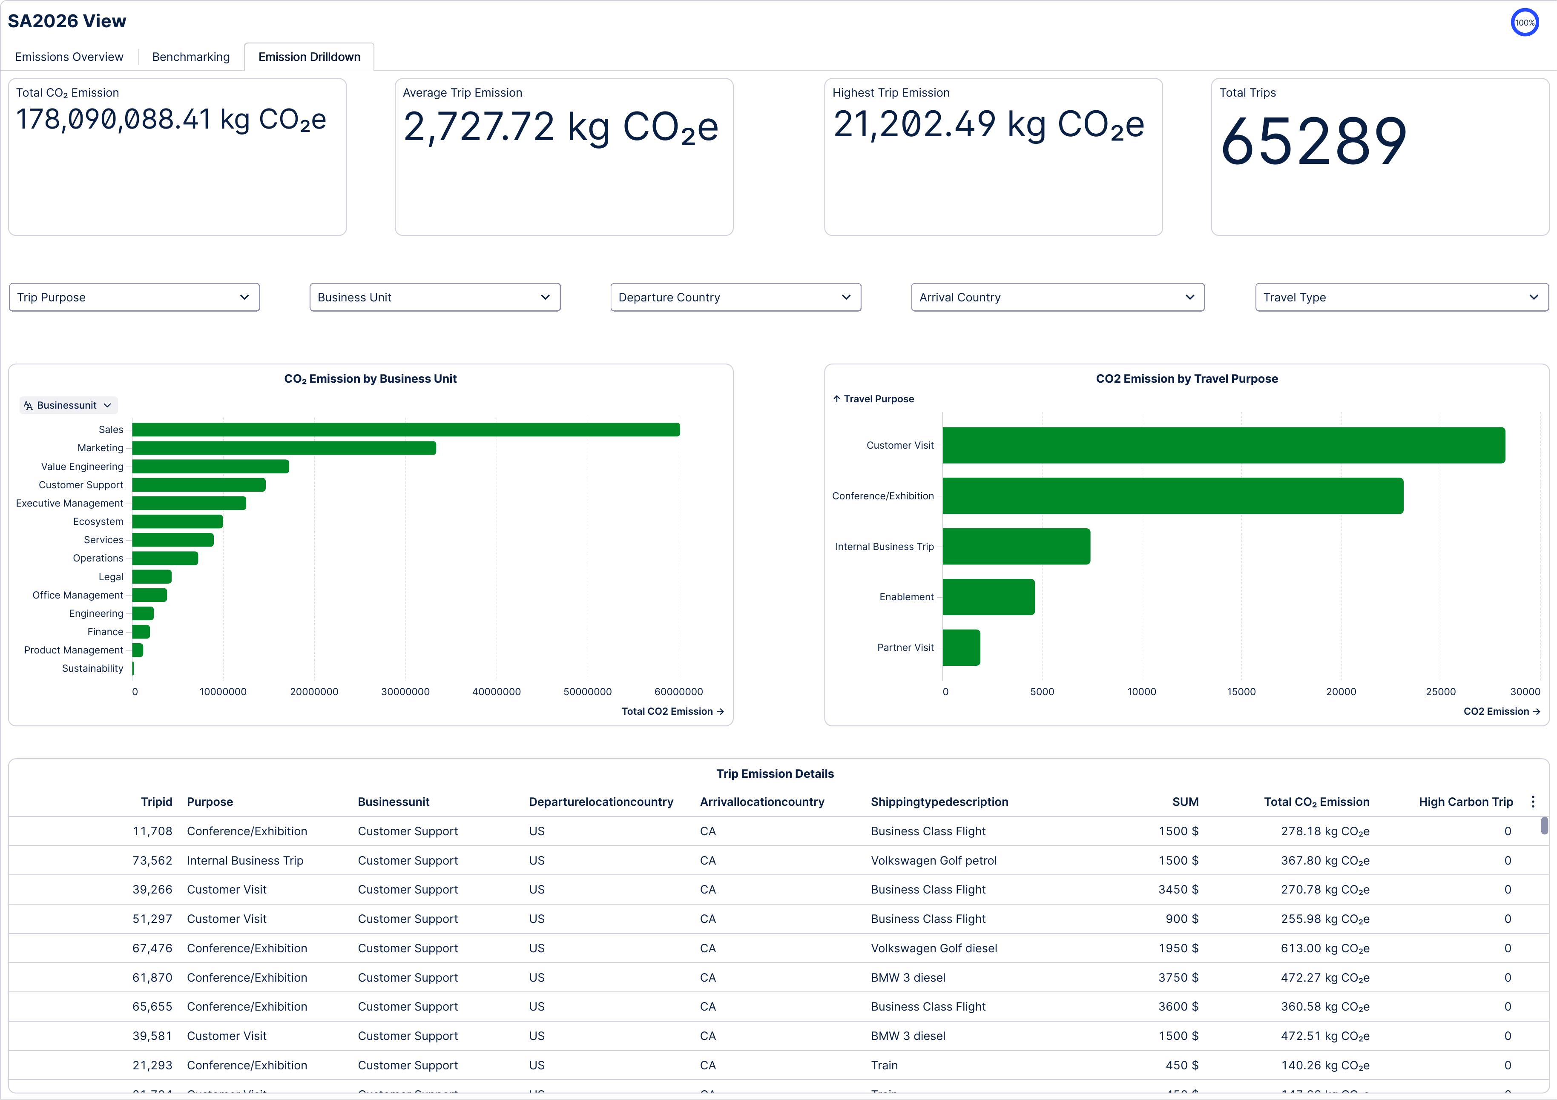


TAB 3 OF 3
Dashboard — Emission Drilldown
KEY INSIGHTS
Highest single trip: 21,202.49 kg CO₂e — 7.8× the 2,727.72 kg average.
Customer Visit and Conference/Exhibition purposes dominate the emission mix.
Trip-level detail table supports root-cause investigation for High-Carbon Trips.
Powers Celonis' Process & Variant Explorer for live executive walkthroughs.
Dashboard — Emission Drilldown

