Slide 1


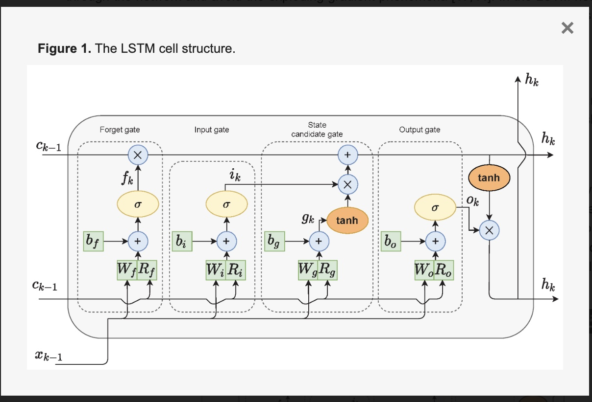

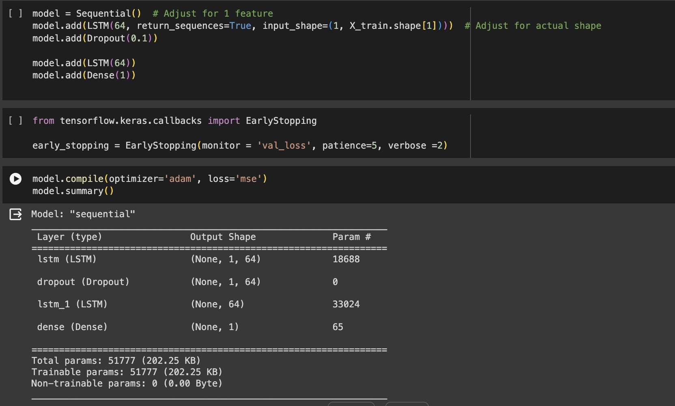
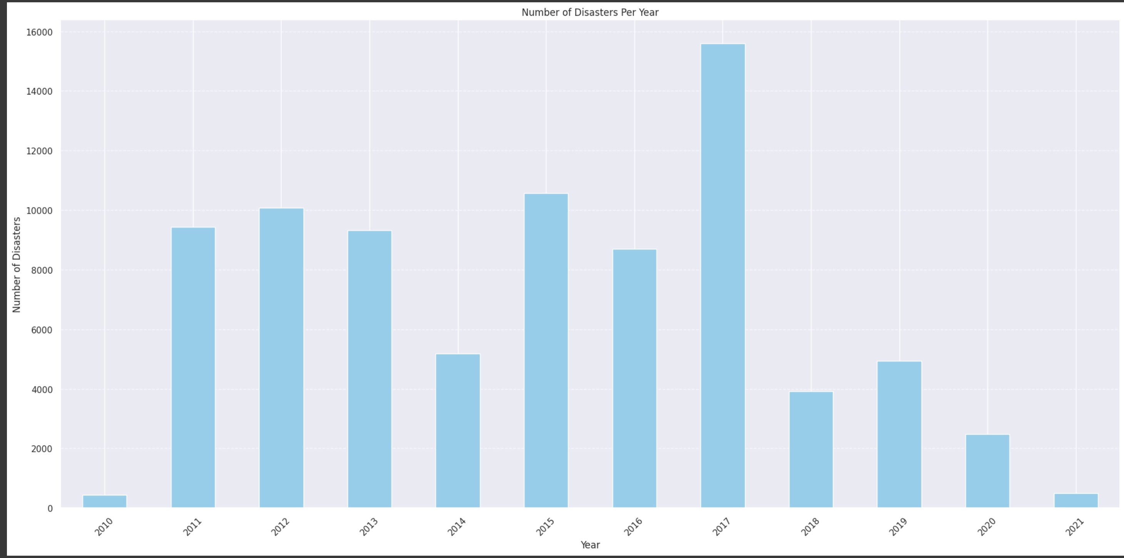
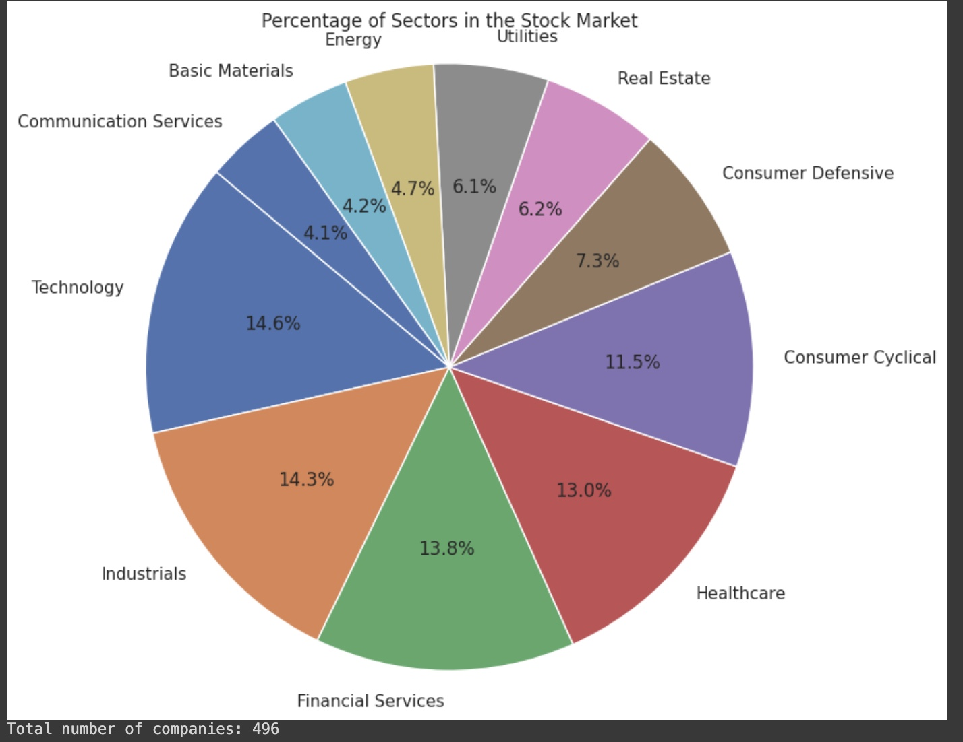
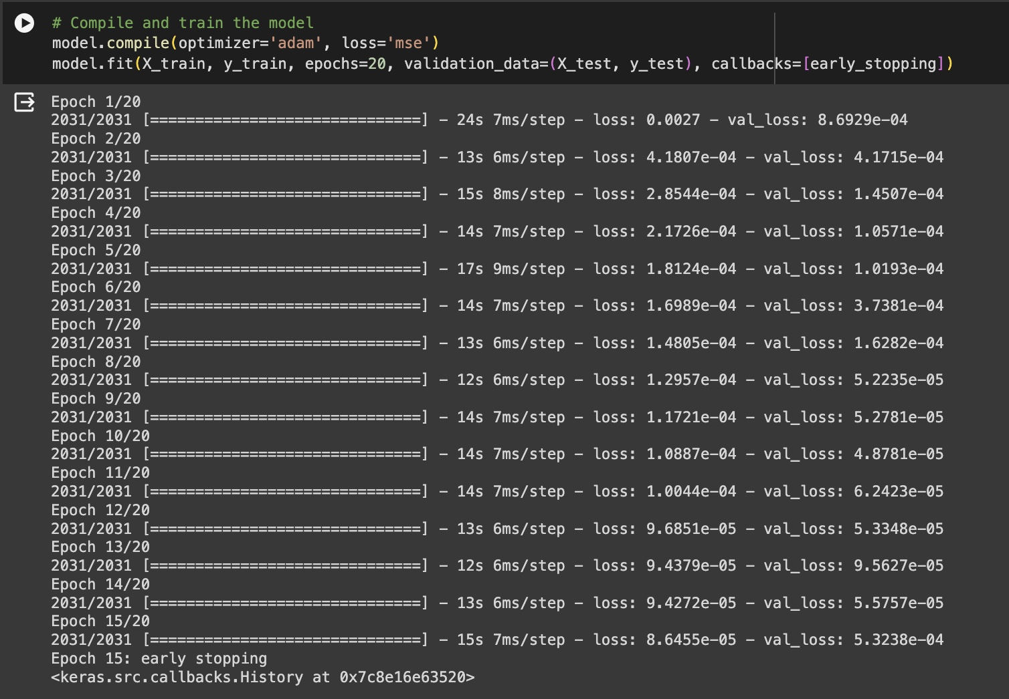
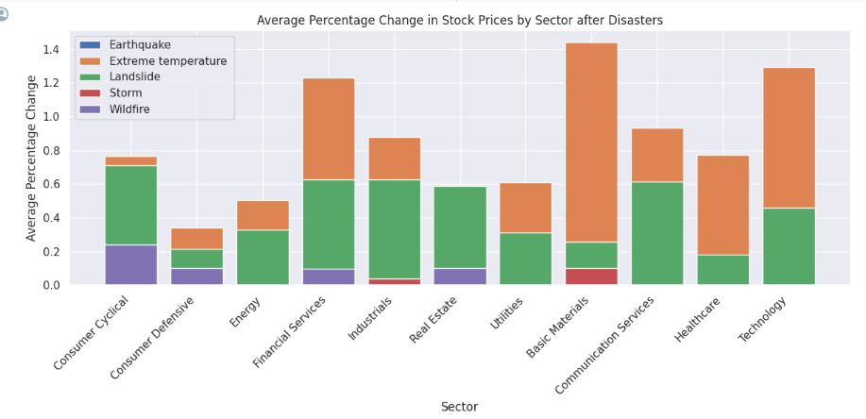
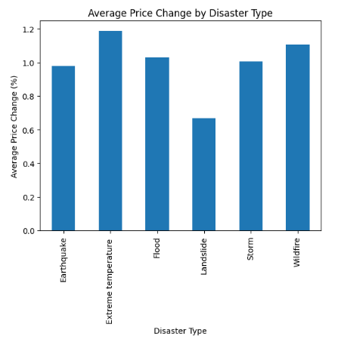

Analysis of the Impact of Natural Disaster on the Stock Market
Othniel Jimmy Adu Mensah
BACKGROUND
RESEARCH METHODOLOGY
The S&P 500 is a significant $42 trillion stock market index that monitors the performance of the top 500 companies on the stock exchange. It serves as a key indicator of the global market, with fluctuations impacting the overall economy.
Natural disasters are uncontrollable
events that have a profound impact on
human lives and societal structures.
These events encompass wildfires,
earthquakes, floods, storms, extreme
temperatures, and more.
It is essential to study and analyze
the patterns of these natural
disasters over time to effectively
manage and mitigate their effects.
This analysis builds an LSTM model to predict stock prices, considering how natural disasters might affect them. The model uses historical stock data and disaster data, transforming the latter into a numerical format the model can understand. The data is then normalized and split
into training,,validation, and test sets for robust
evaluation.
The trained model can be used to make predictions
on new data, allowing for an assessment of its
effectiveness in incorporating disaster data for
stock price prediction.
Steps include
Min Scaler, Hot Encoding
Spliting of the dataset
Reshaped,
Model Architecture
Compilation and Summary
Data Cleansing
An analysis was conducted on a 1,795,710 dataset merging S&P 500 stock data from 496 companies with 503 entries of industry types and sectors, along with a dataset of natural disaster occurrences spanning from 1900 to 2021 totaling 16,126 entries. The datasets were merged based on dates and symbols.
And to find out if there is a stock rise in a disaster.
In doing that we do a pre_window = 5 event window = 1 post window = 10
EVALUATION AND CONCLUSION
PURPOSE
.
A test s score of : 0.0002300350897712633
LSTM model has been trained for 254 epochs and achieved a low training loss. The similar test loss indicates that the model is generalizing well to unseen data.
Mean Squared Error (MSE): 0.00010384
Mean Absolute Error (MAE): 0.00677183
R-squared: 0.99877991
These metrics imply that the LSTM model effectively captured the relationship between disaster data, historical stock prices, and future closing stock prices. The model exhibits high accuracy with low errors and a strong correlation between predictions and actual values.
My goal is to understand and evaluate the pattern that exists between these natural disasters and the stock market. This underlying factor must be defined so we can determine its level of impact on the stock market.
This can be achieved by developing indicators that dissect the volatile metrics of the stocks. Then gauged to determine the impact of these natural disasters.
This research project is very complex and detail-oriented,
The ability to forecast stock market movements in advance could significantly reduce risks (Greenwald & Stiglitz, 1993).
The research, titled "Environmental Disasters and Stock Market Performance" by Ishuwar Seetharam from Stanford University in September 2017, establishes that market returns are likely to be negatively impacted by earthquakes, hurricanes, and tornadoes but positively influenced by floods, tsunamis, and volcanic eruptions. The process of evaluating how natural disasters
affect stock markets is complex and calls for
a methodical approach that combines model
selection, data analysis, and result
interpretation. This comprehensive approach
allows for the extraction of important insight
s on market behavior and risk mitigation techniques,
which in turn helps to make decisions that are more robust and well-informed in the event of natural disasters.
Average Percentage Change in Stock Price of Sectors and Disaster Type
Search Strategies and Literature Review
Outcome OF the analysis of the disasters on the stocks
REFERENCES
The impact of natural disasters on stock markets extends beyond immediate disruptions, influencing sectoral performance and investor confidence. Through comprehensive analysis, proactive measures, and a focus on resilience, stakeholders can navigate the challenges posed by natural disasters and foster a more stable market environment.
The Technology sector is the most susceptible to natural disasters, experiencing disruptions from various events .
Extreme temperature events, despite lower frequency, cause the most significant stock price declines (1.2% on average) followed by the Landslide.
Technology, Energy, and Communication Services sectors exhibit the highest average price changes during natural disasters, highlighting their vulnerability.
Landslide has the least impact on the stock market of about 0.6 percent at its peak of
Julio Gonzalez. (2023, Oct 12) .How war impacts the stock Market. https://www.linkedin.com/pulse/how-war-impacts-stock-market-julio-gonzalez-j9z9e/
Natural disasters – Blessings in disguise? Hardjo Koerniadi* Auckland University of Technology Private
Bag 92006, Auckland, New Zealand Chandrasekhar Krishnamurti University of Southern Queensland
Toowoomba, QLD 4350, Australia Alireza Tourani-Rad Auckland University of Technology Private Bag 92006, Auckland, New Zealand
Spring 2019 Effects of Terrorism on the U.S. Stock Market: Evidence from High Frequency Data Kyla Scanlon Western Kentucky University, kyla.scanlon121@topper.wku.edu

