Slide 1
DATA 201 CAPSTONE
NYC Motor Vehicle Collisions
Where crashes concentrate,
when they peak, and what defines severe collisions.
Executive analysis of 2.27 million police-reported collisions in New York City.
2.27M
2012–2026
3
Collision records
Coverage
Research questions
Jimmy Salto • DATA 201.

Slide 2
EXECUTIVE THESIS
Three signals define the collision story
A concise view of the findings before we examine the evidence.
01
Brooklyn
506,806
THE THESIS
Highest reported borough count.
Crashes cluster
in place, time,
and context.
02
4 PM + Friday
161,385 / 360,747
Peak time pattern.
That pattern suggests where traffic-safety attention and better reporting could matter most.
03
Distraction + Sedan
125,055 / 176,908
Most common in severe crashes.
NYC Open Data • Motor Vehicle Collisions – Crashes • NYPD
2

Slide 3
DATA FOUNDATION
2.27 million collision records spanning nearly 14 years
Official NYC Open Data provides a large, longitudinal view of reported motor vehicle collisions.
COVERAGE
SOURCE
July 2012 → June 15, 2026
NYC Open Data • NYPD
1 row
29 + 4
COLLISION_ID
Daily
One reported collision.
Domain fields + API metadata.
Unique crash identifier.
Intended refresh cadence.
Academic note on provenance
The file is based on NYPD crash reports. Records can be revised as additional information becomes available, so cleaning decisions and limitations are documented explicitly.
NYC Open Data • Motor Vehicle Collisions – Crashes • NYPD
3

Slide 4
ANALYTICAL PREPARATION
From 33 loaded columns to a focused analytical dataset
Only variables needed for the research questions were retained, validated, and engineered.
SELECT
CHECK
VALIDATE
STANDARDIZE
ENGINEER
16 variables.
Missing values + duplicates.
Injury and fatality totals.
Borough, factors, and vehicles.
Hour, weekday, and severity.
30.47%
8,913
18
Borough values missing—kept to preserve otherwise valid crashes.
Missing fatality totals reconstructed.
Missing injury totals reconstructed.
DERIVED VARIABLES
crash_hour • day_of_week • crash_severity
NYC Open Data • Motor Vehicle Collisions – Crashes • NYPD
4

Slide 5
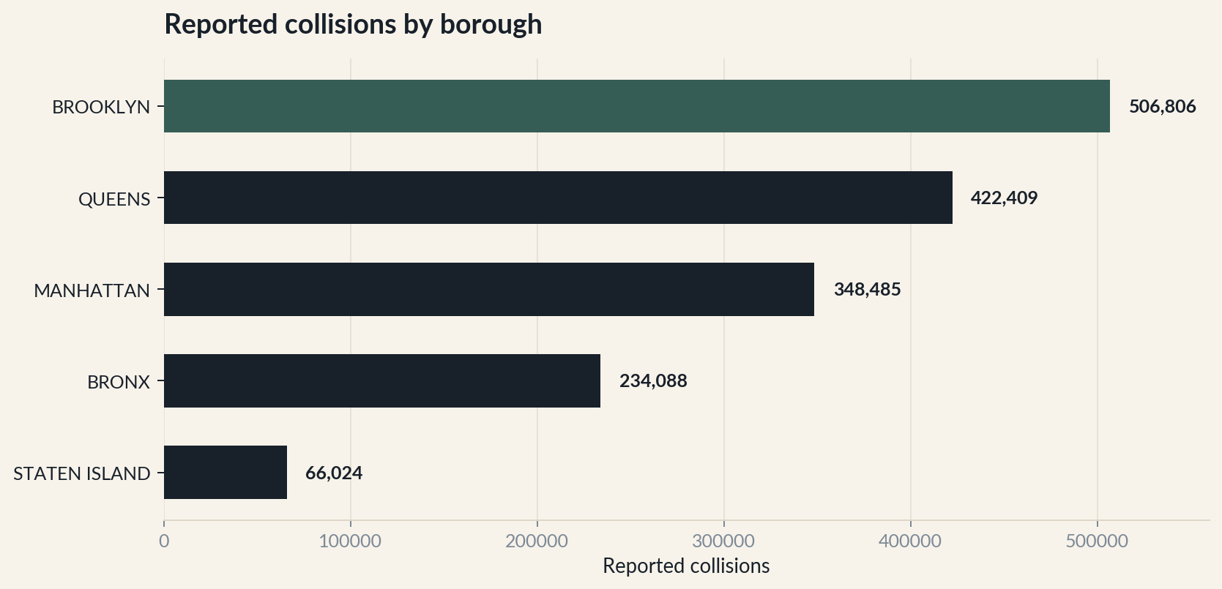
FINDING 1
Brooklyn carries the highest reported collision burden
Among crashes with a known borough, Brooklyn leads every other borough in total collision count.
506,806
Reported collisions
in Brooklyn.
CAVEAT
~30% of records have no borough reported.
Interpret the ranking among known borough records.
NYC Open Data • Motor Vehicle Collisions – Crashes • NYPD
5

Slide 6
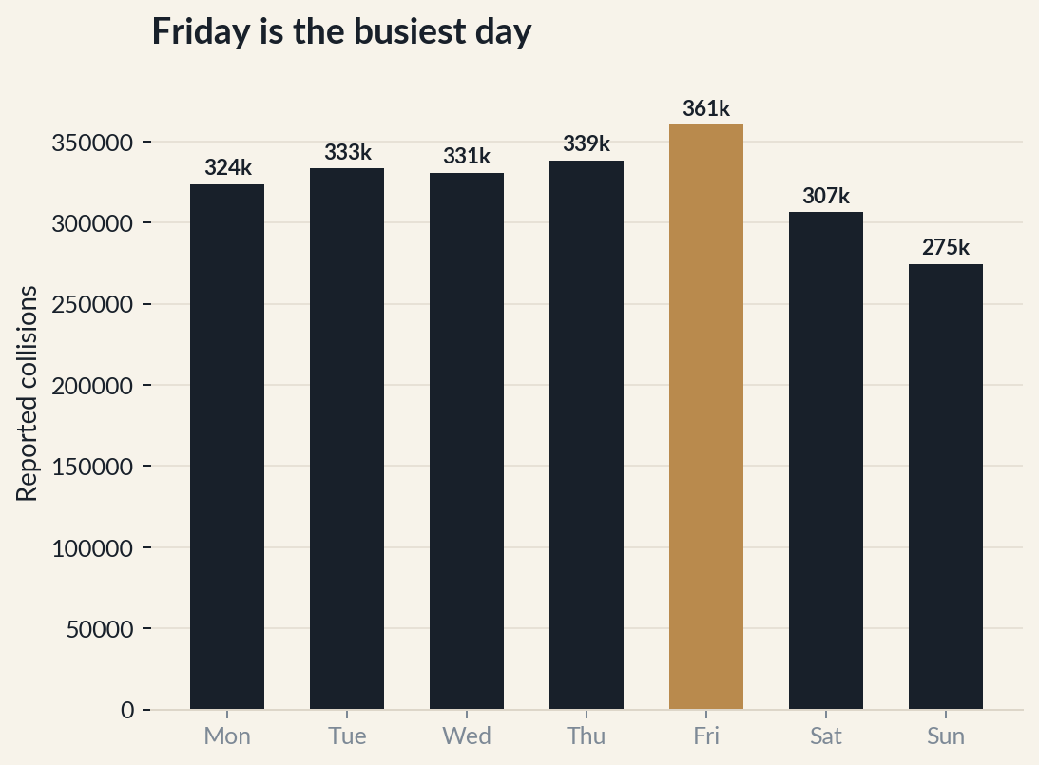
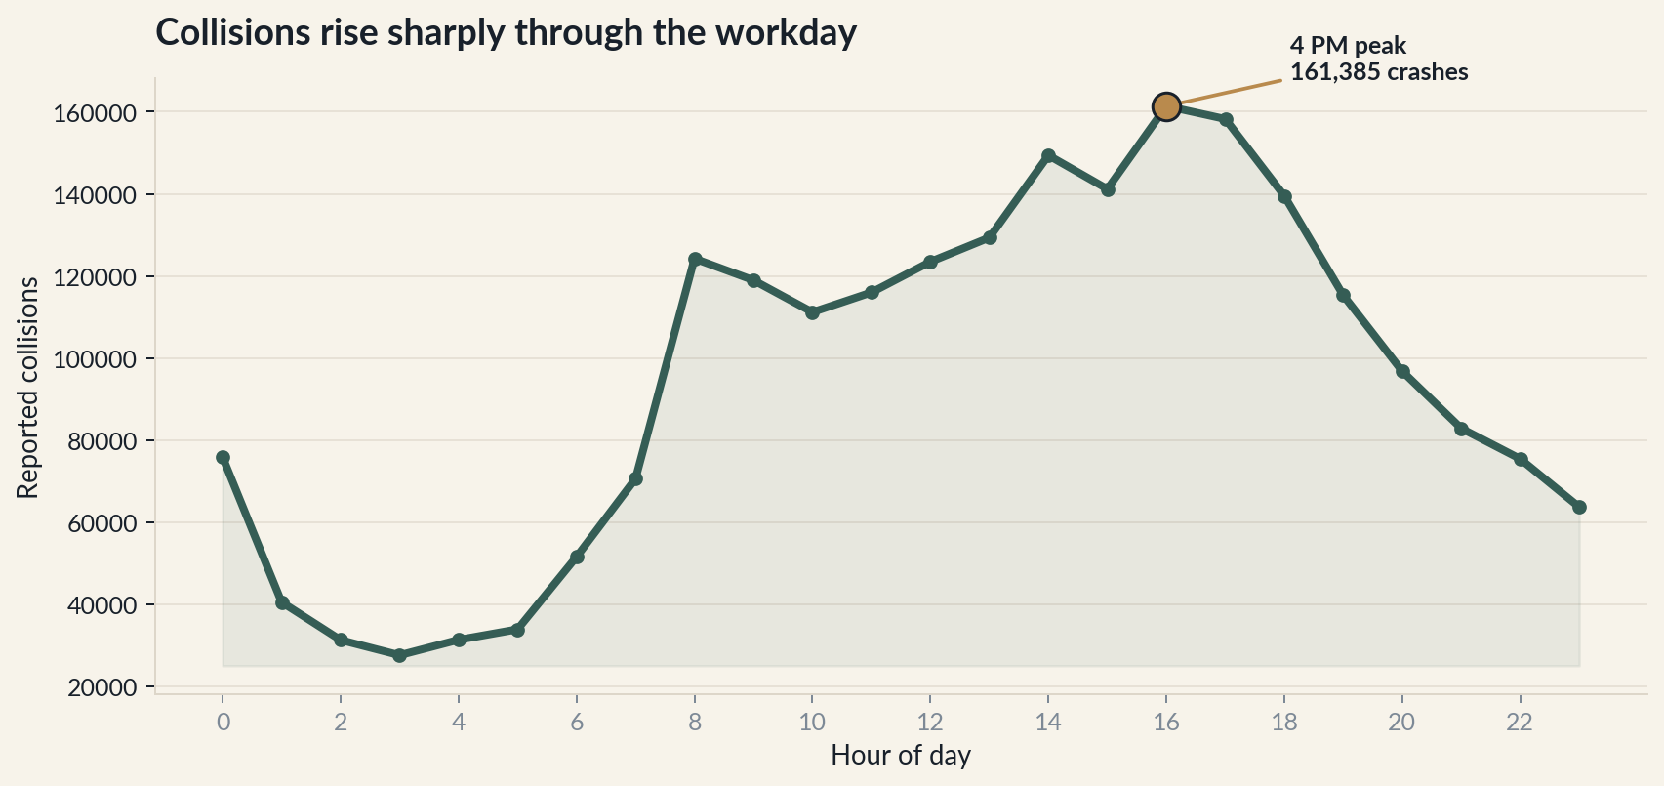
FINDING 2
The crash curve peaks at 4 PM—and Friday is busiest
Both time-of-day and day-of-week patterns point toward heavier late-week commuting activity.
PEAK HOUR
TOP DAY
4 PM
161,385
Friday
360,747
NYC Open Data • Motor Vehicle Collisions – Crashes • NYPD
6

Slide 7
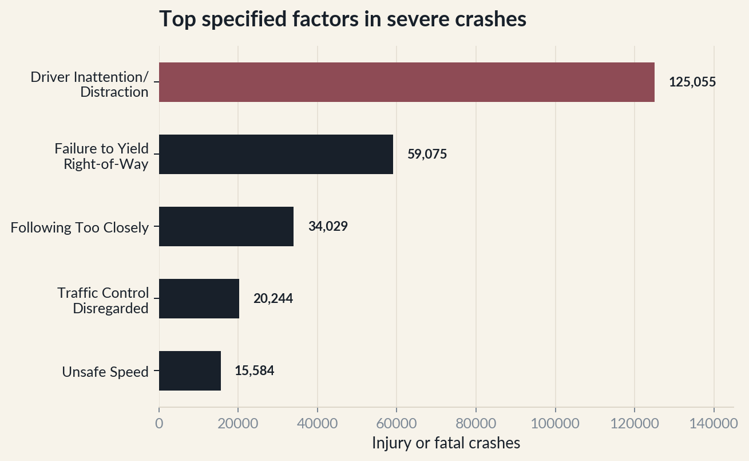
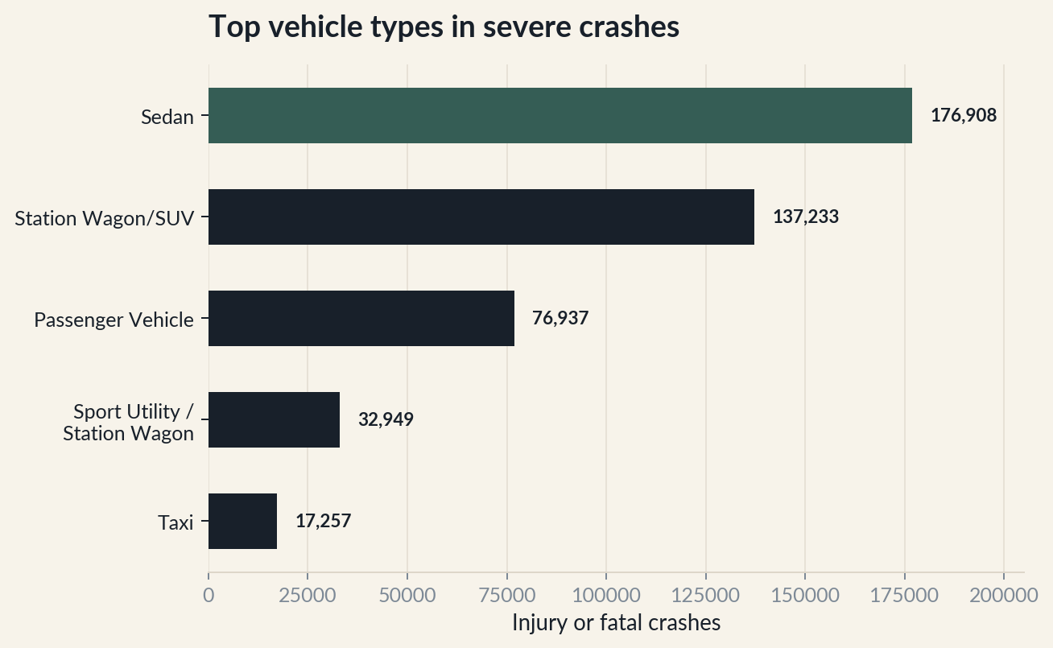
FINDING 3
Severe crashes point to distraction and sedans
After excluding “Unspecified,” Driver Inattention/Distraction is the leading specific factor in injury or fatal crashes.
LEADING FACTOR
Driver Inattention/Distraction
125,055
TOP VEHICLE
Sedan
176,908
NYC Open Data • Motor Vehicle Collisions – Crashes • NYPD
7

Slide 8
IMPLICATIONS
The data suggest where to focus—and what to fix
A strong executive conclusion should connect findings to action while preserving the limitations of the evidence.
WHAT TO DO
WHAT TO QUALIFY
01
Prioritize high-volume windows
Focus traffic-safety attention around late-afternoon and Friday patterns.
30.47%
Missing borough values.
02
Deepen borough-level follow-up
Brooklyn is the strongest candidate for a more granular location analysis.
“Unspecified”
Common in contributing factors.
03
Improve reporting consistency
Vehicle labels
Not fully standardized.
Reduce “Unspecified” factors and normalize vehicle labels.
Use the findings directionally—not as causal proof.
NYC Open Data • Motor Vehicle Collisions – Crashes • NYPD
8

Slide 9
CLOSING
Three takeaways to remember
01
02
03
PLACE
TIME
CONTEXT
Brooklyn leads among known boroughs.
4 PM and Friday define the peak pattern.
Distraction and sedans dominate severe-crash counts.
Questions?
NYC collision analysis.
Thank you. — Jimmy Salto • DATA 201 Capstone Project.
NYC Open Data • Motor Vehicle Collisions – Crashes • NYPD
9

