Slide 1

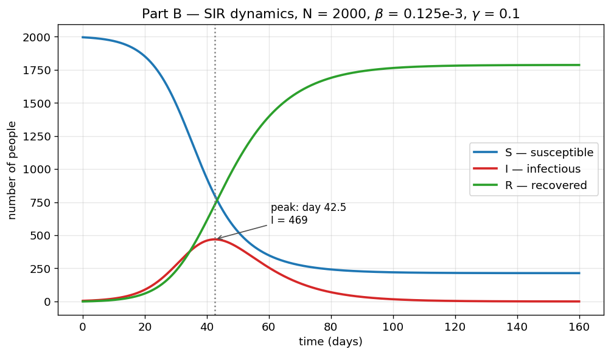
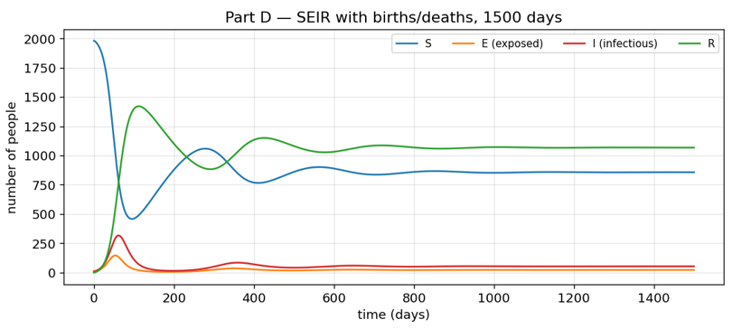
COMPUTER SCIENCE & INFORMATICS × NELL HODGSON WOODRUFF SCHOOL OF NURSING
SIR & SEIR models of pandemic spread
Hypothesis:
The SIR will peak near day 40-50 at 400-500 infected population. (Supported)
Births in the SEIR will produce more than 1 waves of pandemic. (Supported)
β will affect the peak more than γ. (Rejected: γ -1.84 VS β +1.58)
469 infected at day 42.5
A parameter can matter more than what the formula shows.
Although both β and γ affect R₀, γ also controls how quickly people recover, so the epidemic peak was more sensitive to γ than to β.

