Slide 1
HA Database Failover Procedure

Slide 2
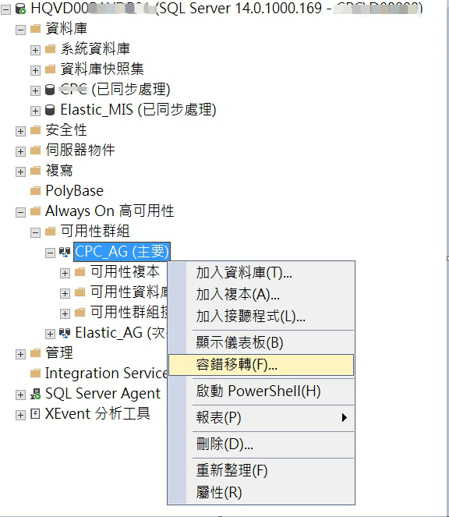
手動容錯移轉
step1

Slide 3
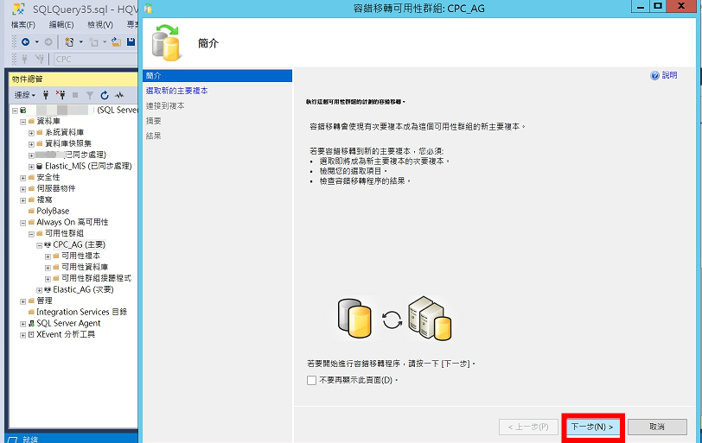
手動容錯移轉
step2

Slide 4
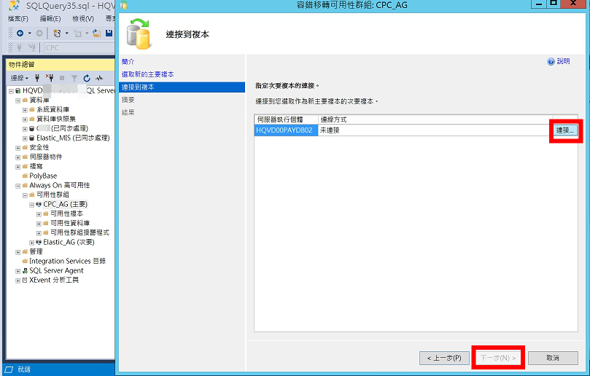
手動容錯移轉
step3

Slide 5
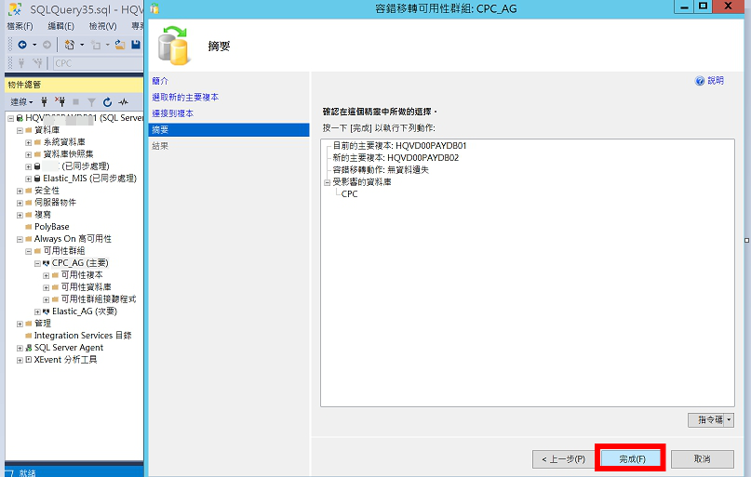
手動容錯移轉
step3

