Slide 1
NOVELTY ANALYSIS
The Plasma Immunome in Cardiovascular Disease
Which plasma immune proteins cause cardiovascular disease, how much of that signal is genuinely new, and what should be done about it
191
61 × 38
78
32
1
causal pairs FDR < 5 %
proteins × CV endpoints
colocalised PP.H4 ≥ 0.8
replicated Finland → England
recovered known drug axis
Human Plasma Immune Atlas · layer 7 · FinnGen R12 cardiovascular chapter

Slide 2
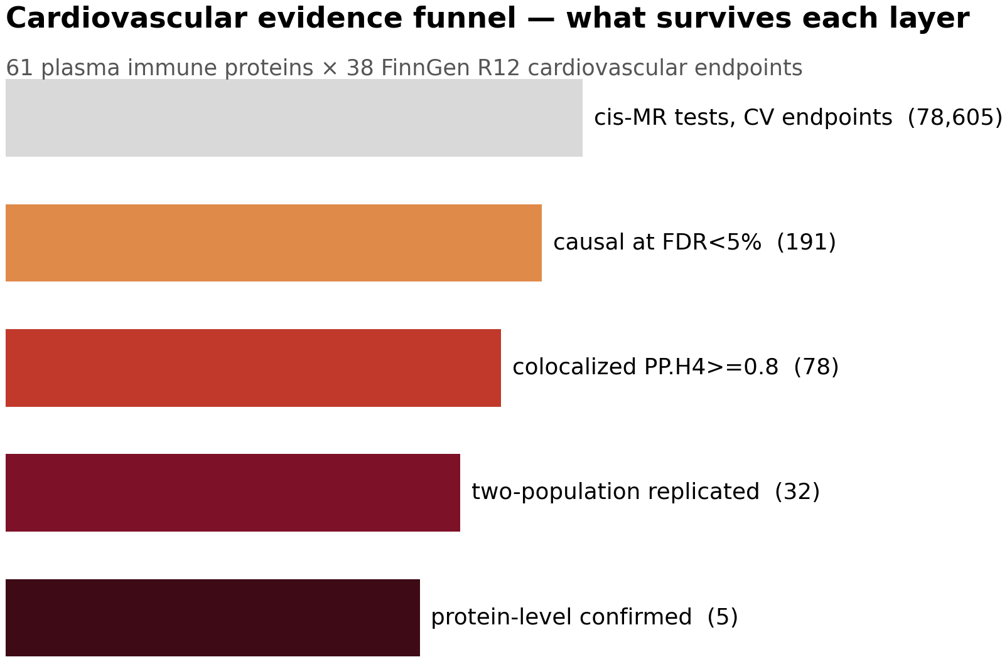
Figure 1 | Cardiovascular evidence funnel
What survives each layer
Of 78,605 cis-MR tests against cardiovascular endpoints, 191 are causal at FDR < 5 %, 78 colocalise at PP.H4 ≥ 0.8, 32 replicate in an independent UK Biobank population, and 5 are confirmed at the circulating-protein level. Each layer is an independent filter, so the surviving set is the therapeutically actionable core.
Human Plasma Immune Atlas · cardiovascular novelty
1

Slide 3
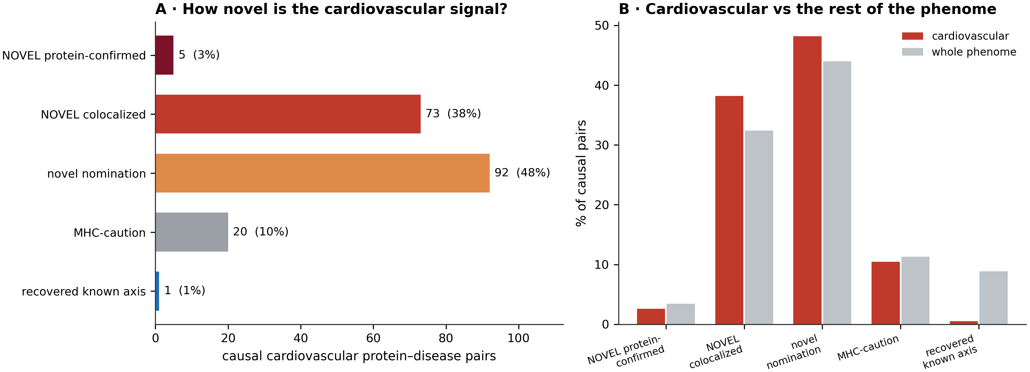
Figure 2 | How novel is the cardiovascular signal?
Engine class composition, and cardiovascular versus the rest of the phenome
(A) The 191 cardiovascular causal pairs split by novelty class: 78 NOVEL with colocalisation support and only 1 recovered known drug axis. (B) Cardiovascular disease is enriched for novel colocalised signal relative to the rest of the phenome and is almost devoid of recovered known axes — it is unexploited therapeutic territory.
Human Plasma Immune Atlas · cardiovascular novelty
2

Slide 4
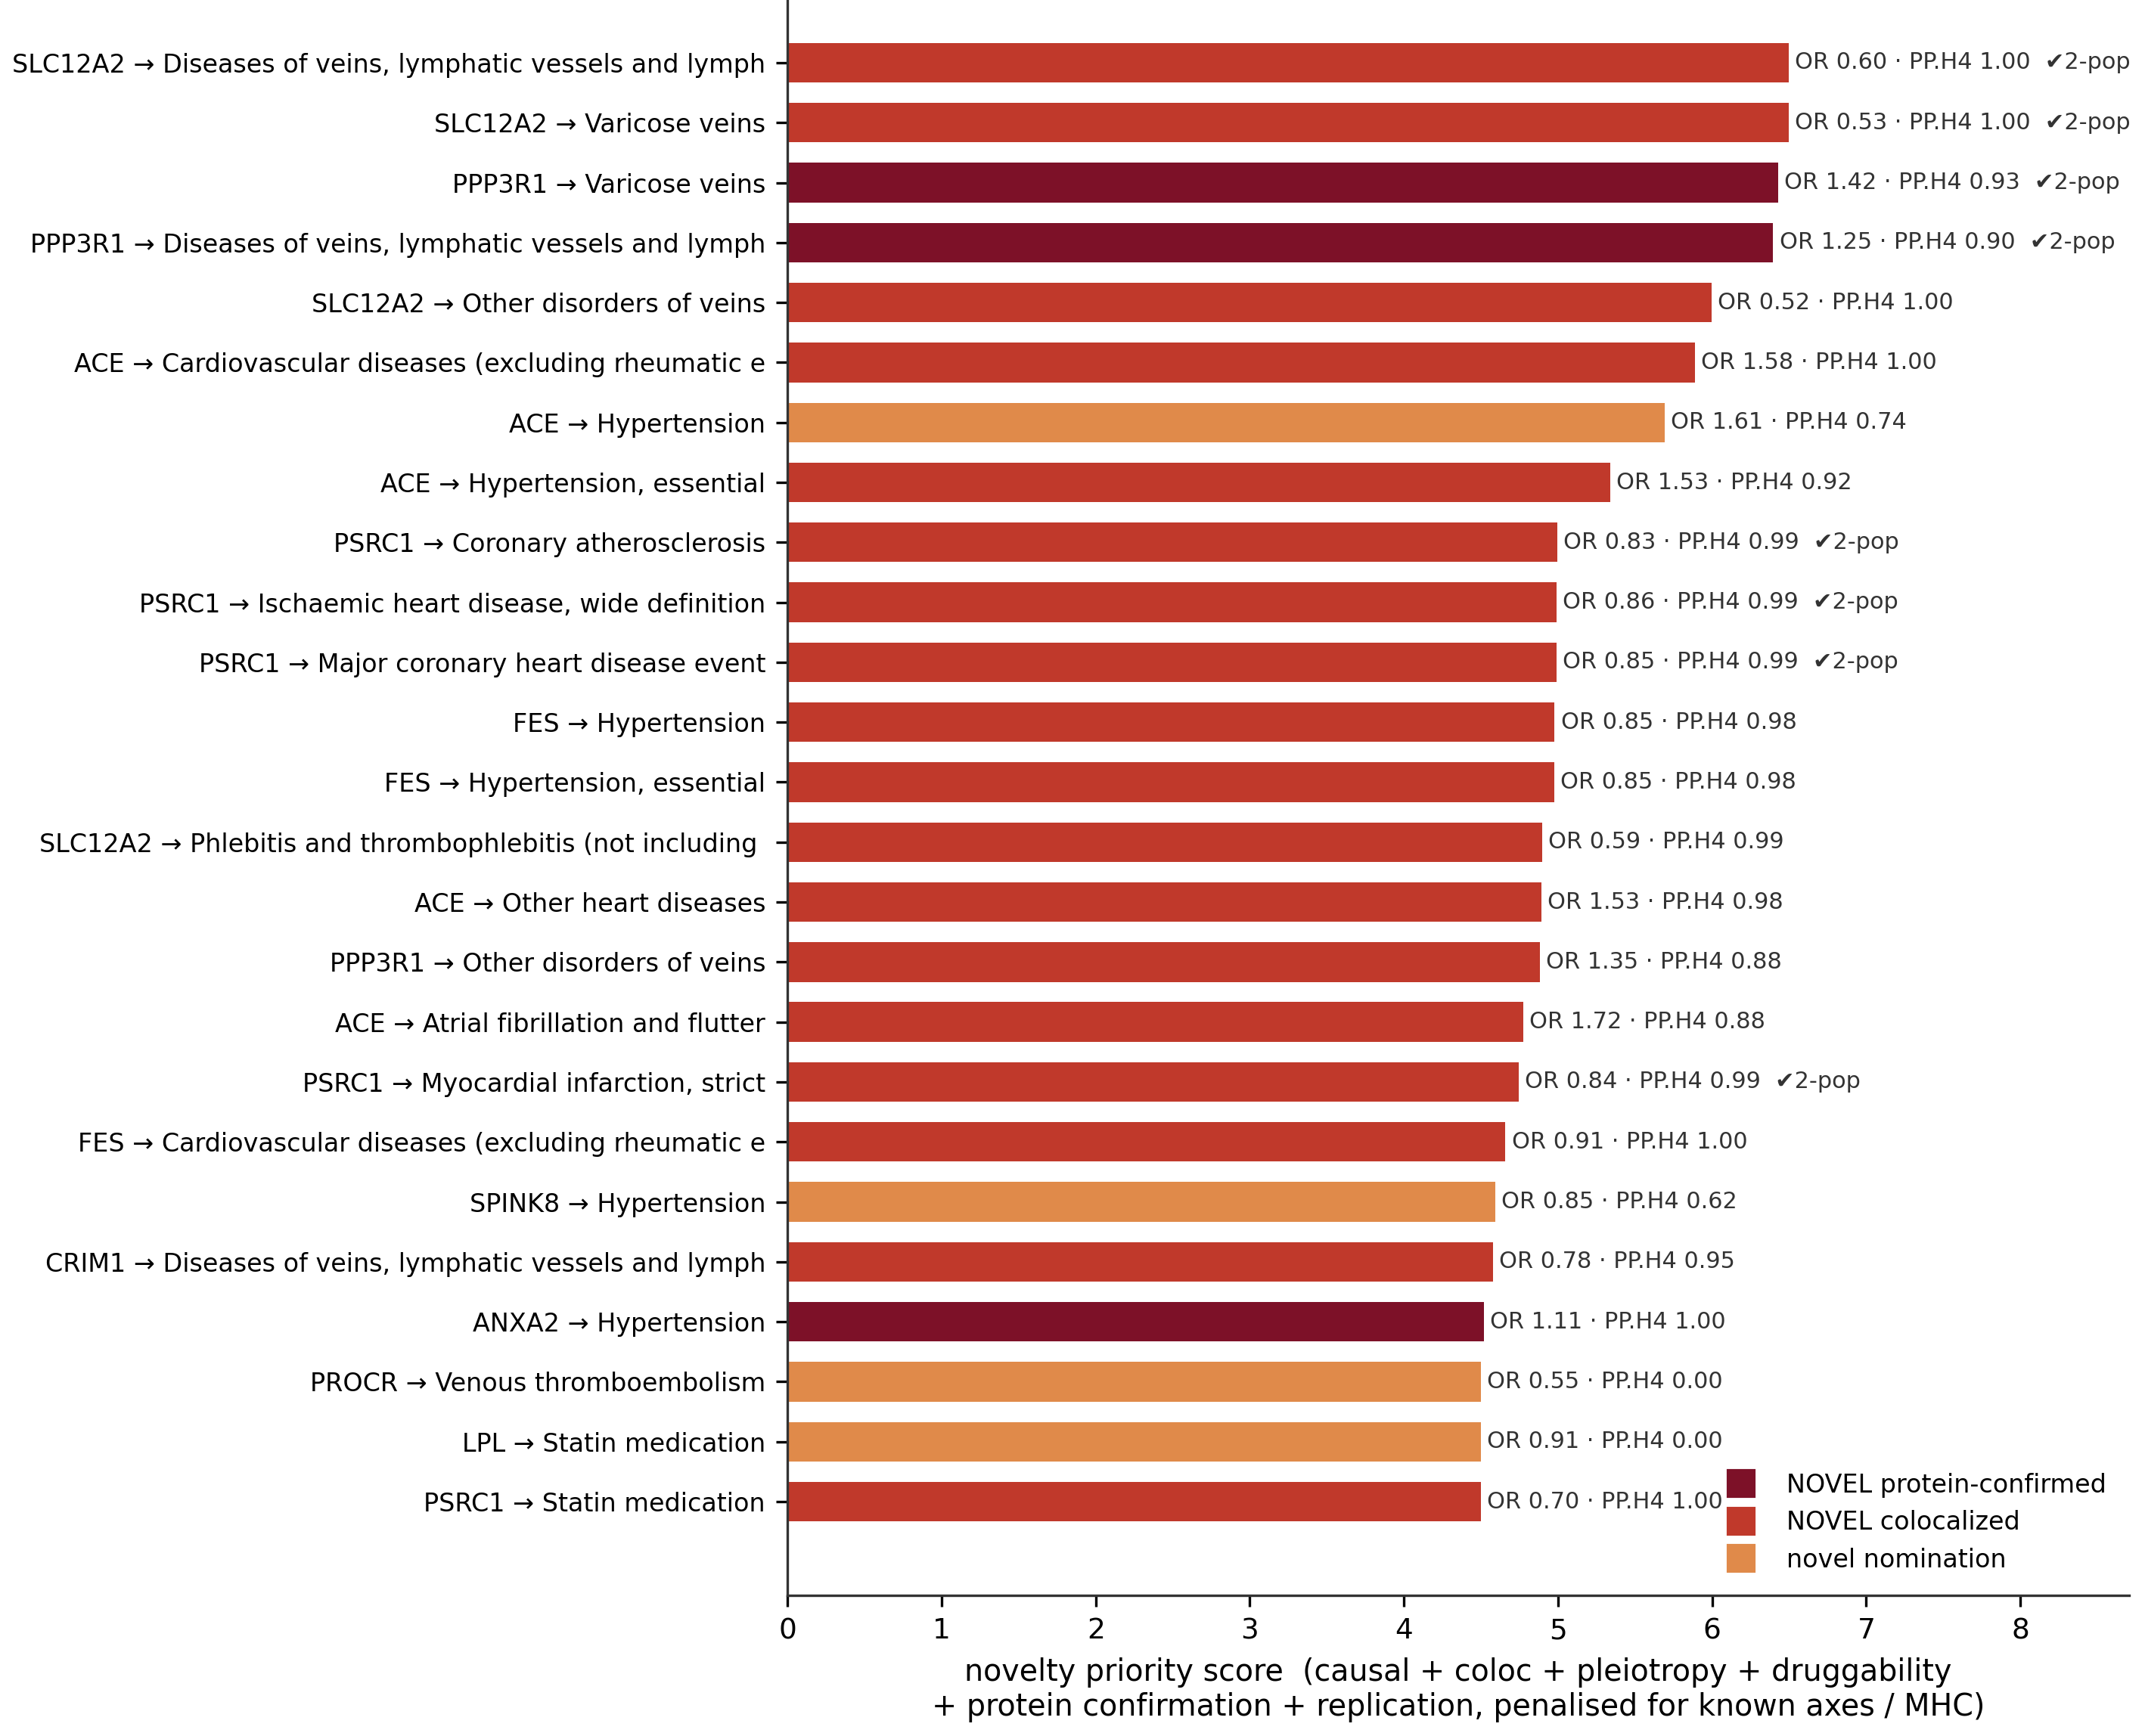
Figure 3 | Top 25 novel cardiovascular targets
Ranked by novelty priority
Every bar is a live causal claim carrying a direction of effect, a colocalisation posterior and, where an independent GWAS exists, a two-population test. SLC12A2 and PPP3R1 dominate the venous endpoints; PSRC1 and FES the coronary and hypertensive ones.
Human Plasma Immune Atlas · cardiovascular novelty
3

Slide 5
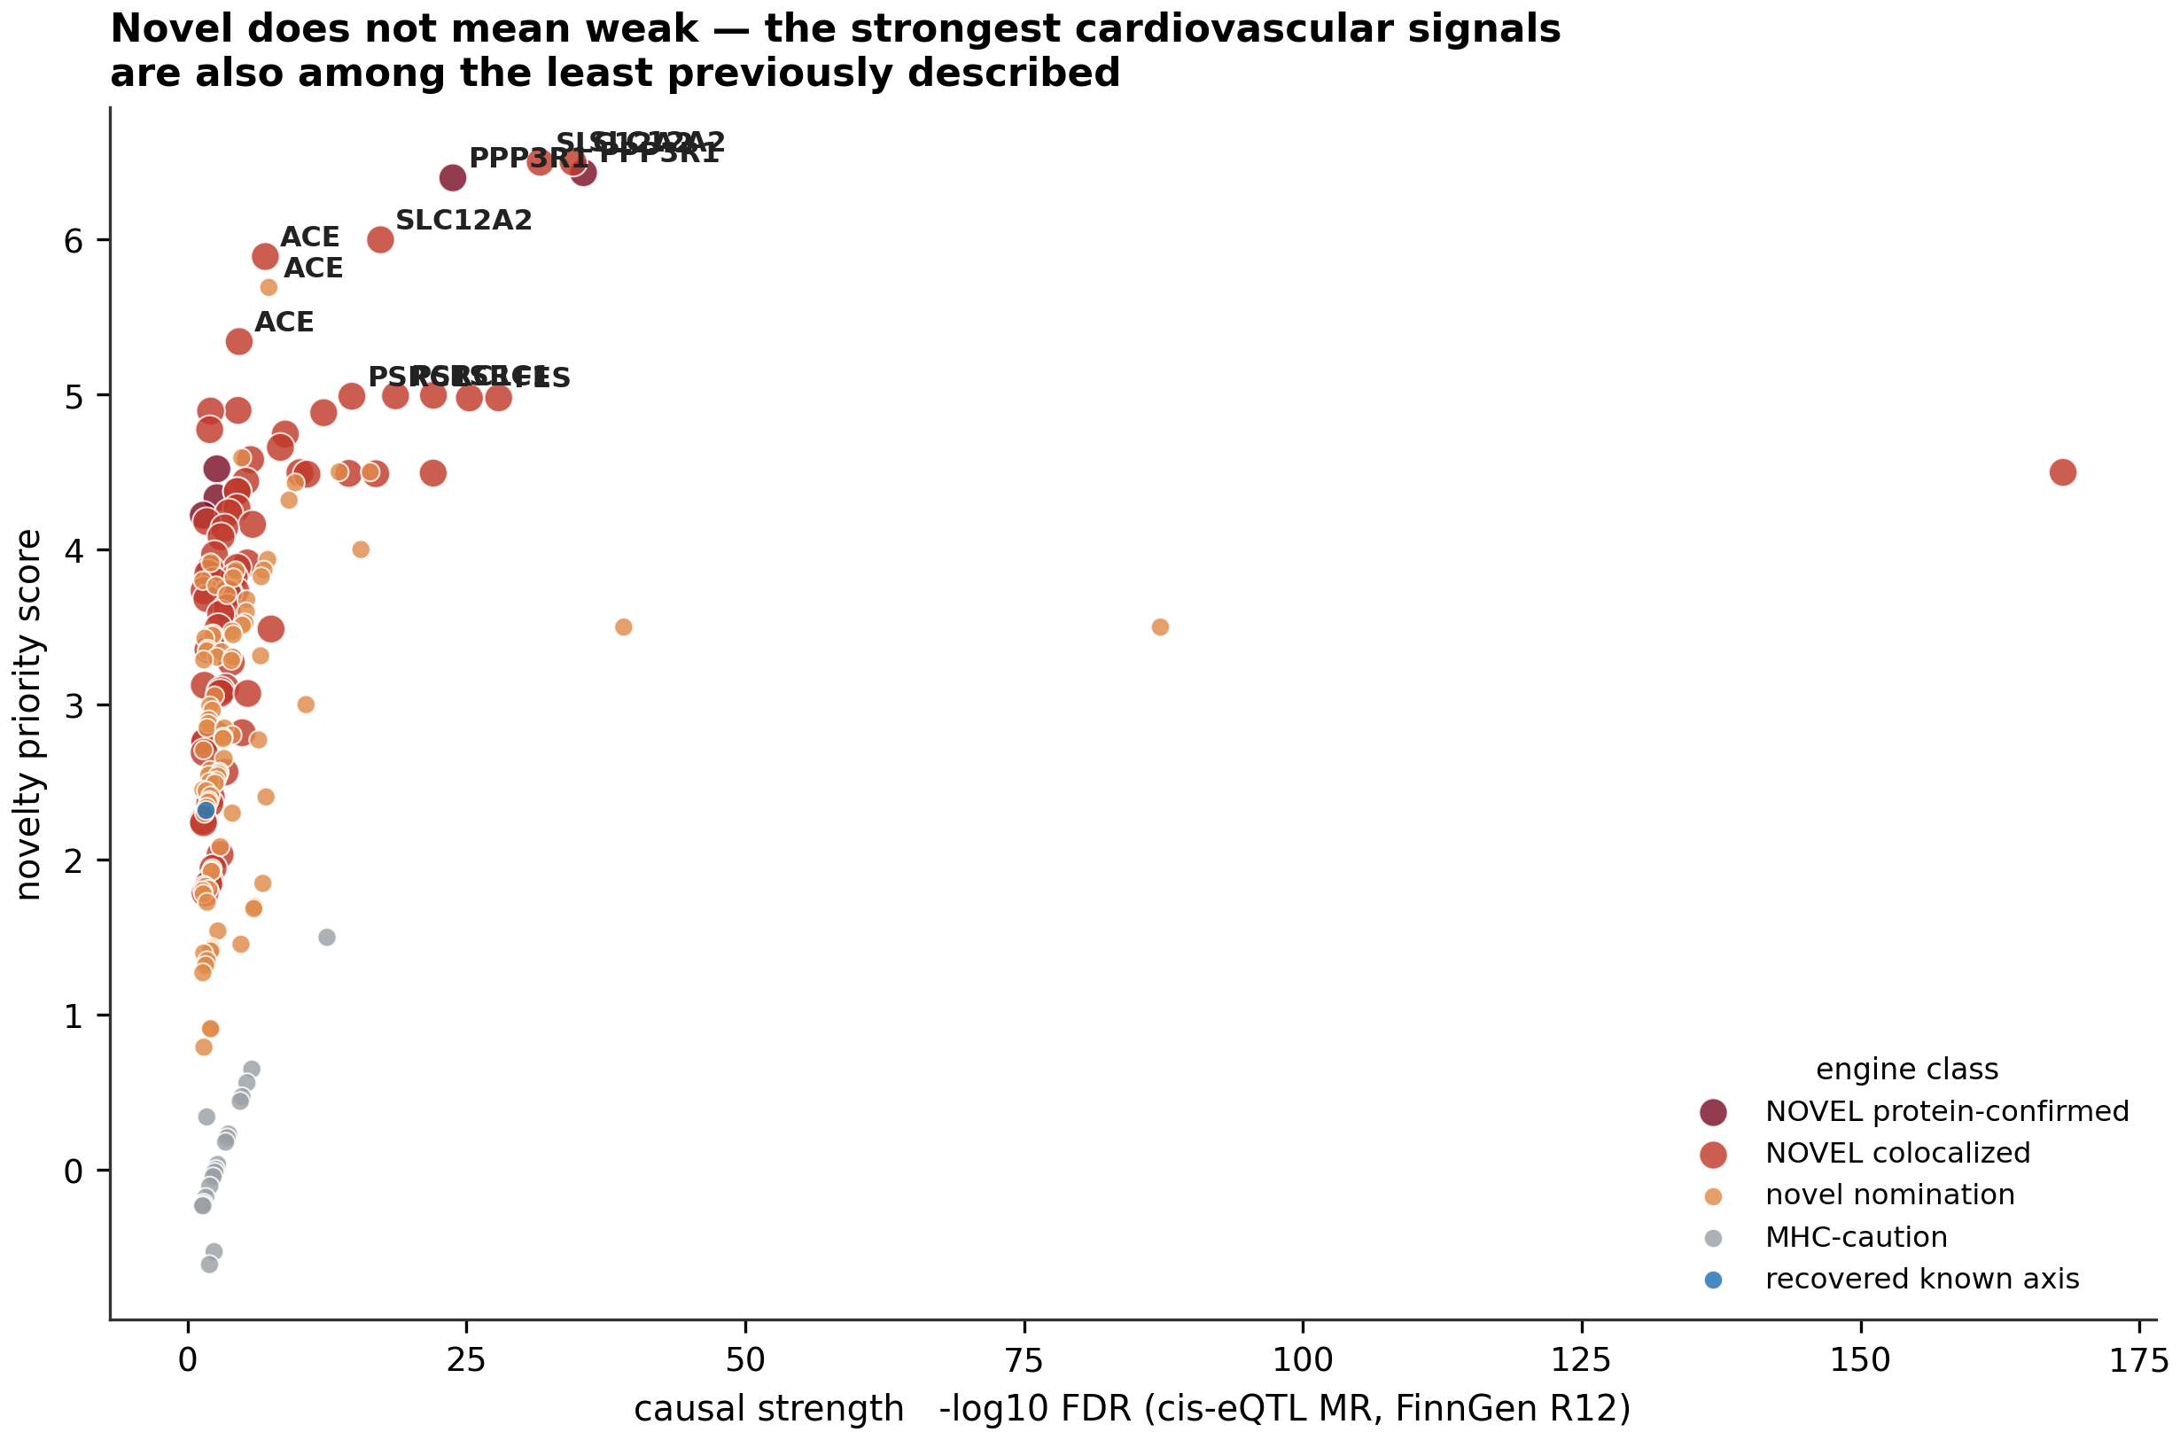
Figure 4 | Novelty against causal strength
Novel does not mean weak
Novelty priority plotted against MR evidence. Several of the least previously described proteins carry the strongest cardiovascular causal evidence in the atlas, so the novel set cannot be dismissed as the residue left after the strong signals were taken.
Human Plasma Immune Atlas · cardiovascular novelty
4

Slide 6
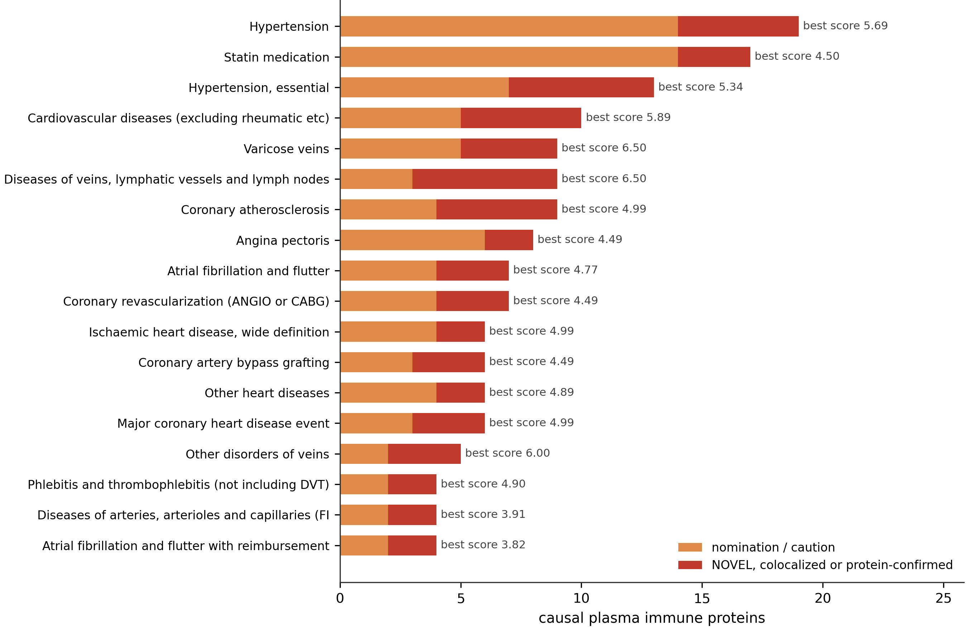
Figure 5 | Cardiovascular endpoints reached
Not only atherosclerosis
Hypertension, venous disease, atrial fibrillation and revascularisation endpoints each carry independent plasma-immune causal architecture. The venous endpoints in particular are dominated by novel colocalised proteins with essentially no prior immune-therapeutic literature.
Human Plasma Immune Atlas · cardiovascular novelty
5

Slide 7
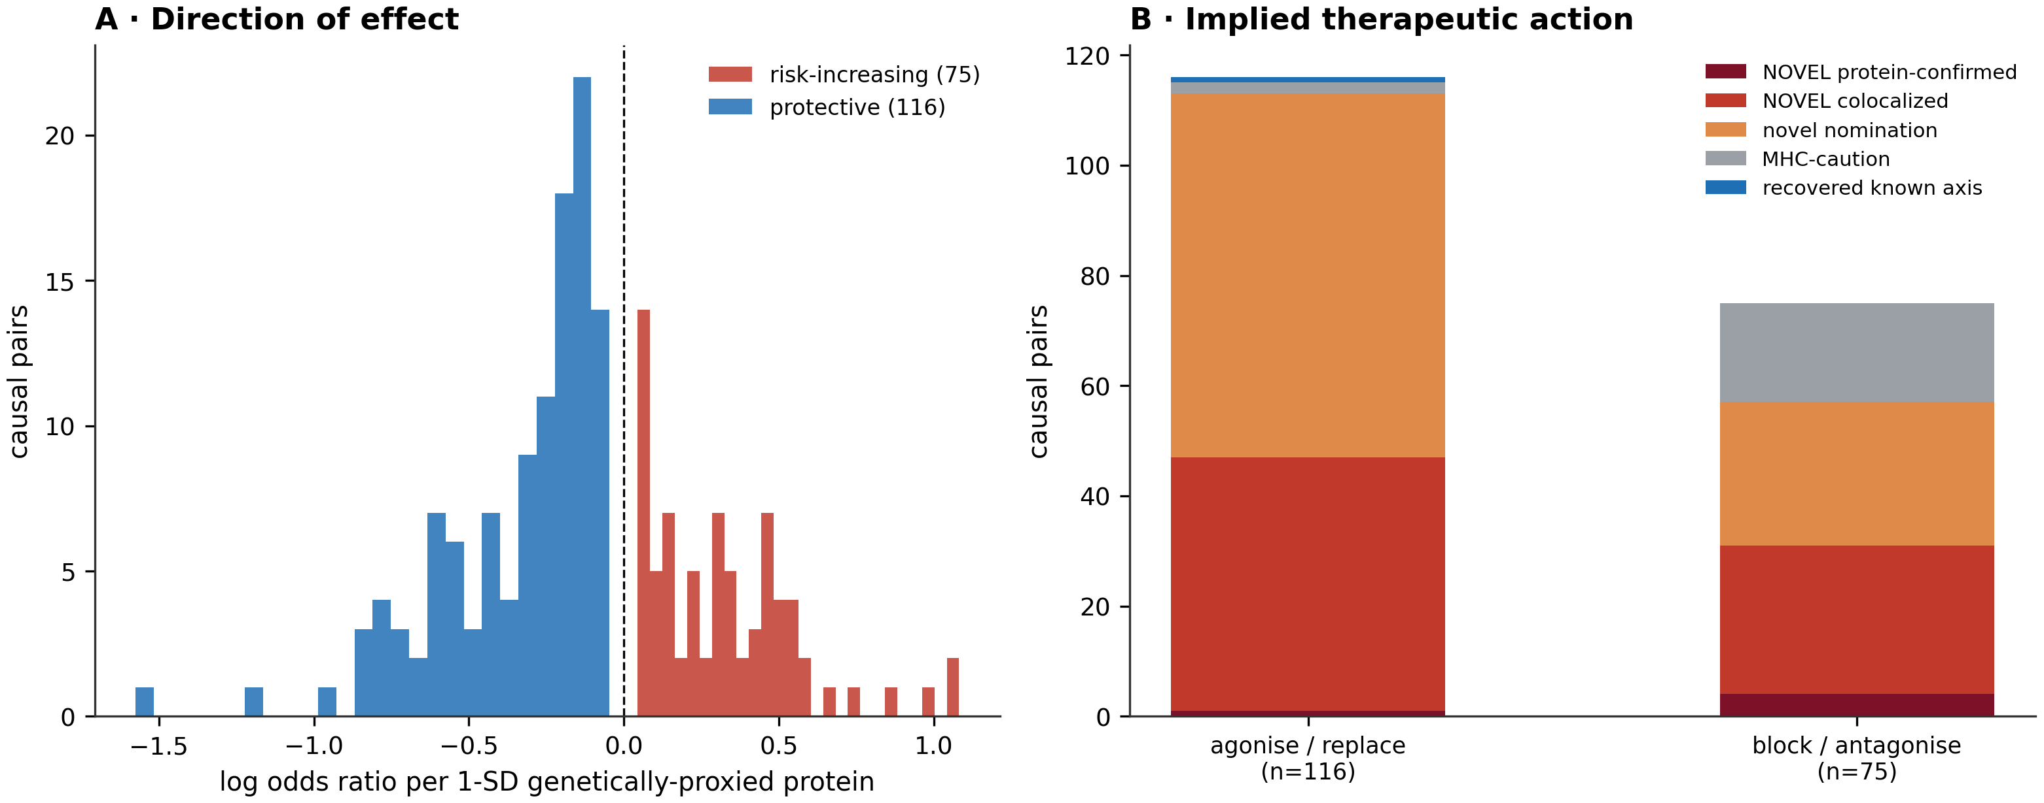
Figure 6 | Therapeutic direction and implied action
The protective majority
(A) Distribution of causal effect direction: 116 of 191 cardiovascular pairs are protective versus 75 risk-increasing. (B) Implied therapeutic action by novelty class. Because protective effects predominate, broad immunosuppression would be expected to harm more of this axis than it helps.
Human Plasma Immune Atlas · cardiovascular novelty
6

Slide 8
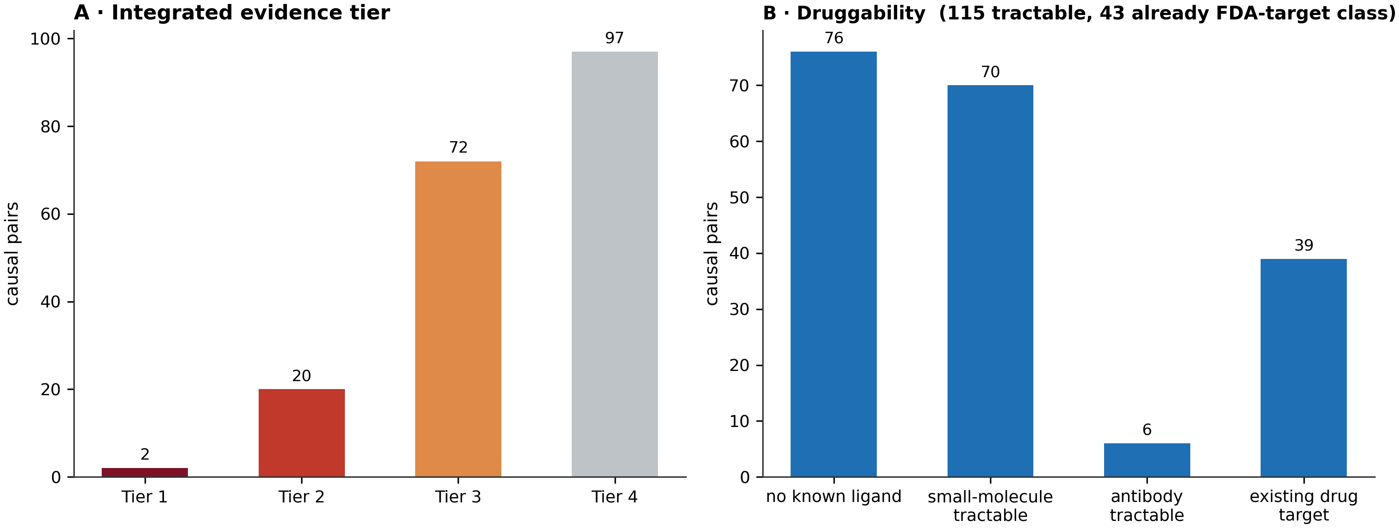
Figure 7 | Evidence tier and druggability
What could be acted on now
(A) Integrated evidence tier; tier 1–2 pairs carry protein-level or replicated colocalised support. (B) Druggability: 115 pairs have a tractability route and 43 sit on proteins already targeted by an approved drug in another indication — immediate repurposing candidates.
Human Plasma Immune Atlas · cardiovascular novelty
7

Slide 9
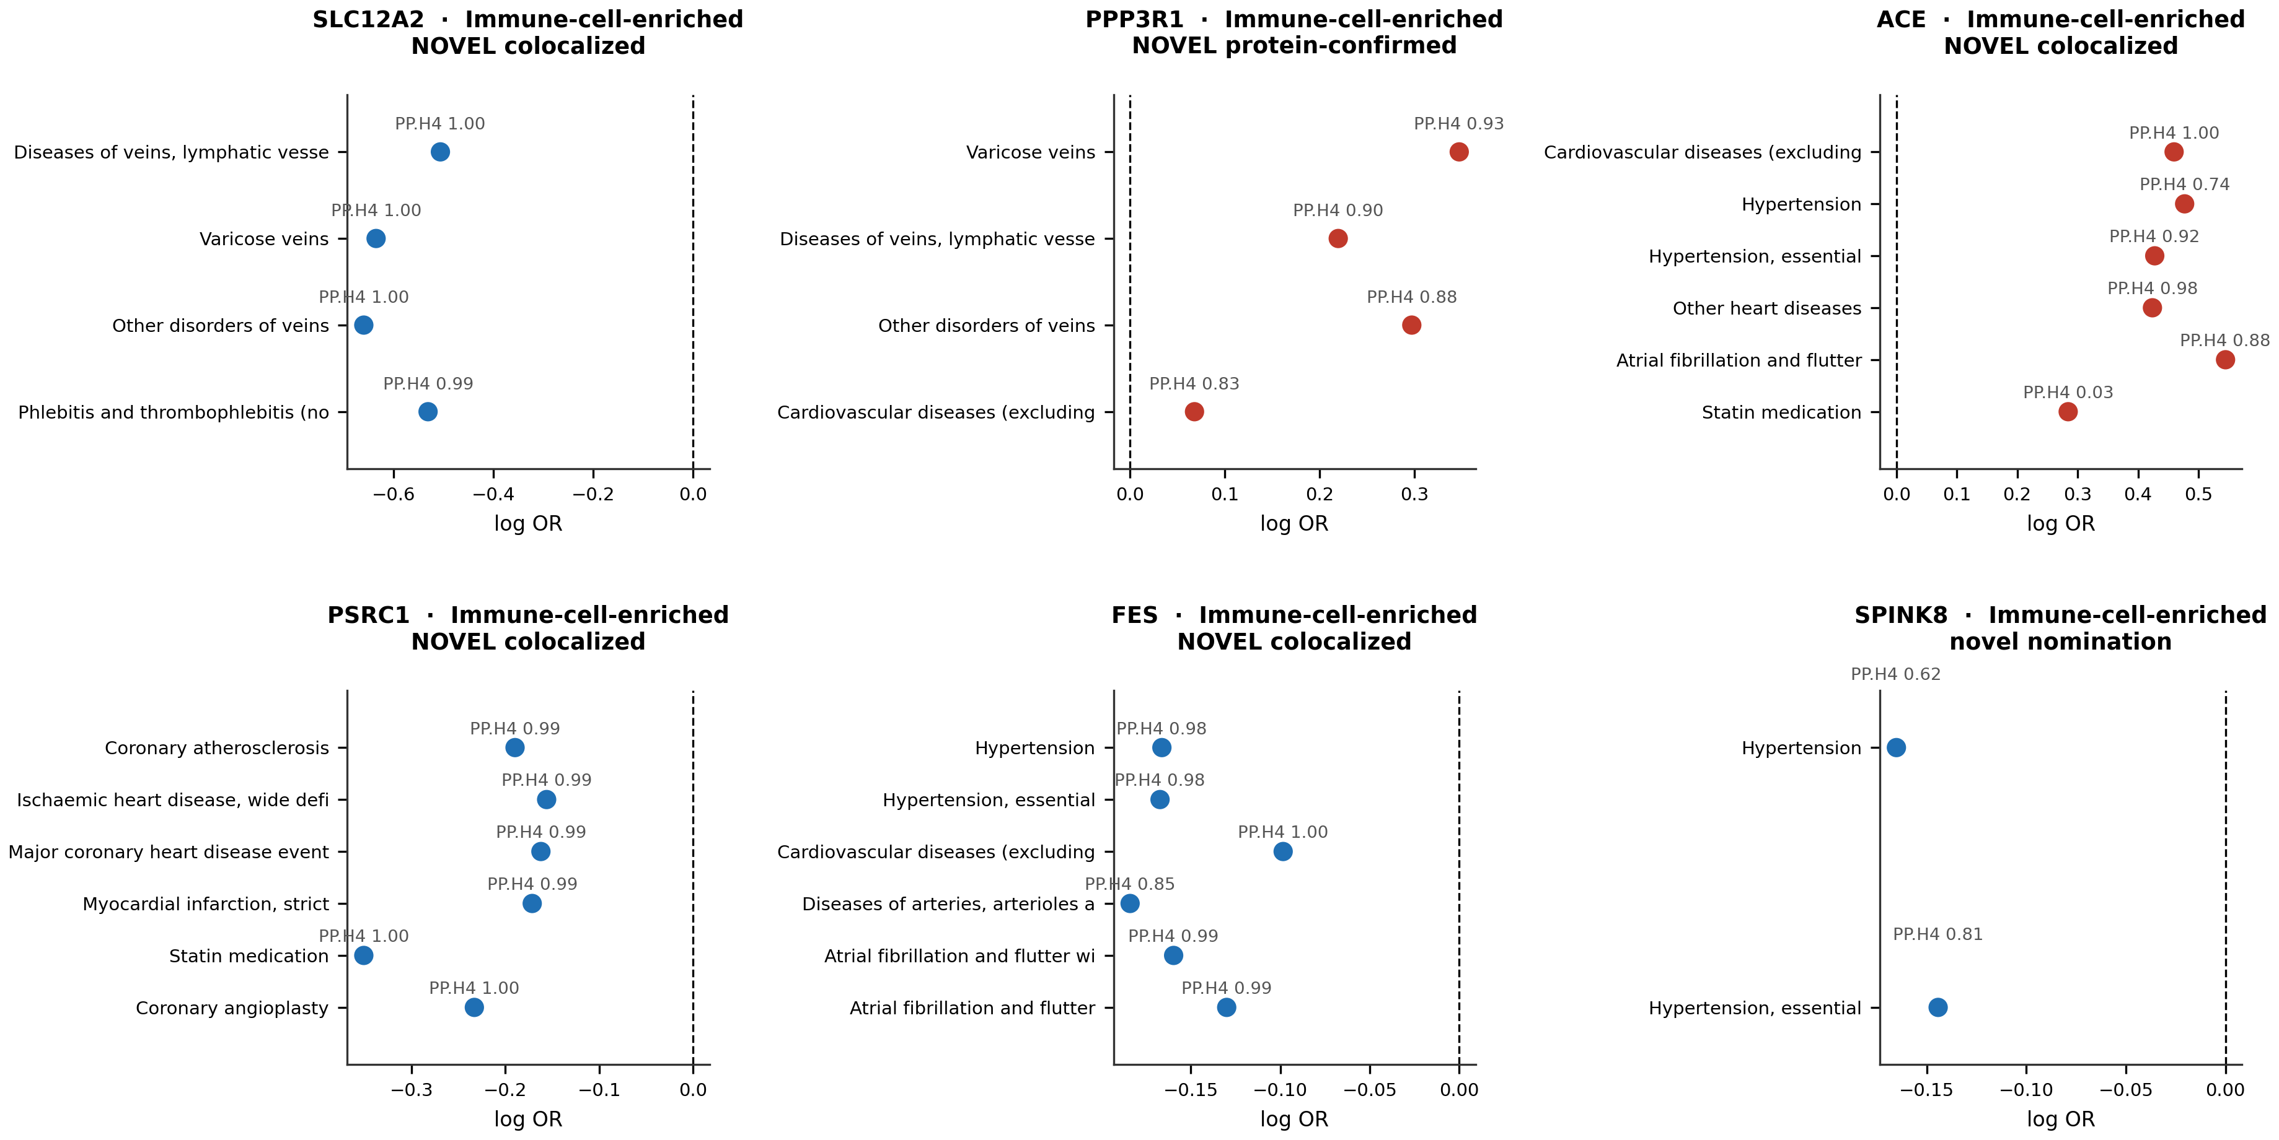
Figure 8 | Worked cardiovascular case studies
The six highest-priority novel proteins
For each protein, every cardiovascular endpoint it causes, with the colocalisation posterior printed above each point. Red = risk-increasing, blue = protective. Consistency of direction across related endpoints is itself evidence: a horizontal-pleiotropy artefact would not respect disease boundaries this cleanly.
Human Plasma Immune Atlas · cardiovascular novelty
8

Slide 10
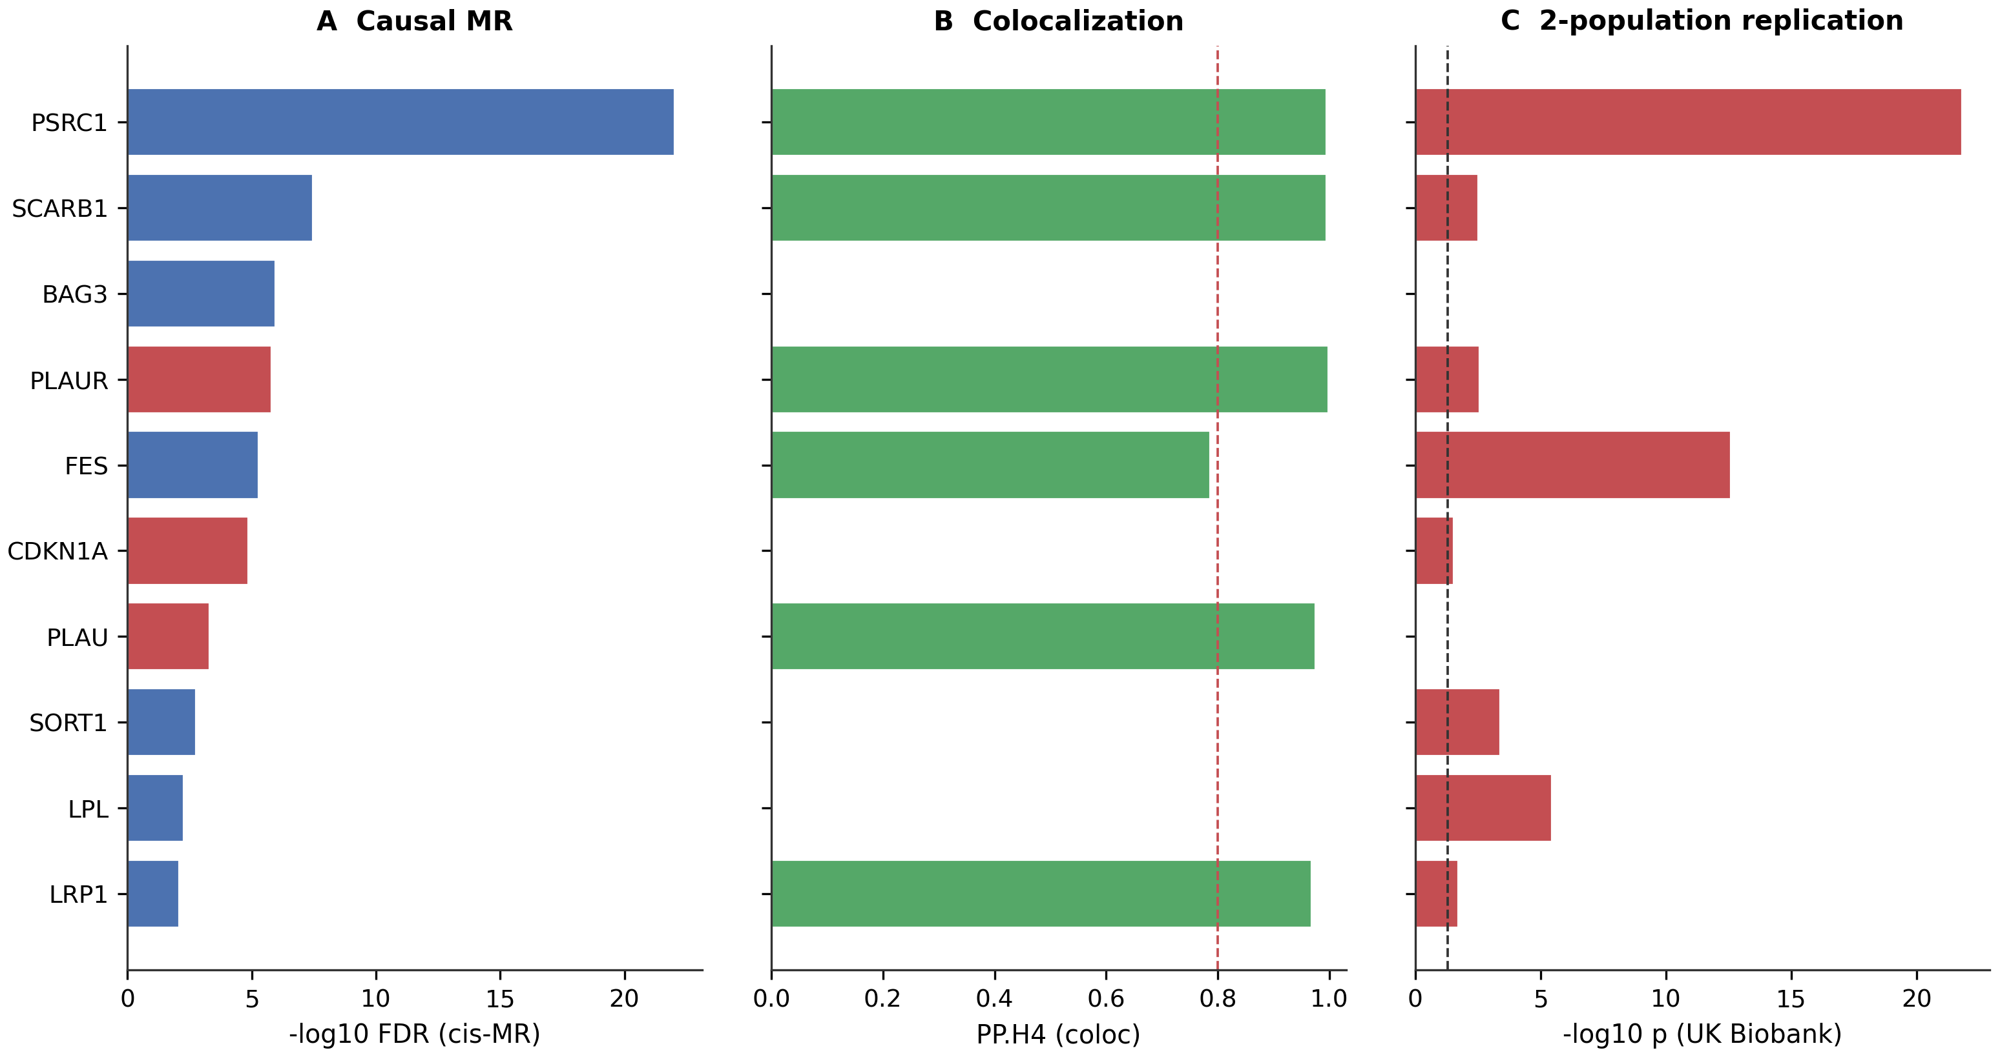
Figure 9 | Coronary disease triangulation
Three independent lines of evidence on one axis
cis-eQTL MR, colocalisation and two-population replication triangulated on coronary heart disease. Agreement across methods that fail in different ways is stronger evidence than any single method at a smaller p-value.
Human Plasma Immune Atlas · cardiovascular novelty
9

Slide 11
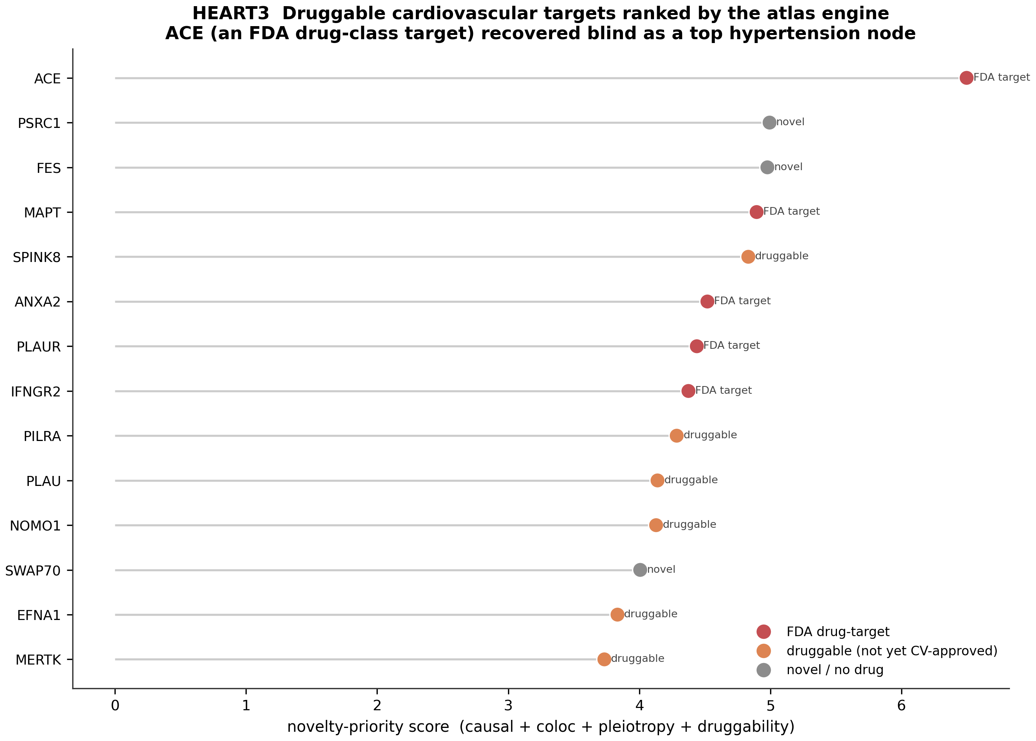
Figure 10 | Druggable cardiovascular targets
The actionable short-list
Cardiovascular causal proteins that are tractable, ordered by evidence. This is the handover point from genetics to a drug-discovery programme.
Human Plasma Immune Atlas · cardiovascular novelty
10

