Slide 1
User
Send requests
Returns output to user
Controller
Validates the user and gives them authority to use functions Processes user requests for the model to return user query to view.
Updates view for the user
View
Returns values of air quality Returns boolean of sensor trustworthiness Send the user requests for data to the controller
User Events
Notifications
Model
Computes the values to return to view Updates the data set to reflect the manipulations of the authorised users Updates the
Updates request for model to return output requested
Refresh request to update output to reflect current database

Slide 2
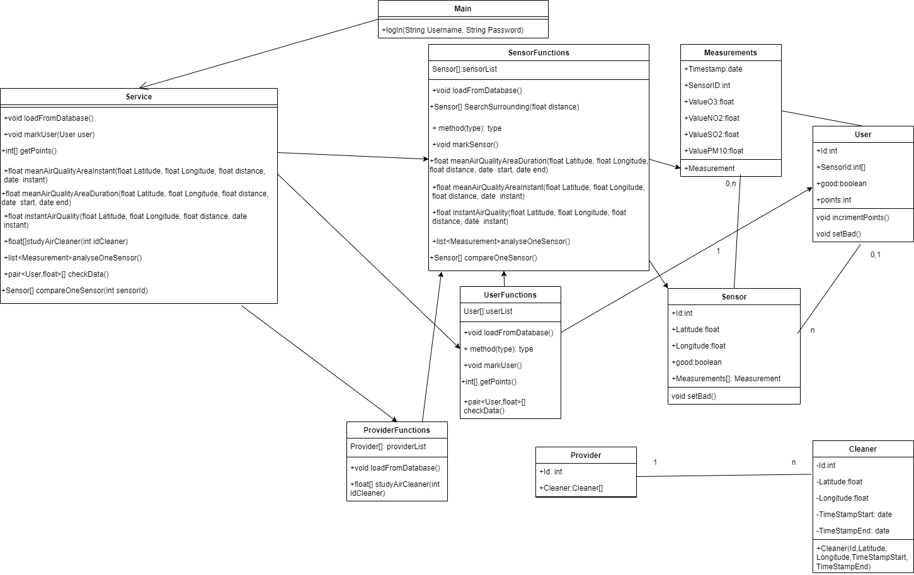
Controller
View
Model

