Slide 1
Data scientist jobs
By
Sarah Klein, Luis Rojas, Jimmy White

Slide 2
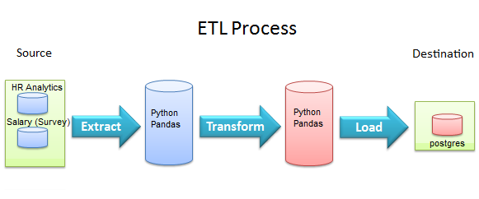
Extract
Two datasets from Kaggle:
“How much do data scientists earn in 2017-2020” – evaluates the impact variables have on expected salary of data scientists in the international market
“HR Analytics” – gauges factors that lead an employee to leave a job, including education, experience, and company loyalty

Slide 3
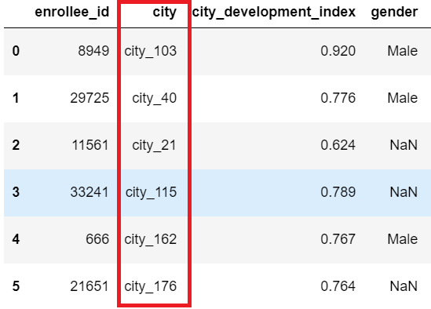
Transform
HR Analytics
City codes were not defined
Concluded column was irrelevant

Slide 4
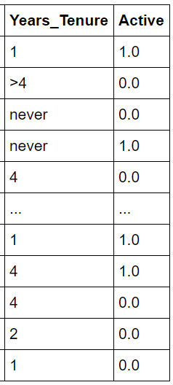
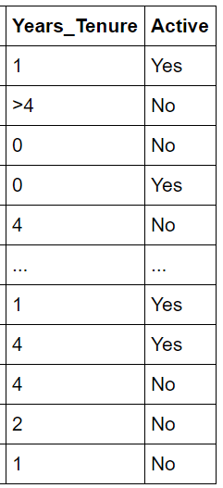






Transform
HR Analytics
Old
New
Less than one year at employer was labeled “never”
Actively searching for new job was labeled 1.0 and 0.0
Corrected “never” to 0 for years employed
Changed 1.0 to “Yes” and 0.0 to “No”

Slide 5
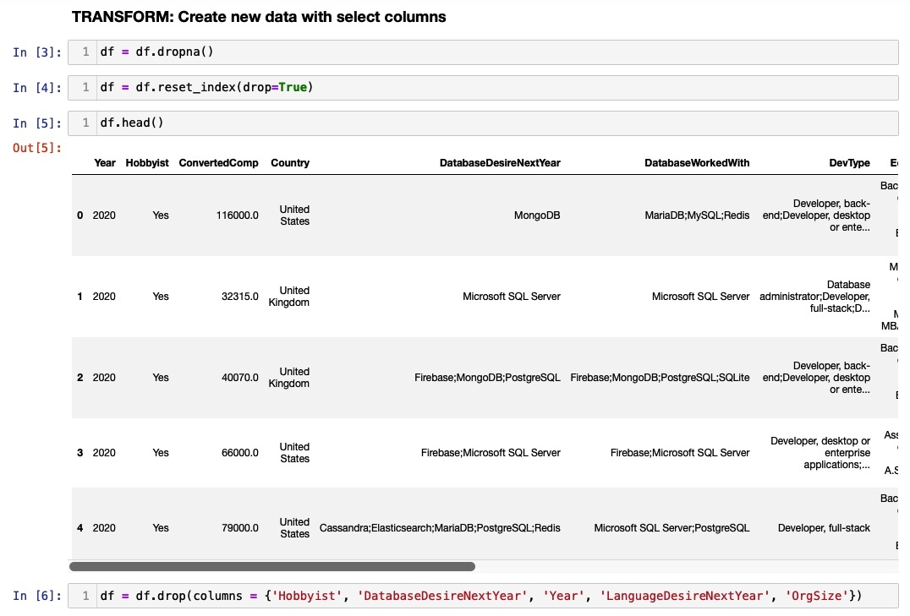
Transform
How much do data scientists earn in 2017-2020
Null values were deleted

Slide 6
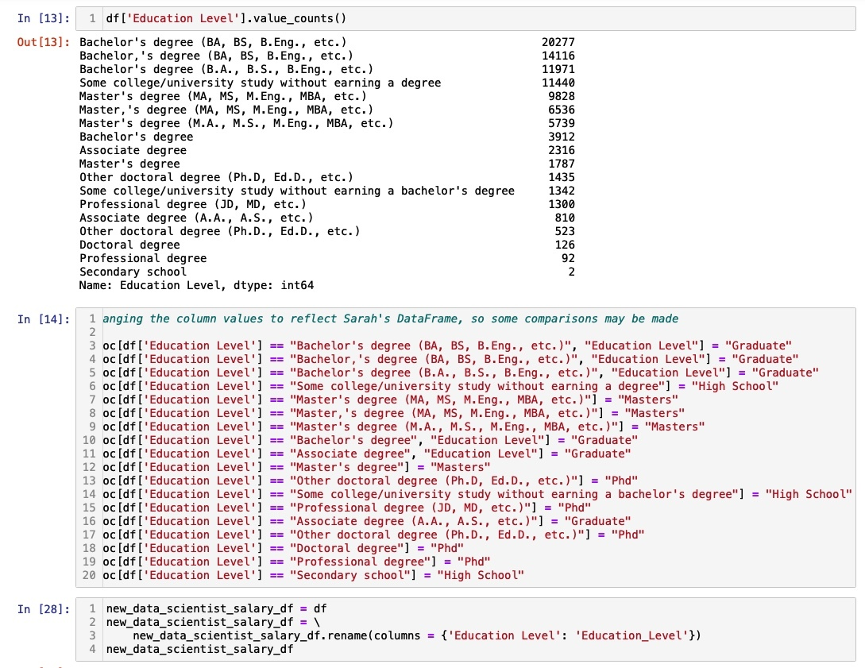
Transform
How much do data scientists earn in 2017-2020
Columns renamed
“Education Level” column occurred in both datasets renamed to match each other
Changed the values in “Education Level” to match values in HR Analytics dataset
Ie. “Bachelor’s degree” became “Graduate”

Slide 7
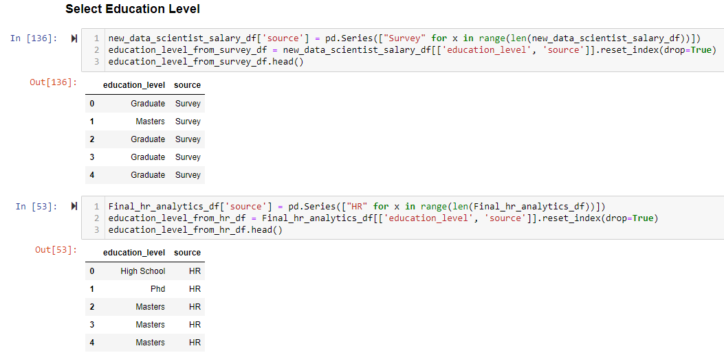
Transform
How much do data scientists earn in 2017-2020
Generated new table for each dataset with common column “education level” per data scientist.
Added column "source"

Slide 8
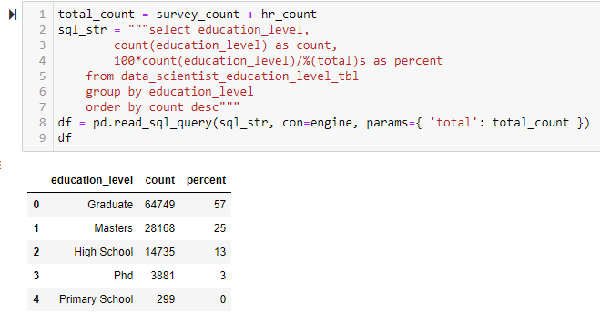
Load
We obtained from postgres, a summary table with typical education level for data scientists

Slide 9
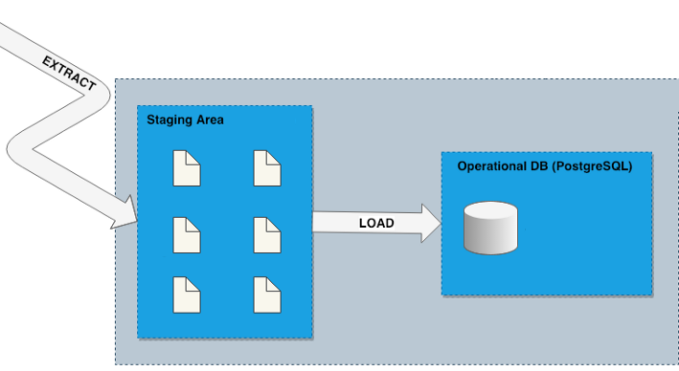
Load
Goal of an extract, transform, and load (ETL) process is to store data in a permanent location
Usually an operational database or data warehouse
We used a relational database, PostgreSQL, to append records from both “education level” dataframes into a single postgres table.
Usage: postgres must be locally operational (localhost:5432) and a database data_scientist_DB must have been previously created with corresponding data_scientist_education_level_tbl. A valid password in config.py file is also needed.

