Slide 1
RE
Radiomics Explorer
USE CASES · INPUT · OUTPUT · RADIOMICS REQUIREMENTS
Inputs, outputs, and who the pipeline is for
Illustrated with the Duke breast MRI cohort

Slide 2
01 · USE CASES
Who this is for, and when to reach for it
— A radiomics or imaging-research team with segmented scans and extracted features. you already have tumor (and optionally peritumoral-vessel) ROIs and a feature CSV — this pipeline turns that into an unbiased read on whether it predicts an outcome.
— Before investing in a deep-learning model. get a fast, interpretable, leakage-free conventional baseline first — sparse linear models with visible coefficients, not a black box.
— Onboarding a new cancer cohort onto an already-validated methodology. same nested-CV pipeline, same dashboard, applied to a different tumor type or institution.
— Producing a shareable result for collaborators. the output is aggregate-only by construction, so it can be handed to a co-investigator or committee without a data-use negotiation.
RADIOMICS EXPLORER
02

Slide 3
01 · USE CASES
Three endpoints, one shared pipeline
Overall survival
Molecular subtype
Pathologic complete
response (pCR)
TIME-TO-EVENT
4-CLASS CLASSIFICATION
BINARY CLASSIFICATION
MODEL
MODEL
MODEL
Cox proportional hazards
(elastic-net, L1-weighted)
Class-weighted L1
logistic regression
Class-weighted L1
logistic regression
PRIMARY METRIC
PRIMARY METRIC
PRIMARY METRIC
Concordance index
Macro ROC AUC
ROC AUC
560 evaluable patients
in the Duke cohort
772 evaluable patients
in the Duke cohort
238 evaluable patients
in the Duke cohort
RADIOMICS EXPLORER
03

Slide 4
01 · USE CASES
A fourth use case: bring your own cohort
— Same three endpoints, a different cancer type or institution. as long as the two input files follow the same naming and sheet conventions described next.
— Swap the two source files, re-run the two Python scripts. run_analysis.py produces the dashboard's analysis.json; run_feature_explorer.py produces the Feature Statistics page's data.
— Load the resulting JSON into the dashboard at runtime. a “Load dataset” button accepts the pipeline's own output — no code change, no rebuild, nothing leaves the browser.
— Every number on every page is recomputed from that JSON. titles, feature counts, interpretation text, and verdicts are all data-driven, so a new cohort renders honestly, not with leftover Duke-specific wording.
RADIOMICS EXPLORER
04

Slide 5
02 · INPUT DATASET
File 1 — the radiomics feature table
One CSV, one row per patient. 772 rows × 2,070 columns in the Duke cohort.
patient
original_firstorder
_energy_vessel
log-sigma-5-0-mm-3d_glszm
_graylevelnonuniformity
wavelet-lhh_firstorder
_energy
…
menopause
er
Patient_001
1.72e11
812.4
0.0091
…
1
0
Patient_002
3.95e11
946.1
0.0084
…
0
1
Patient_003
1.33e9
705.8
0.0117
…
1
1
Illustrative values shown — not real patient data.
COLUMN CONVENTION: {transform}_{family}_{measure}[_vessel] · no suffix = tumor region
— 2,064 numeric radiomic feature columns, plus patient + 4 legacy clinical columns dropped before modeling.
— Patient IDs must be unique — the loader raises an error otherwise.
— Every feature value must be finite. Any NaN or Inf anywhere in the matrix raises an error; nothing is silently imputed.
RADIOMICS EXPLORER
05

Slide 6
02 · INPUT DATASET
File 2 — the clinical workbook
One Excel file, 5 sheets (3 consumed). Patient ID joins every sheet back to the radiomics table.
Demography_tumortypes
Cancer_specific_clinical_data
drugs
· Patient ID
· Patient ID
· Patient ID
· Mol Subtype
· Menopause (at diagnosis)
· Received Neoadjuvant Therapy
· OS_STATUS
· ER
· Overall Near-complete Response
(Stricter Definition)
· OS_MONTHS
· PR
· Nottingham grade
· HER2
· Staging (N / T)
→ Subtype label · → Survival label
→ Descriptive context only — never a predictor
→ pCR proxy label
Joined on Patient ID — exact match, validated one-to-one
Headers live on row 5 of each sheet, per the source workbook's convention — the loader skips to it explicitly.
RADIOMICS EXPLORER
06

Slide 7
02 · INPUT DATASET
What the input has to pass before it's usable
— Radiomics and every clinical sheet join one-to-one on an exact patient ID. the loader validates this explicitly and fails loudly on any mismatch, rather than silently dropping or duplicating rows.
— The radiomic matrix must be completely finite. any NaN or Inf anywhere raises an error before modeling starts — there is no silent imputation.
— Patient IDs must be unique in the radiomics table. a duplicated ID is treated as a data error, not averaged or deduplicated automatically.
— Each endpoint defines its own inclusion rule and reports what it excluded. e.g. survival requires a known status and a positive follow-up time; pCR requires a known strict-response value — excluded counts are written into the output, never hidden.
RADIOMICS EXPLORER
07

Slide 8
03 · RADIOMICS REQUIRED
The feature taxonomy behind the 2,064 columns
2
×
12
×
86
=
2,064
REGIONS
TRANSFORMS
MEASURES
FEATURES
REGIONS · 2
IMAGE TRANSFORMS · 12
FEATURE FAMILIES · 5 (86/region/transform)
· Tumor
· Original
· First order — 18
· Peritumoral vessel — mirrors
every tumor-region feature
· Laplacian-of-Gaussian × 3
(σ = 1.0, 3.0, 5.0 mm)
· GLCM — 22
· GLRLM — 16
· Wavelet decomposition × 8
(LLL, LLH, LHL, LHH, HLL, HLH, HHL, HHH)
· GLSZM — 16
· GLDM — 14
RADIOMICS EXPLORER
08

Slide 9
03 · RADIOMICS REQUIRED
What each feature family actually captures
Descriptions reused verbatim from the dashboard's own Feature Statistics page.
FAMILY
APPROX. COUNT
WHAT IT CAPTURES
First-order intensity
18 / region / transform
Overall signal intensity and intensity variability within the region.
Texture — GLCM / GLRLM / GLSZM / GLDM
68 / region / transform
Intratumoral heterogeneity, uniformity, coarseness, or local contrast.
Wavelet / LoG-filtered texture
recomputed across 11 of 12 transforms
The same first-order and texture measures recomputed on filtered images, capturing patterns at different spatial scales.
Vessel region
mirrors the tumor region exactly
Peritumoral vascular burden, geometry, tortuosity, and heterogeneity, computed independently of the tumor.
RADIOMICS EXPLORER
09

Slide 10
03 · RADIOMICS REQUIRED
Upstream of this pipeline — and what's optional
— This pipeline does not segment images or extract features. it consumes an already-extracted, already-flattened CSV — typically PyRadiomics run on top of an existing tumor (and vessel) segmentation.
— The naming convention is the real contract with the pipeline. {transform}_{family}_{measure}[_vessel] — get this right and region/family/transform filters, groupings, and display labels all derive automatically.
— Shape features are supported by the schema but not present in this cohort. the current extraction has no shape family; the dashboard says so explicitly rather than pretending it was screened out.
— Joint tumor–vessel relationship features are likewise optional. tumor and vessel were extracted independently here; adding spatial-relationship features later needs no pipeline changes — just matching columns in the CSV.
RADIOMICS EXPLORER
10

Slide 11
04 · OUTPUT
Three files out, one dashboard
— analysis.json — aggregate results for the main dashboard. per endpoint: metrics with CIs, ROC/calibration/Kaplan–Meier curve points, the feature funnel, the top-50 feature table, validation design, and data-driven guardrail text.
— feature-explorer.json — cohort quality and per-feature statistics. powers the companion Feature Statistics page: data-quality audit, distribution stats, group comparisons, univariate discrimination.
— feature_rankings_*.csv — the full 2,064-row ranking, one file per endpoint. backs the dashboard's “download full ranking” links, beyond the top-50 shown in the UI.
— These three files are the only things that leave the Python environment. no patient rows, no identifiers, no per-patient predictions — ever.
RADIOMICS EXPLORER
11

Slide 12
04 · OUTPUT
Inside analysis.json
{ meta, endpoints, clinicalContext, guardrails }
└
meta
title, subtitle, patientCount, radiomicFeatureCount, tumor/vesselFeatureCount, join + QC counts
└
endpoints.survival / subtype / pcr
classes, metrics[] with 95% CI, ROC/calibration/KM curve points, featureFunnel, features[50], validation design, method steps
└
clinicalContext[]
descriptive group-comparison rows — never used to select features or train a model
└
guardrails[]
data-driven caveats, e.g. observed-death counts — recomputed per dataset, never hardcoded prose
RADIOMICS EXPLORER
12

Slide 13
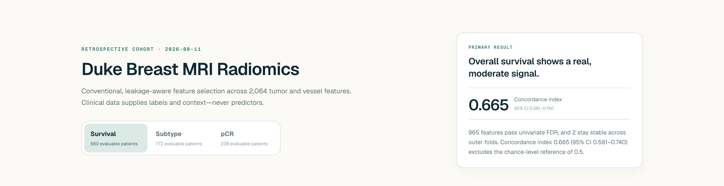
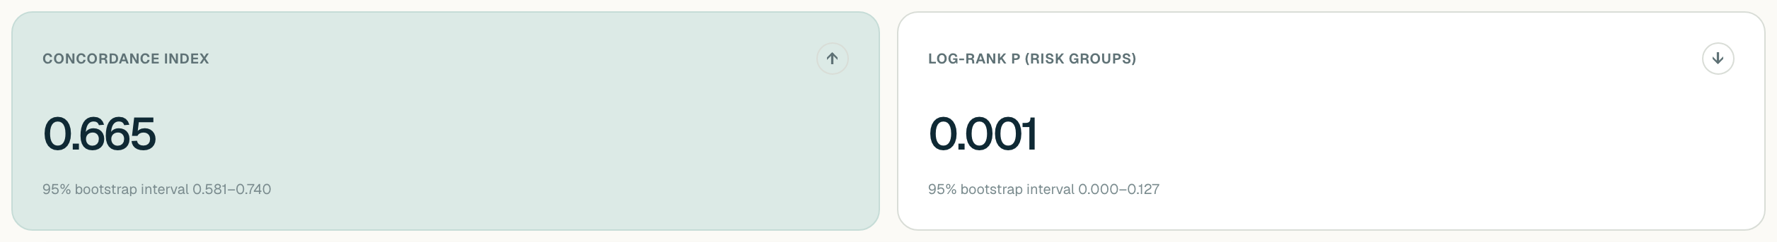
04 · OUTPUT — LIVE
What a reader sees first
Every number here is read directly from analysis.json — nothing is written by hand.
DASHBOARD HERO + PRIMARY RESULT
FULL METRIC GRID, WITH 95% BOOTSTRAP INTERVALS
RADIOMICS EXPLORER
13

Slide 14
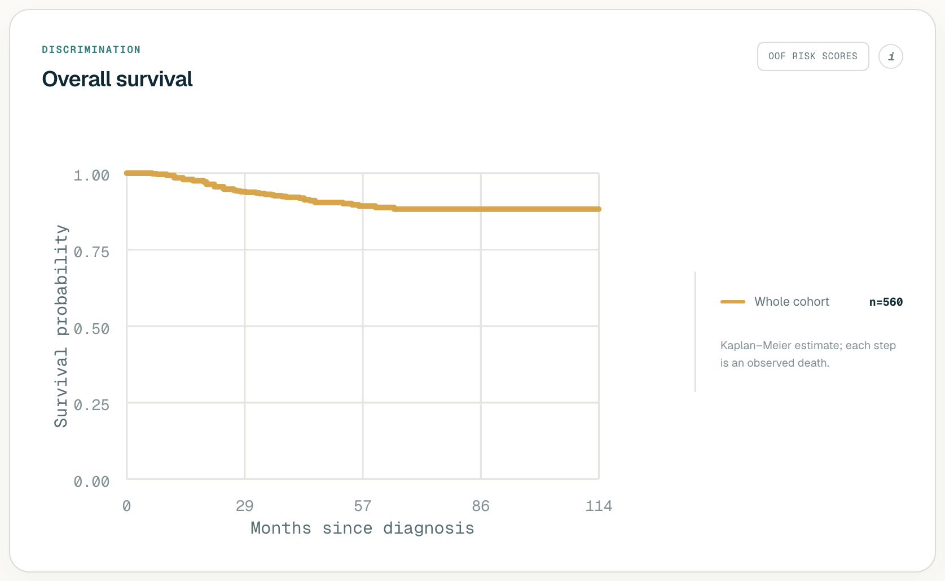
04 · OUTPUT — LIVE
Discrimination, as a curve
The classification endpoints show ROC curves in this same panel instead.
KAPLAN–MEIER CURVE, FROM analysis.json's survivalCurve.points
RADIOMICS EXPLORER
14

Slide 15
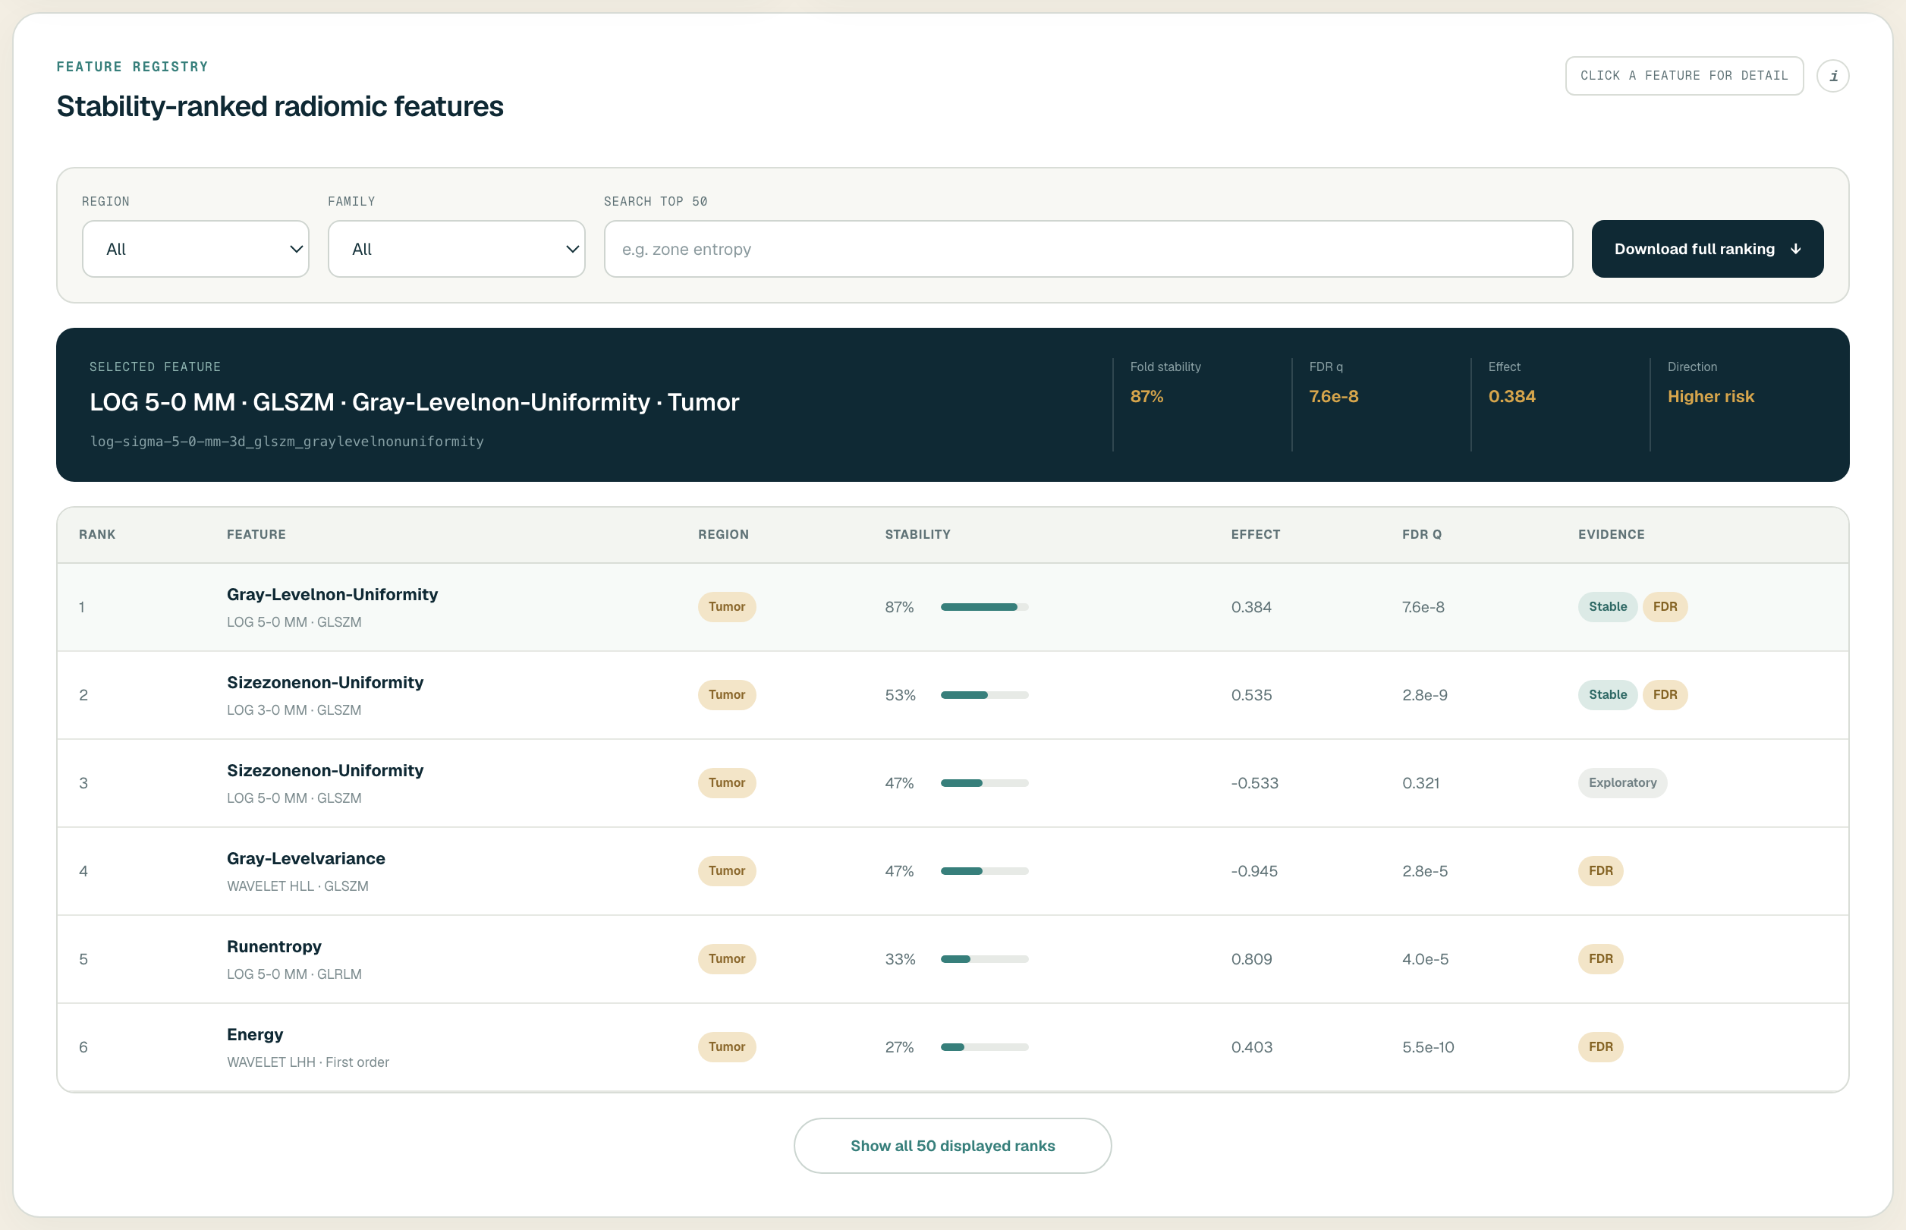
04 · OUTPUT — LIVE
The feature registry
TOP-50 STABILITY-RANKED FEATURES, FROM analysis.json's features[]
RADIOMICS EXPLORER
15

Slide 16
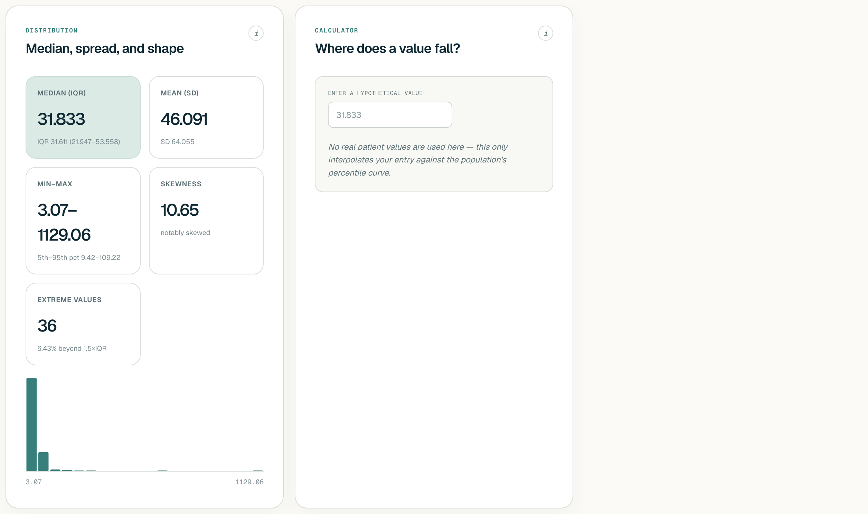
04 · OUTPUT — LIVE
The Feature Statistics companion page
Backed by feature-explorer.json — data quality, distributions, and univariate discrimination per feature.
COHORT STRIP, FROM feature-explorer.json's meta
PER-FEATURE DISTRIBUTION + PERCENTILE CALCULATOR
RADIOMICS EXPLORER
16

Slide 17
05 · GUARDRAIL
What never appears in the output
— No patient identifiers, accession numbers, or free-text notes.
— No per-patient predicted probabilities, risk scores, or model outputs. every curve and table is built from pooled, aggregated out-of-fold predictions.
— No row-level data of any kind. only aggregates, curve points, and ranked feature lists ever leave the Python environment.
— This boundary is structural, not a display filter. the dashboard has no code path that reads a per-patient value — it physically cannot render what isn't in the JSON.
RADIOMICS EXPLORER
17

Slide 18
TAKEAWAYS
What to remember
1
Use cases: survival, subtype, and pCR today — any similarly shaped cohort tomorrow.
2
Input is exactly two files: a radiomics CSV and a clinical workbook, joined on patient ID.
3
Required radiomics: tumor (+ optional vessel) region, 12 transforms, 5 families — named by one fixed convention.
4
Output is exactly three files, and the dashboard is a read-only mirror of them — aggregate only, end to end.
RADIOMICS EXPLORER
18

