Slide 1
H.A.C.C.
Data Structures and Algorithms
Jimmy Zhang
Fall 2022

Slide 2
Agenda
01
Introduction
竞争对手分析
02
Curriculum
产品定位分析
03
Intro to DSA
04
Class Exercise

Slide 3
Intro to DSA
01
Introduction

Slide 4
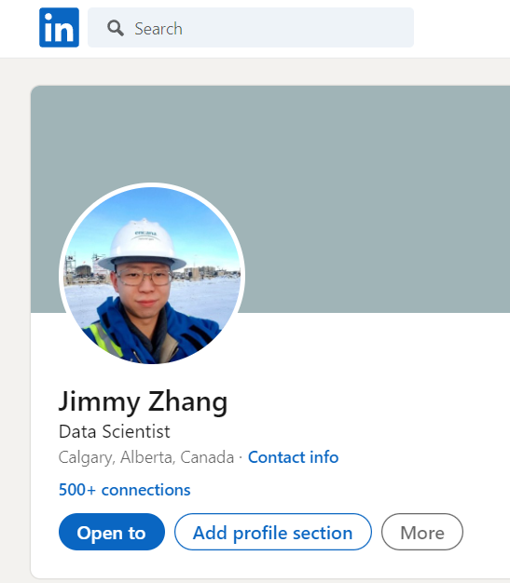
1.1
Instructor Bio
Jimmy Zhang
Education
- B.Sc Engineering: Petroleum
University of Alberta
- M.Sc Computer Science: Data Science
University of Denver
Work
- Data Engineer / Solution Architect at Ovintiv
- Data Scientist at Suncor
- ML Software Engineer at Amazon.ca (current)
https://www.linkedin.com/in/jimmy-zhang-a96a2651/
Notes:
Round table intro: name, location, current job/school, years of python exp

Slide 5
Intro to DSA
02
Curriculum Overview

Slide 6
2.1
Course Curriculum
Week | Topic
1 | Introduction to Algorithms, Paradigms and Asymptotics
2 | Data Structures Overview (Array, Hashtable, Heap)
3 | Data Structures Overview (Stack and Queue)
4 | Data Structures Overview (Linked List, Binary Tree, N-ary Tree)
5 | Recursion, Divide and Conquer
6 | Problem Solving Techniques: Binary Search, Two Pointers, Sliding Window
7 | Graph Data Structure and Search Algorithms
8 | Optimization: Intro to Dynamic Programming
9 | Optimization: Intro to Backtracking and Memoization
10 | Optimization: Intro to Greedy Algorithms

Slide 7
2.2
Pre-Requisites
The following are pre-requisites for successfully completing this 10-week course:
Basic Python Programming
Basics of OOP (Object Oriented Programming)
100-200 Level Post-Secondary Math (Calculus, Linear Algebra, Discrete Math)
Please set up a working Python 3.8 environment
Recommend WSL(ubuntu) as a lightweight setup on Windows, with the added benefit of learning linux bash scripting
Recommend Notepad++ as a text/code editor
Many other IDEs available (VScode, Pycharm, Spyder, Jupyter...etc)

Slide 8
2.3
Course Structure
The course content will be delivered in the following forms:
Live Lecture and Slides
Code Demo
Classroom Exercise
1 on 1 Office time with Instructor (Dependent on Instructor Availability)

Slide 9
Intro to DSA
03.a
Why Study Algorithms

Slide 10
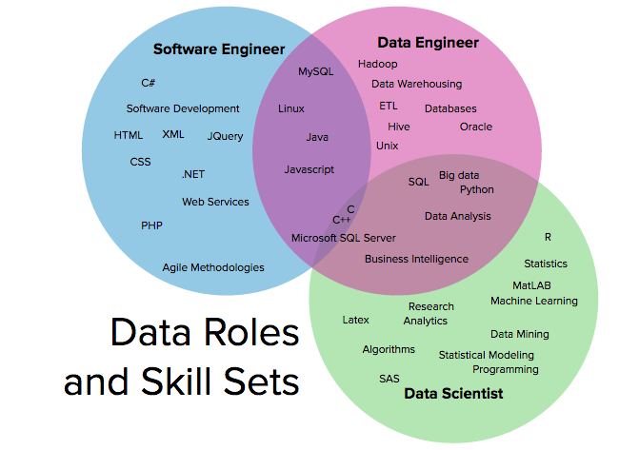
3.1
Class Vote
Who wants to be a...
Data Scientist
Data Engineer
Software Engineer

Slide 11
3.2
Introduction
Core technology of computing in general and data science in particular
Algorithms affect significantly the global behavior of every software system
Moore’s law: # transistors/circuit doubles every two years
What is better, switch from a Θ(n^2) algorithm to a Θ(n) algorithm, or buy a faster computer?
Depends on and impacts other technologies
Hardware with high clock rates, pipelining, cache, parallel computing (e.g., GPGPU)
Local and wide area networking ⇒ distributed data structures and programming, Hadoop, MapReduce

Slide 12
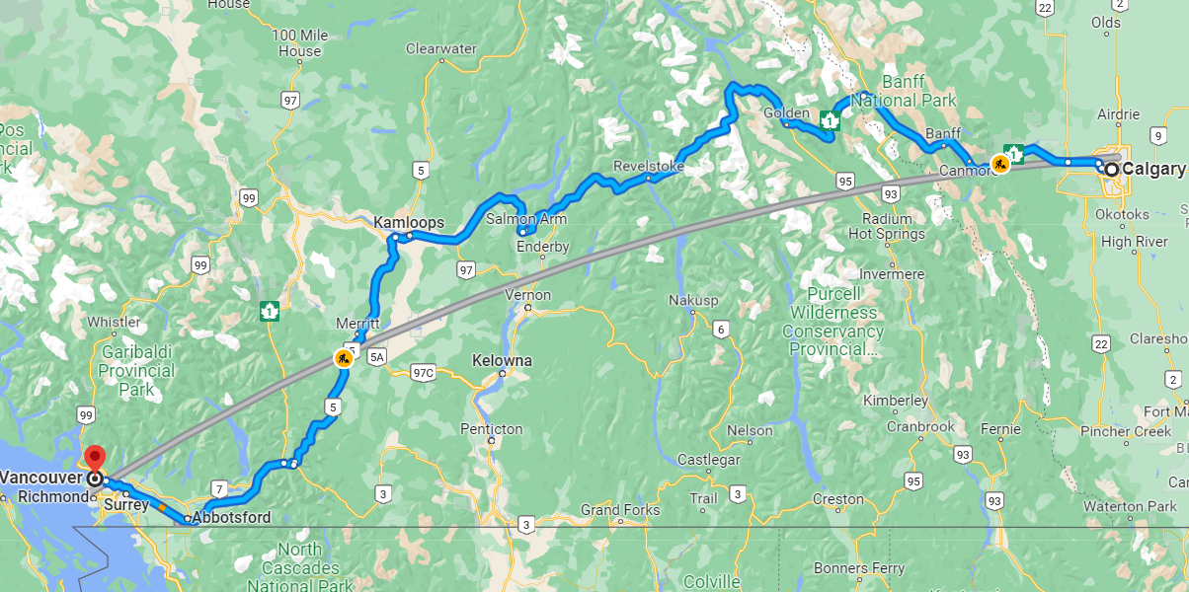
3.3
Real-World Applications
Finding optimal paths
Internet routing
Shortest path in road network
Route inspection
Vehicle routing: UPS, FedEx
Searching and indexing
Web search: Google, Yahoo
Human genome: 100,000 genes, three billion base pairs
Preference management systems: Netflix, Amazon
Determining likely authorship of a document

Slide 13
3.4
Real-World Applications
Data compression
Lossless (e.g., text) or lossy (e.g., music, video)
Privacy and security
RSA encrypting requires the generation of very large primes
Factoring: find a nontrivial factor of a large integer
Programming tools
Is main.java a syntactically correct Java program?
Debugging
Does main.java go into an infinite loop on a given input?
Optimization: find the cheapest/best way to do things
Airline schedules
Network design: AT&T, Sprint, bus transit systems

Slide 14
3.5
Class Objective
Appreciate the importance of efficient algorithms when processing big data sets.
Familiarize yourself with a few important algorithms, data structures, and algorithm design techniques.
Learn to analyze and predict various algorithm performance characteristics.
Obtain a better understanding of the limits of computation (intractability, computability).

Slide 15
Intro to DSA
03.b
What is an Algorithm

Slide 16
3.6
Definition of Algorithm
Abstraction of a computer program
Finite and effective procedure that takes one or more values as input and, in finite time, produces one or more values as output
Finite sequence of instructions expressed in the language of a processing agent
Must solve a general problem, specified by:
Set of infinitely many possible input instances
Properties that the output must satisfy for a given input
Example: sorting, GCD, shortest paths in a graph

Slide 17
3.7
Issues with the Definition
What models/languages do we use to describe algorithms?
Python, Java, C++, pseudo-code, English?
What characterizes good algorithms?
Correctness
Efficiency (cost models)
How do we design good algorithms?
Algorithm design paradigms and data structures
What sort of problems can be solved by algorithms and at what cost?
Computability and intractability

Slide 18
3.8
Properties of a Good Algorithm
Correctness
An algorithm must implement the correct input to output transformation for all input instances
Not enough to try your algorithm on a few instances
Efficiency
Time
Memory
Simplicity
Other things equal, prefer an algorithm that is easier to implement
Generality

Slide 19
3.9
Algorithmic Approach
1. Understand the problem.
What data are available, and what is the desired output?
Special cases and assumptions
2. Formulate the problem formally.
Construct a mathematical model
Input and output format
3. Design an algorithm.
Algorithm design techniques
Data structures
Approximation algorithms and heuristics
4. Implement the algorithm as a program

Slide 20
Intro to DSA
03.c
Efficiency

Slide 21
3.10
Efficiency
What do we mean by efficiency?
Minimum use of resources: time and space required
Time/space are machine, language, implementation dependent
Program efficiency is important, especially for big data, but how do we measure it?
Need a methodology that applies broadly to any algorithm
Expressed as a function of input size (denoted by �)
Defined per problem class: length of list (sorting, searching), number of bits in single input number (primality testing), number of nodes and edges in a graph (transitivity)
Would like to choose among different algorithms before implementation ⇒ need a computation model independent of implementation

Slide 22
3.11
Modelling
The most important skill of an algorithm designer is, arguably, that of modeling, the art of abstracting away the messy details of a real-world application into a mathematical structure suitable for algorithmic solution.
With many fundamental algorithms implemented in Python libraries, you still need to model your problem properly before choosing the right algorithms to use.
Real-world problems deal with real-world entities, such as people, Web pages, accounts, and so on.
An algorithmic solution, on the other hand, deals with properly defined abstract structures, such as graphs, sets, maps, and so on

Slide 23
3.12
What makes a good program?
It works as specified.
It is easy to understand and modify.
Decomposition
Stepwise refinement: Create structure by decomposing program into meaningful units called modules (functions and classes).
Abstraction
Separate the “contractual” interface of an abstraction from its implementation (information hiding).
Generalization
Design functions that have a good chance of being reused elsewhere.
It is reasonably efficient: time and memory

Slide 24
3.13
Algorithmic Efficiency
A first attempt: An algorithm is efficient if, when implemented, it runs quickly on real input instances.
What is missing?
What does “quickly” really mean?
Run where?
Run on what inputs?
Implemented how and in what language?
How do you compare with other algorithms?
How does the performance scale up?

Slide 25
3.14
Algorithmic Efficiency
The exact running time depends on the constants c1, c2, … involved in the previous calculation, the input size (n), and the actual input.
These constants, in turn, depend on the computer and language used and are hard to compute exactly without implementing the algorithm and taking exact measurements.
You need a definition that is independent of platform and language and has predictive value as the problem scales up.

Slide 26
3.15
Algorithmic Efficiency
A second attempt: An algorithm is efficient if, when implemented on any computer and language, it performs a small number of basic steps on real input instances.
A basic step is a block of instructions that takes a constant amount of time each time it is executed (i.e., the time required for one execution is independent of the input size).
An algorithm A is better than algorithm B if A performs fewer basic steps than B

Slide 27
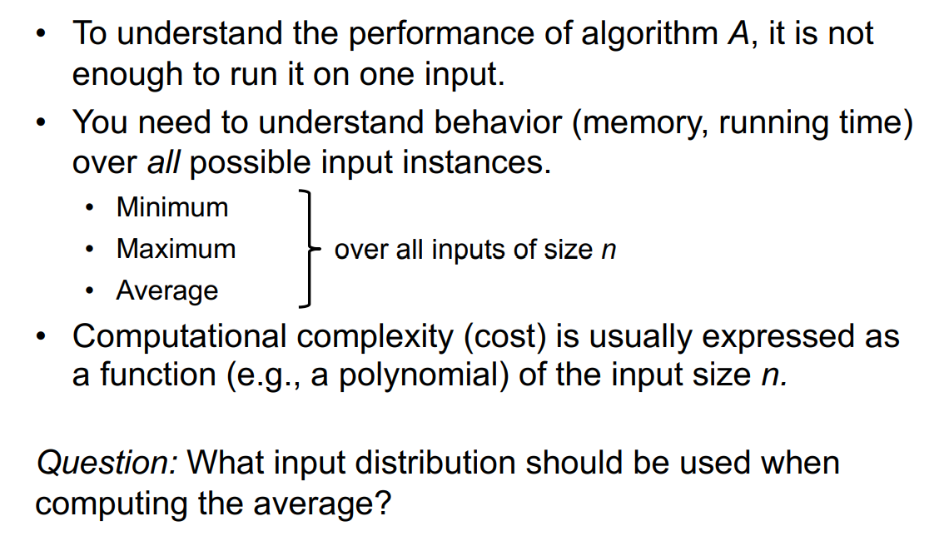
3.16
Algorithmic Efficiency

Slide 28
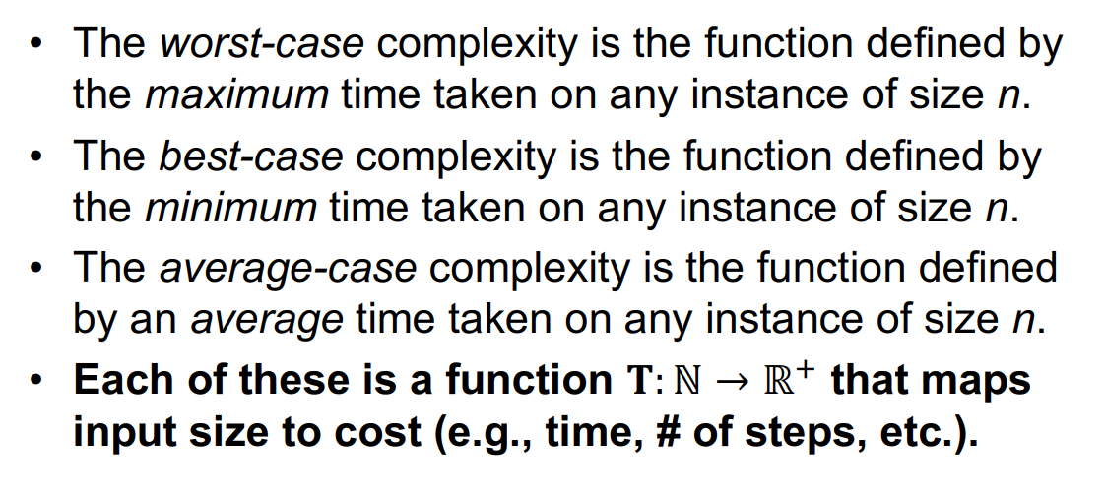
3.17
Worst, Average and Best Case

Slide 29
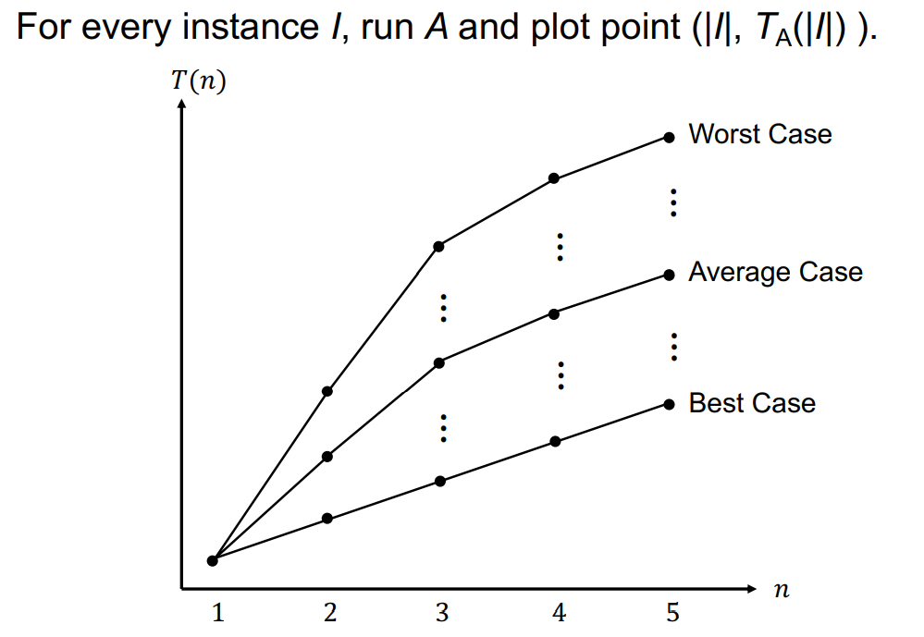
3.18
Worst, Average and Best Case

Slide 30
Intro to DSA
03.e
Intro to Paradigms

Slide 31
3.19
Intro to Paradigms
An algorithm design paradigm is a general approach to solving a problem that is applicable to other problems.
Similar to a design pattern
From Object-Oriented programming
Distills the common structure of “similar” algorithms
Similar implementations
Similar restrictions on use
Similar efficiency
Gives us a language to talk about problem solving

Slide 32
3.20
Algorithmic Design Patterns
Techniques include:
brute force
incremental
divide-and-conquer
decrease-and-conquer
randomization
iterative improvement
backtracking
branch-and-bound
dynamic programming
greedy solutions
approximation

Slide 33
Intro to DSA
03.f
Asymptotics and Big O

Slide 34
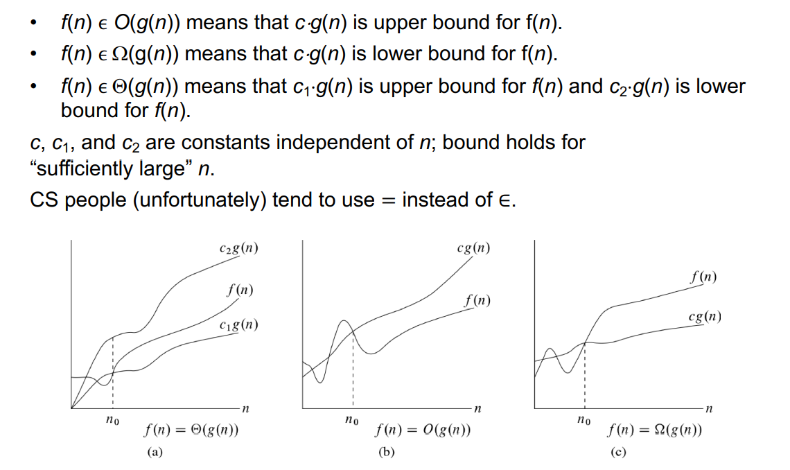
3.21
Complexity Classes

Slide 35
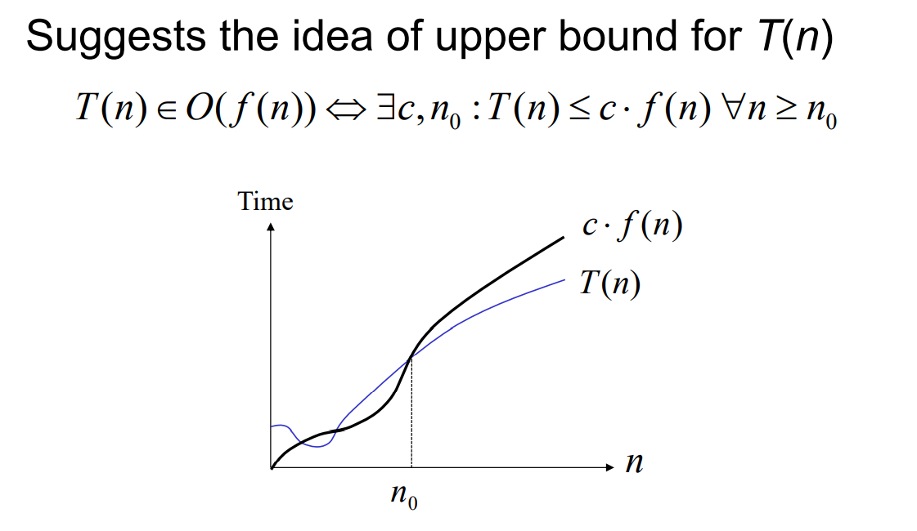
3.22
The Big O

Slide 36
Intro to DSA
04
Class Exercise

Slide 37
4.1
Two-Sum
Given an array of integers nums and an integer target, return True if there are two numbers such that they add up to target, else return False
You may assume that each input would have exactly one solution, and you may not use the same element twice. You may also assume all elements in the list array are unique.
Input: nums = [2,7,11,15], target = 9
Output: True

Slide 38
4.2
Fibonacci Numbers
A Fibonacci sequence is the integer sequence of 0, 1, 1, 2, 3, 5, 8....
The first two terms are 0 and 1. All other terms are obtained by adding the preceding two terms. This means to say the nth term is the sum of (n-1)th and (n-2)th term.
Your task is to write a python program to print the first n numbers of the fibonacci sequence
Input: n=7
Output: [0,1,1,2,3,5,8]

Slide 39
4.2
Homework: Bruteforce Sort
Your objective is to implement a function as follows:
def sort_array(nums):
The function takes as input a list of unsorted integers
for example sort_array(nums=[5,1,7,2,3,6,6])
The function performs a brute force sorting of the integers on the list in place
The function does not return any outputs
Estimate the O(n) time and space complexity of this function

Slide 40
THANK YOU

