Slide 1
H.A.C.C.
Data Structures and Algorithms
Jimmy Zhang
Fall 2022

Slide 2
Agenda
01
Week 3 Recap
02
Recursion
竞争对手分析
产品定位分析
03
Divide&Conquer
04
Class Exercise
05

Slide 3
Week3 Recap
01a
Week 4 Recap

Slide 4
1.1
Week4 Recap
Linked List
Binary Tree
Tree Traversals
Level order
Pre order
Post order
In order

Slide 5
Week3 Recap
01b
Homework Recap

Slide 6
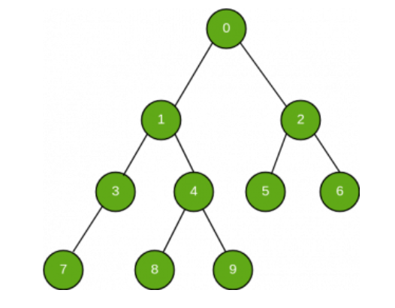
1.2
Homework: Find Value in Binary Tree
Given the starting (root) node of a Binary Tree, search and check if a given value exists in this tree:
Note the values of every node is in “node.value”
Return True if the value exists in the binary tree, otherwise return False
Example:
Input: Value = 4
Output: True
Input: Value = 20
Output: False

Slide 7
Data Structure
02
Recursion

Slide 8
1.1
Title

Slide 9
Data Structure
03
Divide & Conquer

Slide 10
1.1
Title

Slide 11
Class Exercise
04
Class Exercises

Slide 12
1.1
Fibonacci - Recursion

Slide 13
1.1
Tree Traversals - Recursion

Slide 14
1.1
Merge Sort

Slide 15
4.4
Homework
Best Time to Buy/Sell Stocks

Slide 16
THANK YOU

