Slide 1
H.A.C.C.
Data Structures and Algorithms
Jimmy Zhang
Fall 2022

Slide 2
Agenda
01
Week 2 Recap
竞争对手分析
02
Stack
产品定位分析
03
Queue
05
04
Class Exercise

Slide 3
Week2 Recap
01a
Week 2 Recap

Slide 4
1.1
Week 2 Recap
Definitions
Abstract Data Types
Data Structures
Array (list)
Hashtable (dictionary and set)
Heap (heapq)

Slide 5
Week2 Recap
01b
Homework Recap

Slide 6
1.2
Homework Recap
Homework: Find Kth Largest Element in Array
Create a class MyArray with an integer array nums and a FindKLargest method:
FindKLargest: Given an integer k, return the kth largest element in the array
This method may be called many times, try to optimize for time efficiency
Note that the array is not sorted, we’re looking for the kth largest element in the sorted order, not the kth distinct element.
Solve this without using the “sort” method on the list, which data structure would you use?

Slide 7
Data Structure
02
Stack

Slide 8
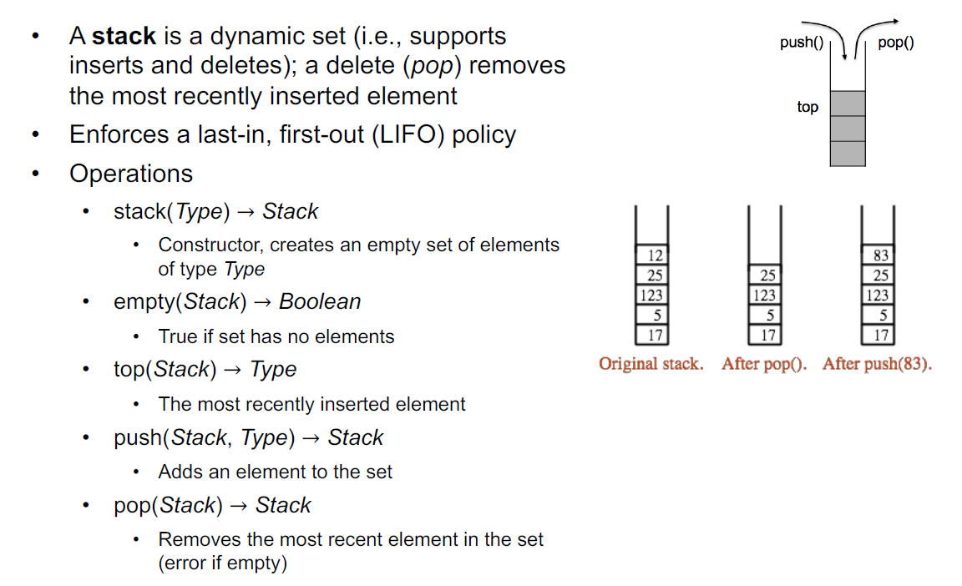
2.1
Stack ADT Introduction

Slide 9
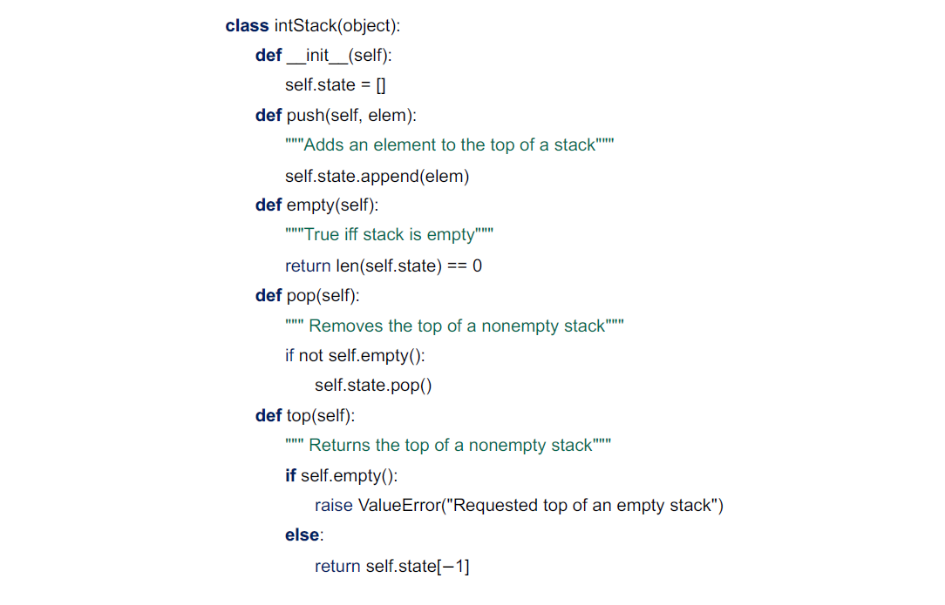
2.2
Stack ADT Implementation
An Integer Stack Example:

Slide 10
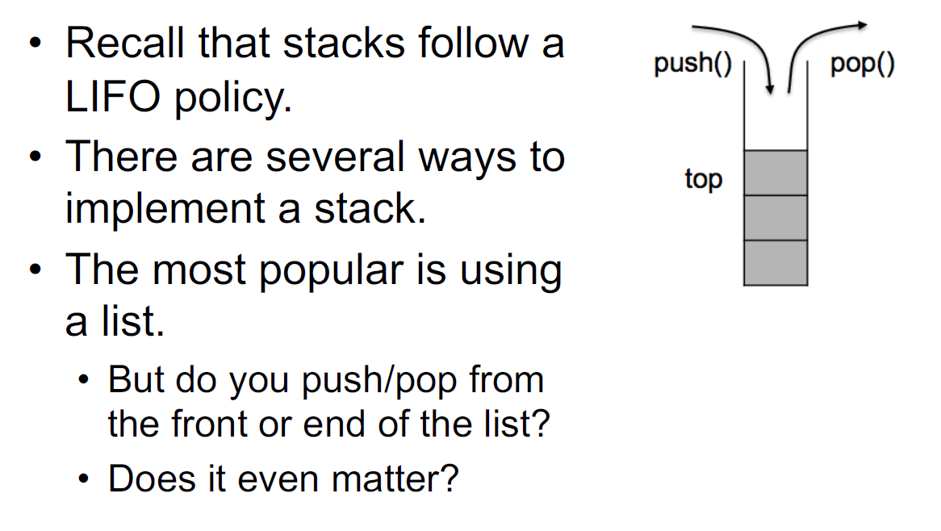
2.3
Stack

Slide 11
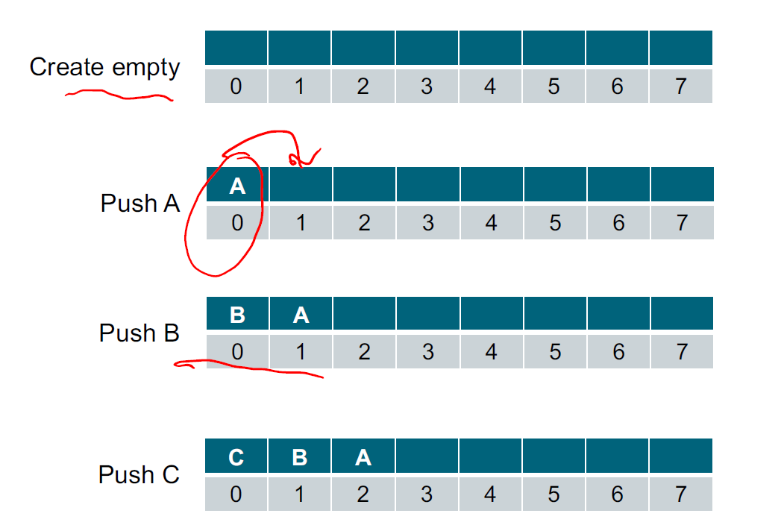
2.4
Stack Push

Slide 12
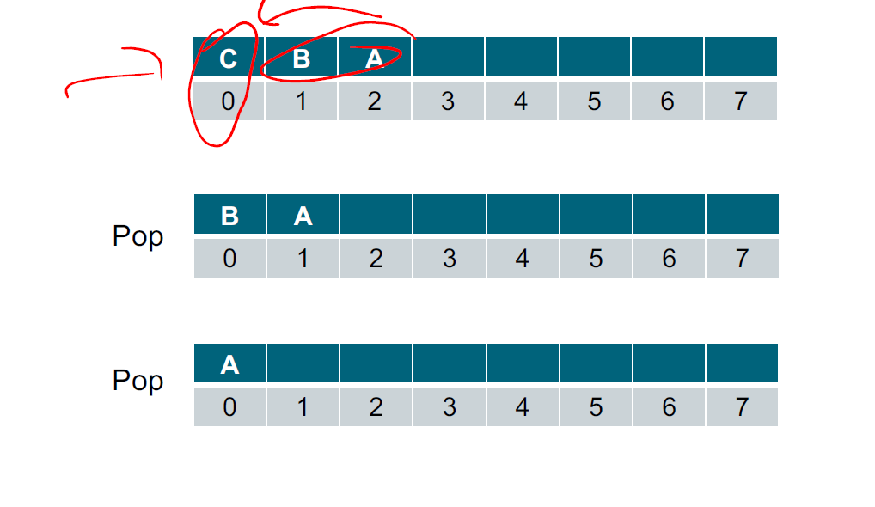
2.5
Stack Pop

Slide 13
2.6
Stack: List Implementation Details
O(n) to push/pop from the front
O(1) to push/pop from the end
Order is maintained
stack = [ ]
stack.append(element)
stack.pop()

Slide 14
Data Structure
03
Queue

Slide 15
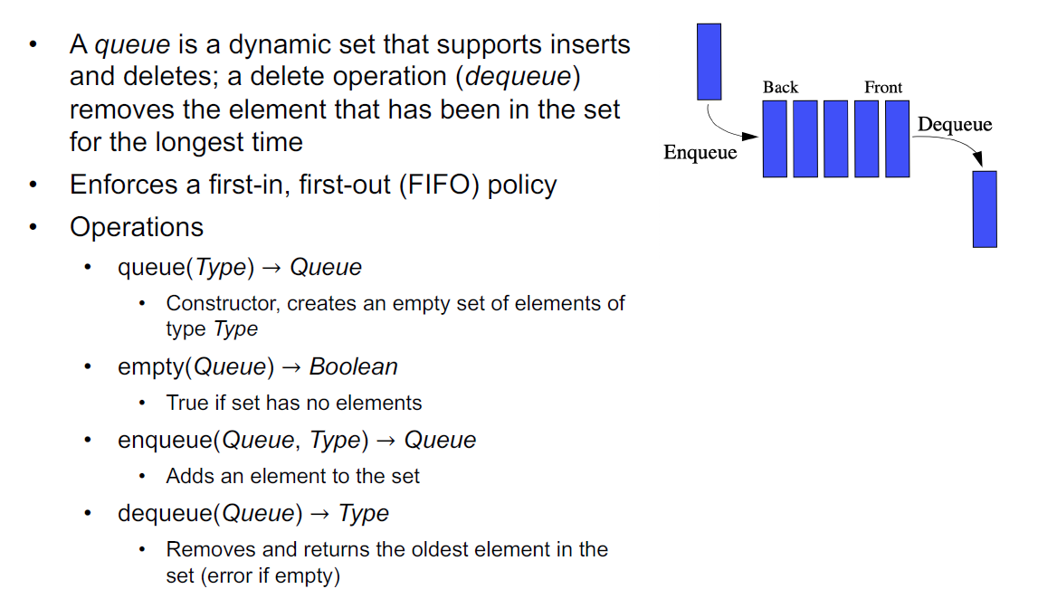
3.1
Queue ADT Introduction

Slide 16
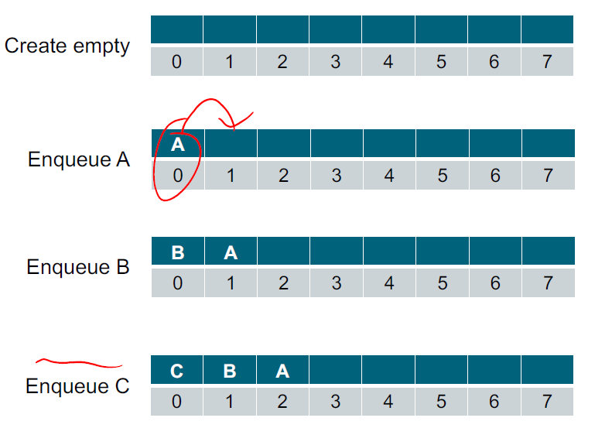
3.2
Queue: Enqueue

Slide 17
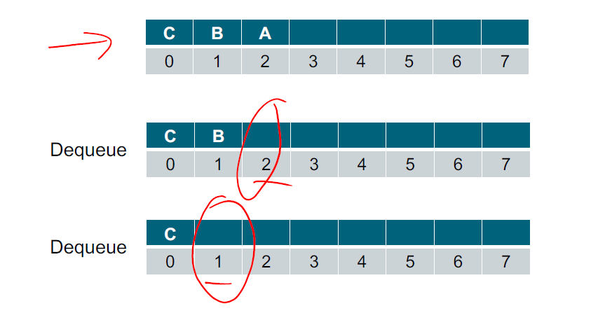
3.3
Queue: Dequeue

Slide 18
3.4
Queue Implementations
List: O(n) to enqueue, O(1) to dequeue
Circular list: O(1) to enqueue/dequeue
Doubly linked list: O(1) to enqueue/dequeue
q = collections.deque()
q.append(element)
q.popleft()
q.pop()
Double-Ended Queue (collections.deque)
- Pop from Front or Back in O(1) time

Slide 19
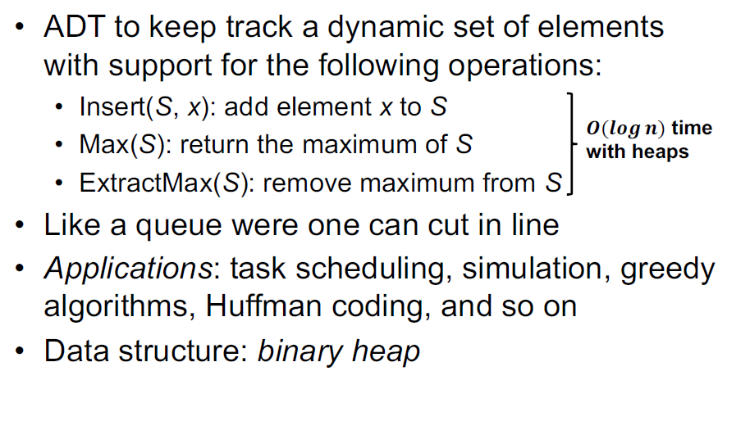
3.5
Priority Queue

Slide 20
3.6
Use Cases: Stack and Queue
The most powerful usecases will come in later weeks:
Binary Tree Traversals
Graph Traversals
Recursion (ie Stack Overflow)
Job Queues

Slide 21
Class Exercise
04
Class Exercises

Slide 22
4.1
Implement a Simple Calculator
You are given a list of inputs, consisting of either an integer, or one of the four basic math operators (+, -, *, /).
Your task is to build a simple calculator that will evaluate these inputs and return the final result
Use Integer division to return the result as an integer
Example input: [3, 3, “+”, 2, “-”, 2, “*”]
Example output: 8
Explaination: We’re evaluating this list of inputs in sequence:
3 + 3 = 6
6 - 2 = 4
4 * 2 = 8 -> return this as output

Slide 23
4.2
Remove Adjacent Duplicates in String
You are given a string s consisting of lowercase English letters. A duplicate removal consists of choosing two adjacent and equal letters and removing them.
We repeatedly make duplicate removals on s until we no longer can.
Return the final string after all such duplicate removals have been made. It can be proven that the answer is unique.
Input: s = "abbaca"
Output: "ca"
For example, in "abbaca" we could remove "bb" since the letters are adjacent and equal, and this is the only possible move. The result of this move is that the string is "aaca", of which only "aa" is possible, so the final string is "ca".

Slide 24
4.3
First Unique Character in String
Given a string s, find the first non-repeating character in it and return its index. If it does not exist, return -1.
Example:
Input: s = "leetcode", Output: 0
Input: s = "loveleetcode", Output: 2
Input: s = "aabb", Output: -1

Slide 25
4.4
Homework
Implement the Fibonacci function using a stack data structure
The function takes as input a single integer n
The function returns as output a single integer, the nth number in the fibonacci sequence
Fibonacci sequence: 0, 1, 1, 2, 3, 5, 8...
Example:
Input n=5, Output = 3
Input n=7, Output = 8

Slide 26
THANK YOU

