Slide 1
H.A.C.C.
Data Structures and Algorithms
Jimmy Zhang
Fall 2022

Slide 2
Agenda
01
Week 9 Recap
02
Greedy
竞争对手分析
产品定位分析
03
Course Summary
04
Knowledge Wrap-up
05

Slide 3
Week9 Recap
01a
Week 9 Recap

Slide 4
1.1
Week9 Recap
Memoization
Top Down Memoization vs Bottom Up Dynamic Programming
Memoization = Recursive DAC + Caching Results (hash table)
Backtracking
Depth First Search on State Space Tree (Decision Tree)
Always try to first visualize the State Space Tree

Slide 5
Week9 Recap
01b
Homework Recap

Slide 6
2.1
Homework - Find all Subsets
Given a set of distinct integers, nums, return all possible subsets (the power set).
The solution set must not contain duplicate subsets.
Input: nums = [1,2,3]
Output: [ [3], [1], [2], [1,2,3], [1,3], [2,3], [1,2], []]

Slide 7
Algorithms
02
Greedy

Slide 8
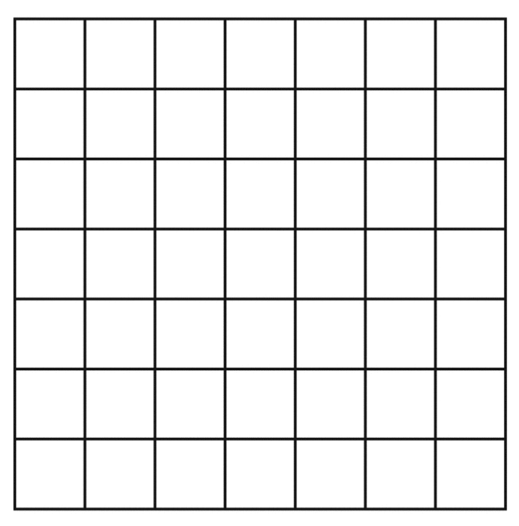
2.1
Greedy - Introduction
Consider a “map”, how would you go from point A to B when there are multiple paths available?
- We pick a direction and keep going until the next step no longer gets us closer to the destination
- We pick another direction, and keep going
- Repeat above steps...
- Eventually we reach the destination
- Is this the shortest path? Maybe...
A
B

Slide 9
2.2
Greedy Algorithm Design
Algorithm design technique
Usually more efficient than divide and conquer
But not always applicable
Constructs optimal solution incrementally by repeatedly choosing what looks promising right now
Problem must satisfy the greedy choice property
A locally optimal choice is guaranteed to lead to some globally optimal solution
Often tricky to prove

Slide 10
2.3
NCoins - Greedy
For coin values 1, 5, 10, 25
Give highest value coin you can at each step
This is a Greedy solution
Works for US/CAD coins
When a 12 was added
The Greedy choice property no longer holds
We developed DAC/DP algorithms to solve
Choice was not “local,” but we “looked ahead”

Slide 11
2.4
Hallmark of Greedy Algorithms
Greedy choice property: a locally optimal choice leads to a globally optimal solution
Identify a simple heuristic to make the local choice.
Prove that the choices made are part of some optimal solution.
Think of greedy like a “short cut” or a “short sighted decision and hoping this will lead to at least a feasible, maybe even optimal solution”
Common Methods of “Proving” we have the optimal:
Proof by Contradiction
Proof by Induction

Slide 12
2.5
Greedy vs Dynamic Programming
Dynamic programming
Make a choice at each step.
Choice depends on solution to subproblems.
Solve subproblems first.
Solve bottom-up.
Greedy
Make a choice at each step.
Make the choice before solving the subproblems (and then solve the remaining subproblems).
Solve top-down.

Slide 13
2.6
Comparing Algorithm Paradigms
Greedy | Divide & Conquer | Dynamic Programming
Optimises by making the best choice at the moment | Optimises by breaking down a subproblem into simpler versions of itself and using multi-threading & recursion to solve | Same as Divide and Conquer, but optimises by caching the answers to each subproblem as not to repeat the calculation twice.
Doesn't always find the optimal solution, but is very fast | Always finds the optimal solution, but is slower than Greedy | Always finds the optimal solution, but could be pointless on small datasets.
Requires almost no memory | Requires some memory to remember recursive calls | Requires a lot of memory for memoisation / tabulation

Slide 14
2.7
Code Demo - NCoins
How do you give change for N cents?
We’ll use the normal coin denominations of
1, 5, 10, 25
Select the “optimal” solution
For NCoins: the least number of coins
25, 1, 1, 1, 1
We’re going to demonstrate the greedy approach today

Slide 15
2.8
Code Demo - Activity Selection
You are given n activities with their start and finish times.
Select the maximum number of activities that can be performed by a single person, assuming that a person can only work on a single activity at a time.
Input: activities = [(10,20), (15,25), (20,30)]
Output:[(10,20) ,(20,30)]
Activity | 10 | 15 | 20 | 25 | 30
1 | Activity 1
2 |  | Activity 2
3 |  |  | Activity 3

Slide 16
Summary
03
Course Summary

Slide 17
3.1
Summary of Sessions
Week | Topic
1 | Introduction to Algorithms, Paradigms and Asymptotics
2 | Data Structures Overview (Array, Hashtable, Heap)
3 | Data Structures Overview (Stack and Queue)
4 | Data Structures Overview (Linked List, Binary Tree, N-ary Tree)
5 | Recursion, Divide and Conquer
6 | Problem Solving Techniques: Binary Search, Two Pointers, Sliding Window
7 | Graph Data Structure and Search Algorithms
8 | Optimization: Intro to Dynamic Programming
9 | Optimization: Intro to Backtracking and Memoization
10 | Optimization: Intro to Greedy Algorithms

Slide 18
3.2
Course Summary
Focus on core concepts
Data Structures
Array, Hashtable, Heap, Linked List, Stack, Queue, Tree and Graph
Algorithmic Problem Solving Techniques
Sorting, Recursion, Two Pointers, Binary Search
State Space Trees, DFS/BFS, Shortest Path, Optimization
Algorithm and Paradigms
Incremental (Brute Force), Divide and Conquer, Backtracking, Dynamic Programming, Greedy

Slide 19
Course Summary
04
Knowledge Wrap-up

Slide 20
4.1
Knowledge Check
We covered several data structures: list, stacks, queues, heaps, and hash tables. For each problem below, choose the best data structure that can be used to solve the problem efficiently.
Given a list A of n integers, reverse the order of the elements in A.
Given a list A of n integers, report the 10 largest integers in A.
Given an undirected graph G, determine if all nodes in G are connected.
Given a list A of n Strings, check which element from another list B of m strings exists in A.

Slide 21
4.2
Knowledge Check - Answers
We covered several data structures: list, stacks, queues, heaps, hash tables, linked lists. For each problem below, choose the best data structure that can be used to solve the problem efficiently.
Given a list A of n integers, reverse the order of the elements in A.
Array, Stack, Queue (double ended)
Given a list A of n integers, report the 10 largest integers in A.
Heap
Given an undirected graph G, determine if all nodes in G are connected.
Stack DFS or Queue BFS
Given a list A of n Strings, check which element from another list B of m strings exists in A.
Hash Table

Slide 22
4.3
Knowledge Check
We covered several algorithm design techniques: incremental, divide-and conquer, dynamic programming, greedy, and backtracking. For each problem below, choose the most efficient technique that can be used to solve the problem efficiently. If more than one choice is available, select the one that is simplest to implement.
Given a list of n triangles, find the range (i.e., min and max) of the perimeters of the input triangles.
Sort a list of n triangles in decreasing order of perimeter.
Given a list of n items and their corresponding integer weights, maximize the total weight of items that fit in a backpack of capacity W by selecting items from the given list.
Given a list of n items and their corresponding integer weights, maximize the total number of items, selected from the given list, that fit in a backpack of maximum capacity W.

Slide 23
4.4
Knowledge Check - Answers
We covered several algorithm design techniques: brute force, divide-and conquer, dynamic programming, greedy, and backtracking. For each problem below, choose the most efficient technique that can be used to solve the problem efficiently. If more than one choice is available, select the one that is simplest to implement.
Given a list of n triangles, find the range (i.e., min and max) of the perimeters of the input triangles.
Brute Force
Sort a list of n triangles in decreasing order of perimeter.
Divide and Conquer
Given a list of n items and their corresponding integer weights, maximize the total weight of items that fit in a backpack of capacity W by selecting items from the given list.
Dynamic Programming
Given a list of n items and their corresponding integer weights, maximize the total number of items, selected from the given list, that fit in a backpack of maximum capacity W.
Greedy

Slide 24
THANK YOU

