Slide 1
H.A.C.C.
Data Structures and Algorithms
Jimmy Zhang
Fall 2022

Slide 2
Agenda
01
Week 7 Recap
02
Optimization Theory
竞争对手分析
产品定位分析
03
Dynamic Programming Intro
04
Class Exercise
05

Slide 3
Week7 Recap
01a
Week 7 Recap

Slide 4
1.1
Week7 Recap
Graph Theory
Graph Data Structure
Graph Traversals
Breadth-first-search (BFS)
Depth-first-search (DFS)

Slide 5
Week6 Recap
01b
Homework Recap

Slide 6
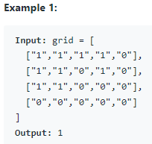
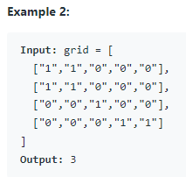
4.3
Homework - Number of Islands
Given an m x n 2D binary grid grid which represents a map of '1's (land) and '0's (water), return the number of islands.
An island is surrounded by water and is formed by connecting adjacent lands horizontally or vertically. You may assume all four edges of the grid are all surrounded by water.

Slide 7
Algorithms
02
Optimizations

Slide 8
2.1
Introduction
An optimization problem is a problem of finding an optimal (biggest, smallest, best in some sense, etc.) solution among those in a set of candidate solutions.
This usually involves finding a target configuration (ordering, subset, partition, parameter values, etc.) of/for a finite set of input objects.
An optimization problem consists of two parts:
1. An objective function of the input that we want to maximize or minimize
2. A set of constraints that limits the search space (i.e., the set of feasible solutions)
Usually, an exhaustive search is prohibitively expensive.

Slide 9
2.1
Examples of Optimization
Traveling salesman: Find the shortest route that visits each point from a set exactly one.
Minimum spanning tree: Find the cheapest way to connect a set of terminals.
Activity selection: Schedule a maximum number of compatible activities requesting the same resource.
Clique: Given a social network, find the largest subset whose members know every other member in the subset.
Knapsack: Given a set of potential investments, find those that maximize the return for a given budget.
Clustering: Given a set 𝑆 of points in ℝ# and 𝑘 ∈ ℕ, partition 𝑆 into 𝑘 sets such the minimum distance between points in different sets is maximized.
Machine Learning: Most ML algorithms are solved via optimizing on a maximum or minimum function evaluation

Slide 10
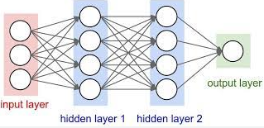
2.1
Examples of Optimization
Neural Networks: The “algorithm” behind most of today’s AI and advanced machine learning technologies
One of its key component, the back-propagation, is based on:
Optimization (DSA) + Derivatives (Calculus)

Slide 11
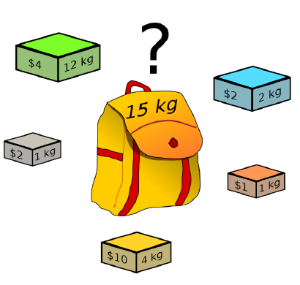
2.1
Example: Knapsack Problem
You are given a container with a limited weight capacity 𝑊 and a list of items, each with a weight and a value.
Choose which items to place in the container so that the weight limit is not exceeded and the total value of the packed items is as large as possible.

Slide 12
2.1
Example: Extending the Knapsack Problem
A more practical example as an extension of the classic knapsack problem
A fund manager is considering 100 potential investments and has estimated the expected return from each one. Choose which ones to buy to maximize the return without exceeding the budget.

Slide 13
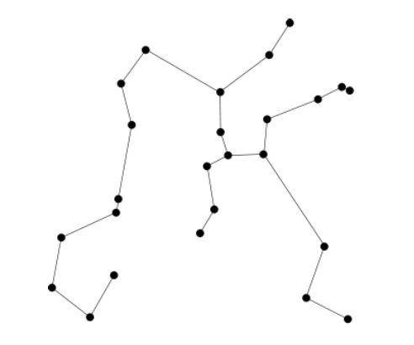
2.1
Example: Minimum Spanning Tree
Given a set of points in the plane, connect pairs of points with edges so that the sum of lengths of all edges is minimal and there is a path, using the edges, from every point to every other point.

Slide 14
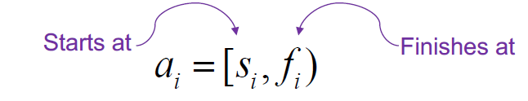
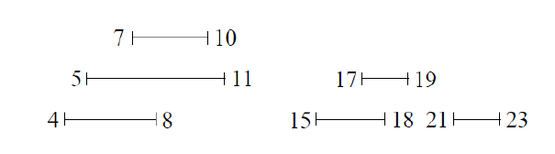
2.1
Example: Activity Selection
Input: set A = {a1 ,…,an} of n activities/events requiring exclusive access to a common resource
Output: the largest set A of nonoverlapping activities
Example: schedule use of a room to maximize the number of events that use it

Slide 15
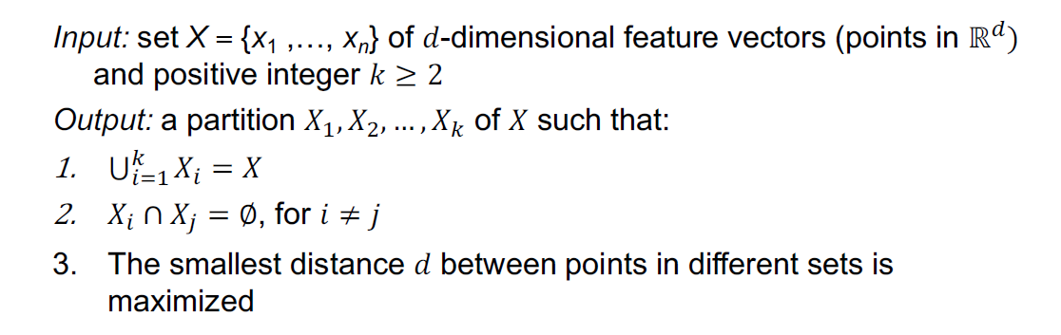
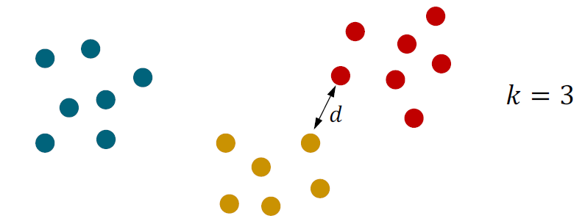
2.1
Example: Clustering

Slide 16
Algorithms
03
Dynamic Programming

Slide 17
2.1
Introduction to DP
Algorithm design technique
Many apparently exponential optimization problems have polynomial solutions using DP.
Has been described as divide and conquer with memory
Title refers not to computer programming, but to the process of gradually (i.e., dynamically) filling a table of partial results in a systematic way

Slide 18
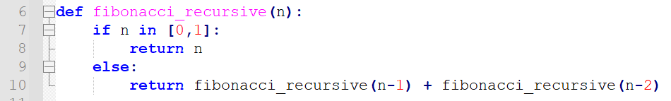
2.1
Recall the Fibonacci Problem
Given n, find the nth number in the Fibonacci sequence
We’ve seen the recursive version, which is resembles a form of divide-and-conquer
Time complexity:
T(n) = T(n-1) + T(n-2) + 1 >= 2T(n-2) + 1 >= 2^(n/2)
Therefore O(n) = 2^n

Slide 19
2.1
DP Hallmarks
Optimal substructure:
An optimal solution to a problem instance is made up of optimal solutions to subproblem instances.
This suggests the possibility of DAC.
Overlapping subproblems:
A recursive solution contains a small number of distinct problem instances repeated many times.
This suggests storing solutions to subproblems in case they are needed later.

Slide 20
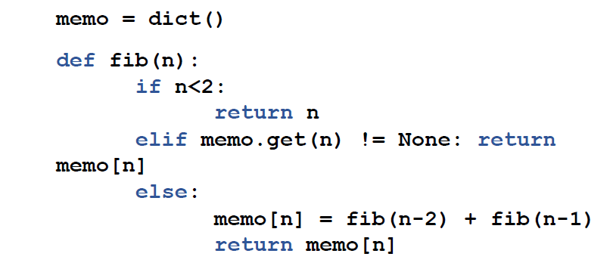
2.1
Recursive (DAC) Fibonacci with Memo(r)ization
Can speed up the algorithm by storing the results of our recursive calls in a “memo” and reusing them when needed again

Slide 21
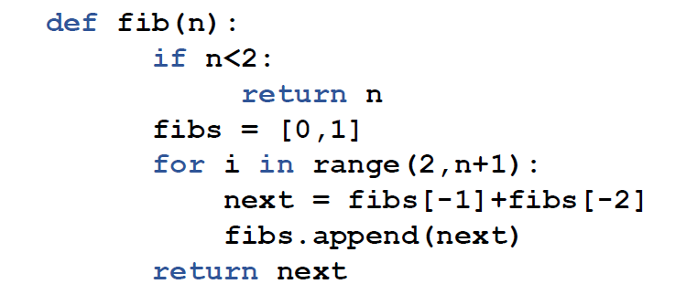
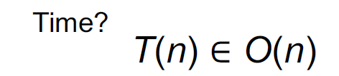
2.1
Dynamic Programming for Fibonacci Number
Can get a simpler algorithm with the same performance as solution 2 by proceeding bottom-up and recording previous solutions in a list

Slide 22
2.1
Key Differences DP vs Memo
Memoization (memorize with memory)
Top-down
Cache answers
Dynamic programming
Bottom-up
Calculate the answers to the subproblems first

Slide 23
Class Exercise
04
Class Exercises

Slide 24
2.1
Fibonacci - Revisited

Slide 25
2.1
Demo Exercise: NCoins
How does one make change for N cents?
Example: N = 29
25, 1, 1, 1, 1
But there are other ways of doing it
10, 10, 5, 1, 1, 1, 1
5, 5, 5, 5, 5, 1, 1, 1, 1
1, 1, 1, 1, 1, 1, 1, 1, 1, 1, 1, 1, 1, 1,
1…………., 1

Slide 26
2.1
Demo Exercise: NCoins
There are multiple solutions to a problem.
Select the “optimal” solution
For NCoins: the least number of coins
25, 1, 1, 1, 1
This is a “greedy” approach, will be covered in more detail in latter weeks

Slide 27
2.1
Demo Exercise: NCoins – Solution Mindset
First let’s consider divide-and-conquer
Hand each coin one at a time (N = 29).
At each step, there are five coin choices:
1. Give a 25 → leaving 4 cents to give
2. Give a 12 → leaving 17 cents to give
3. Give a 10 → leaving 19 cents to give
4. Give a 5 → leaving 24 cents to give
5. Give a 1 → leaving 28 cents to give
Select the choice giving the least coins.

Slide 28
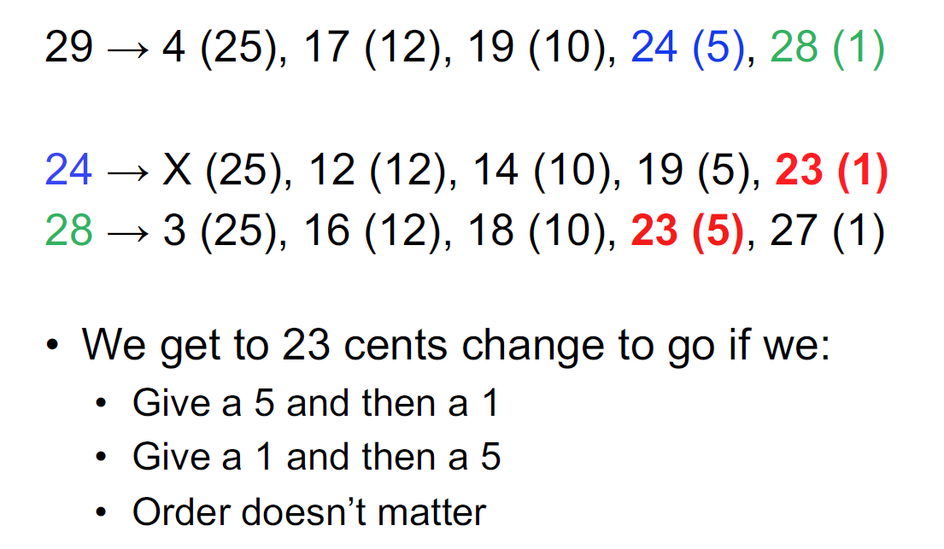
2.1
Demo Exercise: NCoins – DAC is Inefficient
Overlapping Subproblems…aka repeated work

Slide 29
2.1
Demo Exercise: NCoins – MinCoins Table
NCoins is a problem with one variable (N).
Will require a 1D table
Fill in the table with the known base cases.
Identify the goal location in the table.
Determine the order to fill in the table.
Each subgoal must already be filled in

Slide 30
2.1
Demo Exercise: Ncoins – Second Table
However, this minCoins table only gives the minimum number of coins needed.
The thing being optimized
We usually also want the actual coins used.
So we can make the change
Build a second “winner” or “traceback” table.

Slide 31
2.1
Demo Exercise: Ncoins – Traceback Table
Can reconstruct the coins used by tracing backwards through the table of winners
Sometimes called the traceback table
Note that the traceback table is built during the construction of the optimal table
But never used to determine values in the optimal table

Slide 32
2.1
Demo Exercise: Ncoins – Code Demo

Slide 33
2.1
Homework - 0/1 Knapsack Problem
Given weights and values of n items, put these items into a knapsack of capacity W
You want to maximize the total value of the knapsack
You cannot break an item, either pick it or don’t pick it (the 0/1 property)
Example:
value = [60, 100, 120], weight = [10, 15, 20], W = 40
Answer = 220
Explanation:
You can put the second and third items in the knapsack, with a combined weight of 15+20 = 35 which is less than the total capacity W. This also maximizes the value of the items in the knapsack at 220.

Slide 34
THANK YOU

