Slide 1
H.A.C.C.
Data Structures and Algorithms
Jimmy Zhang
Fall 2022

Slide 2
Agenda
01
Week 8 Recap
02
Memoization
竞争对手分析
产品定位分析
03
Backtracking
04
Class Exercise
05

Slide 3
Week8 Recap
01a
Week 8 Recap

Slide 4
1.1
Week8 Recap
Optimizations
Dynamic Programming
NCoins problem

Slide 5
Week8 Recap
01b
Homework Recap

Slide 6
2.1
Homework - Knapsack Problem
Given weights and values of n items, put these items into a knapsack of capacity W
You want to maximize the total value of the knapsack
You cannot break an item, either pick it or don’t pick it (the 0-1 property)
Example:
value = [60, 100, 120], weight = [10, 15, 20], W = 40
Answer = 220
Explanation:
You can put the second and third items in the knapsack, with a combined weight of 15+20 = 35 which is less than the total capacity W. This also maximizes the value of the items in the knapsack at 220.

Slide 7
Algorithms
02
Memoization

Slide 8
2.1
Revisit - DP Hallmarks
Optimal substructure:
An optimal solution to a problem instance is made up of optimal solutions to subproblem instances.
This suggests the possibility of DAC.
Overlapping subproblems:
A recursive solution contains a small number of distinct problem instances repeated many times.
This suggests storing solutions to subproblems in case they are needed later.

Slide 9
2.2
Key Differences DP vs Memo
Memoization (memorize with memory)
Top-down
Cache answers
Dynamic programming
Bottom-up
Calculate the answers to the subproblems first

Slide 10
2.3
Memoization
Similar to caching
Involves “caching” of values from expensive function calls so we don’t repeat the same work again
We can use constant time O(1) to retrieve a value from the “memo” rather than repeat the calculation

Slide 11
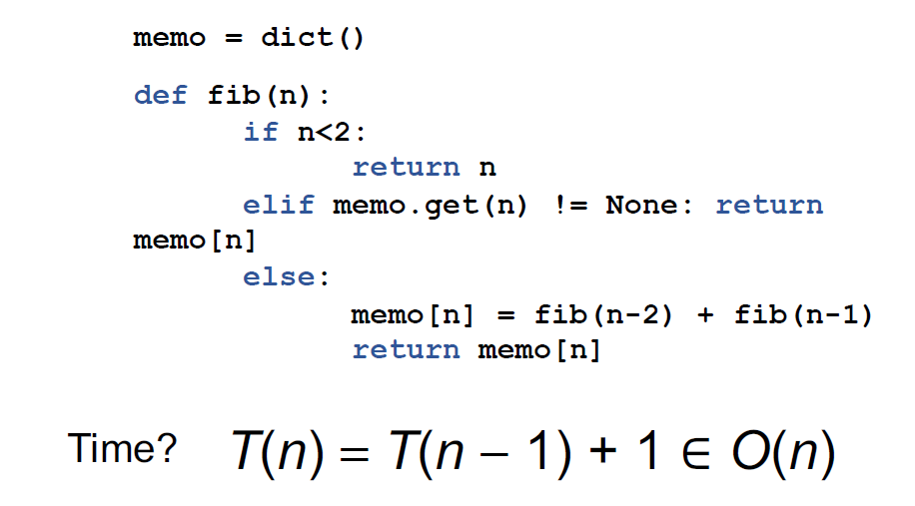
2.4
Fibonacci with Memoization
Can speed up the algorithm by storing the results of our recursive calls in a “memo” and reusing them when needed again

Slide 12
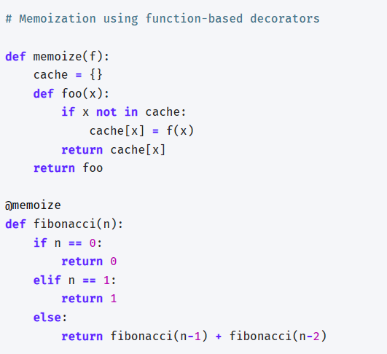
2.5
Fibonacci with Memoization - Decorators

Slide 13
2.6
Code Demo

Slide 14
Algorithms
03
Backtracking

Slide 15
3.1
Backtracking Intro
Backtracking == DFS on a tree
Combinatorial search problems involve finding groupings and assignments of objects that satisfy certain conditions
In combinatorial search problems, the search space (a fancy way of saying all the possibilities to search) is in the shape of a tree.
The tree that represents all the possible states is called a state-space tree (because it represents all the possible states in the search space)

Slide 16
3.2
Backtracking as Depth First Search
One can view backtracking as a depth-first search through the state space.
We start our search at the root
We end our search when we find a valid leaf node
A depth-first search expands the deepest node next.
A child children will be expanded before the child’s siblings are expanded.
This type of search gets you to the leaf nodes as fast as you can.

Slide 17
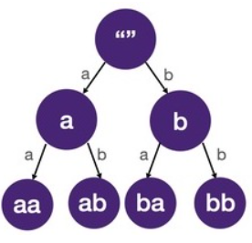
3.3
Visualizing a State Space Tree
Below are the state-space trees for all 2-letter words composed using only 'a' and 'b':
Leaf nodes are the solutions to the problem

Slide 18
3.4
Backtracking in State Space Tree
Solving combinatorial search problems boils down to DFS on the state-space tree.
Since the search space can be quite large, we often have to "prune" the tree
i.e. discard branches and stop further traversals.
This is why it's often called backtracking.

Slide 19
3.5
Backtracking vs DFS
The main difference is that in backtracking:
we are not given a tree to traverse but rather we construct the tree/generate the edges and tree nodes as we go.
At each step of a backtracking algorithm, we write logic to find the edges and child nodes.

Slide 20
3.6
Building the State Space Tree
Draw a state-space tree to visualize the problem
When drawing the tree, bear in mind:
how do we know if we have reached a solution?
how do we branch (generate possible children)?

Slide 21
Class Exercise
04
Class Exercises

Slide 22
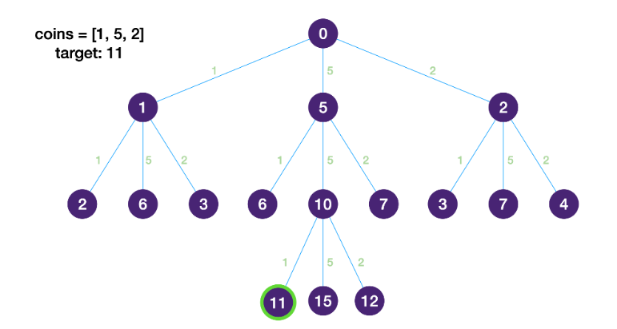
4.1
NCoins Revisited -
Using Memoization and Backtracking
You are given coins of different denominations and an amount. Calculate the fewest number of coins that you need to make up that amount. If that amount of money cannot be made up by any combination of the coins, return -1.
State space tree:
At each step, we’re always picking the node that get us closest to our answer to start exploring

Slide 23
4.2
Demo Exercise: Graph Coloring
Graph coloring is the problem of coloring each vertex in a graph such that no two adjacent vertices are the same color.
Some direct examples include:
Map coloring
Register assignment

Slide 24
4.3
Demo Exercise: Graph Coloring
We don’t want to simply pick all subsets.
There are way too many.
We want to prune the state-space tree as soon as we find something that won’t work.
This implies that we need a sequence of vertices to color.
As we color the next vertex, we need to make sure that it doesn’t conflict with any of its previously colored neighbors.
We may need to backtrack.

Slide 25
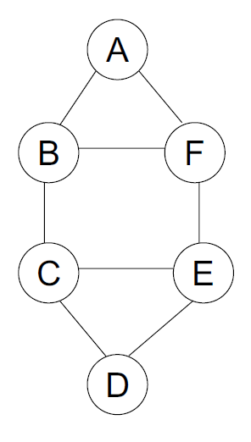
4.4
Demo Exercise: Graph Coloring
As an example:
The vertices are enumerated in order A–F.
The colors are given in order R, G, B.
Let’s look at a demo animation

Slide 26
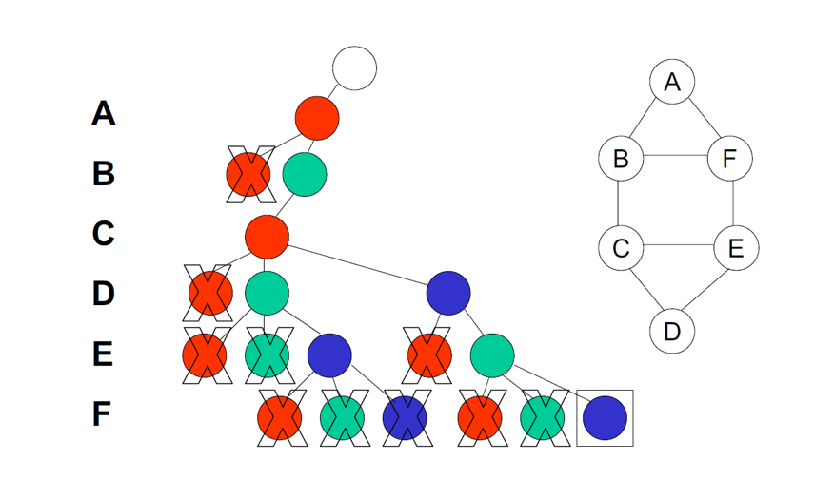
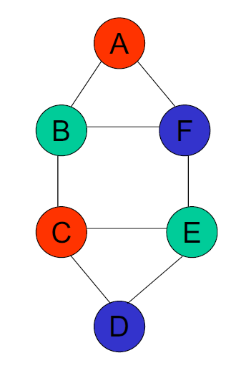
4.5
Demo Exercise: Graph Coloring
State Space Tree

Slide 27
4.6
Demo Exercise: Graph Coloring
Given a list of edges for a graph, and a list of colors, find all ways to assign colors to each node such that no two adjacent nodes share the same color
Using integers for vertices
colors = [‘r’, ‘g’, ‘b’]
edges = [(0,1),(0,5),(1,5),(1,2),(2,3),(2,4),(3,4),(4,5)]
result = [['r', 'g', 'r', 'b', 'g', 'b']...]
0
1
5
2
4
3

Slide 28
4.7
Homework - Find all Subsets
Given a set of distinct integers, nums, return all possible subsets (the power set).
The solution set must not contain duplicate subsets.
Input: nums = [1,2,3]
Output: [ [3], [1], [2], [1,2,3], [1,3], [2,3], [1,2], []]

Slide 29
THANK YOU

