Slide 1
H.A.C.C.
Data Structures and Algorithms
Jimmy Zhang
Fall 2022

Slide 2
Agenda
01
Week 1 Recap
03
Array
竞争对手分析
04
Hashtable
产品定位分析
02
Abstract Data Types
05
Heap
06
Class Exercise

Slide 3
Week1 Recap
01a
Week 1 Recap

Slide 4
1.1
Week 1 Recap - Topics
Definitions
Algorithm
Efficiency
Paradigm
Big O Notation
https://www.bigocheatsheet.com/

Slide 5
Week1 Recap
01b
Homework Review

Slide 6
1.2
Homework Recap
Bruteforce Sort
Your objective is to implement a function as follows:
def sort_array(nums):
The function takes as input a list of unsorted integers
for example sort_array(nums=[5,1,7,2,3,6,6])
The function performs a brute force sorting of the integers on the list in place
The function does not return any outputs
Estimate the O(n) time and space complexity of this function

Slide 7
Data Structure
02
Abstract Data Types

Slide 8
2.1
Abstract Data Types
An abstract data type is a set of values (represented by a model) and a set of operations (methods) that can be performed on those values
Abstract because it separates the specification (what you can do with the objects) from the implementation (how the objects are represented with state variables and how the operations realize the desired behavior)
Access to the data is exclusively through an interface that prescribes what the methods are and how they are invoked and what the parameters are.
Specification includes an unambiguous description of the behavior of the operations, without specifying how this behavior is implemented.
Advantages
Code is easier to understand ⇒ more likely to be correct
Implementation can change (e.g., for efficiency) without requiring changes to client code (code that uses the ADT)
Promotes reusability

Slide 9
2.2
Abstract Data Types
Each abstract data type consists of two components:
1. The public or external portion, which consists of:
A conceptual or user’s view of what the objects look like
The methods or conceptual operations available to the users of the type
2. The private or internal portion, which consists of:
The object representation or state (how each object is actually stored)
The implementation of the public methods
The implementation of some internal methods (not available directly to users of the ADT)

Slide 10
2.3
Abstract Data Types
Methods usually fall into one of the following categories:
Initialization—to be used when an object is created
State changing (e.g., adding or removing data to/from the object)
Access—to query different portions of the data
Destruction—to eliminate an object

Slide 11
2.4
Data Structure
A data structure is a policy for storing a collection of data values in computer memory with the goal of supporting a specific set of operations efficiently
Example: given a list of values 〈𝑥$, 𝑥&,…, 𝑥(〉, determine if a query value 𝑥 appears in the list, find the smallest value in the list, find the median, and so on
Used to implement an abstract data type (ADT)
The ADT defines the logical form of the data
The data structure implements the physical form via state variables
Example: dictionaries, adjacency matrix, adjacency list

Slide 12
2.5
Data Structure Selection
Each one offers a different set of operations.
Each one has a different runtime efficiency.
As a general rule, the more restrictive the set of operations, the faster the internal implementation.

Slide 13
Data Structure
03
Arrays

Slide 14
3.1
Array A.K.A Lists in Python
Lists are the most general in terms of operations
Every element can be accessed in any order
Can do anything with a list
Just not always fast
O(1) if we know the index of the element we want
Slower runtimes if we need to
Maintain a particular ordering
Rearrange elements
Search for a particular target element
Search for an element meeting a property (maximum)

Slide 15
3.2
List Properties
Python lists use contiguous blocks of memory to make indexing and lookup by index very fast
You can easily find the count of elements in the list
Subtract memory position of last index by first index and add one
Therefore you can also point to any index (memory position) to retrieve the value in that index
Lists are MUTABLE
Tuples operate similarly to Lists but are NOT MUTABLE
Memory Address | 0x16 | 0x17 | 0x18 | 0x19
Value | “red” | “blue” | “green” | “yellow”

Slide 16
Data Structure
04
Hashtable

Slide 17
4.1
Dictionaries and Sets
Python dictionaries and sets are implemented using hashing.
Sets consist of a collection of n keys drawn from an immutable universe or domain 𝒰.
Dictionaries consist of a collection of (key,value) pairs, with keys drawn from an immutable domain 𝒰.
Members of sets and dictionaries are stored in a list of size m, called the hash table, by using a function ℎ:𝒰 → {0,…,𝑚 − 1} that maps objects in 𝒰 to a position on the list.
Hashtable is implemented via an Array data structure in Python, hence the “abstraction”

Slide 18
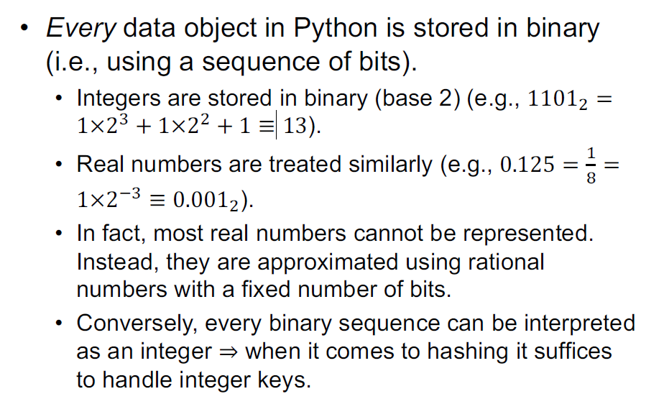
4.2
CompSci 101 Recall

Slide 19
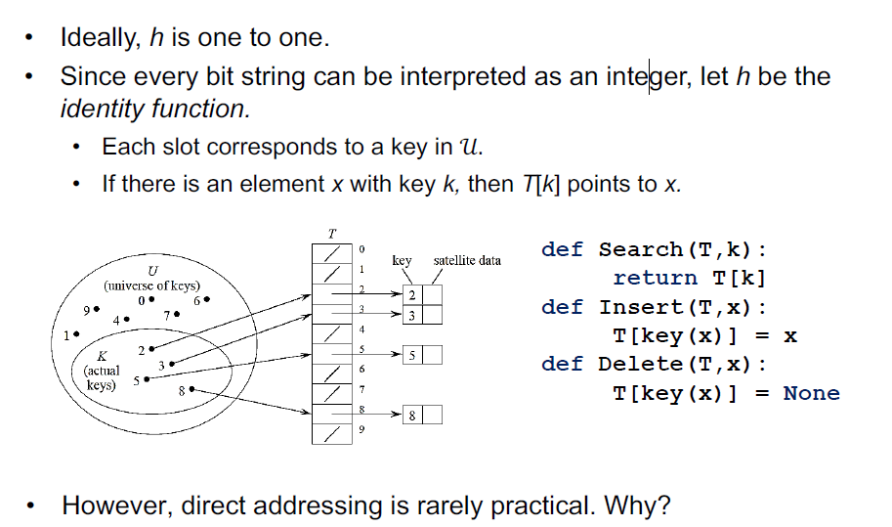
4.3
Direct Addressing

Slide 20
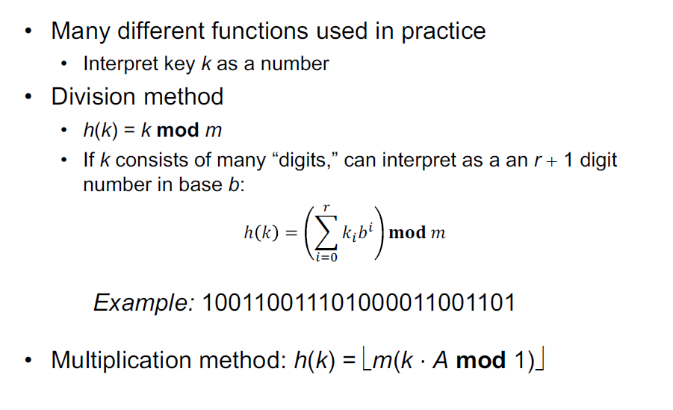
4.4
Hash Function

Slide 21
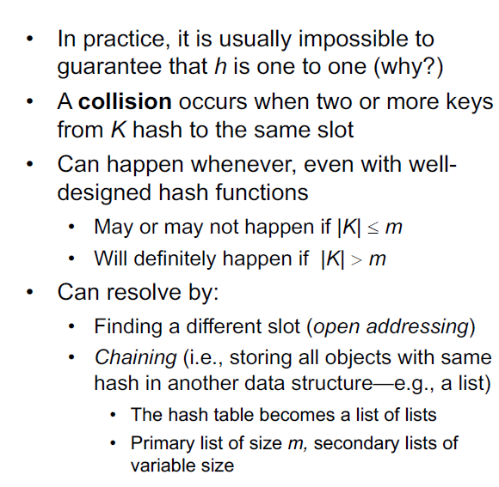
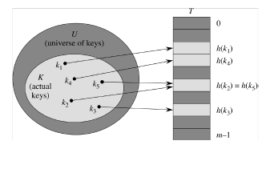
4.5
Hash Collisions

Slide 22
4.6
Hashtable Performance
Good performance is guaranteed provided that secondary lists are short.
Long lists can form if too many items hash to the same value.
In the worst case, the hash function is 0 and everything goes into the list at the 0th position.
This is no different than just using a list.
Picking a good hash function is a function of the table size as well as the specific data being put into the table.

Slide 23
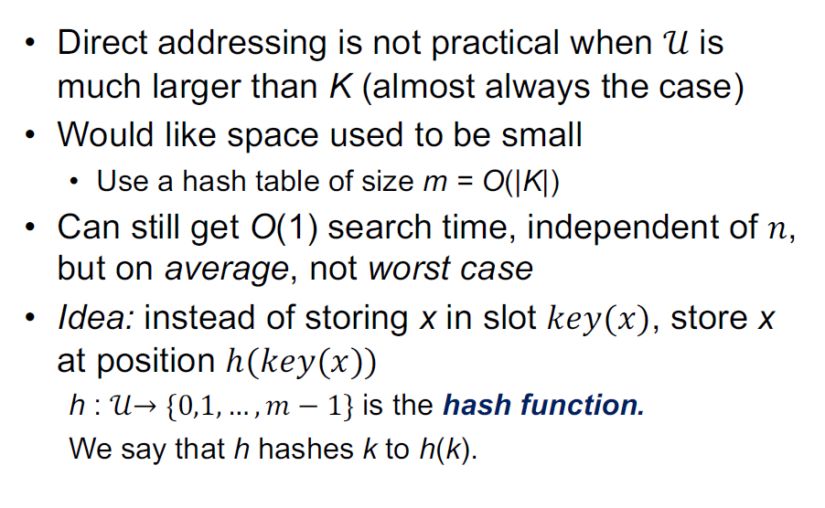
4.7
Hash Table

Slide 24
Data Structure
05
Heap

Slide 25
5.1
Heaps
A heap is a rooted binary tree 𝐻 that satisfies two properties:
1. Structural property
(Almost) complete binary tree (it fills from top to bottom and, at each level, from left to right)
2. Order or heap property (for maximum heaps)
H(parent(v)) >= H(v), for all nodes v
Heap is implemented via an Array data structure in Python, hence the “abstraction”

Slide 26
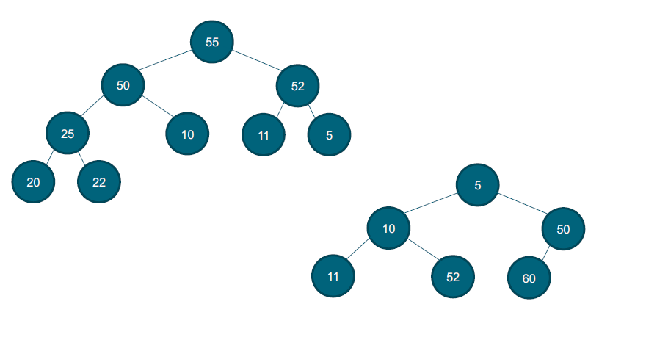
5.2
Heap Examples

Slide 27
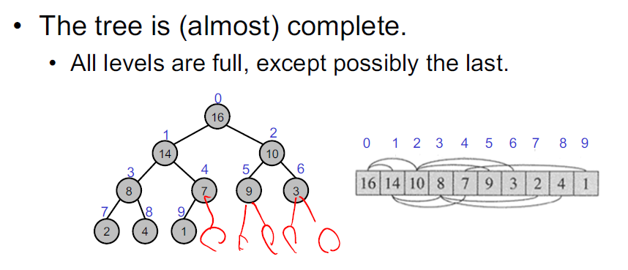
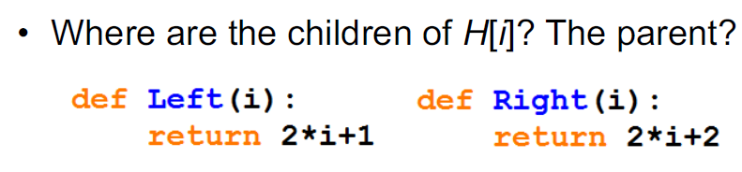
5.3
List Representation of Heaps

Slide 28
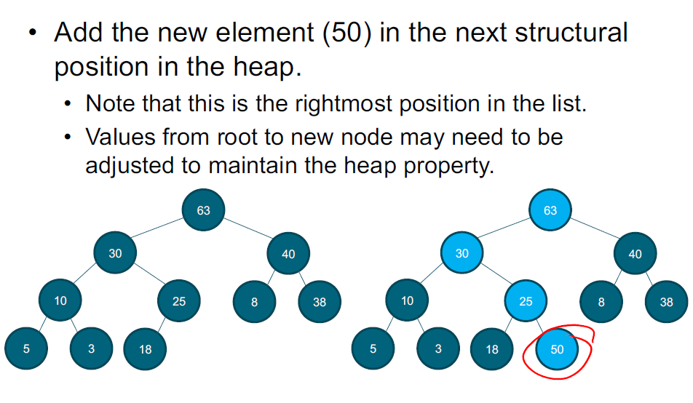
5.4
Inserting Into a Heap

Slide 29
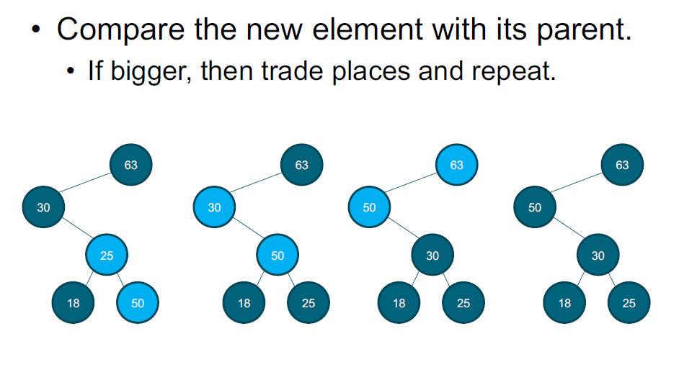
5.5
Inserting Into a Heap

Slide 30
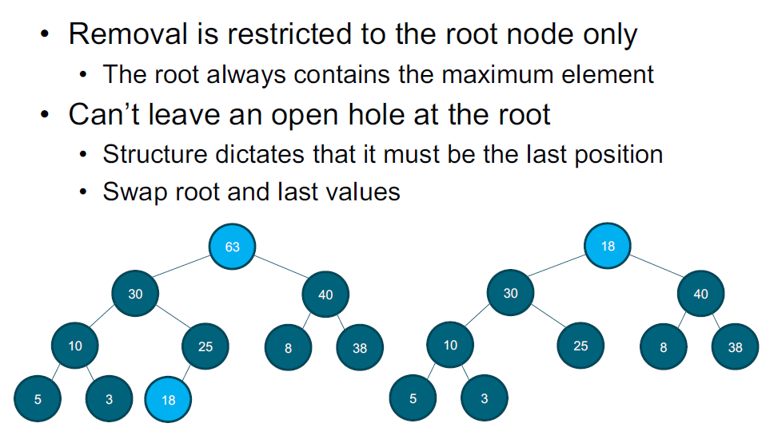
5.6
Remove From a Heap

Slide 31
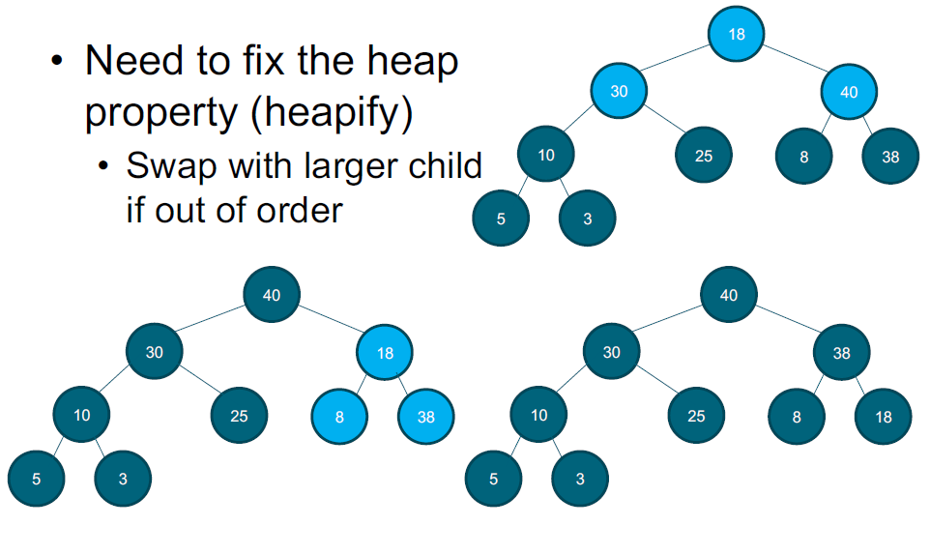
5.7
Remove From a Heap

Slide 32
5.8
Python Application and Use Case Examples
In Python, we have the “heapq” module from the PSL (Python Standard Library) that performs most of the typical heap operations for us
https://docs.python.org/3/library/heapq.html
Very useful for Priority Queues (Covered in future weeks)
ie Hospital Triage system:
Patients are admitted and assigned a “severity” rating (Insert into Heap, Heapify)
Always treat the patient with the highest “severity” rating first (Remove from the top of heap)
The triage system automatically re-balances as patients are being treated and discharged

Slide 33
Class Exercise
06
Class Exercises

Slide 34
6.1
Implement a Hash Table
Create a class called MyHashTable with a size of 10
Implement Standard Hashtable functions Insert, Member, Delete
Use List as the underlying Data Structure
Every Hashtable location is a List
Use the below hash function:
All values treated as strings
The “Hash” value is the ASCII value of the first character in the string
“amy” -> “a” -> 97
Use Modulus Division to get the actual hashed location
97 % 10 -> 7
When multiple values hash to the same location, append to that list

Slide 35
6.2
Twosum Revisited - Solve Using Hashtable
Given an array of integers nums and an integer target, return True if there are two numbers such that they add up to target, else return False
You may assume that each input would have exactly one solution, and you may not use the same element twice. You may also assume all elements in the list array are unique.
Input: nums = [2,7,11,15], target = 9
Output: True

Slide 36
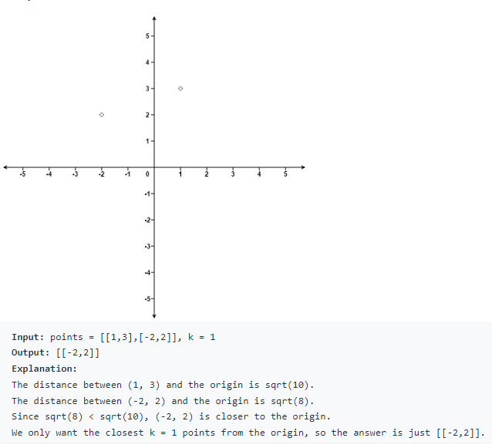
6.3
K-Closest Points to Origin
Given an array of points where points[i] = [xi, yi] represents a point on the X-Y plane and an integer k, return the k closest points to the origin (0, 0).
The distance between two points on the X-Y plane is the Euclidean distance (i.e., √(x1 - x2)2 + (y1 - y2)2).
You may return the answer in any order. The answer is guaranteed to be unique (except for the order that it is in).

Slide 37
6.4
Homework: Find Kth Largest Element in Array
Create a class MyArray with an integer array nums and a FindKLargest method:
FindKLargest: Given an integer k, return the kth largest element in the array
This method may be called many times, try to optimize for time efficiency
Note that the array is not sorted, we’re looking for the kth largest element in the sorted order, not the kth distinct element.
Solve this without using the “sort” method on the list, which data structure would you use?

Slide 38
THANK YOU

