Slide 1
H.A.C.C.
Data Structures and Algorithms
Jimmy Zhang
Fall 2022

Slide 2
Agenda
01
Week 3 Recap
04
Tree Traversal
02
Linked List
竞争对手分析
05
Class Exercise
产品定位分析
03
Binary/N-ary Tree
05

Slide 3
Week3 Recap
01a
Week 3 Recap

Slide 4
1.1
Week 3 Recap
Abstract Data Structures
Stack (LIFO)
Queue (FIFO)

Slide 5
Week3 Recap
01b
Homework Recap

Slide 6
1.2
Homework
Implement the Fibonacci function using a stack data structure
The function takes as input a single integer n
The function returns as output a single integer, the nth number in the fibonacci sequence
Fibonacci sequence: 0, 1, 1, 2, 3, 5, 8...
Example:
Input n=5, Output = 3
Input n=7, Output = 8

Slide 7
Data Structure
02
Linked List

Slide 8
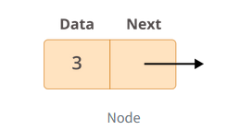
2.1
Linked List
Linked list, although the name contains a “list”, is actually operated via a Node data structure:
Data contains the value to be stored in the node
Next contains a reference/pointer to another node

Slide 9
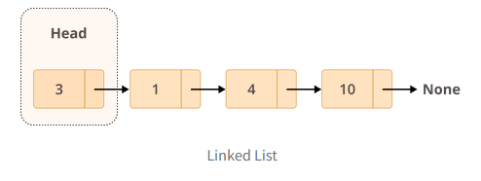
2.2
Linked List
An actual linked list is a collection of nodes
The first node is called HEAD, and is the starting point for any iteration through the list
The last node is called TAIL, and is the ending point of a full iteration through the list

Slide 10
2.3
Linked List
Specifically in Python, linked lists and array lists have very similar memory performance
No native indexing (ie retrieve value at index n), but there are workarounds
Basic implementation of Linked Lists has O(n) retrieval/search time
O(1) Insertion/Deletion of elements, anywhere in the list
Linked Lists are especially useful for implementing:
Stacks and Queues
Hashtables (in some cases)
Trees and Graphs

Slide 11
2.4
Hybrid Data Structures
Many basic data structures are often provided by the programming language libraries.
List, dequeue, dictionary, and so on
But sometimes a hybrid structure needs to be implemented for a particular application.
We need fast lookup of names but also want to maintain the order in which the names were entered into the system
Linked list running through a hash table

Slide 12
2.5
Linked List - Demo Exercise

Slide 13
Data Structure
03
Binary Tree

Slide 14
3.1
Binary Tree
Terminology: Tree
A tree is a directed graph with no cycles
Trees, like Graphs, are non-linear data structures that represent nodes connected by edges
In the case of binary trees, every parent node will have up to two child nodes
Some other terminologies:
Leaf, internal node, sibling, parent, child, ancestor, descendant, degree, full tree, complete tree, height, depth

Slide 15
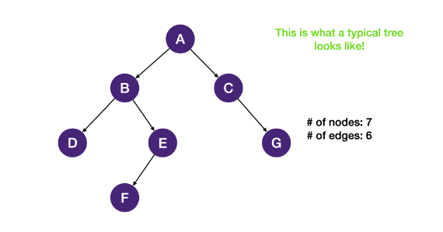
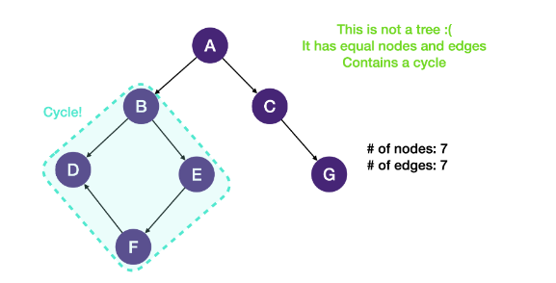
3.2
Definitions
There exists a path from the root to any node
The tree has N-1 Edges, where N is the number of nodes in the tree
Each node has exactly one parent node, except the root node
Each parent has up to two children nodes

Slide 16
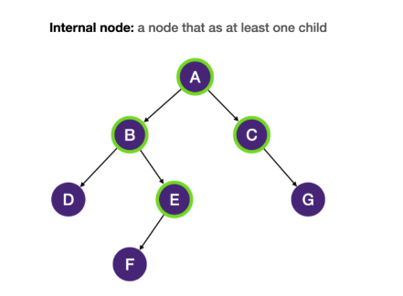
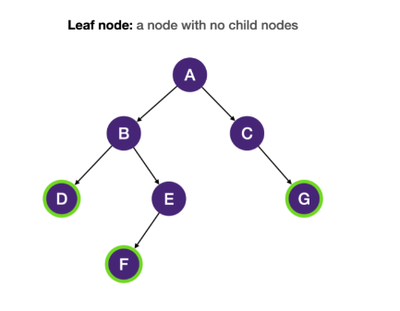
3.3
Definitions
Internal node: every node in a tree that has at least one child node.
Leaf node: every node in a tree that has no child nodes.

Slide 17
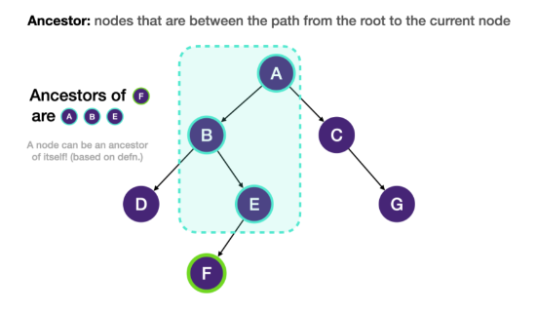
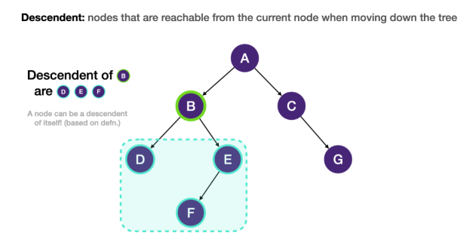
3.4
Definitions
Ancestor: all the nodes that are between the path from the root to the current node are the ancestors of the current node. An ancestor node of the current node is either the parent of the current node or the parent of another ancestor of the node.
Descendent: all the nodes that are reachable from the current node when moving down the tree are the descendants of the current node. A descendant of the current node is either a child of the node or a child of another descendant of the node.

Slide 18
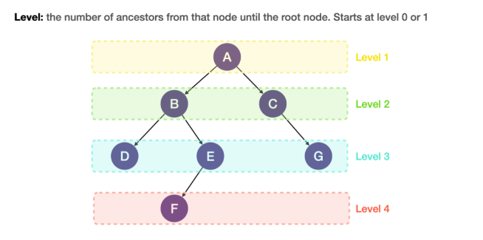
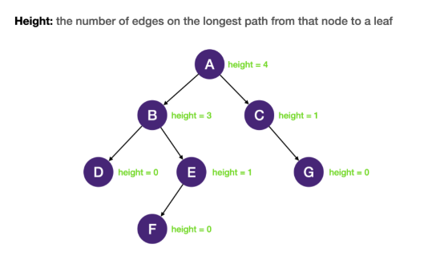
3.5
Definitions
Depth: the depth of a node is the number of edges on the path from the root to that node.

Slide 19
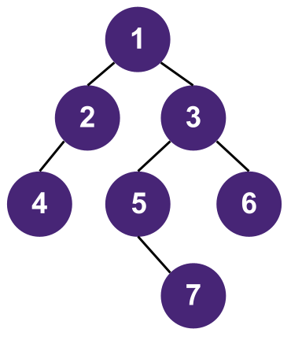
3.6
Balanced Binary Trees
Every node in a balanced binary tree fullfills the condition
the height difference of the left and right subtree of the node is not more than 1. Searching, insertion, and deletion in a balanced binary tree takes O(log n) instead of O(n) in an unbalanced binary tree. This is an example of a balanced binary tree:
Height | Nodes | Log Calculation
0 | 1 | Log1 = 0
1 | 3 | Log3 ~= 1
2 | 7 | Log7 ~= 2
3 | 15 | Log15 ~= 3
*Computers work in binary, hence log base 2
*ie Log2 of any number from 7 to 15, rounded down to integer, will be 3

Slide 20
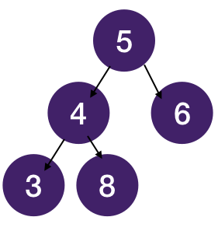
3.7
Implementation of Binary Trees
Binary trees are implemented using a special type of ADT called Nodes which operate similarily to linked list nodes
To represent a binary tree in python, we can again use lists
Example Binary Tree
In List Representation: [5,4,3,x,x,8,x,x,6,x,x]
This approach leverages the pre-order traversal

Slide 21
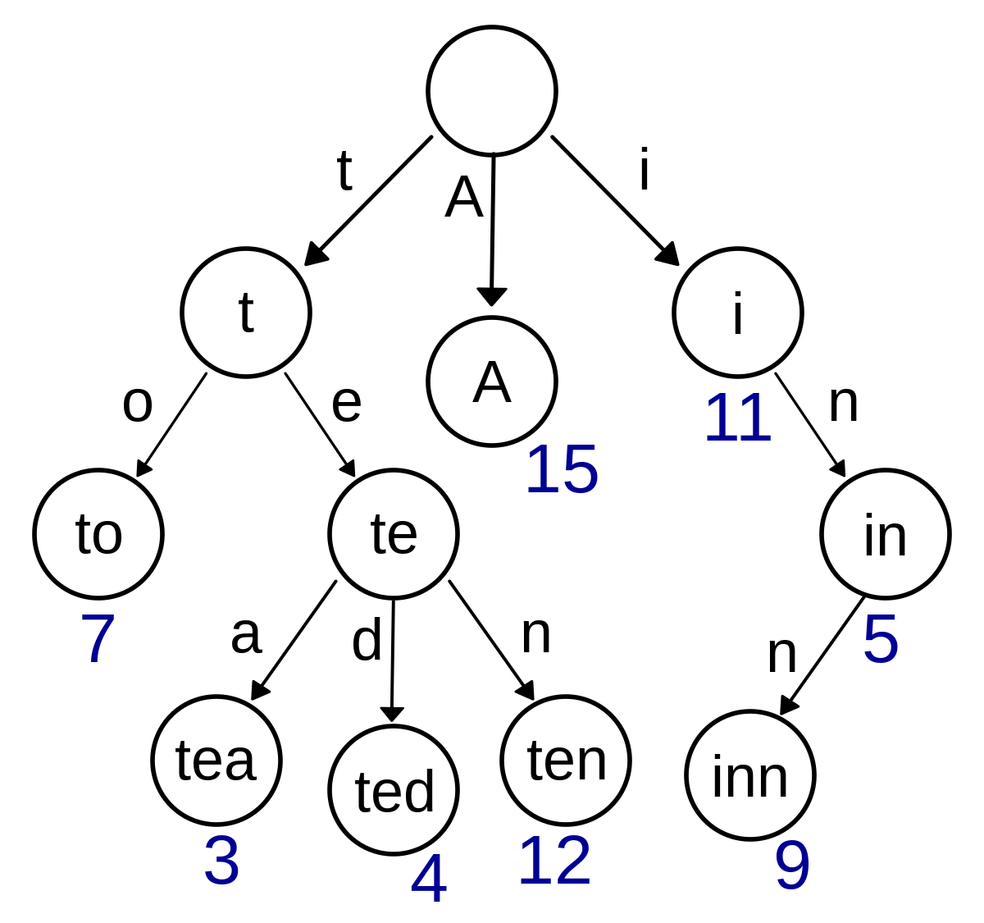
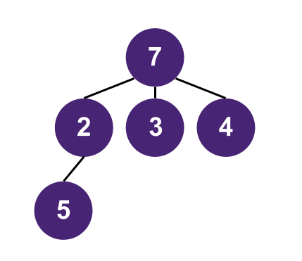
3.8
N-Ary Trees
For trees that do not follow the “binary” structure, we consider them as N-Ary Trees
N-Ary Trees can contain up to N (N>2) number of children at each parent node
Implementation in python is nearly identical
One of the most common applications is Prefix-Trie

Slide 22
3.9
Binary Tree - Demo Exercise

Slide 23
Data Structure
03
Tree Traversal

Slide 24
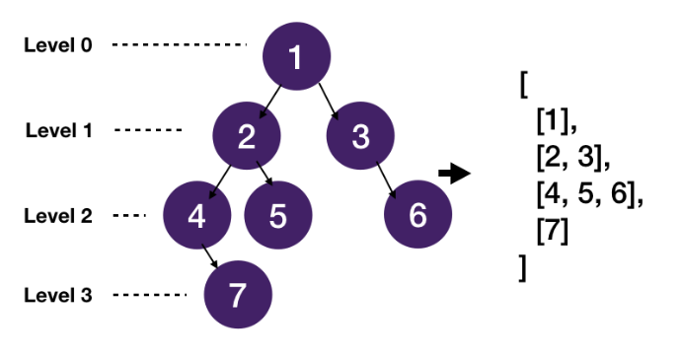
3.10
Level-order Traversal
Level-order traversal starts at the root node, and visits each and every node from left to right, moving down a level when there is no more nodes to visit

Slide 25
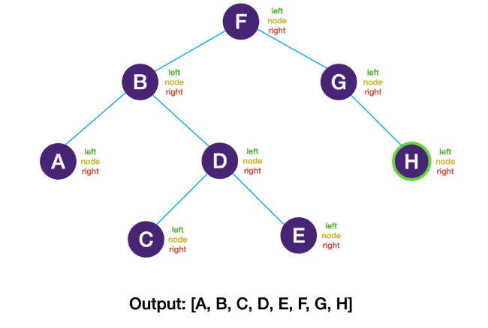
3.11
In-order Traversal
In-order traversal visits the left branch first, then the current node, and finally the right branch.
Left -> Current -> Right
The diagram below shows the traversal order of an in-order traversal on a binary tree.

Slide 26
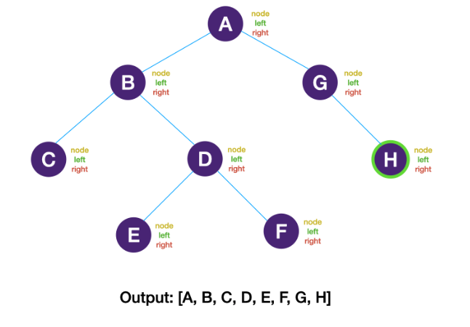
3.12
Pre-order Traversal
Pre-order traversal visits the current node first, then the left subtree, and finally the right subtree.
Current -> Left -> Right
The diagram below shows the traversal order of a pre-order traversal on a binary tree.

Slide 27
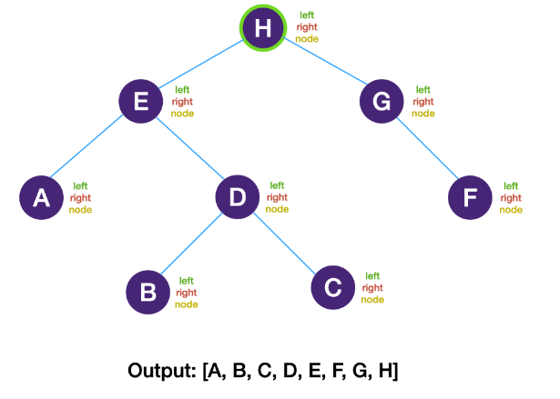
3.13
Post-order Traversal
Post-order traversal visits the left subtree first, then the right subtree, and finally the current node.
Left -> Right -> Current
The diagram below shows the traversal order of a post-order traversal on a binary tree.

Slide 28
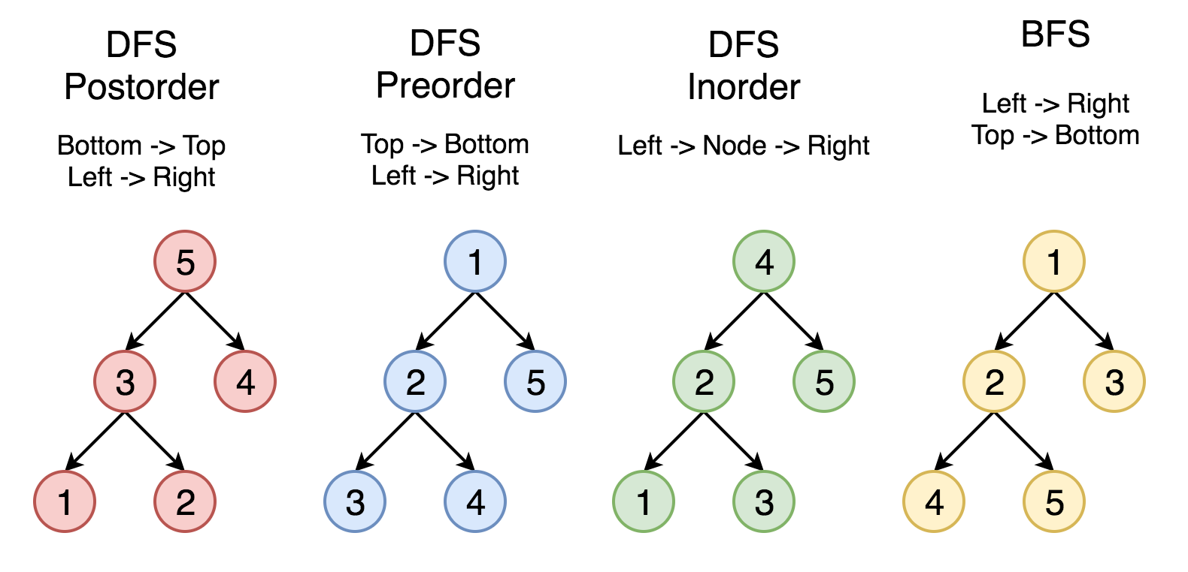
3.14
All Traversal Methods

Slide 29
Class Exercise
04
Class Exercises

Slide 30
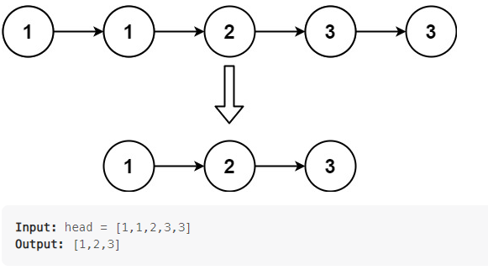
4.1
Delete Duplicates in Linked List
Given the head of a sorted linked list, delete all duplicates such that each element appears only once. Return the linked list sorted as well.

Slide 31
4.2
Tree Traversals - Demo Exercise
For each of the tree traversal methods, what data structure would you choose to implement it:
Level order traversal
In order traversal
Pre order traversal
Post order traversal

Slide 32
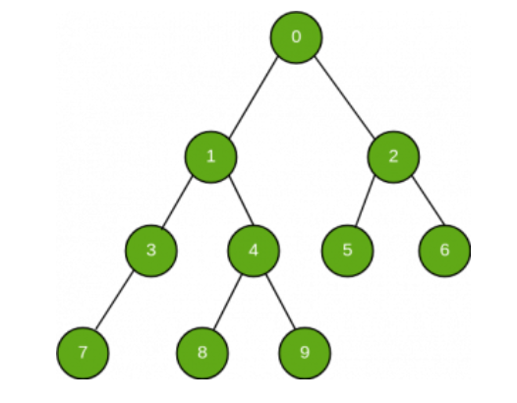
4.3
Homework: Find Value in Binary Tree
Given the starting (root) node of a Binary Tree, search and check if a given value exists in this tree:
Note the values of every node is in “node.value”
Return True if the value exists in the binary tree, otherwise return False
Example:
Input: Value = 4
Output: True
Input: Value = 20
Output: False

Slide 33
THANK YOU

