Slide 1
H.A.C.C.
Data Structures and Algorithms
Jimmy Zhang
Fall 2022

Slide 2
Agenda
01
Week 4 Recap
02
Recursion
竞争对手分析
产品定位分析
03
Divide&Conquer
04
Class Exercise
05

Slide 3
Week4 Recap
01a
Week 4 Recap

Slide 4
1.1
Week4 Recap
Linked List
Binary Tree
Tree Traversals
Level order
Pre order
Post order
In order

Slide 5
Week4 Recap
01b
Homework Recap

Slide 6
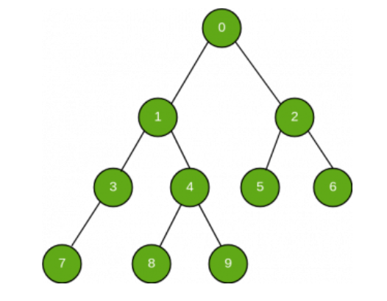
1.2
Homework: Find Value in Binary Tree
Given the starting (root) node of a Binary Tree, search and check if a given value exists in this tree:
Note the values of every node is in “node.value”
Return True if the value exists in the binary tree, otherwise return False
Example:
Input: Value = 4
Output: True
Input: Value = 20
Output: False

Slide 7
Algorithm
02
Recursion

Slide 8
2.1
What is Recursion
Recursion is the process of defining something in terms of itself
Python Example:
def recursion():
#...do something
recurions()

Slide 9
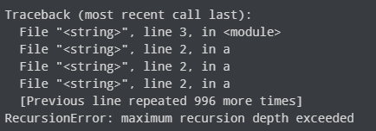
2.2
Recursion Function Setup
Every recursive function must have a base case that stops the recursion or else the function calls itself infinitely
In Python, the interpreter limits the depths of recursion to help avoid infinite recursions, raising an error “RecursionError: Stack Overflow” error when you exceed a maximum depth of 1000

Slide 10
2.3
Using Recursion
Advantages
Recursive code often tends to look cleaner and more elegant
A complex task can be broken down into simpler sub-problems using recursion
Sequence generation is easier with recursion than using some nested iteration
Disadvantages
Sometimes the logic behind recursion is hard to follow through
Recursive calls are expensive (inefficient) as they take up a lot of memory and time
Recursive functions are hard to debug

Slide 11
2.4
Using Recursion
Traversals of tree or graph data structures
Often...traversals of any “nested” or non-linear data structure
Space complexity is proportional to the maximum depth of the recursion tree
ie Any recursive call in Fibonacci will go down n levels, hence O(n)
Time complexity is proportional to number of recursive calls within the function, often a function of k^n where k is the number of recursive calls
ie Fibonacci calls itself twice, that’s O(2^n)

Slide 12
2.5
Recursion Code Demo
fibonacci number revisited
counting items of nested list

Slide 13
Algorithm
03
Divide & Conquer

Slide 14
3.1
Divide-and-Conquer
Think about cutting a rope into 8 exact length pieces, without any instrument to measure
We have a hard time of estimating where to perform our cuts
Solution:
We fold the rope in half
We fold again
Cut through the middle and two ends
We have 8 (almost) exact length pieces
We can solve a Base Case fairly easily (cutting the middle)
We can divide our problem into subproblems, and continue to apply the Base Case solution

Slide 15
3.2
Divide-and-Conquer Template
Given a problem of size n:
1) Divide the problem into k subproblems of size n/k each
2) Conquer by solving each subproblem independently
3) Combine the k solutions to subproblems into a solution to the original problem
Often, Recursion is used when implementing a DAC algorithm
Sometimes, we may not need to explicitly perform Combine step
ie. Binary Search

Slide 16
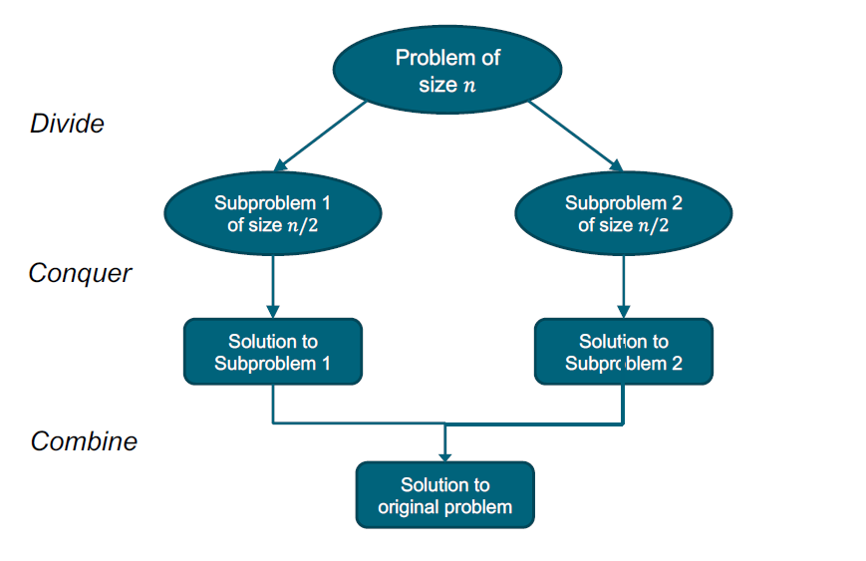
3.3
DAC with Two Subproblems
Think back to our rope example, let’s say we wanted 8 pieces arranged side-by-side
DAC
Combine

Slide 17
3.4
Divide and Conquer Use Cases
There are many problems that can be solved using DAC
Binary Search, Merge/Quick sort
Polynomial/Matrix multiplication, Exponentiation
Order Statistics
Stock Profit
Closest Point Pairs, Merge/Quick Hull

Slide 18
3.5
DAC code demo - Merge Sort
def mergeSort(L):
if len(L) < 2:
return L[:]
else:
mid = len(L) // 2
Left = mergeSort(L[:mid])
Right = mergeSort(L[mid:])
return merge(Left, Right)
Divide and Conquer
Combine

Slide 19
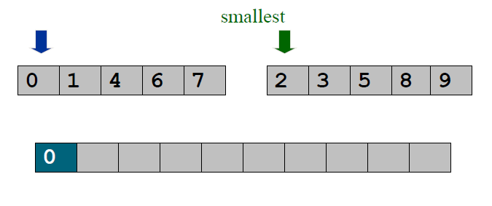
3.6
Merge Sort - Merging
After solving the sub-problems recursively, we need to Combine these to form our final solution
Keep track of the smallest element in each sorted half
Insert the smallest of the two elements into the auxiliary array
Repeat until done

Slide 20
3.7
Time Complexity of Merge Sort
Looking at the recursive DAC component, this resembles a Binary Tree
What is the height(depth) of a Binary Tree?
What is the time complexity of our Merge Sort algorithm?

Slide 21
3.8
Time Complexity of Merge Sort
Recall in our first week, we practiced a brute-force sorting algorithm that achieved O(n^2) time complexity
Compare that against the Merge Sort at O(nlogn) time complexity

Slide 22
3.9
Merge Sort Code Demo

Slide 23
3.10
Divide and Conquer - Summary
Implementation
Mostly Recursive implementation
Divide problem into subproblems
Solve subproblems (usually, we prefer O(1) solutions at base case)
Combine subproblems to form solution (sometimes not explicitly needed)
Fairly fast (usually involves O(logn) time complexity)
Sometimes tricky to combine subproblems properly
Sometimes we might be repeatedly solving overlapping subproblems
In which case we can use Dynamic Programming / Memoization

Slide 24
Class Exercise
04
Class Exercises

Slide 25
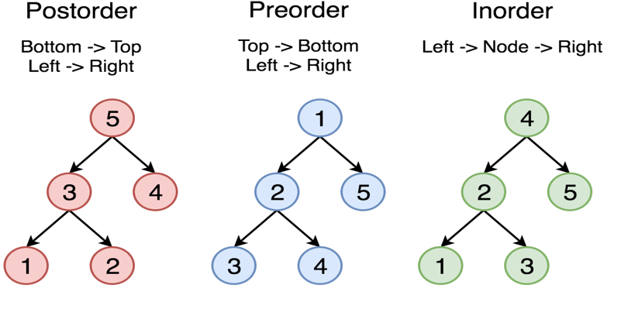
4.1
Tree Traversals - Recursion

Slide 26
4.2
Homework
Unique numbers in Array
Given a sorted input list of integers “nums”, return a sorted list containing only the unique values in the input
Implement a solution using Divide-And-Conquer and Recursion
Think about how your base case would look, what’s the simplest problem you can solve?
Example Input: [1,1,1,2,2,3,3,3,3]
Example Output: [1,2,3]

Slide 27
THANK YOU

