Slide 1
H.A.C.C.
Data Structures and Algorithms
Jimmy Zhang
Fall 2022

Slide 2
Agenda
01
Week 6 Recap
02
Graph Theory
竞争对手分析
产品定位分析
03
Graph Traversals
04
Class Exercise
05

Slide 3
Week6 Recap
01a
Week 6 Recap

Slide 4
1.1
Week6 Recap
Algorithmic methods for working with array or array-like data structures
Binary Search
Two Pointers
Same Direction
Opposite Direction
Sliding Window

Slide 5
Week6 Recap
01b
Homework Recap

Slide 6
1.2
Homework - Revisit Unique Elements in Array
Given a sorted array nums, find all unique elements in array.
The total number of elements in the array is much larger than the number of unique elements in the array.
Constraint: Must solve in less than O(n) time where n is number of elements in array
You may use any algorithm or data structure you’ve learnt so far

Slide 7
Algorithms
02
Graph Theory

Slide 8
2.1
Graph Overview
Trees are special graphs that have no cycle, aka the DAG (Directed Acyclic Graph)
In Graphs, we often have cycles (paths that lead back to where we started)
Therefore we have to record the nodes we have visited and avoiding re-visiting them and going into an infinite loop

Slide 9
2.2
Intro to Graphs - Small World Problem Example
What does the phrase “it’s such a small world” mean?
How far apart are two random individuals?
Six degrees of separation
Why should we care?
Spreading of rumors, disease, and so on?
Want to test if the SWP holds for a system of interactions (people, proteins, computers, etc.)
How do we test it algorithmically?
Need a mathematical model of the relation “knows”

Slide 10
2.3
Graph-type Problems
Find a path from point A to B
Variants include: find shortest/longest path, etc
Think Google Maps
Here the “path” could be anything, a mathematical formula, a logical statement, an object, etc...
Find connected components
Detect cycles

Slide 11
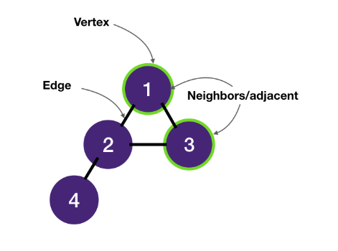
2.4
Graph Terminologies
A graph consists of vertices ("nodes" in trees) and edges.
Vertices are connected by edges.
Two vertices connected by an edge are called neighbors and are adjacent ("children" and "parents" in trees).

Slide 12
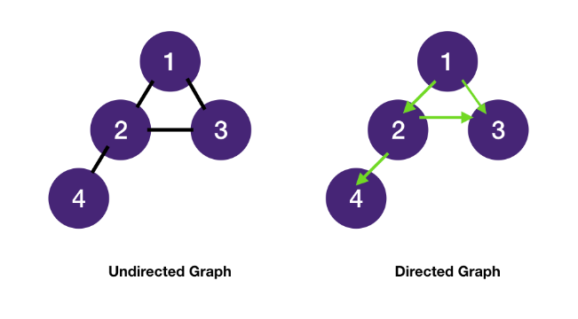
2.5
Graph Terminologies
Edges can be undirected or directed.
A tree is also an undirected graph.

Slide 13
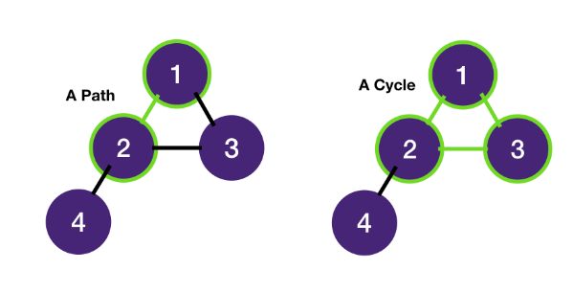
2.6
Graph Terminologies
A path is a sequence of vertices.
A cycle is a path that starts and ends at the same vertex.

Slide 14
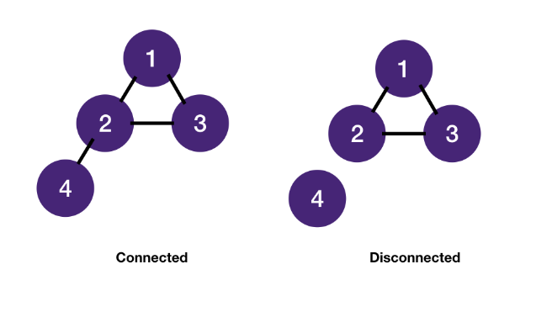
2.7
Graph Terminologies
An undirected graph is connected if every vertex is joined by a path to another vertex.
Otherwise, it's disconnected.

Slide 15
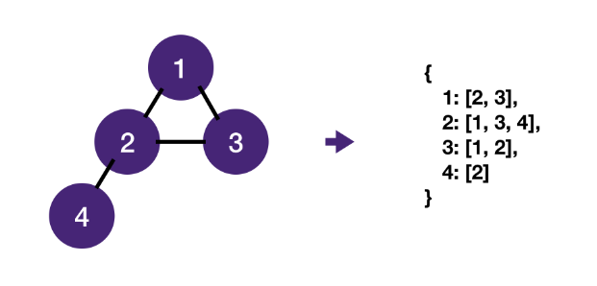
2.8
Graph Data Implementation
A graph is most commonly stored as a map of adjacency lists:
for each vertex, store a list of its neighbors.

Slide 16
Algorithms
03
Graph Traversals

Slide 17
3.1
Traversing a Graph Data Structure
Graph exploration: visit all nodes and edges of a graph.
Done to compute some properties (e.g., paths between nodes, existence of cycles, connectedness, etc.)
Many applications (Web, social networks, routing, games, etc.)

Slide 18
3.2
Systematically Exploring a Graph
Two procedures allow you to explore a graph in linear time and compile information about the graph:
Breadth-first search (BFS)
Think about how a disease (ie covid) spreads from person to person, it starts with one person, then those around him/her, and then spreads outwards until the entire population has been infected
Depth-first search (DFS)
Think about walking through a maze, you follow one path until you either reach the exit or a deadend, then you try other paths until one leads you to the exit

Slide 19
3.2
Systematically Exploring a Graph
DFS and BFS have similar structure.
Both keep a data structure D of pending edges to explore and repeatedly choose an edge from D to explore.
D is initially loaded with the edges adjacent to an arbitrary vertex v.
Both procedures run in linear time.
DFS and BFS differ only on the nature of D.
DFS uses a stack.
BFS uses a queue.
Recall Binary Tree Traversals
Level Order -> BFS
In Order, Pre Order, Post Order -> DFS

Slide 20
3.3
DFS/BFS Steps
Given a graph G, containing vertices (V) and edges (E)
Pick the starting vertex, V1
Mark V1 as processed
Push V1 and all its edges to neighboring nodes into the data structure (stack or queue)
While the data structure is not empty:
Pop top/front element off data structure
Mark vertex as processed (if not already)
Record edge as part of the spanning tree
Push all neighbors of vertex that have not already been processed onto data structure
Along with the edges to those neighbors

Slide 21
3.4
BFS
BFS is a method to systematically explore the nodes of a graph starting from a designated source node 𝑠
Visit 𝑠and its neighbors; then, for each neighbor, visit its neighbors, and so on until no more nodes can be visited!
A graph is explored level by level—level 0: 𝑠 .
Level 𝑖: vertices reachable by path of length 𝑖 but not shorter
Level 𝑖 built from level 𝑖 − 1 by trying all outgoing edges but ignoring vertices from previous levels

Slide 22
3.5
BFS
Question: How do we make sure that all the neighbors of a node are visited before any of their neighbors are (i.e., how do we guarantee that all nodes at level 𝑖 are visited before any node of level 𝑖 + 1)?
Answer: We do so by using a queue to store the nodes pending exploration.
All nodes at level 𝑖 appear earlier in the queue than any node at level 𝑖 + 1.

Slide 23
3.6
BFS
Each node is enqueued/dequeued at most once.
Each edge is examined at most twice.
As implemented, BFS runs in 𝑂(𝑛 + 𝑚) time,
n = num verts,
m = num edges

Slide 24
3.7
DFS
We start our search at the root
We end our search when we find a valid leaf node
A depth-first search expands the deepest node next.
A child children will be expanded before the child’s siblings are expanded.
This type of search gets you to the leaf nodes as fast as you can.

Slide 25
3.8
DFS
Instead of explicitly implementing a stack DFS, we often prefer to let the system stack do the heavy lifting and use a recursive implementation

Slide 26
3.9
DFS
Algorithmic Paradigm
Think of DFS as a combination of Divide-and-Conquer and Backtracking (will be covered later)
Recall our preorder binary tree traversal DFS
We have recursive calls to dfs(root.left), dfs(root.right)
This is effectively dividing the problem, conquering each one independently, and combining the solution at the end

Slide 27
3.10
Use Case Examples
Consider a wireless sensor network consisting of 𝑛 sensors, each of which can transmit within distance 𝑟. Pairs of sensors that can directly communicate are linked with an edge.
This information can be used to partition the sensors into sets of sensors that can communicate directly or indirectly.

Slide 28
3.11
Use Case Examples
Consider a pool of customers using different accounts. You wish to identify related sets of people (e.g., families). You create edges between customer IDs based on the same credit card usage, or address, and so on.
The information can be used, for example, to estimate the possibility of fraud.

Slide 29
3.12
Graph Traversal Summary
Question: Which is better, DFS or BFS?
Answer: It depends...
BFS is better at:
Finding shortest distance between two vertices
Graph of unkown size, or even infinite size
Ie Google Maps find path from A to B in a city
DFS is better at:
Using less memory than BFS for wide graphs, since BFS has to keep all the nodes in the queue, and for wide graphs this can be quite large
Finding nodes far away from the root
ie Web Scraping to build an index for Google Search

Slide 30
Class Exercise
04
Class Exercises

Slide 31
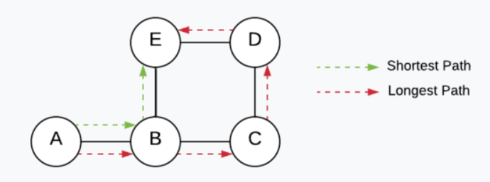
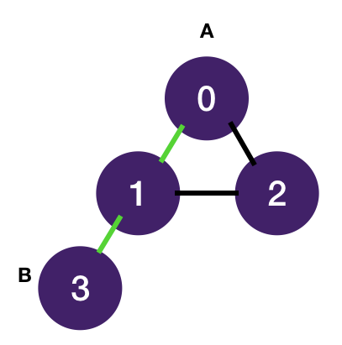
4.1
Shortest Path between A and B
Given an (unweighted) graph, return the length of the shortest path between two nodes A and B, in terms of the number of edges.
Input:
graph: {0: [1, 2], 1: [0, 2, 3], 2: [0, 1], 3: [1]}, A: 0, B: 3
Output: 2

Slide 32
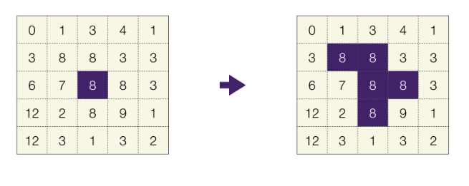
4.2
Flood Fill
In computer graphics, an uncompressed raster image is presented as a matrix of numbers. Each entry of the matrix represents the color of a pixel.
A flood fill algorithm takes a coordinate r, c and a replacement color, and replaces all pixels connected to r, c that have the same color (i.e., the pixels connected to the given coordinate with of same color and all the other pixels connected to the those pixels of the same color) with the replacement color. (e.g. MS-Paint's paint bucket tool).

Slide 33
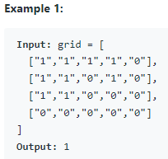
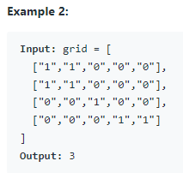
4.3
Homework - Number of Islands
Given an m x n 2D binary grid grid which represents a map of '1's (land) and '0's (water), return the number of islands.
An island is surrounded by water and is formed by connecting adjacent lands horizontally or vertically. You may assume all four edges of the grid are all surrounded by water.

Slide 34
THANK YOU

