Slide 1
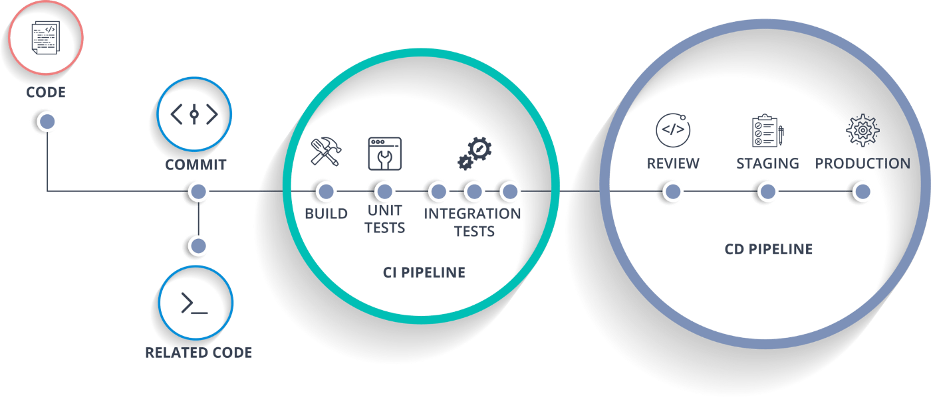
The Fundamentals and Benefits of CI/CD to Achieve, Build, and Deploy Automation for Cloud-Based Software Products

Slide 2

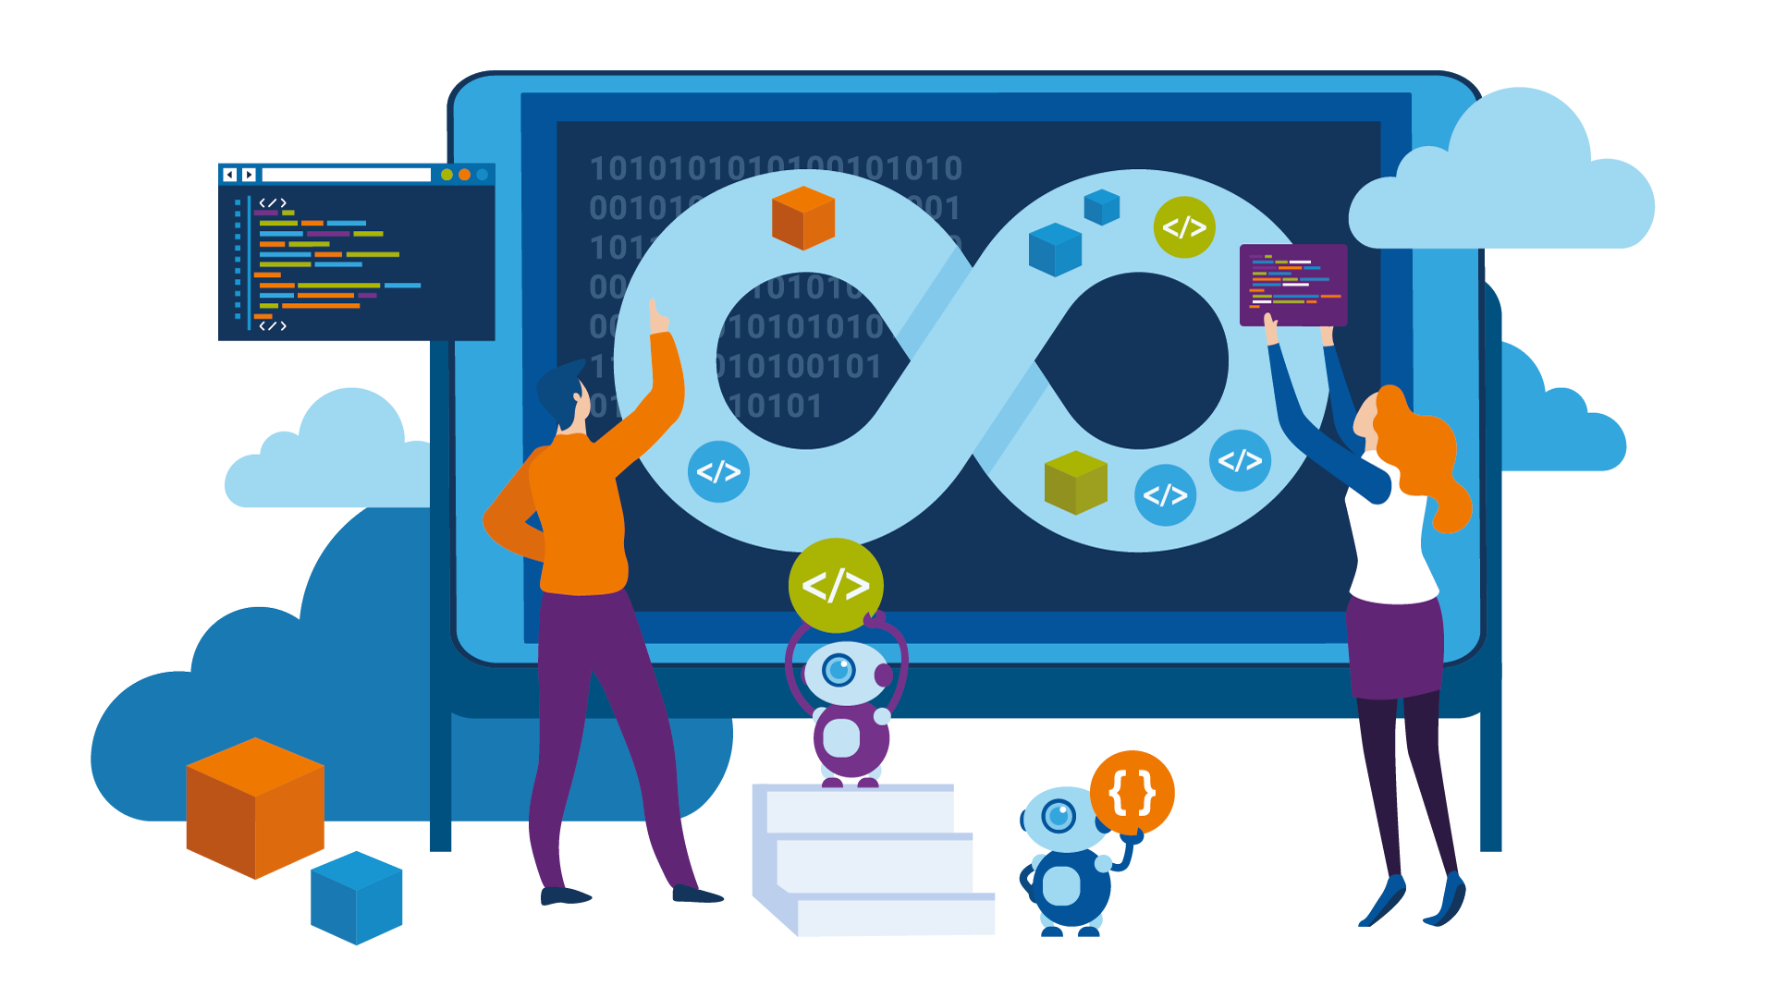
Introduction
Continuous integration (CI) and continuous delivery (CD) are processes for developing, packaging, and distributing applications. Essentially, it lays out some practices to follow in order for developer to integrate code into a share repository, test and push to the market more quickly and safely, ultimately increasing revenue and lowering costs and time to push to production. Faster time to market, tighter feedback loops, and greater interaction with internal and external customers are all benefits of CI/CD processes.

Slide 3




Why CI/CD
Faster developer iteration
Better release quality
Benefit of CI/CD
Let’s look at four benefits of implementing a CI/CD pipeline to understand why many organizations have shifted toward this approach.
Make easier rollbacks
Lower risk of poor user experience

Slide 4


Conclusion
The world is moving toward rapid release cycles, and CI/CD pipelines have accelerated the release rate. With careful planning and implementation, such a pipeline can help us find defects faster, implement fixes immediately, and increase overall customer satisfaction.

