Slide 1












$$v_{1}$$
$$v_{4}$$
$$v_{5}$$
#triangles $=4$
$$v_{7}$$
#2-stars $=29$
$$v_{6}$$
$$v_{2}$$
$$v_{3}$$
$$v_{9}$$
clustering coeffieicent $=0.41$
$$v_{8}$$

Slide 2










1st Round
ARR (Asymmetric RR)
1
$$p_{1}$$
1
$$p_{2}$$
1
noisy edges (ARR)
User $v_{i}$
Server
$$1−p_{1}$$
$$1−p_{2}$$
0
$$p_{1}$$
0
0
2nd Round
Noisy Triangles
noisy edges between others
$$v_{i}$$
User $v_{i}$
Server
original edges
#noisy triangles + corrective term + Lap
noisy edges
$$v_{j}$$
$$v_{k}$$

Slide 3




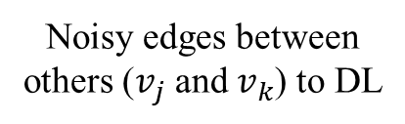
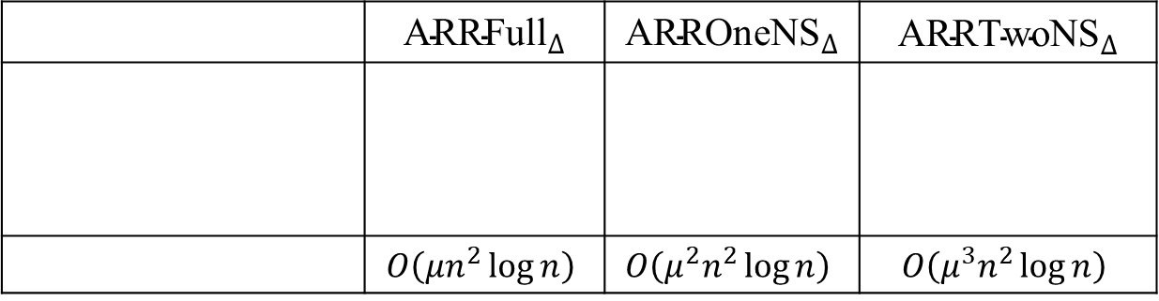






 | $${\text{ARRFull}}_{∆}$$ | $${\text{ARR}\text{OneNS}}_{∆}$$ | $${\text{ARR}\text{TwoNS}}_{∆}$$
 | $$O\left(μn^{2}\log{n}\right)$$ | $$O\left(μ^{2}n^{2}\log{n}\right)$$ | $$O\left(μ^{3}n^{2}\log{n}\right)$$
$$v_{i}$$
$$v_{i}$$
$$v_{i}$$
Noisy edges between others ($v_{j}$ and $v_{k}$) to DL
$$v_{j}$$
$$v_{k}$$
$$v_{j}$$
$$v_{k}$$
$$v_{j}$$
$$v_{k}$$
$${Cost}_{DL}$$

Slide 4



















Original Graph
$${\text{ARRFull}}_{∆}$$
$${\text{ARR}\text{OneNS}}_{∆}$$
$${\text{ARR}\text{TwoNS}}_{∆}$$
$$v_{i}$$
$$v_{i}$$
$$v_{i}$$
$$v_{i}$$
$$v_{j}$$
$$v_{k}$$
$$v_{j}$$
$$v_{k}$$
$$v_{j}$$
$$v_{k}$$
$$v_{j}$$
$$v_{k}$$
$$v_{i^{′}}$$
$$v_{i^{′}}$$
$$v_{i^{′}}$$
$$v_{i^{′}}$$
original edges
noisy edges

Slide 5


















$${\text{ARRFull}}_{∆}$$
$${\text{ARR}\text{OneNS}}_{∆}$$
$${\text{ARR}\text{TwoNS}}_{∆}$$
$$v_{i}$$
$$v_{i}$$
$$v_{i}$$
$$v_{l}$$
$$v_{l}$$
$$v_{l}$$
$$v_{j}$$
$$v_{k}$$
$$v_{j}$$
$$v_{k}$$
$$v_{j}$$
$$v_{k}$$
$$v_{m}$$
$$v_{m}$$
$$v_{m}$$
original edges
noisy edges

Slide 6














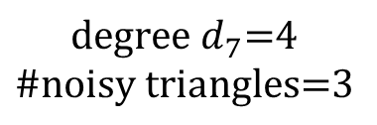


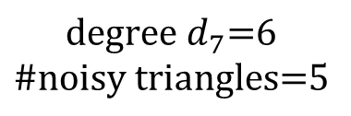

$$v_{7}$$
$$v_{6}$$
$$v_{7}$$
$$v_{6}$$
$$v_{5}$$
$$v_{5}$$
$$v_{1}$$
$$v_{4}$$
$$v_{1}$$
$$v_{4}$$
$$v_{3}$$
(1)
$$v_{3}$$
(2)
$$\text{\#}\text{noisy} \text{triangles}\text{=2}$$
$$v_{2}$$
$$v_{2}$$
$$\text{degree} d_{7}\text{=}\text{6}$$
$$\text{\#}\text{noisy} \text{triangles}\text{=5}$$
$$\text{degree} d_{7}\text{=}\text{4}$$
$$\text{\#}\text{noisy} \text{triangles}\text{=3}$$
(1) edge clipping (${\tilde{d}}_{7}=4.2$)
(2) noisy triangle clipping ($κ_{7}=2.5$)

Slide 7





Name
4-cycle
3-path
2-star
3-star
Shape
Count in $G$
$$C_{4}(G)$$
$$P_{3}(G)$$
$$S_{2}(G)$$
$$S_{3}(G)$$

Slide 8



































4-cycles
2-stars
$$j=j′$$
$$i$$
$$j=j′$$
$$i′$$
$$j=j′$$
1
4
1
4
1
3
2
3
2
3
2
$$i′$$
$$k=k′$$
$$i$$
$$k=k′$$
$$i=i′$$
$$k=k′$$
3-stars
$$j=j′$$
$$k$$
$$j=j′$$
$$k′$$
$$j$$
$$k=j′$$
$$j′$$
$$k′=j$$
$$j$$
$$j′$$
$$j′$$
$$j$$
1
2
1
2
1
2
1
2
1
2
1
2
4
3
4
3
4
3
4
3
4
3
4
3
$$i=i′$$
$$k′$$
$$i=i′$$
$$k$$
$$i=i′$$
$$k′$$
$$i=i′$$
$$k$$
$$i=i′$$
$$k=k′$$
$$i=i′$$
$$k=k′$$

Slide 9




















(a) Gplus ($μ^{∗}={10}^{−3}$)
(b) IMDB ($μ^{∗}={10}^{−3}$)
1
1
$${\text{ARRFull}}_{∆}$$
$${\text{ARRFull}}_{∆}$$
$${\text{ARR}\text{OneNS}}_{∆}$$
$${\text{ARR}\text{OneNS}}_{∆}$$
10⁻¹
$${\text{ARR}\text{TwoNS}}_{∆}$$
10⁻¹
$${\text{ARR}\text{TwoNS}}_{∆}$$
Relative Error
Relative Error
10⁻²
10⁻²
10⁻³
10⁻³
0
0.5
1
1.5
2
0
0.5
1
1.5
2
$$ε_{1}$$
$$ε_{1}$$
(c) Gplus ($ε_{1}=1$)
(d) IMDB ($ε_{1}=1$)
10
10
$${\text{ARRFull}}_{∆}$$
$${\text{ARRFull}}_{∆}$$
1
$${\text{ARR}\text{OneNS}}_{∆}$$
1
$${\text{ARR}\text{OneNS}}_{∆}$$
$${\text{ARR}\text{TwoNS}}_{∆}$$
$${\text{ARR}\text{TwoNS}}_{∆}$$
10⁻¹
10⁻¹
Relative Error
Relative Error
10⁻²
10⁻²
10⁻³
10⁻³
10⁻⁴
10⁻⁴
10⁻⁶
10⁻⁵
10⁻⁴
10⁻³
10⁻²
10⁻¹
1
10⁻⁶
10⁻⁵
10⁻⁴
10⁻³
10⁻²
10⁻¹
1
$$μ^{∗}$$
$$μ^{∗}$$

Slide 10







$${\text{ARRFull}}_{∆} (DC)$$
$${\text{ARR}\text{OneNS}}_{∆} (DC)$$
$${\text{ARR}\text{TwoNS}}_{∆} (DC)$$
0.08
0.08
0.04
0.04
0.06
0.06
0.03
0.03
Relative Error
0.04
0.02
0.04
0.02
0.02
0.02
0.01
0.01
0
0
0
0
Gplus ($ε=1$)
Gplus ($ε=2$)
IMDB ($ε=1$)
IMDB ($ε=2$)

Slide 11
$${\text{ARRFull}}_{∆} (DC)$$
$${\text{ARR}\text{OneNS}}_{∆} (DC)$$
$${\text{ARR}\text{TwoNS}}_{∆} (DC)$$
0.08
0.05
0.04
0.02
0.06
0.04
0.03
0.015
0.03
Relative Error
0.02
0.04
0.01
0.02
0.02
0.01
0.01
0.005
0
0
0
0
Gplus ($ε=1$)
Gplus ($ε=2$)
IMDB ($ε=1$)
IMDB ($ε=2$)

Slide 12


















$${\text{ARRFull}}_{∆} (DC)$$
$${\text{ARRFull}}_{∆} (d_{max})$$
$${\text{ARR}\text{OneNS}}_{∆} (DC)$$
$${\text{ARR}\text{OneNS}}_{∆} (d_{max})$$
$${\text{ARR}\text{TwoNS}}_{∆} (DC)$$
$${\text{ARR}\text{TwoNS}}_{∆} (d_{max})$$
(a) Gplus ($μ^{∗}={10}^{−3}$)
(b) IMDB ($μ^{∗}={10}^{−3}$)
10³
10⁴
10²
10³
10
10²
10
1
Relative Error
Relative Error
1
10⁻¹
10⁻¹
10⁻²
10⁻²
10⁻³
10⁻³
0
0.5
1
1.5
2
0
0.5
1
1.5
2
$$ε$$
$$ε$$
(c) Gplus ($ε=1$)
(d) IMDB ($ε=1$)
10⁴
10⁵
10³
$${\text{RRFull}}_{∆} (d_{max})$$
10⁴
$${\text{RRFull}}_{∆} (d_{max})$$
10³
10²
10²
10
10
Relative Error
Relative Error
1
1
10⁻¹
10⁻¹
10⁻²
10⁻²
10⁻³
10⁻³
10⁻⁴
10⁻⁶
10⁻⁵
10⁻⁴
10⁻³
10⁻²
10⁻¹
1
10⁻⁶
10⁻⁵
10⁻⁴
10⁻³
10⁻²
10⁻¹
1
$$μ^{∗}$$
$$μ^{∗}$$
190K
1.9M
19M
190M
1.9G
19G
190G
16M
160M
1.6G
16G
160G
1.6T
16T
$${Cost}_{DL} (bits)$$
(6G)
$${Cost}_{DL} (bits)$$
(400G)

Slide 13











$${\text{ARRFull}}_{∆} (d_{max})$$
$${\text{ARR}\text{OneNS}}_{∆} (d_{max})$$
$${\text{ARR}\text{TwoNS}}_{∆} (d_{max})$$
$${\text{ARRFull}}_{∆} (EC)$$
$${\text{ARR}\text{OneNS}}_{∆} (EC)$$
$${\text{ARR}\text{TwoNS}}_{∆} (EC)$$
$${\text{ARRFull}}_{∆} (DC)$$
$${\text{ARR}\text{OneNS}}_{∆} (DC)$$
$${\text{ARR}\text{TwoNS}}_{∆} (DC)$$
(a) Gplus
(b) IMDB
10⁴
10⁵
10³
10⁴
10²
10³
10²
10
Relative Error
Relative Error
10
1
1
10⁻¹
10⁻¹
10⁻²
10⁻²
10⁻⁶
10⁻³
10⁻⁶
10⁻³
$$μ^{∗}$$
$$μ^{∗}$$

Slide 14








(a) Gplus
(b) IMDB
10²
10
$${\text{ARRFull}}_{∆}$$
$${\text{ARRFull}}_{∆}$$
10
$${\text{ARR}\text{OneNS}}_{∆}$$
$${\text{ARR}\text{OneNS}}_{∆}$$
$${\text{ARR}\text{TwoNS}}_{∆}$$
1
$${\text{ARR}\text{TwoNS}}_{∆}$$
Relative Error
Relative Error
1
10⁻¹
10⁻¹
10⁻²
10⁻²
0
2
4
6
8
10
12
0
1
2
3
4
5
6
7
8
9
$$n (×{10}^{4})$$
$$n (×{10}^{5})$$

Slide 15














$${\text{ARRFull}}_{∆} (emp)$$
$${\text{ARR}\text{OneNS}}_{∆} (emp)$$
$${\text{ARR}\text{TwoNS}}_{∆} (emp)$$
$${\text{ARRFull}}_{∆} (Lap)$$
$${\text{ARR}\text{OneNS}}_{∆} (Lap)$$
$${\text{ARR}\text{TwoNS}}_{∆} (Lap)$$
(a) Gplus
(b) IMDB
10²
10
10
1
1
10⁻¹
Relative Error
10⁻¹
10⁻²
10⁻²
10⁻³
10⁻³
10⁻⁴
$$10000$$
$$60000$$
$$107614$$
$$100000$$
$$400000$$
$$896308$$
$$n$$
$$n$$

Slide 16
















$${10}^{13}$$
$${10}^{13}$$
$${10}^{12}$$
Gplus
$${10}^{12}$$
IMDB
$$C_{4}$$
$${10}^{11}$$
$${10}^{11}$$
$${10}^{10}$$
$$C_{4}$$
$${10}^{10}$$
$${10}^{9}$$
$${10}^{9}$$
$${10}^{8}$$
0
$${10}^{8}$$
2
4
6
8
10
12
0
1
2
3
4
5
6
7
8
9
$$n (×{10}^{4})$$
$$n (×{10}^{5})$$

Slide 17









#triangles
#2-stars
clustering coefficient
(a) Gplus ($μ^{∗}={10}^{−3}$)
(b) IMDB (${μ^{∗}=10}^{−3}$)
10
1
1
10⁻¹
10⁻¹
10⁻²
10⁻²
Relative Error
Relative Error
10⁻³
10⁻³
10⁻⁴
10⁻⁴
10⁻⁵
10⁻⁵
10⁻⁶
10⁻⁶
0
0.5
1
1.5
2
0
0.5
1
1.5
2
$$ε$$
$$ε$$
(c) Gplus ($ε=1$)
(d) IMDB ($ε=1$)
10
10
1
1
10⁻¹
10⁻¹
10⁻²
10⁻²
Relative Error
Relative Error
10⁻³
10⁻³
10⁻⁴
10⁻⁴
10⁻⁵
10⁻⁵
10⁻⁶
10⁻⁶
10⁻⁵
10⁻⁴
10⁻³
10⁻²
10⁻¹
1
10⁻⁶
10⁻⁵
10⁻⁴
10⁻³
10⁻²
10⁻¹
1
$$μ^{∗}$$
$$μ^{∗}$$
190K
1.9M
19M
190M
1.9G
19G
190G
16M
160M
1.6G
16G
160G
1.6T
16T
$${Cost}_{DL} (bits)$$
(6G)
$${Cost}_{DL} (bits)$$
(400G)

Slide 18






$${\text{ARRFu}ll}_{∆} (DC)$$
$${\text{ARR}\text{OneNS}}_{∆} (DC)$$
$${\text{ARR}\text{TwoNS}}_{∆} (DC)$$
12
1.4
0.06
1.2
0.05
9
1
0.04
0.8
6
0.03
Relative Error
0.6
0.4
0.02
3
0.2
0.01
0
0
0
$$m=50$$
$$m=114$$
$$m=500$$

Slide 19









$${\text{ARRFull}}_{∆} (emp)$$
$${\text{ARR}\text{OneNS}}_{∆} (emp)$$
$${\text{ARR}\text{TwoNS}}_{∆} (emp)$$
$${\text{ARRFull}}_{∆} (Lap)$$
$${\text{ARR}\text{OneNS}}_{∆} (Lap)$$
$${\text{ARR}\text{TwoNS}}_{∆} (Lap)$$
100
10
Relative Error
1
0.1
0.01
$$m=50$$
$$m=114$$
$$m=500$$

Slide 20




RR (biased)
RR (bias-reduced)
RR (unbiased)
(a) Gplus ($n={10}^{4}$)
(b) IMDB ($n={10}^{4}$)
10⁵
10⁷
10⁴
10⁶
10³
10⁵
10²
10⁴
Relative Error
Relative Error
10
10³
1
10²
10⁻¹
10
10⁻²
1
0
0.5
1
1.5
2
0
0.5
1
1.5
2
$$ε$$
$$ε$$

Slide 21






$$\text{ARR}\text{ (}\text{unbiased}\text{)}$$
$${\text{ARRFull}}_{∆} (DC)$$
$${\text{ARR}\text{OneNS}}_{∆} (DC)$$
$${\text{ARR}\text{TwoNS}}_{∆} (DC)$$
10⁵
10⁷
10⁴
10⁶
10⁵
10³
10⁴
10²
10³
Relative Error
Relative Error
10
10²
1
10
1
10⁻¹
10⁻¹
10⁻²
10⁻²
10⁻⁶
10⁻³
10⁻⁶
10⁻³
$$μ^{∗}$$
$$μ^{∗}$$

Slide 22
Back Up

Slide 23




1st Round
ARR (Asymmetric RR)
1
$$μ$$
1
noisy edges (ARR)
$$1−μ$$
User $v_{i}$
Server
$$μρ$$
0
$$1−μρ$$
0
2nd Round
Noisy Triangles
noisy edges between others
$$v_{i}$$
User $v_{i}$
Server
original edges
#noisy triangles + corrective term + Lap
noisy edges
$$v_{j}$$
$$v_{k}$$

Slide 24
1st Round
ARR (Asymmetric RR)
1
$$μ$$
1
noisy edges (ARR)
$$1−μ$$
User $v_{i}$
Server
$$μρ$$
0
$$1−μρ$$
0
2nd Round
Noisy Triangles
noisy edges between others
$$v_{i}$$
User $v_{i}$
Server
original edges
#noisy triangles + post-processing + Lap
noisy edges
$$v_{j}$$
$$v_{k}$$

Slide 25







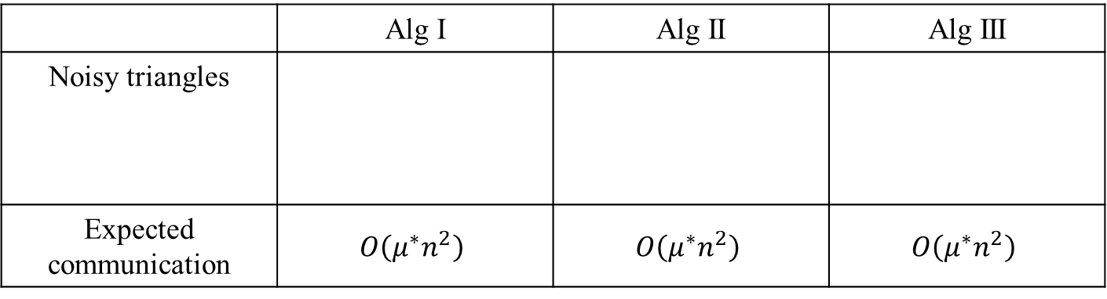







1st Round
2nd Round
noisy edges (ARR)
#noisy triangles + post-processing
User $v_{1}$
User $v_{1}$
Server
Server
User $v_{n}$
User $v_{n}$
noisy edges (ARR)
 | Alg I | Alg II | Alg III
Noisy triangles
Expected communication | $$O\left(μ^{∗}n^{2}\right)$$ | $$O\left(μ^{∗}n^{2}\right)$$ | $$O\left(μ^{∗}n^{2}\right)$$
$$v_{i}$$
$$v_{i}$$
$$v_{i}$$
original edges
noisy edges
$$v_{j}$$
$$v_{k}$$
$$v_{j}$$
$$v_{k}$$
$$v_{j}$$
$$v_{k}$$
($μ^{∗}=μ, μ^{2},μ^{3}$ in Alg I, II, III)

Slide 26





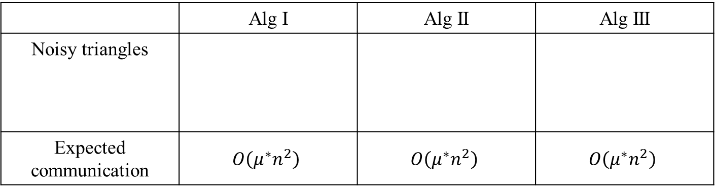









1st Round
noisy edges of $v_{i}$ (ARR)
User $v_{i}$
Server
noisy edges between others
2nd Round
#noisy triangles of $v_{i}$ + post-processing + Lap
User $v_{i}$
Server
 | Alg I | Alg II | Alg III
Noisy triangles
Expected communication | $$O\left(μ^{∗}n^{2}\right)$$ | $$O\left(μ^{∗}n^{2}\right)$$ | $$O\left(μ^{∗}n^{2}\right)$$
$$v_{i}$$
$$v_{i}$$
$$v_{i}$$
original edges
noisy edges
$$v_{j}$$
$$v_{k}$$
$$v_{j}$$
$$v_{k}$$
$$v_{j}$$
$$v_{k}$$
($μ^{∗}=μ, μ^{2},μ^{3}$ in Alg I, II, III)

Slide 27




ARR (Asymmetric RR)
1st Round
1
$$μ$$
1
$$1−μ$$
noisy edges (ARR)
$$μρ$$
User $v_{i}$
Server
0
$$1−μρ$$
0
2nd Round
noisy edges between others
User $v_{i}$
Server
#noisy triangles + post-processing + Lap
 | Alg I | Alg II | Alg III
Noisy triangles
Expected communication | $$O\left(μ^{∗}n^{2}\right)$$ | $$O\left(μ^{∗}n^{2}\right)$$ | $$O\left(μ^{∗}n^{2}\right)$$
$$v_{i}$$
$$v_{i}$$
$$v_{i}$$
original edges
noisy edges
$$v_{j}$$
$$v_{k}$$
$$v_{j}$$
$$v_{k}$$
$$v_{j}$$
$$v_{k}$$
($μ^{∗}=μ, μ^{2},μ^{3}$ in Alg I, II, III)

Slide 28










ARR (Asymmetric RR)
1st Round
1
$$μ$$
1
$$1−μ$$
noisy edges (ARR)
$$μρ$$
User $v_{i}$
Server
0
$$1−μρ$$
0
Noisy Triangles
2nd Round
$$v_{i}$$
noisy edges between others
original edges
User $v_{i}$
Server
noisy edges
#noisy triangles + post-processing + Lap
$$v_{j}$$
$$v_{k}$$
$$μ∈\left[0,1\right]$$
$$ρ=e^{−ε_{1}}$$

Slide 29









1st Round
ARR (Asymmetric RR)
1
$$μ$$
1
noisy edges (ARR)
$$1−μ$$
User $v_{i}$
Server
$$μρ$$
0
$$1−μρ$$
0
2nd Round
Noisy Triangles
noisy edges between others
$$v_{i}$$
User $v_{i}$
Server
original edges
#noisy triangles + post-processing + Lap
noisy edges
$$v_{j}$$
$$v_{k}$$

Slide 30






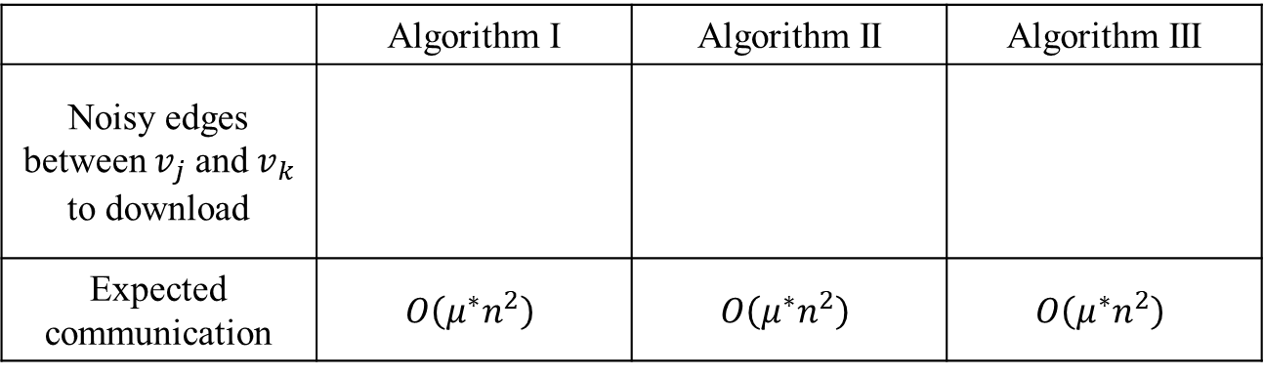














1st Round
ARR (Asymmetric RR)
1
$$μ$$
1
noisy edges (ARR)
$$1−μ$$
User $v_{i}$
Server
$$μρ$$
0
$$1−μρ$$
0
2nd Round
Noisy Triangles
noisy edges between $v_{j}$ and $v_{k}$
$$v_{i}$$
User $v_{i}$
Server
original edges
#noisy triangles + post-processing + Lap
noisy edges
$$v_{j}$$
$$v_{k}$$
 | Algorithm I | Algorithm II | Algorithm III
Noisy edges between $v_{j}$ and $v_{k}$ to download
Expected communication | $$O\left(μ^{∗}n^{2}\right)$$ | $$O\left(μ^{∗}n^{2}\right)$$ | $$O\left(μ^{∗}n^{2}\right)$$
$$v_{i}$$
$$v_{i}$$
$$v_{i}$$
$$v_{j}$$
$$v_{k}$$
$$v_{j}$$
$$v_{k}$$
$$v_{j}$$
$$v_{k}$$
($μ^{∗}=μ, μ^{2},μ^{3}$ in Algorithms I, II, III)

Slide 31
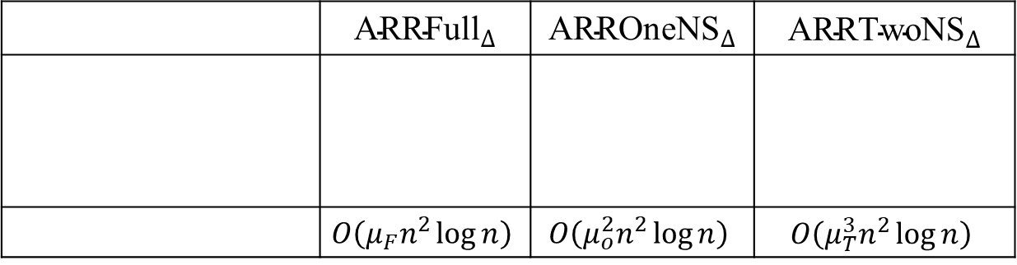
 | $${\text{ARRFull}}_{∆}$$ | $${\text{ARR}\text{OneNS}}_{∆}$$ | $${\text{ARR}\text{TwoNS}}_{∆}$$
 | $$O\left(μ_{F}n^{2}\log{n}\right)$$ | $$O\left(μ_{o}^{2}n^{2}\log{n}\right)$$ | $$O\left(μ_{T}^{3}n^{2}\log{n}\right)$$
$$v_{i}$$
$$v_{i}$$
$$v_{i}$$
Noisy edges between others ($v_{j}$ and $v_{k}$) to DL
$$v_{j}$$
$$v_{k}$$
$$v_{j}$$
$$v_{k}$$
$$v_{j}$$
$$v_{k}$$
Expected DL size

Slide 32
















Original Graph | Algorithm I | Algorithm II | Algorithm III
$$v_{i}$$
$$v_{i}$$
$$v_{i}$$
$$v_{i}$$
$$v_{j}$$
$$v_{k}$$
$$v_{j}$$
$$v_{k}$$
$$v_{j}$$
$$v_{k}$$
$$v_{j}$$
$$v_{k}$$
$$v_{i^{′}}$$
$$v_{i^{′}}$$
$$v_{i^{′}}$$
$$v_{i^{′}}$$

Slide 33



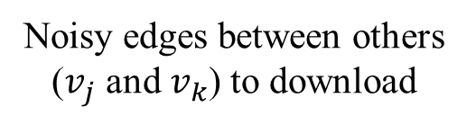
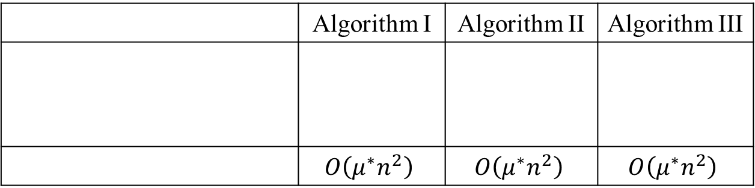






 | Algorithm I | Algorithm II | Algorithm III
 | $$O\left(μ^{∗}n^{2}\right)$$ | $$O\left(μ^{∗}n^{2}\right)$$ | $$O\left(μ^{∗}n^{2}\right)$$
Noisy edges between others ($v_{j}$ and $v_{k}$) to download
$$v_{i}$$
$$v_{i}$$
$$v_{i}$$
noisy edges
$$v_{j}$$
$$v_{k}$$
$$v_{j}$$
$$v_{k}$$
$$v_{j}$$
$$v_{k}$$
Expected communication
($μ^{∗}=μ$, $μ^{2}$, and $μ^{3}$ in Algorithms I, II, and III, respectively.)

Slide 34
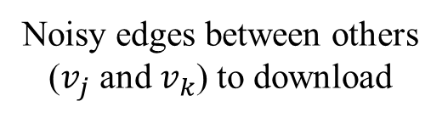
 | Algorithm I | Algorithm II | Algorithm III
 | $$O\left(μ^{∗}n^{2}\right)$$ | $$O\left(μ^{∗}n^{2}\right)$$ | $$O\left(μ^{∗}n^{2}\right)$$
$$v_{i}$$
$$v_{i}$$
$$v_{i}$$
Noisy edges between others ($v_{j}$ and $v_{k}$) to download
$$v_{j}$$
$$v_{k}$$
$$v_{j}$$
$$v_{k}$$
$$v_{j}$$
$$v_{k}$$
Expected communication
($μ^{∗}=μ$, $μ^{2}$, and $μ^{3}$ in Algorithms I, II, and III, respectively.)

Slide 35












Original Graph | Algorithm I | Algorithm II | Algorithm III
$$v_{i}$$
$$v_{i}$$
$$v_{i}$$
$$v_{i}$$
original edges
$$v_{j}$$
$$v_{k}$$
$$v_{j}$$
$$v_{k}$$
$$v_{j}$$
$$v_{k}$$
$$v_{j}$$
$$v_{k}$$
noisy edges
$$v_{i^{′}}$$
$$v_{i^{′}}$$
$$v_{i^{′}}$$
$$v_{i^{′}}$$

Slide 36


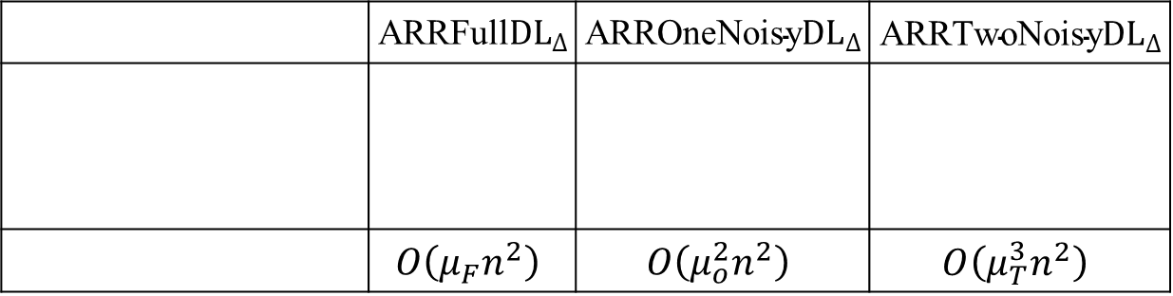

 | $${\text{ARRFull}DL}_{∆}$$ | $${\text{ARR}\text{OneNoisy}DL}_{∆}$$ | $${\text{ARR}\text{TwoNoisy}DL}_{∆}$$
 | $$O\left(μ_{F}n^{2}\right)$$ | $$O\left(μ_{o}^{2}n^{2}\right)$$ | $$O\left(μ_{T}^{3}n^{2}\right)$$
$$v_{i}$$
$$v_{i}$$
$$v_{i}$$
Noisy edges between others ($v_{j}$ and $v_{k}$) to DL
$$v_{j}$$
$$v_{k}$$
$$v_{j}$$
$$v_{k}$$
$$v_{j}$$
$$v_{k}$$
Expected DL size

Slide 37
















Original Graph
Algorithm I
Algorithm II
Algorithm III
$$v_{i}$$
$$v_{i}$$
$$v_{i}$$
$$v_{i}$$
$$v_{j}$$
$$v_{k}$$
$$v_{j}$$
$$v_{k}$$
$$v_{j}$$
$$v_{k}$$
$$v_{j}$$
$$v_{k}$$
$$v_{i^{′}}$$
$$v_{i^{′}}$$
$$v_{i^{′}}$$
$$v_{i^{′}}$$
original edges
noisy edges

Slide 38






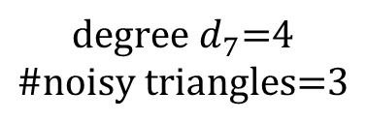










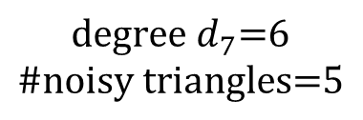

$$v_{7}$$
$$v_{6}$$
$$v_{7}$$
$$v_{6}$$
$$v_{1}$$
$$v_{5}$$
$$v_{1}$$
$$v_{5}$$
$$v_{2}$$
$$v_{4}$$
$$v_{2}$$
$$v_{4}$$
(1)
(2)
$$\text{\#}\text{noisy} \text{triangles}\text{=2}$$
$$v_{3}$$
$$v_{3}$$
$$\text{degree} d_{7}\text{=}\text{6}$$
$$\text{\#}\text{noisy} \text{triangles}\text{=5}$$
$$\text{degree} d_{7}\text{=}\text{4}$$
$$\text{\#}\text{noisy} \text{triangles}\text{=3}$$
(1) adaptive edge clipping (${\tilde{d}}_{7}=4$)
(2) noisy triangle clipping ($κ_{7}=2$)

Slide 39















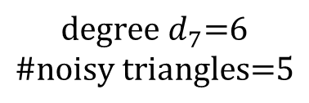

$$v_{7}$$
$$v_{6}$$
$$v_{7}$$
$$v_{6}$$
$$v_{5}$$
$$v_{5}$$
$$v_{1}$$
$$v_{4}$$
$$v_{1}$$
$$v_{4}$$
$$v_{3}$$
(1)
$$v_{3}$$
(2)
$$\text{\#}\text{noisy} \text{triangles}\text{=2}$$
$$v_{2}$$
$$v_{2}$$
$$\text{degree} d_{7}\text{=}\text{6}$$
$$\text{\#}\text{noisy} \text{triangles}\text{=5}$$
$$\text{degree} d_{7}\text{=}\text{4}$$
$$\text{\#}\text{noisy} \text{triangles}\text{=3}$$
(1) adaptive edge clipping (${\tilde{d}}_{7}=4.2$)
(2) noisy triangle clipping ($κ_{7}=2.1$)

Slide 40


$$v_{7}$$
$$v_{6}$$
$$v_{7}$$
$$v_{6}$$
$$v_{5}$$
$$v_{5}$$
$$v_{1}$$
$$v_{4}$$
$$v_{1}$$
$$v_{4}$$
$$v_{3}$$
(1)
$$v_{3}$$
(2)
$$\text{\#}\text{noisy} \text{triangles}\text{=2}$$
$$v_{2}$$
$$v_{2}$$
$$\text{degree} d_{7}\text{=}\text{6}$$
$$\text{\#}\text{noisy} \text{triangles}\text{=5}$$
$$\text{degree} d_{7}\text{=}\text{4}$$
$$\text{\#}\text{noisy} \text{triangles}\text{=3}$$
(1) adaptive edge clipping (${\tilde{d}}_{7}=4.2$)
(2) noisy triangle clipping ($κ_{7}=2.5$)

Slide 41
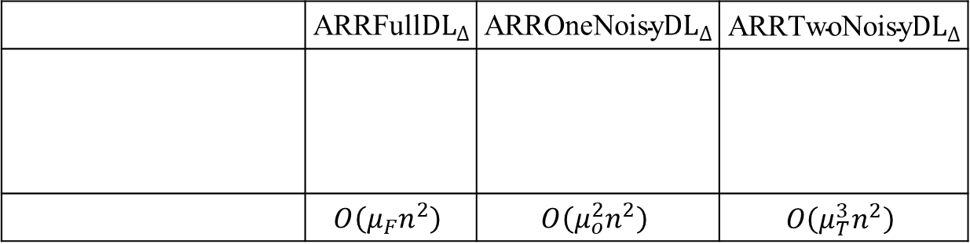
 | $${\text{ARRFull}DL}_{∆}$$ | $${\text{ARR}\text{OneNoisy}DL}_{∆}$$ | $${\text{ARR}\text{TwoNoisy}DL}_{∆}$$
 | $$O\left(μ_{F}n^{2}\right)$$ | $$O\left(μ_{o}^{2}n^{2}\right)$$ | $$O\left(μ_{T}^{3}n^{2}\right)$$
$$v_{i}$$
$$v_{i}$$
$$v_{i}$$
Noisy edges between others ($v_{j}$ and $v_{k}$) to DL
$$v_{j}$$
$$v_{k}$$
$$v_{j}$$
$$v_{k}$$
$$v_{j}$$
$$v_{k}$$
Expected DL size

Slide 42



Original Graph
$${\text{ARRFull}DL}_{∆}$$
$${\text{ARR}\text{OneNoisy}DL}_{∆}$$
$${\text{ARR}\text{TwoNoisy}DL}_{∆}$$
$$v_{i}$$
$$v_{i}$$
$$v_{i}$$
$$v_{i}$$
$$v_{j}$$
$$v_{k}$$
$$v_{j}$$
$$v_{k}$$
$$v_{j}$$
$$v_{k}$$
$$v_{j}$$
$$v_{k}$$
$$v_{i^{′}}$$
$$v_{i^{′}}$$
$$v_{i^{′}}$$
$$v_{i^{′}}$$
original edges
noisy edges

Slide 43



$${\text{ARRFull}DL}_{∆}$$
$${\text{ARR}\text{OneNoisy}DL}_{∆}$$
$${\text{ARR}\text{TwoNoisy}DL}_{∆}$$
$$v_{i}$$
$$v_{i}$$
$$v_{i}$$
$$v_{l}$$
$$v_{l}$$
$$v_{l}$$
$$v_{j}$$
$$v_{k}$$
$$v_{j}$$
$$v_{k}$$
$$v_{j}$$
$$v_{k}$$
$$v_{m}$$
$$v_{m}$$
$$v_{m}$$
original edges
noisy edges

Slide 44




















(a) Gplus ($μ_{F}={10}^{−3}$)
(b) IMDB ($μ_{F}={10}^{−3}$)
1
1
$${\text{ARRFull}DL}_{∆}$$
$${\text{ARRFull}DL}_{∆}$$
$${\text{ARR}\text{OneNoisy}DL}_{∆}$$
$${\text{ARR}\text{OneNoisy}DL}_{∆}$$
$${\text{ARR}\text{TwoNoisy}DL}_{∆}$$
$${\text{ARR}\text{TwoNoisy}DL}_{∆}$$
10⁻¹
10⁻¹
Relative Error
Relative Error
10⁻²
10⁻²
10⁻³
10⁻³
0
0.5
1
1.5
2
0
0.5
1
1.5
2
$$ε_{1}$$
$$ε_{1}$$
(c) Gplus ($ε_{1}=1$)
(d) IMDB ($ε_{1}=1$)
10
10
$${\text{ARRFull}DL}_{∆}$$
$${\text{ARRFull}DL}_{∆}$$
1
$${\text{ARR}\text{OneNoisy}DL}_{∆}$$
1
$${\text{ARR}\text{OneNoisy}DL}_{∆}$$
$${\text{ARR}\text{TwoNoisy}DL}_{∆}$$
$${\text{ARR}\text{TwoNoisy}DL}_{∆}$$
10⁻¹
10⁻¹
Relative Error
Relative Error
10⁻²
10⁻²
10⁻³
10⁻³
10⁻⁴
10⁻⁴
10⁻⁶
10⁻⁵
10⁻⁴
10⁻³
10⁻²
10⁻¹
1
10⁻⁶
10⁻⁵
10⁻⁴
10⁻³
10⁻²
10⁻¹
1
$$μ_{F}(=μ_{O}^{2}=μ_{T}^{3})$$
$$μ_{F}(=μ_{O}^{2}=μ_{T}^{3})$$

Slide 45







$${\text{ARRFull}DL}_{∆} (DC)$$
$${\text{ARR}\text{OneNoisy}DL}_{∆} (DC)$$
$${\text{ARR}\text{TwoNoisy}DL}_{∆} (DC)$$
0.08
0.05
0.04
0.02
0.06
0.04
0.03
0.015
0.03
Relative Error
0.02
0.01
0.04
0.02
0.02
0.01
0.01
0.005
0
0
0
0
Gplus ($ε=1$)
Gplus ($ε=2$)
IMDB ($ε=1$)
IMDB ($ε=2$)

Slide 46
















$${\text{ARRFull}DL}_{∆} (DC)$$
$${\text{ARRFull}DL}_{∆} (d_{max})$$
$${\text{ARR}\text{OneNoisy}DL}_{∆} (DC)$$
$${\text{ARR}\text{OneNoisy}DL}_{∆} (d_{max})$$
$${\text{ARR}\text{OneNoisy}DL}_{∆} (DC)$$
$${\text{ARR}\text{OneNoisy}DL}_{∆} (d_{max})$$
(a) Gplus ($μ_{F}={10}^{−3}$)
(b) IMDB ($μ_{F}={10}^{−3}$)
10³
10⁴
10²
10³
10
10²
10
1
Relative Error
Relative Error
1
10⁻¹
10⁻¹
10⁻²
10⁻²
10⁻³
10⁻³
0
0.5
1
1.5
2
0
0.5
1
1.5
2
$$ε$$
$$ε$$
(c) Gplus ($ε=1$)
(d) IMDB ($ε=1$)
10⁴
10⁵
10³
$${\text{RRFull}DL}_{∆} (d_{max})$$
10⁴
$${\text{RRFull}DL}_{∆} (d_{max})$$
10³
10²
10²
10
10
Relative Error
Relative Error
1
1
10⁻¹
10⁻¹
10⁻²
10⁻²
10⁻³
10⁻³
10⁻⁴
10⁻⁶
10⁻⁵
10⁻⁴
10⁻³
10⁻²
10⁻¹
1
10⁻⁶
10⁻⁵
10⁻⁴
10⁻³
10⁻²
10⁻¹
1
$$μ_{F}(=μ_{O}^{2}=μ_{T}^{3})$$
$$μ_{F}(=μ_{O}^{2}=μ_{T}^{3})$$
10M
100M
1G
10G
100G
1T
10T
100K
1M
10M
100M
1G
10G
100G
$${Cost}_{DL} (bits)$$
$${Cost}_{DL} (bits)$$

Slide 47











$${\text{ARRFull}DL}_{∆} (d_{max})$$
$${\text{ARR}\text{OneNoisy}DL}_{∆} (d_{max})$$
$${\text{ARR}\text{TwoNoisy}DL}_{∆} (d_{max})$$
$${\text{ARRFull}DL}_{∆} (EC)$$
$${\text{ARR}\text{OneNoisy}DL}_{∆} (EC)$$
$${\text{ARR}\text{TwoNoisy}DL}_{∆} (EC)$$
$${\text{ARRFull}DL}_{∆} (DC)$$
$${\text{ARR}\text{OneNoisy}DL}_{∆} (DC)$$
$${\text{ARR}\text{TwoNoisy}DL}_{∆} (DC)$$
(a) Gplus
(b) IMDB
10⁴
10⁵
10³
10⁴
10²
10³
10²
10
Relative Error
Relative Error
10
1
1
10⁻¹
10⁻¹
10⁻²
10⁻²
10⁻⁶
10⁻³
10⁻⁶
10⁻³
$$μ_{F}(=μ_{O}^{2}=μ_{T}^{3})$$
$$μ_{F}(=μ_{O}^{2}=μ_{T}^{3})$$

Slide 48





(a) Gplus
(b) IMDB
10²
10
$${\text{ARRFull}DL}_{∆}$$
$${\text{ARRFull}DL}_{∆}$$
$${\text{ARR}\text{OneNoisy}DL}_{∆}$$
$${\text{ARR}\text{OneNoisy}DL}_{∆}$$
10
$${\text{ARR}\text{TwoNoisy}DL}_{∆}$$
$${\text{ARR}\text{TwoNoisy}DL}_{∆}$$
1
Relative Error
Relative Error
1
10⁻¹
10⁻¹
10⁻²
10⁻²
0
2
4
6
8
10
12
0
1
2
3
4
5
6
7
8
9
$$n (×{10}^{4})$$
$$n (×{10}^{5})$$

Slide 49












16
$${10}^{13}$$
12
IMDB
$${10}^{12}$$
IMDB
8
$$C_{4}$$
$${10}^{11}$$
$d_{max}$ $(×{10}^{3})$
$${10}^{10}$$
4
$${10}^{9}$$
0
$${10}^{8}$$
0
0
1
2
3
4
5
6
7
8
9
1
2
3
4
5
6
7
8
9
$$n (×{10}^{5})$$
$$n (×{10}^{5})$$
16
$${10}^{13}$$
12
IMDB
$${10}^{12}$$
IMDB
8
$$C_{4}$$
$${10}^{11}$$
$d_{max}$ $(×{10}^{3})$
$${10}^{10}$$
4
$${10}^{9}$$
0
$${10}^{8}$$
0
0
1
2
3
4
5
6
7
8
9
1
2
3
4
5
6
7
8
9
$$n (×{10}^{5})$$
$$n (×{10}^{5})$$

Slide 50






(a) Gplus ($μ_{F}={10}^{−3}$)
(b) IMDB ($μ_{F}={10}^{−3}$)
1
1
$${\text{ARRFull}}_{∆}$$
$${\text{ARRFull}}_{∆}$$
$${\text{ARR}\text{OneNS}}_{∆}$$
$${\text{ARR}\text{OneNS}}_{∆}$$
$${\text{ARR}\text{TwoNS}}_{∆}$$
$${\text{ARR}\text{TwoNS}}_{∆}$$
10⁻¹
10⁻¹
Relative Error
Relative Error
10⁻²
10⁻²
10⁻³
10⁻³
0
0.5
1
1.5
2
0
0.5
1
1.5
2
$$ε_{1}$$
$$ε_{1}$$
(c) Gplus ($ε_{1}=1$)
(d) IMDB ($ε_{1}=1$)
10
10
$${\text{ARRFull}}_{∆}$$
$${\text{ARRFull}}_{∆}$$
1
$${\text{ARR}\text{OneNS}}_{∆}$$
1
$${\text{ARR}\text{OneNS}}_{∆}$$
$${\text{ARR}\text{TwoNS}}_{∆}$$
$${\text{ARR}\text{TwoNS}}_{∆}$$
10⁻¹
10⁻¹
Relative Error
Relative Error
10⁻²
10⁻²
10⁻³
10⁻³
10⁻⁴
10⁻⁴
10⁻⁶
10⁻⁵
10⁻⁴
10⁻³
10⁻²
10⁻¹
1
10⁻⁶
10⁻⁵
10⁻⁴
10⁻³
10⁻²
10⁻¹
1
$$μ_{F}(=μ_{O}^{2}=μ_{T}^{3})$$
$$μ_{F}(=μ_{O}^{2}=μ_{T}^{3})$$

Slide 51








$${\text{ARRFull}}_{∆} (DC)$$
$${\text{ARRFull}}_{∆} (d_{max})$$
$${\text{ARR}\text{OneNS}}_{∆} (DC)$$
$${\text{ARR}\text{OneNS}}_{∆} (d_{max})$$
$${\text{ARR}\text{TwoNS}}_{∆} (DC)$$
$${\text{ARR}\text{TwoNS}}_{∆} (d_{max})$$
(a) Gplus ($μ_{F}={10}^{−3}$)
(b) IMDB ($μ_{F}={10}^{−3}$)
10³
10⁴
10²
10³
10
10²
10
1
Relative Error
Relative Error
1
10⁻¹
10⁻¹
10⁻²
10⁻²
10⁻³
10⁻³
0
0.5
1
1.5
2
0
0.5
1
1.5
2
$$ε$$
$$ε$$
(c) Gplus ($ε=1$)
(d) IMDB ($ε=1$)
10⁴
10⁵
10³
$${\text{RRFull}}_{∆} (d_{max})$$
10⁴
$${\text{RRFull}}_{∆} (d_{max})$$
10³
10²
10²
10
10
Relative Error
Relative Error
1
1
10⁻¹
10⁻¹
10⁻²
10⁻²
10⁻³
10⁻³
10⁻⁴
10⁻⁶
10⁻⁵
10⁻⁴
10⁻³
10⁻²
10⁻¹
1
10⁻⁶
10⁻⁵
10⁻⁴
10⁻³
10⁻²
10⁻¹
1
$$μ_{F}(=μ_{O}^{2}=μ_{T}^{3})$$
$$μ_{F}(=μ_{O}^{2}=μ_{T}^{3})$$
100K
1M
10M
100M
1G
10G
100G
10M
100M
1G
10G
100G
1T
10T
$${Cost}_{DL} (bits)$$
(6G)
$${Cost}_{DL} (bits)$$
(400G)

Slide 52
$${\text{ARRFull}}_{∆} (d_{max})$$
$${\text{ARR}\text{OneNS}}_{∆} (d_{max})$$
$${\text{ARR}\text{TwoNS}}_{∆} (d_{max})$$
$${\text{ARRFull}}_{∆} (EC)$$
$${\text{ARR}\text{OneNS}}_{∆} (EC)$$
$${\text{ARR}\text{TwoNS}}_{∆} (EC)$$
$${\text{ARRFull}}_{∆} (DC)$$
$${\text{ARR}\text{OneNS}}_{∆} (DC)$$
$${\text{ARR}\text{TwoNS}}_{∆} (DC)$$
(a) Gplus
(b) IMDB
10⁴
10⁵
10³
10⁴
10²
10³
10²
10
Relative Error
Relative Error
10
1
1
10⁻¹
10⁻¹
10⁻²
10⁻²
10⁻⁶
10⁻³
10⁻⁶
10⁻³
$$μ_{F}(=μ_{O}^{2}=μ_{T}^{3})$$
$$μ_{F}(=μ_{O}^{2}=μ_{T}^{3})$$

Slide 53



#triangles
#2-stars
clustering coefficient
(a) Gplus ($μ_{F}={10}^{−3}$)
(b) IMDB ($μ_{F}={10}^{−3}$)
10
1
1
10⁻¹
10⁻¹
10⁻²
10⁻²
Relative Error
Relative Error
10⁻³
10⁻³
10⁻⁴
10⁻⁴
10⁻⁵
10⁻⁵
10⁻⁶
10⁻⁶
0
0.5
1
1.5
2
0
0.5
1
1.5
2
$$ε$$
$$ε$$
(c) Gplus ($ε=1$)
(d) IMDB ($ε=1$)
10
10
1
1
10⁻¹
10⁻¹
10⁻²
10⁻²
Relative Error
Relative Error
10⁻³
10⁻³
10⁻⁴
10⁻⁴
10⁻⁵
10⁻⁵
10⁻⁶
10⁻⁶
10⁻⁵
10⁻⁴
10⁻³
10⁻²
10⁻¹
1
10⁻⁶
10⁻⁵
10⁻⁴
10⁻³
10⁻²
10⁻¹
1
$$μ_{F}(=μ_{O}^{2}=μ_{T}^{3})$$
$$μ_{F}(=μ_{O}^{2}=μ_{T}^{3})$$

Slide 54


$$\text{ARR}\text{ (}\text{unbiased}\text{)}$$
$${\text{ARRFull}}_{∆} (DC)$$
$${\text{ARR}\text{OneNS}}_{∆} (DC)$$
$${\text{ARR}\text{TwoNS}}_{∆} (DC)$$
10⁵
10⁷
10⁴
10⁶
10⁵
10³
10⁴
10²
10³
Relative Error
Relative Error
10
10²
1
10
1
10⁻¹
10⁻¹
10⁻²
10⁻²
10⁻⁶
10⁻³
10⁻⁶
10⁻³
$$μ_{F}(=μ_{O}^{2}=μ_{T}^{3})$$
$$μ_{F}(=μ_{O}^{2}=μ_{T}^{3})$$

Slide 55


$${\text{ARRFull}}_{∆} (DC)$$
$${\text{ARRFull}}_{∆} (d_{max})$$
$${\text{ARR}\text{OneNS}}_{∆} (DC)$$
$${\text{ARR}\text{OneNS}}_{∆} (d_{max})$$
$${\text{ARR}\text{TwoNS}}_{∆} (DC)$$
$${\text{ARR}\text{TwoNS}}_{∆} (d_{max})$$
(a) Gplus ($μ^{∗}={10}^{−3}$)
(b) IMDB ($μ^{∗}={10}^{−3}$)
10³
10⁴
10²
10³
10
10²
10
1
Relative Error
Relative Error
1
10⁻¹
10⁻¹
10⁻²
10⁻²
10⁻³
10⁻³
0
0.5
1
1.5
2
0
0.5
1
1.5
2
$$ε$$
$$ε$$
(c) Gplus ($ε=1$)
(d) IMDB ($ε=1$)
10⁴
10⁵
10³
$${\text{RRFull}}_{∆} (d_{max})$$
10⁴
$${\text{RRFull}}_{∆} (d_{max})$$
10³
10²
10²
10
10
Relative Error
Relative Error
1
1
10⁻¹
10⁻¹
10⁻²
10⁻²
10⁻³
10⁻³
10⁻⁴
10⁻⁶
10⁻⁵
10⁻⁴
10⁻³
10⁻²
10⁻¹
1
10⁻⁶
10⁻⁵
10⁻⁴
10⁻³
10⁻²
10⁻¹
1
$$μ^{∗}$$
$$μ^{∗}$$
100K
1M
10M
100M
1G
10G
100G
10M
100M
1G
10G
100G
1T
10T
$${Cost}_{DL} (bits)$$
(6G)
$${Cost}_{DL} (bits)$$
(400G)

Slide 56


#triangles
#2-stars
clustering coefficient
(a) Gplus ($μ^{∗}={10}^{−3}$)
(b) IMDB (${μ^{∗}=10}^{−3}$)
10
1
1
10⁻¹
10⁻¹
10⁻²
10⁻²
Relative Error
Relative Error
10⁻³
10⁻³
10⁻⁴
10⁻⁴
10⁻⁵
10⁻⁵
10⁻⁶
10⁻⁶
0
0.5
1
1.5
2
0
0.5
1
1.5
2
$$ε$$
$$ε$$
(c) Gplus ($ε=1$)
(d) IMDB ($ε=1$)
10
10
1
1
10⁻¹
10⁻¹
10⁻²
10⁻²
Relative Error
Relative Error
10⁻³
10⁻³
10⁻⁴
10⁻⁴
10⁻⁵
10⁻⁵
10⁻⁶
10⁻⁶
10⁻⁵
10⁻⁴
10⁻³
10⁻²
10⁻¹
1
10⁻⁶
10⁻⁵
10⁻⁴
10⁻³
10⁻²
10⁻¹
1
$$μ^{∗}$$
$$μ^{∗}$$
100K
1M
10M
100M
1G
10G
100G
10M
100M
1G
10G
100G
1T
10T
$${Cost}_{DL} (bits)$$
(6G)
$${Cost}_{DL} (bits)$$
(400G)

Slide 57
$${\text{ARRFull}}_{∆} (DC)$$
$${\text{ARR}\text{OneNS}}_{∆} (DC)$$
$${\text{ARR}\text{TwoNS}}_{∆} (DC)$$
0.08
0.05
0.04
0.02
0.06
0.04
0.03
0.015
0.03
Relative Error
0.02
0.01
0.04
0.02
0.02
0.01
0.01
0.005
0
0
0
0
Gplus ($ε=1$)
Gplus ($ε=2$)
IMDB ($ε=1$)
IMDB ($ε=2$)

Slide 58


(a) Gplus ($μ^{∗}={10}^{−3}$)
(b) IMDB ($μ^{∗}={10}^{−3}$)
1
1
$${\text{ARRFull}}_{∆}$$
$${\text{ARRFull}}_{∆}$$
$${\text{ARR}\text{OneNS}}_{∆}$$
$${\text{ARR}\text{OneNS}}_{∆}$$
$${\text{ARR}\text{TwoNS}}_{∆}$$
$${\text{ARR}\text{TwoNS}}_{∆}$$
10⁻¹
10⁻¹
Relative Error
Relative Error
10⁻²
10⁻²
10⁻³
10⁻³
0
0.5
1
1.5
2
0
0.5
1
1.5
2
$$ε_{1}$$
$$ε_{1}$$
(c) Gplus ($ε_{1}=1$)
(d) IMDB ($ε_{1}=1$)
10
10
$${\text{ARRFull}}_{∆}$$
$${\text{ARRFull}}_{∆}$$
1
$${\text{ARR}\text{OneNS}}_{∆}$$
1
$${\text{ARR}\text{OneNS}}_{∆}$$
$${\text{ARR}\text{TwoNS}}_{∆}$$
$${\text{ARR}\text{TwoNS}}_{∆}$$
10⁻¹
10⁻¹
Relative Error
Relative Error
10⁻²
10⁻²
10⁻³
10⁻³
10⁻⁴
10⁻⁴
10⁻⁶
10⁻⁵
10⁻⁴
10⁻³
10⁻²
10⁻¹
1
10⁻⁶
10⁻⁵
10⁻⁴
10⁻³
10⁻²
10⁻¹
1
$$μ^{∗}$$
$$μ^{∗}$$

Slide 59
(a) Gplus
(b) IMDB
10²
10
$${\text{ARRFull}}_{∆}$$
$${\text{ARRFull}}_{∆}$$
$${\text{ARR}\text{OneNS}}_{∆}$$
$${\text{ARR}\text{OneNS}}_{∆}$$
10
$${\text{ARR}\text{TwoNS}}_{∆}$$
$${\text{ARR}\text{TwoNS}}_{∆}$$
1
Relative Error
Relative Error
1
10⁻¹
10⁻¹
10⁻²
10⁻²
0
2
4
6
8
10
12
0
1
2
3
4
5
6
7
8
9
$$n (×{10}^{4})$$
$$n (×{10}^{5})$$

