Slide 1








$$v_{1}$$
$$v_{5}$$
#triangles = 5
$$v_{7}$$
$$v_{2}$$
$$v_{3}$$
#2-stars = 28
$$v_{4}$$
$$v_{6}$$
$$v_{8}$$
#4-cycles = 3

Slide 2








User
Neighbor list
Randomizer
$$v_{1}$$
$$a\text{1}∈{\{0,1\}}^{n}$$
$$ℛ$$
obfuscated data
shuffled data
Data collector
Shuffler
$$v_{n}$$
$$a\text{n}∈{\{0,1\}}^{n}$$
$$ℛ$$
obfuscated data
$ε_{L}$-LDP
$(ε,δ)$-DP

Slide 3






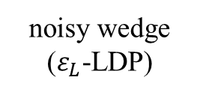



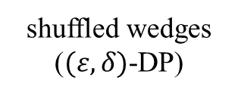






$$v_{k}$$
$$v_{π(1)}$$
$$v_{π(2)}$$
$$v_{π(3)}$$
$$v_{π(4)}$$
$$v_{π(n−2)}$$
otherwise
$$v_{i}$$
$$v_{j}$$
$$1$$
$$0$$
$$v_{i}$$
$$v_{j}$$
User
Wedge indicator
noisy wedge ($ε_{L}$-LDP)
shuffled wedges ($(ε,δ)$-DP)
$$v_{k}$$
$$w_{i−k−j}∈\{0,1\}$$
$$RR$$
Shuffler
Data collector

Slide 4











$$v_{k}$$
User
Wedge indicator
Wedge information (small noise)
noisy wedge ($ε_{L}$-LDP)
shuffled wedges ($(ε,δ)$-DP)
$$v_{i}$$
$$v_{j}$$
$$v_{k}$$
$$w_{i−k−j}∈\{0,1\}$$
$$RR$$
Shuffler
User
Edge indicator
Data collector
Edge information (large noise)
$$v_{i}$$
$$a_{i,j}∈\{0,1\}$$
$$RR$$
noisy edge ($ε$-LDP)
$$v_{j}$$
$$a_{j,i}∈\{0,1\}$$
$$RR$$
noisy edge($ε$-LDP)

Slide 5
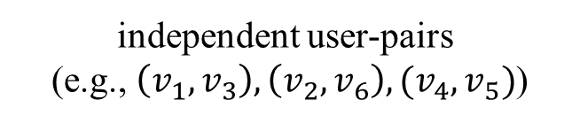
independent user-pairs (e.g., $\left(v_{1},v_{3}\right),\left(v_{2},v_{6}\right),(v_{4},v_{5})$)
Data collector
Users
shuffled wedges + noisy edges

Slide 6
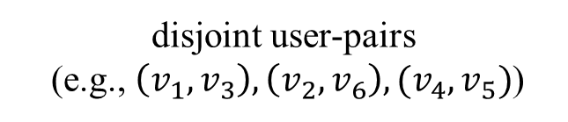
disjoint user-pairs (e.g., $\left(v_{1},v_{3}\right),\left(v_{2},v_{6}\right),(v_{4},v_{5})$)
Data collector
Users
shuffled wedges + noisy edges

Slide 7












(a) Triangles
${WShuffle}_{△}^{∗}$ (w/o Lap)
$${WShuffle}_{△}^{∗}$$
$${WShuffle}_{△}$$
$${WLocal}_{△}$$
$${ARR}_{△} (p_{0}=n^{−1/3})$$
$${ARR}_{△} (p_{0}=n^{−1/3}/10)$$
10⁷
10⁷
10⁶
Gplus
10⁶
IMDB
10⁵
10⁵
10⁴
10⁴
Relative Error
Relative Error
10³
10³
10²
10²
10
10
1
1
10⁻¹
10⁻¹
0
0.2
0.4
0.6
0.8
1
1.2
1.4
1.6
1.8
2
0
0.2
0.4
0.6
0.8
1
1.2
1.4
1.6
1.8
2
$$ε$$
$$ε$$
(b) 4-Cycles
$$WShuffle$$
$$WLocal$$
10⁴
10⁴
10³
Gplus
10³
IMDB
10²
10²
Relative Error
Relative Error
10
10
1
1
10⁻¹
10⁻¹
0
0.2
0.4
0.6
0.8
1
1.2
1.4
1.6
1.8
2
0
0.2
0.4
0.6
0.8
1
1.2
1.4
1.6
1.8
2
$$ε$$
$$ε$$

Slide 8




(a) Triangles
${WShuffle}_{△}^{∗}$ (w/o Lap)
$${WShuffle}_{△}^{∗}$$
$${WShuffle}_{△}$$
$${WLocal}_{△}$$
$${ARR}_{△} (p_{0}=n^{−1/3})$$
$${ARR}_{△} (p_{0}=n^{−1/3}/10)$$
10⁷
10⁷
10⁶
Gplus
10⁶
IMDB
10⁵
10⁵
10⁴
10⁴
Relative Error
Relative Error
10³
10³
10²
10²
10
10
1
1
10⁻¹
10⁻¹
0
2
4
6
8
10
12
0
2
4
6
8
10
$$n(×{10}^{4})$$
$$n(×{10}^{5})$$
(b) 4-Cycles
$$WShuffle$$
$$WLocal$$
10⁶
10⁶
10⁵
Gplus
10⁵
IMDB
10⁴
10⁴
10³
10³
Relative Error
Relative Error
10²
10²
10
10
1
1
10⁻¹
10⁻¹
0
2
4
6
8
10
12
0
2
4
6
8
10
$$n(×{10}^{4})$$
$$n(×{10}^{5})$$

Slide 9










(a) $ε=0.1$
$${WShuffle}_{△}^{∗}$$
$${WShuffle}_{△}$$
30
30
25
Gplus
25
IMDB
20
20
Relative Error
Relative Error
15
15
10
10
5
5
0
0.5
1
1.5
2
3
3.5
4
0
0.5
1
1.5
2
3
3.5
4
0
2.5
0
2.5
$$c$$
$$c$$
(b) $ε=1$
$${WShuffle}_{△}^{∗}$$
$${WShuffle}_{△}$$
0.6
0.6
Gplus
0.5
0.5
Relative Error
Relative Error
0.4
0.4
0.3
0.3
IMDB
0.2
0.5
1
1.5
2
3
3.5
4
0.2
0.5
1
1.5
2
3
3.5
4
0
2.5
0
2.5
$$c$$
$$c$$

Slide 10








$${WShuffle}_{△}^{∗}$$
$${WShuffle}_{△}^{∗}$$
$2R$-${Small}_{△}$ (DL cost = 1.8M bits)
$2R$-${Small}_{△}$ (DL cost = 18M bits)
$2R$-${Large}_{△}$ (DL cost = 6G bits)
$2R$-${Large}_{△}$ (DL cost = 400G bits)
10³
10³
10²
Gplus
10²
IMDB
10
10
1
1
Relative Error
Relative Error
10⁻¹
10⁻¹
10⁻²
10⁻²
10⁻³
10⁻³
10⁻⁴
0.2
0.4
0.6
0.8
1
1.2
1.4
1.6
1.8
2
10⁻⁴
0.2
0.4
0.6
0.8
1
1.2
1.4
1.6
1.8
2
0
0
$$ε$$
$$ε$$

Slide 11








${WShuffle}_{△}^{∗}$ (numerical)
${WShuffle}_{△}^{∗}$ (closed form)
${WShuffle}_{△}$ (numerical)
${WShuffle}_{△}$ (closed form)
$$WShuffle$$
(numerical)
$$WShuffle$$
(closed form)
10²
10²
Gplus
IMDB
10
10
Relative Error
Relative Error
1
1
0.1
1.6
1.8
2
0.1
0.6
0.8
1.2
1.4
1.6
1.8
2
0
0.2
0.4
0.6
0.8
1
1.2
1.4
0
0.2
0.4
1
$$ε$$
$$ε$$

Slide 12

triangles
2-stars
clustering coefficient
10²
10²
10
10
1
1
10⁻¹
10⁻¹
Relative Error
Relative Error
10⁻²
Gplus
10⁻²
IMDB
10⁻³
10⁻³
10⁻⁴
10⁻⁴
10⁻⁵
10⁻⁵
10⁻⁶
0.2
0.4
0.6
0.8
1
1.2
1.4
1.6
1.8
2
10⁻⁶
0.2
0.4
0.6
0.8
1
1.2
1.4
1.6
1.8
2
0
0
$$ε$$
$$ε$$

Slide 13
















(a) Triangles
${WShuffle}_{△}^{∗}$ (w/o Lap)
$${WShuffle}_{△}^{∗}$$
$${WShuffle}_{△}$$
$${WLocal}_{△}$$
$${ARR}_{△} (p_{0}=n^{−1/3})$$
$${ARR}_{△} (p_{0}=n^{−1/3}/10)$$
10⁸
10⁸
10⁷
$$m=100$$
10⁷
$$m=200$$
10⁶
10⁶
10⁵
10⁵
10⁴
10⁴
Relative Error
Relative Error
10³
10³
10²
10²
10
10
1
1
10⁻¹
10⁻¹
0
0.2
0.4
0.6
0.8
1
1.2
1.4
1.6
1.8
2
0
0.2
0.4
0.6
0.8
1
1.2
1.4
1.6
1.8
2
$$ε$$
$$ε$$
(b) 4-Cycles
$$WShuffle$$
$$WLocal$$
10⁵
10⁵
10⁴
$$m=100$$
10⁴
$$m=200$$
10³
10³
10²
10²
Relative Error
Relative Error
10
10
1
1
10⁻¹
10⁻¹
10⁻²
10⁻²
0
0.2
0.4
0.6
0.8
1
1.2
1.4
1.6
1.8
2
0
0.2
0.4
0.6
0.8
1
1.2
1.4
1.6
1.8
2
$$ε$$
$$ε$$

Slide 14
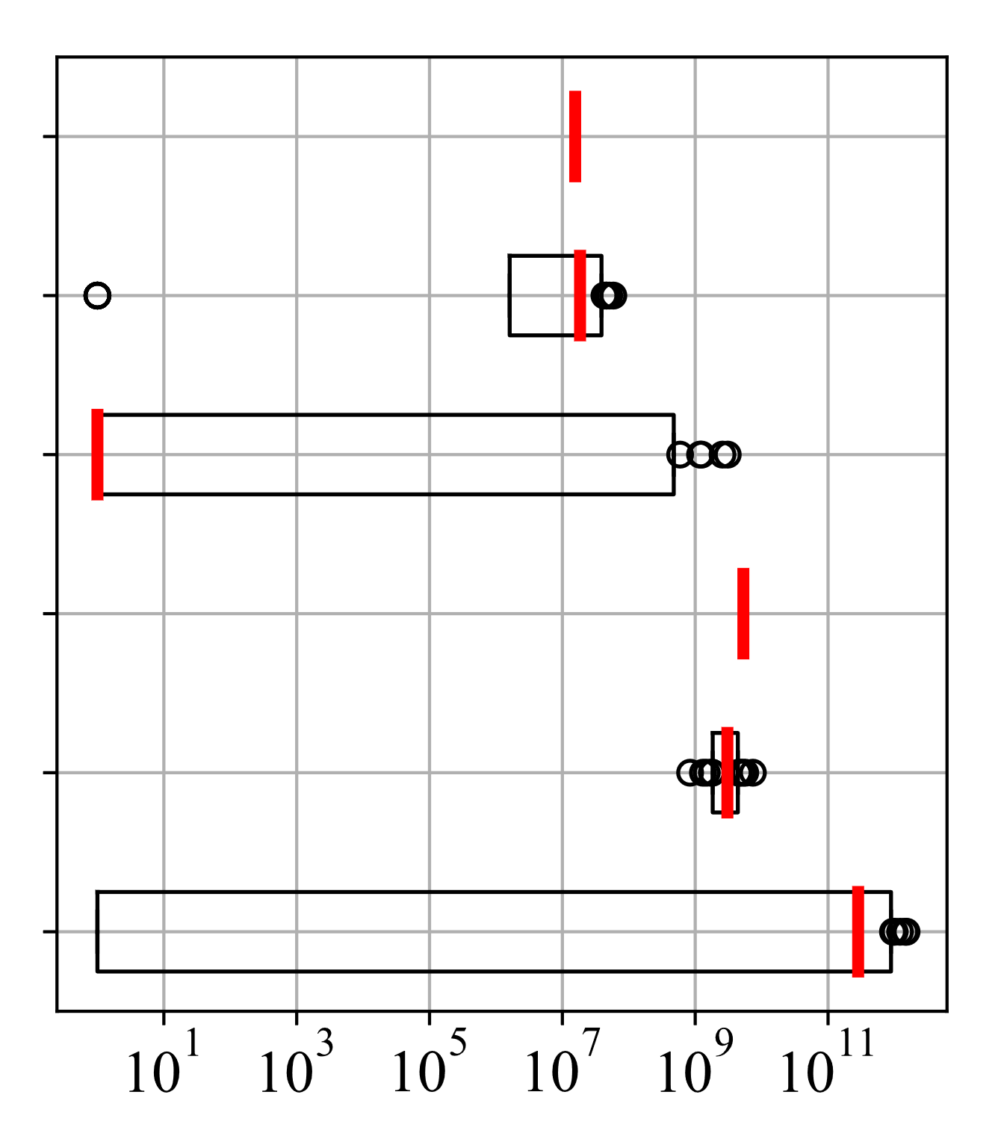
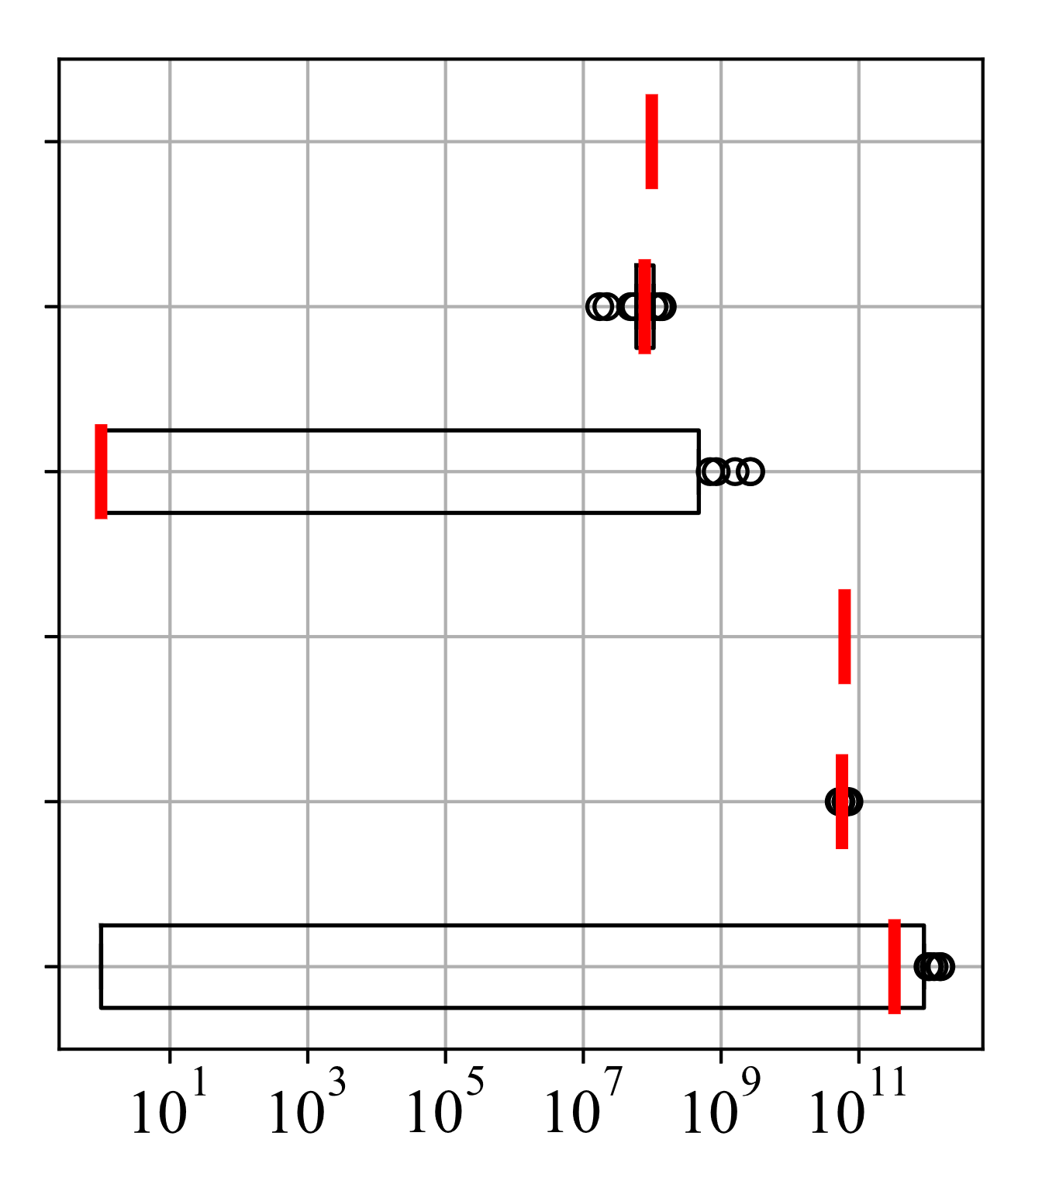








(a) $m=100 (ε=1)$
(b) $m=200 (ε=1)$
$$\#Triangles$$
$${WShuffle}_{△}^{∗}$$
$${WLocal}_{△}$$
$\#4$-$Cycles$
$$WShuffle$$
$$WLocal$$
Count/Estimate
Count/Estimate

Slide 15




$$WShuffle$$
$$WLocal$$
10⁵
10⁵
10⁴
Bipartite Gplus
10⁴
Bipartite IMDB
10³
10³
Relative Error
Relative Error
10²
10²
10
10
1
1
10⁻¹
10⁻¹
0
0.2
0.4
0.6
0.8
1
1.2
1.4
1.6
1.8
2
0
0.2
0.4
0.6
0.8
1
1.2
1.4
1.6
1.8
2
$$ε$$
$$ε$$

Slide 16
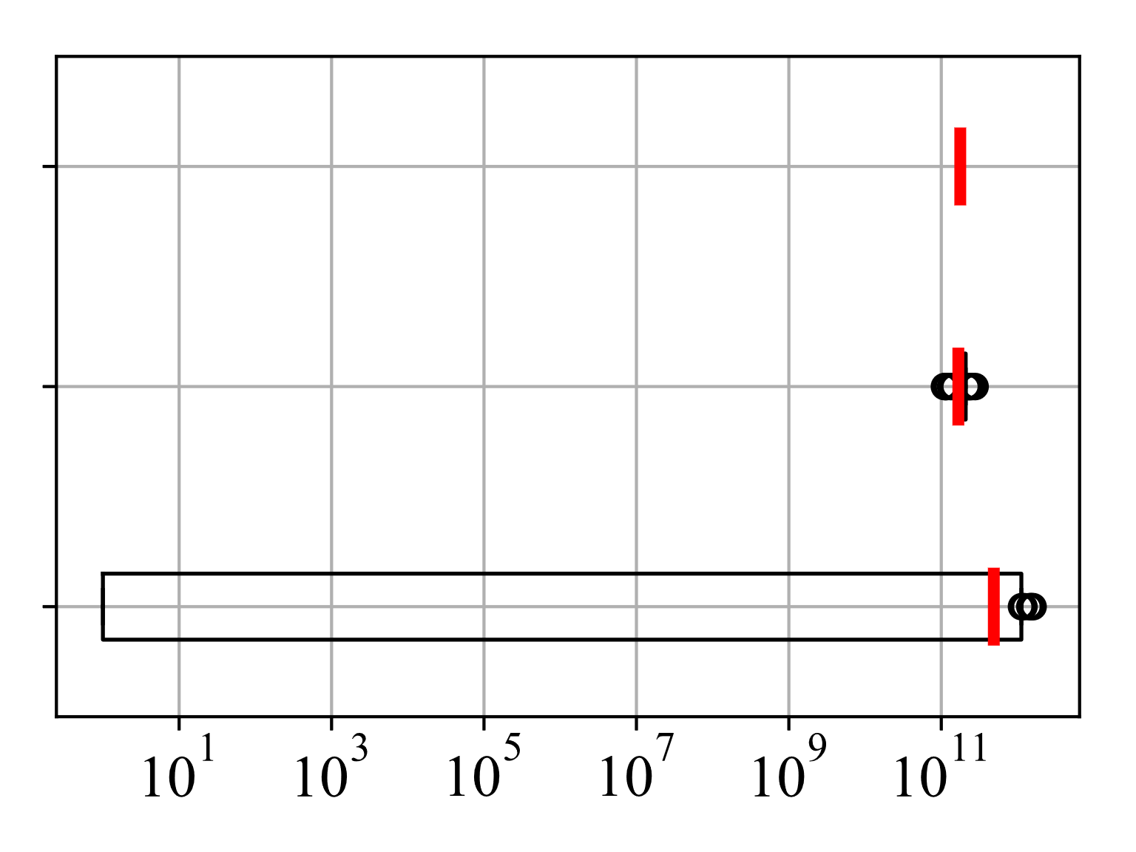
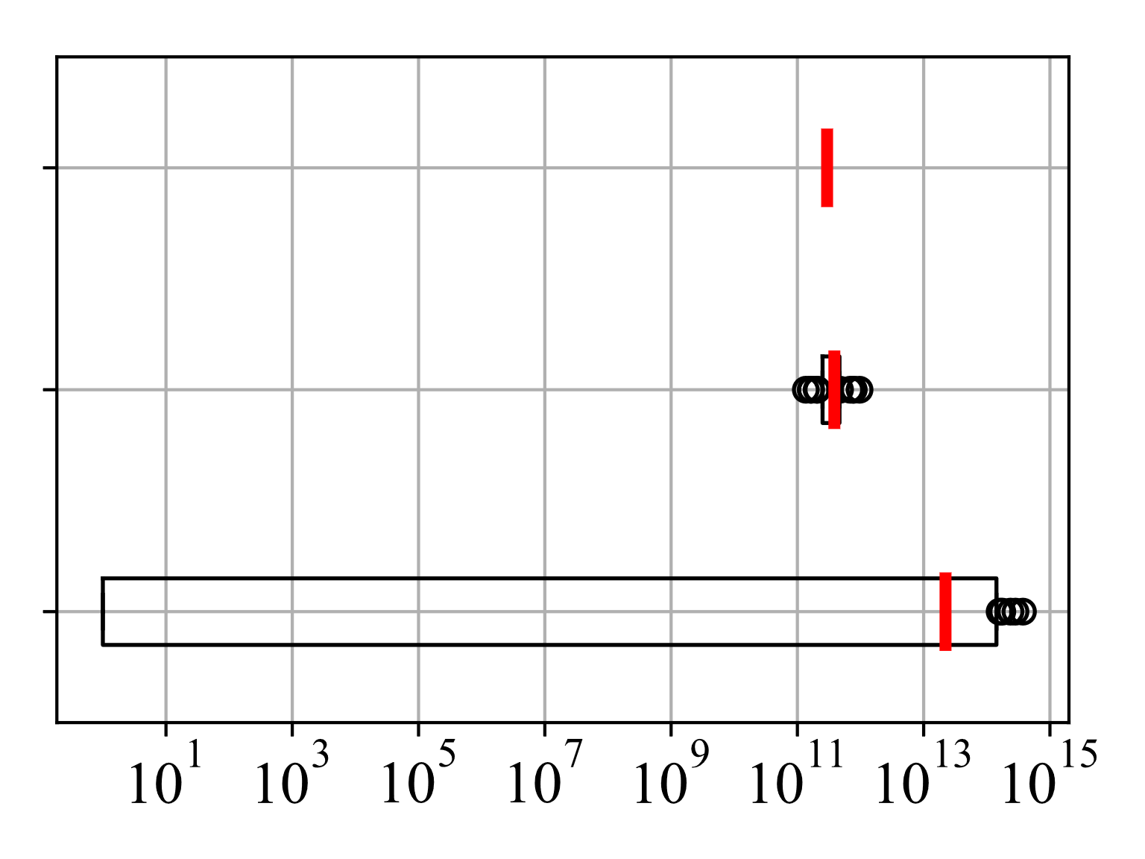





(a) Bipartite Gplus $(ε=1)$
(b) Bipartite IMDB $(ε=1)$
$\#4$-$Cycles$
$$WShuffle$$
$$WLocal$$
Count/Estimate
Count/Estimate

Slide 17
Back Up

Slide 18














Randomizer ($ε_{L}$-LDP)
User
Neighbor list
$$v_{1}$$
$$x_{1}$$
Data collector
$$a\text{1}∈{\{0,1\}}^{n}$$
$$ℛ$$
$$ℛ\text{(}x_{1}\text{)}$$
$$ℛ\text{(}x_{π(1)}\text{)}\text{, }…,ℛ\text{(}x_{π(n)}\text{)}$$
Shuffler
Shuffler
$$v_{n}$$
$$x_{n}$$
$$a\text{n}∈{\{0,1\}}^{n}$$
$$ℛ$$
$$ℛ\text{(}x_{n}\text{)}$$
$ε_{L}$-LDP
$(ε,δ)$-DP

Slide 19







User
Randomizer
$$v_{1}$$
$$x_{1}$$
$$ℛ$$
$$ℛ\text{(}x_{1}\text{)}$$
$$ℛ\text{(}x_{π(1)}\text{)}\text{, }…,ℛ\text{(}x_{π(n)}\text{)}$$
Data collector
Shuffler
$$v_{n}$$
$$x_{n}$$
$$ℛ$$
$$ℛ\text{(}x_{n}\text{)}$$
$ε_{L}$-LDP
$(ε,δ)$-DP

Slide 20



User
Randomizer
$$v_{1}$$
$$x_{1}$$
$$ℛ$$
$$y_{1}$$
$$y_{π(1)}\text{,}…,y_{π(n)}$$
Data collector
Shuffler
$$v_{n}$$
$$x_{n}$$
$$ℛ$$
$$y_{n}$$
$ε_{L}$-LDP
$(ε,δ)$-DP

Slide 21







User
Neighbor list
Randomizer
$$v_{1}$$
$$x_{1}$$
$$a\text{1}∈{\{0,1\}}^{n}$$
$$ℛ$$
$$y_{1}$$
$$y_{π(1)}\text{,}…,y_{π(n)}$$
Data collector
Shuffler
$$x_{n}$$
$$y_{n}$$
$$v_{n}$$
$$a\text{n}∈{\{0,1\}}^{n}$$
$$ℛ$$
$ε_{L}$-LDP
$(ε,δ)$-DP

Slide 22







User
Neighbor list
Randomizer
$$v_{1}$$
$$x_{1}$$
$$a\text{1}∈{\{0,1\}}^{n}$$
$$ℛ$$
$$y_{1}$$
$$y_{π(1)}\text{,}…,y_{π(n)}$$
Data collector
Shuffler
$$v_{n}$$
$$x_{n}$$
$$y_{n}$$
$$a\text{n}∈{\{0,1\}}^{n}$$
$$ℛ$$
$ε_{L}$-LDP
$(ε,δ)$-DP

Slide 23


User
Input data
Randomizer
$$v_{1}$$
$$x_{1}$$
$$ℛ$$
$$y_{1}$$
$$y_{π(1)}\text{,}…,y_{π(n)}$$
Data collector
Shuffler
$$v_{n}$$
$$y_{n}$$
$$x_{n}$$
$$ℛ$$
$ε_{L}$-LDP
$(ε,δ)$-DP

Slide 24
User
Neighbor list
Randomizer
$$v_{1}$$
$$a\text{1}∈{\{0,1\}}^{n}$$
$$ℛ$$
$$y_{1}$$
$$y_{π(1)}\text{,}…,y_{π(n)}$$
Data collector
Shuffler
$$v_{n}$$
$$y_{n}$$
$$a\text{n}∈{\{0,1\}}^{n}$$
$$ℛ$$
$ε_{L}$-LDP
$(ε,δ)$-DP

Slide 25








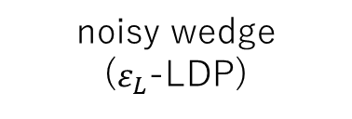

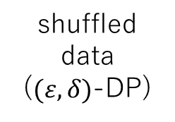






Wedge Information (Small Noise)
$$v_{k}$$
user
wedge
shuffler
noisy wedge ($ε_{L}$-LDP)
shuffled data ($(ε,δ)$-DP)
$$v_{i}$$
$$v_{j}$$
$$v_{k}$$
$$w_{i−k−j}∈\{0,1\}$$
$$RR$$
data collector
edge
Edge Information (Large Noise)
$$v_{i}$$
$$a_{i,j}∈\{0,1\}$$
$$RR$$
noisy edge ($ε$-LDP)
$$v_{j}$$
$$a_{j,i}∈\{0,1\}$$
$$RR$$
noisy edge($ε$-LDP)

Slide 26












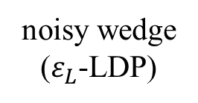





$$v_{k}$$
otherwise
$$v_{i}$$
$$v_{j}$$
$$1$$
$$0$$
Wedge Information (Small Noise)
$$v_{k}$$
User
Wedge
noisy wedge ($ε_{L}$-LDP)
shuffled wedges ($(ε,δ)$-DP)
$$v_{i}$$
$$v_{j}$$
$$v_{k}$$
$$w_{i−k−j}∈\{0,1\}$$
$$RR$$
Shuffler
Data collector
User
Edge
Edge Information (Large Noise)
$$v_{i}$$
$$a_{i,j}∈\{0,1\}$$
$$RR$$
noisy edge ($ε$-LDP)
$$v_{j}$$
$$a_{j,i}∈\{0,1\}$$
$$RR$$
noisy edge($ε$-LDP)

Slide 27





$$v_{k}$$
otherwise
$$v_{k}$$
$$v_{i}$$
$$v_{j}$$
$$1$$
$$0$$
Wedge Information (Small Noise)
$$v_{i}$$
$$v_{j}$$
User
Wedge
noisy wedge ($ε_{L}$-LDP)
shuffled wedges ($(ε,δ)$-DP)
$$v_{k}$$
$$w_{i−k−j}∈\{0,1\}$$
$$RR$$
Shuffler
Data collector
User
Edge
Edge Information (Large Noise)
$$v_{i}$$
$$a_{i,j}∈\{0,1\}$$
$$RR$$
noisy edge ($ε$-LDP)
$$v_{j}$$
$$a_{j,i}∈\{0,1\}$$
$$RR$$
noisy edge($ε$-LDP)

Slide 28


$$v_{k}$$
otherwise
$$v_{k}$$
$$v_{i}$$
$$v_{j}$$
$$1$$
$$0$$
Wedge information (small noise)
$$v_{i}$$
$$v_{j}$$
User
Wedge indicator
noisy wedge ($ε_{L}$-LDP)
shuffled wedges ($(ε,δ)$-DP)
$$v_{k}$$
$$w_{i−k−j}∈\{0,1\}$$
$$RR$$
Shuffler
Data collector
User
Edge indicator
Edge information (large noise)
$$v_{i}$$
$$a_{i,j}∈\{0,1\}$$
$$RR$$
noisy edge ($ε$-LDP)
$$v_{j}$$
$$a_{j,i}∈\{0,1\}$$
$$RR$$
noisy edge($ε$-LDP)

Slide 29



$$v_{k}$$
Wedge information (small noise)
User
Wedge indicator
noisy wedge ($ε_{L}$-LDP)
shuffled wedges ($(ε,δ)$-DP)
$$v_{i}$$
$$v_{j}$$
$$v_{k}$$
$$w_{i−k−j}∈\{0,1\}$$
$$RR$$
Shuffler
Data collector
User
Edge indicator
Edge information (large noise)
$$v_{i}$$
$$a_{i,j}∈\{0,1\}$$
$$RR$$
noisy edge ($ε$-LDP)
$$v_{j}$$
$$a_{j,i}∈\{0,1\}$$
$$RR$$
noisy edge($ε$-LDP)

Slide 30









Graph $G$
$$v_{1}$$
$$v_{5}$$
$$v_{7}$$
independent pairs of nodes
Data collector
$$v_{4}$$
Users
shuffled wedges + noisy edges
$$v_{2}$$
$$v_{8}$$
$$v_{3}$$
$$v_{6}$$
independent edges

Slide 31
independent pairs of nodes
Data collector
Users
shuffled wedges + noisy edges

Slide 32








10⁷
${WShuffle}_{△}^{∗}$ (w/o Lap)
10⁷
10⁶
$${WShuffle}_{△}^{∗}$$
10⁶
10⁵
$${WShuffle}_{△}$$
10⁵
$${WLocal}_{△}$$
10⁴
$${ARR}_{△} (p_{0}=n^{−1/3})$$
10⁴
$${ARR}_{△} (p_{0}=0.1n^{−1/3})$$
Relative Error
Relative Error
10³
10³
10²
10²
10
10
1
1
10⁻¹
10⁻¹
0
0.2
0.4
0.6
0.8
1
1.2
1.4
1.6
1.8
2
0
0.2
0.4
0.6
0.8
1
1.2
1.4
1.6
1.8
2
$$ε$$
$$ε$$

Slide 33






${WShuffle}_{△}^{∗}$ (w/o Lap)
$${WShuffle}_{△}^{∗}$$
$${WShuffle}_{△}$$
$${WLocal}_{△}$$
$${ARR}_{△} (p_{0}=n^{−1/3})$$
$${ARR}_{△} (p_{0}=n^{−1/3}/10)$$
(a) Gplus
(b) IMDB
10⁷
10⁷
10⁶
10⁶
10⁵
10⁵
10⁴
10⁴
Relative Error
Relative Error
10³
10³
10²
10²
10
10
1
1
10⁻¹
10⁻¹
0
0.2
0.4
0.6
0.8
1
1.2
1.4
1.6
1.8
2
0
0.2
0.4
0.6
0.8
1
1.2
1.4
1.6
1.8
2
$$ε$$
$$ε$$

Slide 34








(a) $ε=0.1$
(b) $ε=1$
25
0.6
$$Gplus$$
$$Gplus$$
20
$$IMDB$$
0.5
$$IMDB$$
15
Relative Error
Relative Error
0.4
10
5
0.3
0
0.2
0
0.5
1
1.5
2
2.5
3
3.5
4
0
0.5
1
1.5
2
2.5
3
3.5
4
$$c$$
$$c$$

