Slide 1
REVIEW BOARD
Getting Started with Code Review
Jim Priest
SRA International
December 7th, 2009

Slide 2
What is code review?
”Code review is systematic examination ( often as peer review) of computer source code intended to find and fix mistakes overlooked in the initial development phase, improving both the overall quality of software and the developers’ skills.” – Wikipedia
Why do code review?
Jeff Atwood (Coding Horror) says: "I believe that peer code reviews are the single biggest thing you can do to improve your code."
Steve McConnell author of Code Complete says "...software testing alone has limited effectiveness -- the average defect detection rate is only 25 percent for unit testing, 35 percent for function testing, and 45 percent for integration testing. In contrast, the average effectiveness of design and code inspections are 55 and 60 percent."

Slide 3
Contributors assume their code is fine, but...
Bugs are often overseen by the contributor!
Benefits…
More eyes is better.
Design errors are caught early before implemented.
Senior developers helps less experienced developers by sharing their knowledge. Everyone learns and everyone teaches!
Silo busting – code review exposes more people to more code.
“The Ego Effect” - Code is written better when you know somebody is going to look at it…

Slide 4
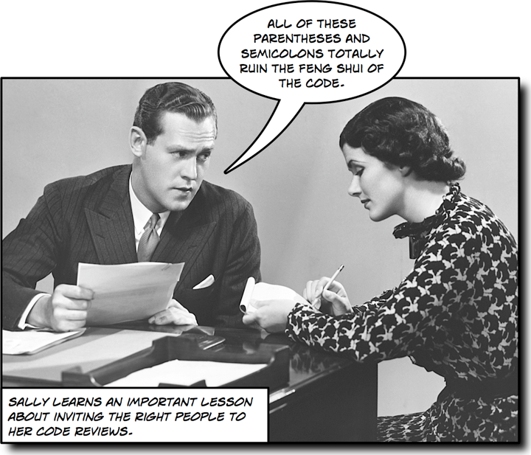

Slide 5

Formal Code Review Alternatives
Over-the-shoulder: Just like it sounds.

Slide 6
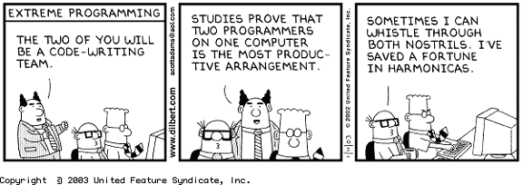
Formal Code Review Alternatives
Pair Programming

Slide 7
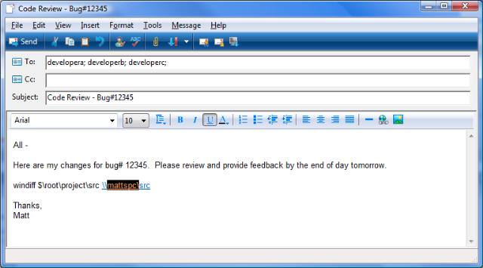
Formal Code Review Alternatives
Email

Slide 8
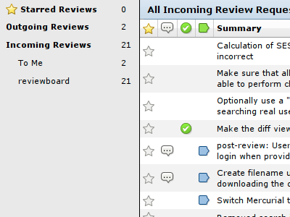
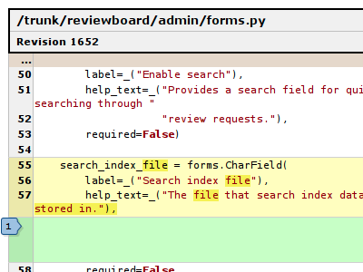
Formal Code Review Alternatives
Tool assisted – web based tools help you collaborate

Slide 9
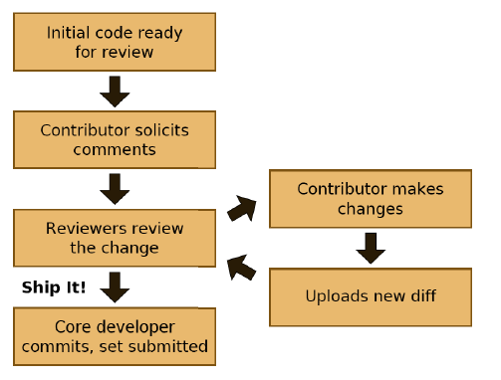
Code Review with Review Board

Slide 10
Code Review with Review Board
Some Rules

Slide 11

Code Review with Review Board
It's Not Personal

Slide 12
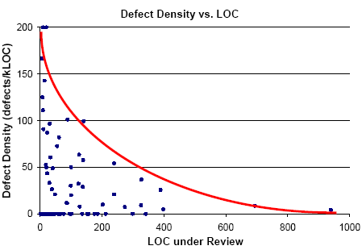
Code Review with Review Board
Don't Review Too Much

Slide 13
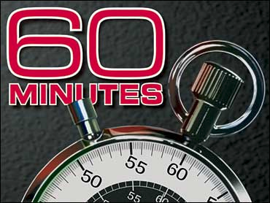
Code Review with Review Board
Don't Review Too Long

Slide 14
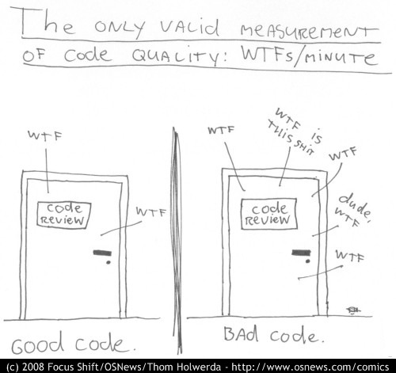
Code Review with Review Board
More on wiki...

