Slide 1

Jim Priest
SRA International

Slide 2
Prepare to be wowed
Who is Atlassian?
Confluence Overview
Why A Wiki?
Agenda
Live Demonstration
Plugins
Q & A

Slide 3
Who are those Atlassian guys?
Who is Atlassian?
Confluence Overview
Why A Wiki?
Agenda
Live Demonstration
Plugins
Q & A

Slide 4

Who are those Atlassian guys?
Who is Atlassian?
Global software company
  Offices in Sydney, San Francisco & Amsterdam
One of the world’s fastest growing software companies
Over 12,500 customers in more than 105 countries
Founded in 2002 > self-funded > always profitable
Partner Network for professional services
Highly transparent and open

Slide 5
What’s this thing called Confluence?
Who is Atlassian?
Confluence Overview
Why A Wiki?
Agenda
Live Demonstration
Plugins
Q & A

Slide 6
What’s this thing called Confluence?
Confluence Overview
We could not find a tool for our own needs
Designed for the needs of enterprise
World’s most popular commercial enterprise wiki
Best aspects of open source
Surprisingly-practical platform

Slide 7

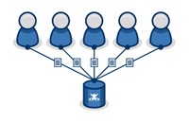
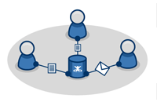
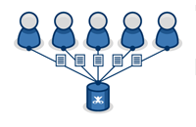
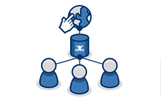
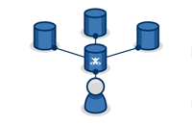
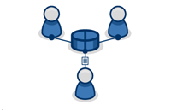
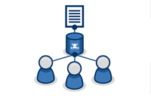
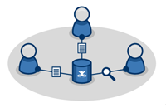
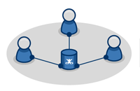
An intranet that people actually use
One Application. Many Uses.
Knowledge Management
Collaboration
Intranet
Intranet
Web Publishing
Business Intelligence
Extranet
Documentation
Shared Drives
Reducing Emails

Slide 8
How does it all work?
Architecture
Web-based application
  No client software headaches
  Operating system independent
Open Architecture
  Supports for variety of application and database servers
  SOAP and XML RPC Interfaces
  Java API
  Source code access for commercial/academic license holders
  Plugin sub-system

Slide 9
















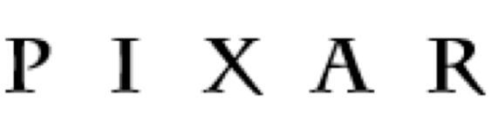














Over 6,000 customers in more than 100 countries
Who uses Confluence?

Slide 10




Confluence is the Über wiki
Confluence Concepts
Dashboard
Intranet
space
Website
space
Intranet
space
Partners
space
HR
space
Sales
space
FAQ
personal
space !

Slide 11





Private or public. It’s your choice
Confluence Concepts
Intranet
Public
Space
Private
Space
(top secret info)

Slide 12









Content, content and more content
Confluence Concepts
What can I put on a page?
Intranet
Images
Bookmarks
Attachments
Comments
Labels
Charts
RSS Feeds
Videos
Diagrams
Spreadsheets

Slide 13
Confluence the chameleon
Who is Atlassian?
Confluence Overview
Why A Wiki?
Agenda
Live Demonstration
Plugins
Q & A

Slide 14

10,000,000 Articles…
Why A Wiki?
Notes:
"Wiki“ is a Hawaiian word for "fast".
10 Million + articles on Wikipedia (created in 2001)
Community driven!
First wiki - WikiWikiWeb in 1994
684 million visitors yearly by 2008
There are more than 75,000 active contributors
10,000,000 articles
260 languages

Slide 15

Flexibility!
Why A Wiki?
Intranet

Slide 16

Your content!! Community Driven!
Why A Wiki?
Notes:
"Wiki“ is a Hawaiian word for "fast".
10 Million + articles on Wikipedia (created in 2001)
Community driven!
First wiki - WikiWikiWeb in 1994
684 million visitors yearly by 2008
There are more than 75,000 active contributors
10,000,000 articles
260 languages

Slide 17
Prepare to be wowed
Who is Atlassian?
Confluence Overview
Live Confluence Sites
Agenda
Live Demonstration
Plugins
Q & A

Slide 18
Over 350 plugins...
Who is Atlassian?
Confluence Overview
Live Confluence Sites
Agenda
Live Demonstration
Plugins
Q & A

Slide 19
Fire away
Who is Atlassian?
Confluence Overview
Live Confluence Sites
Agenda
Live Demonstration
Plugins
Q & A

