Slide 1

Jim Priest
SRA International

Slide 2
Let’s have some fun
Who is Atlassian?
JIRA Overview
JIRA Concepts
Agenda
Effective JIRA Issues
Live Demonstration
Q & A

Slide 3
Who is Atlassian?
JIRA Overview
JIRA Concepts
Agenda
Effective JIRA Issues
Live Demonstration
Q & A
Who are those Atlassian guys?

Slide 4

Who are those Atlassian guys?
Who Is Atlassian?
Global software company
Over 12,500 customers in more than 105 countries
Founded in 2002 > self-funded > always profitable
Highly transparent and open

Slide 5
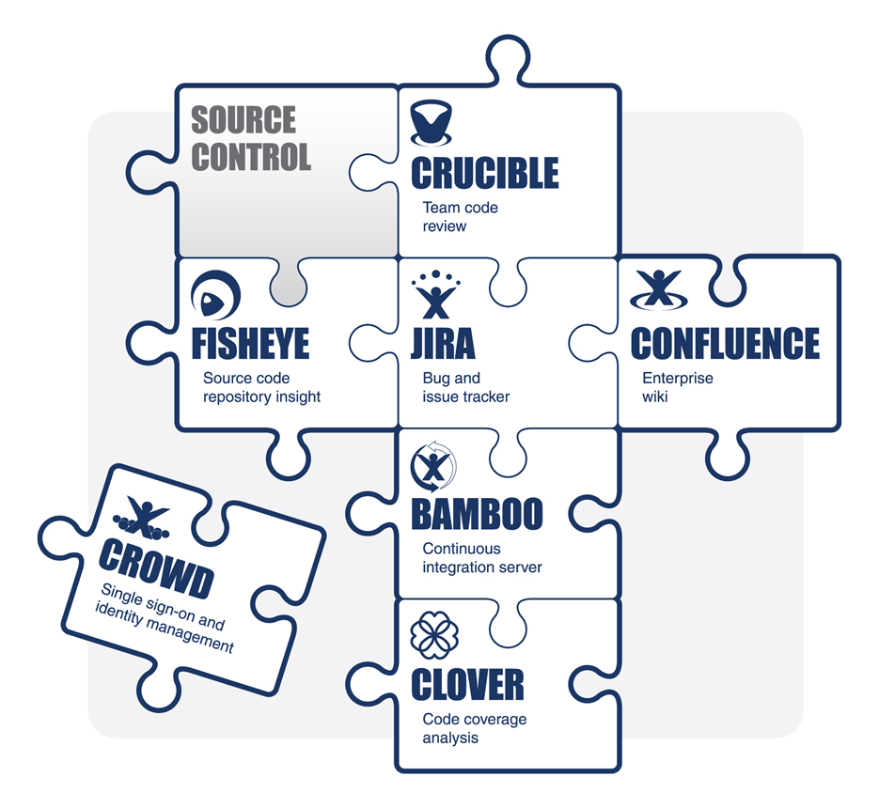
The Atlassian Product Family
The Atlassian Product Family

Slide 6
So what is JIRA?
Who is Atlassian?
JIRA Overview
JIRA Concepts
Agenda
Effective JIRA Issues
Live Demonstration
Q & A

Slide 7
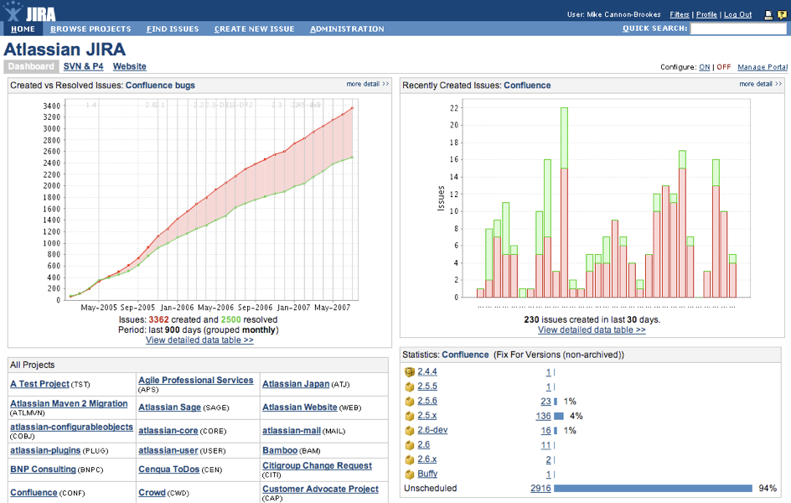
So what is JIRA?
JIRA Overview
We could not find an issue tracker that met our own needs
Started out as a bug tracking system
Highly flexible and customisable platform
Designed for real issues

Slide 8
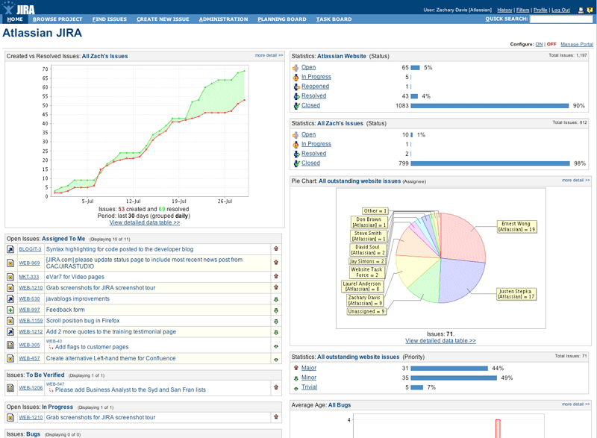
There are many reasons JIRA is so popular, this is only some of them
JIRA Benefits
Lightweight
Flexible
Customisable
Source Access

Slide 9
Architecture
JIRA Architecture
Web-based application
  No client software / OS independent
Open
  Supports many application/database servers
  SOAP, XML-RPC, Java API Interfaces
  Plugin sub-system

Slide 10






An issue tracking platform for all teams
One Application. Many uses.
Issue Tracking
Help-desk / Support / Customer Service
Project Management
Task Tracking
Requirements Management
Workflow / Process Management

Slide 11





























Over 9,000 customers in more than 100 countries
Who Uses JIRA?

Slide 12
Let’s start with the basics
Who is Atlassian?
JIRA Overview
JIRA Concepts
Agenda
Effective JIRA Issues
Live Demonstration
Q & A

Slide 13
Let’s start with the basics
JIRA Concepts
Project Categories
Level 1
Projects
Level 2
Components (sub-section)
Versions (milestones)
Issues
Level 3
Issue Types
Issue Types
Sub-Tasks
Sub-Tasks
Sub-Tasks
Sub-Tasks
Level 4

Slide 14
Let’s start with the basics
JIRA Concepts
Project Categories
Level 1
Projects
Level 2
Components (sub-section)
Versions (milestones)
Issues
Level 3
Issue Types
Issue Types
Sub-Tasks
Sub-Tasks
Sub-Tasks
Sub-Tasks
Level 4

Slide 15
Let’s start with the basics
JIRA Concepts
Project Categories
Level 1
Projects
Level 2
Components (sub-section)
Versions (milestones)
Issues
Level 3
Issue Types
Issue Types
Sub-Tasks
Sub-Tasks
Sub-Tasks
Sub-Tasks
Level 4

Slide 16
Let’s start with the basics
JIRA Concepts
Project Categories
Level 1
Projects
Level 2
Components (sub-section)
Versions (milestones)
Issues
Level 3
Issue Types
Issue Types
Sub-Tasks
Sub-Tasks
Sub-Tasks
Sub-Tasks
Level 4

Slide 17
Let’s start with the basics
JIRA Concepts
Project Categories
Level 1
Projects
Level 2
Components (sub-section)
Versions (milestones)
Issues
Level 3
Issue Types
Issue Types
Sub-Tasks
Sub-Tasks
Sub-Tasks
Sub-Tasks
Level 4

Slide 18
JIRA For An Aerospace Engineering Project
JIRA Conceptual Example
Project Categories
Aeronautical Division
Level 1
Project
Jet Fighter
Level 2
Components
Wings, Landing Gear, Fuselage
Versions
Design, Construction, Test Flight
Issues
Level 3
Task
Bug
Verification Request
Sub-Tasks
Sub-Tasks
Sub-Tasks
Sub-Tasks
Sub-Tasks
Sub-Tasks
Level 4

Slide 19
JIRA For A Software Development Project
JIRA Conceptual Example
Project Categories
Information Technology
Level 1
Project
Time Tracking Application
Level 2
Components
User Interface, Reports, Workflow
Versions
0.1, 0.2, 1.0, 1.1, 1.1.1, 2.0
Issues
Level 3
New Feature
Bug
Support Ticket
Sub-Tasks
Sub-Tasks
Sub-Tasks
Sub-Tasks
Sub-Tasks
Sub-Tasks
Level 4

Slide 20
Hundreds of plugins
Who is Atlassian?
JIRA Overview
JIRA Concepts
Agenda
Effective JIRA Issues
Live Demonstration
Q & A

Slide 21

Today there are over 2000 issues in JIRA!
Effective JIRA Issues
Search
      (For duplicates)
Notes:
Before entering a bug - search for duplicates!!
2000+ bugs
Maybe this bug has been entered (and possibly resolved?)

Slide 22

Developers should avoid writing quick-and-dirty issues.
Effective JIRA Issues
Be Verbose
(Summary and description)
Notes:
Developers should avoid writing quick-and-dirty issues.
What happens when priorities change, and the problem isn't looked at for the next six month
Write good summaries/descriptions –
You should err in favour of putting too much information in a summary, rather than too little.
Bad: Space export doesn't work
Good: Space export fails with NullPointerException when performed by the anonymous user

Slide 23

Entering good bugs makes everyone’s job easier!
Effective JIRA Issues
Screenshots
      (Picture = 1,000 words)

Slide 24

Entering good bugs makes everyone’s job easier!
Effective JIRA Issues
Attachments
      (Include important docs)

Slide 25
Nothing beats the real thing
Who is Atlassian?
JIRA Overview
JIRA Concepts
Agenda
Effective JIRA Issues
Live Demonstration
Q & A

Slide 26
Fire away!
Who is Atlassian?
JIRA Overview
JIRA Concepts
Agenda
Effective JIRA Issues
Live Demonstration
Q & A

