Slide 1

Introducing jQuery
Jim Priest
NIEHS AppDev Meeting
June 26th, 2008

Slide 2
About
Jim Priest
Application Developer at Lockheed Martin
Online: http://www.thecrumb.com
  Blog
  Wiki

Slide 3
Introduction
Unobtrusive JavaScript
Separation between web page structure/content and presentation.
Graceful degradation in browsers where the advanced JavaScript functionality will not work as desired.
Progressive enhancement.
jQuery
A lightweight JavaScript library that emphasizes interaction between JavaScript and HTML.
Notes:
Lightweight footprint - About < 20KB in size (compressed)
Cross-browser - IE 6.0+, FF 1.5+, Safari 2.0+, Opera 9.0+
FIXES crossbrowser workarounds.
CSS3 Compliant - Supports CSS 1-3 and basic XPath

Slide 4

Goal
Build application that works WITHOUT JavaScript
( Develop for least capable device FIRST )
Use JavaScript to ENHANCE application
Notes:
No Javascript
Accessibility
Some mobile devices = no JS.
Firewall
Browser settings, plugins (NoScript)

Slide 5
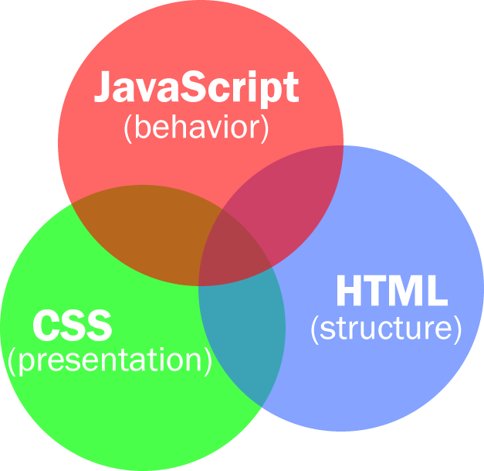
Steps
Notes:
MVC = HCJ

Slide 6
Example
Bad:
<a href="javascript:window.open(‘popup.html', 'popup','height=400,width=400');">read more</a>
Good:
<a href=“popup.html“ class=“popup”>read more</a>
Notes:
Graceful degradation - Avoid inline JavaScript !!!
Assume JavaScript is DISABLED! The site remains usable without JavaScript
All code is contained in external .js files
JavaScript dependent elements are dynamically added to the page = JQUERY

Slide 7
jQuery
jQuery(document).ready() or…
$(document).ready() or…
$().ready(function() or…
$(function() {
$('a.popup').click(function() {
    var href = jQuery(this).attr('href');
    window.open(href, 'popup',
    'height=500,width=400,toolbar=no');
    return false;
});
});
Notes:
$(document).ready() Replacement for window.onload event
Executes as soon DOM is ready

Slide 8
jQuery Basics
jQuery: Select something then act upon it.
CSS Selectors:
$('#nav')
$('div#intro h2')
jQuery Custom Selectors:
:first, :last, :even, :odd
:hidden, :visible
:even, :odd
Many more!
Notes:
- jQuery provides enhanced methods for traversing the DOM

Slide 9
More jQuery
Collections
$(‘#foo’) – returns a jQuery collection
Methods - do stuff!
Chaining
$(’#foo’).show(‘bar’).hide(‘me’);
Events
blur() click() keydown()… many more!
Ajax & Plugins
Notes:
- Most jQuery methods operate on all of the matched elements in the collection
- Most jQuery methods return another jQuery object - often one representing the same collection. This means you can chain methods together.
Methods:
Introspectors – (GETTER) return data about the selected nodes css(‘color’)
Modifiers – (SETTER) alter the selected nodes in some way .css('color', 'red')
Navigators - traverse the DOM, change the selection .parent() .next()
DOM modifiers - move nodes within the DOM .append() .insertAfter()

Slide 10
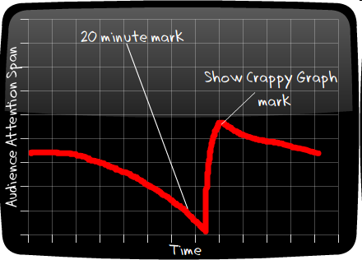
Code
Notes:
- Most jQuery methods operate on all of the matched elements in the collection
- Some methods return results from the first matched element
- Most jQuery methods return another jQuery object - often one representing the same collection. This means you can chain methods together.

Slide 11
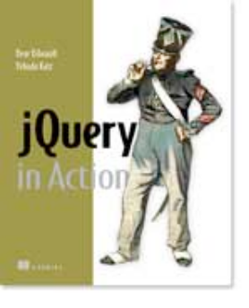

Books
jQuery in Action by Bear Bibeault, Yehuda Katz, and John Resig (Paperback - Feb 7, 2008)
Learning jQuery: Better Interaction Design and Web Development with Simple JavaScript Techniques by Karl Swedberg and Jonathan Chaffer (Paperback - Jun 29, 2007)

Slide 12
Resources
jQuery | http://jquery.com/
jQuery UI | http://ui.jquery.com/
Learning jQuery | http://www.learningjquery.com/
15 Days of jQuery | http://15daysofjquery.com/
CFJS | http://cfjs.riaforge.org/ ColdFusion Javascript Functions
Tutorials | http://docs.jquery.com/Tutorials

Slide 13
Questions?

