Slide 1
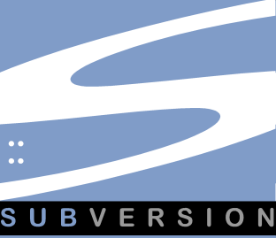
SVN: Subversion
Jim Priest
January, 2012

Slide 2

Introduction
Jim Priest
Manage Triangle Area ColdFusion User Group (TACFUG)
Developer at CGI Federal
Organize NCDevCon – Annual developer conference in Raleigh
Blog: thecrumb.com
Subversion (SVN) - Jim Priest

Slide 3
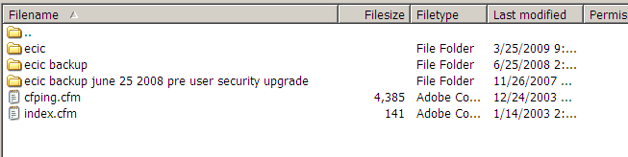
You Know You’ve Done This
site-backup.zip
index-1-23-12.html
compliance.bak
logo-old.png
Subversion (SVN) - Jim Priest
Notes:
Who’s done this before?
Be honest

Slide 4
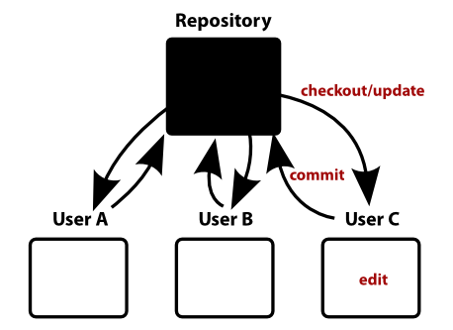
What Is Subversion?
Subversion (SVN) - Jim Priest
Notes:
Source Control
Version Management
Management of changes to documents over time
CVS First publicly released July 3, 1986; based on RCS

Slide 5

Why Use Source Control?
Subversion (SVN) - Jim Priest
Notes:
The question here is really “WHY WOULD YOU NOT USE VERSION CONTROL”
It provides one method for an entire team to use; everybody operates under the same 'ground rules'.
Changes are orderly vs. chaotic, saving development time
The ability to track changes promotes accountability and makes it easier to find the right persom to solve problems in the materials maintained.
A list of exact changes made can be generated quickly and easily, making it easier to advise users of the information on how it has changed from version to version.
It is easy to 'roll back' to an earlier version of the information, if a serious mistake was made during a change.

Slide 6



Workflow Basics
Checkout
Update
Commit
Subversion (SVN) - Jim Priest

Slide 7
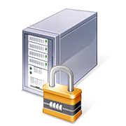



Checkout
Repository
You
( Working Copy )
Subversion (SVN) - Jim Priest

Slide 8


Update
Subversion (SVN) - Jim Priest

Slide 9
Commit
You
Repository
Subversion (SVN) - Jim Priest
Notes:
Example of what gets committed (stored in SVN) – w/paper
Commits are atomic – all or nothing!
GOTCHAS
CLEANUP
RENAME
DELETE
ASK FOR HELP

Slide 10






Organization
Repository
Project 1
trunk
tags
branches
Project 2
trunk
tags
branches
Subversion (SVN) - Jim Priest

Slide 11
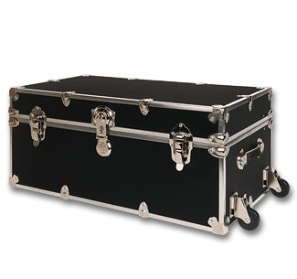

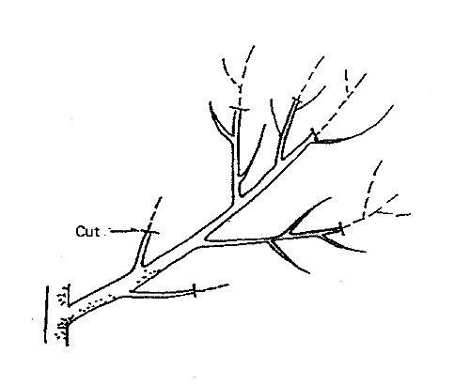
Trunk / Tags / Branches
Subversion (SVN) - Jim Priest

Slide 12

Merge
Subversion (SVN) - Jim Priest

Slide 13
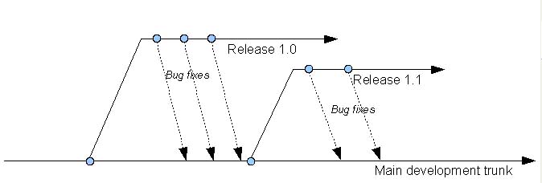
Merge Madness
Subversion (SVN) - Jim Priest

Slide 14
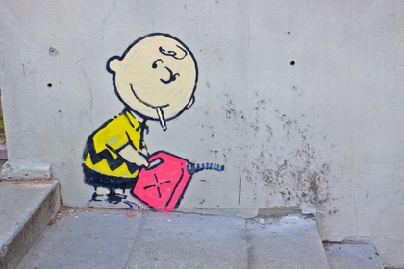
Don’t Be Afraid To Try…
Subversion (SVN) - Jim Priest

Slide 15
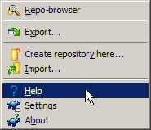
Resources
Official Site: http://subversion.apache.org
TortoiseSVN:
  Download: http://tortoisesvn.net
  Read the included HELP file!
    Daily Use Guide
    Getting Started
Subversion (SVN) - Jim Priest

Slide 16
The End
Questions?
Subversion (SVN) - Jim Priest

