Slide 1

Ant: Another Neat Tool
Jim Priest
ColdFusion Meetup Group
March 20th, 2008

Slide 2

Introduction
Jim Priest
Application Developer at Lockheed Martin
CFEclipse Team
http://www.thecrumb.com
  Blog
  Wiki

Slide 3

What Is Ant?
Q: What are ants good at?
A: Doing small, short, repetitive tasks!
Notes:
Written by James Duncan Davidson on an airplane
Open source, Java-based Build tool from Apache
Files are written in XML
‘make’ on Unix systems
Platform independent
Ant engine translates to OS specific commands
Extensible

Slide 4

Why Use Ant?
Make the computer do the work
Eliminate human error
Get Automated (not frustrated!)
Notes:
FTP and forget files, etc.
Repeat the SAME task over and over… deploy app to server, rebuild db, etc.

Slide 5

Installing Ant
Download
http://ant.apache.org
RTFM
Manual - http://ant.apache.org/manual/
FAQ - http://ant.apache.org/faq.html
Ant In Anger – located in /ant/docs directory
Notes:
Read the docs – they are good!
And in Anger summary…

Slide 6

Running Ant
Type “ant” at the command line
ant –diagnostics
ant –help (-h)
ant –version (-v)
ant –projecthelp (-p)
Notes:
Running CLI ant… quick flags for help, etc.

Slide 7
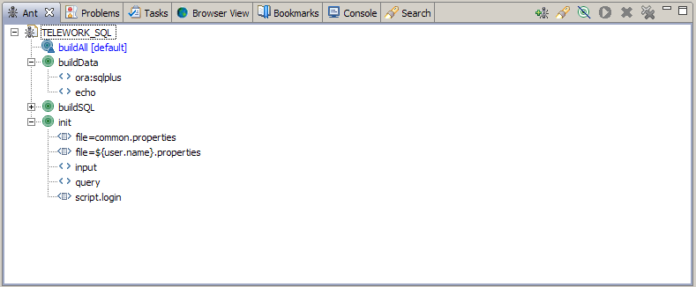
IDE Integration/Alternatives
Eclipse (CFEclipse!) and almost any other Java IDE has Ant integration built-in to the system
Notes:
Refer to each IDE’s documentation for how to use Ant with that IDE
JEdit

Slide 8
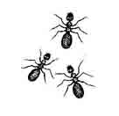
Projects
One project tag per build file
<project name=“Test” default=“init” basedir=“.”>
The project tag defines the following:
Name - the name of the project
Default - the default target to run
Base directory - all activity is relative to the directory specified by basedir. If no basedir is specified, it defaults to “.” (the directory the build file lives in)

Slide 9
Targets
Each project is made up of one or more targets
Targets consist of a series tasks that define specific actions for Ant to take
Targets can depend on each other
    <target name=“sayHelloWorld">
    <echo message="Hello World!"/>
    </target>

Slide 10
Tasks
Tasks do the actual “build” work in Ant
Ant has many built in tasks and the ability to define custom tasks
antcall exec concat copy delete filter get zip/unzip telnet mkdir xmlproperty move sshexec sync touch record mail script echo input replaceregexp sound sql microsoft visual sourcesafe tstamp copy condition ftp
And more!

Slide 11
Examples
Hello World!
Modify, write data to files
Moving files / sync
Zip
Interacting with Subversion
Sending email
Interact with database (Oracle)
StatSVN http://www.statsvn.org/

Slide 12
Resources
My resources
  wiki: http://www.thecrumb.com/wiki/Ant
  del.icio.us: http://del.icio.us/thecrumb/ant
Apache Ant Online
  Manual: http://ant.apache.org/manual/index.html
  FAQ: http://ant.apache.org/faq.html

Slide 13
The End
Questions?

