Slide 1
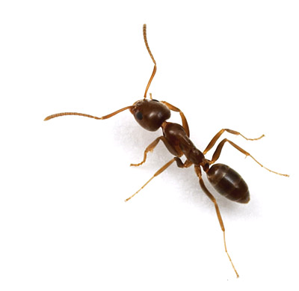
Ant: Another Neat Tool
Jim Priest
Triangle ColdFusion User Group (TACFUG)
June 25th, 2009

Slide 2

Introduction
Jim Priest
Application Developer at SRA
CFEclipse Team
http://www.thecrumb.com
  Blog
  Wiki

Slide 3
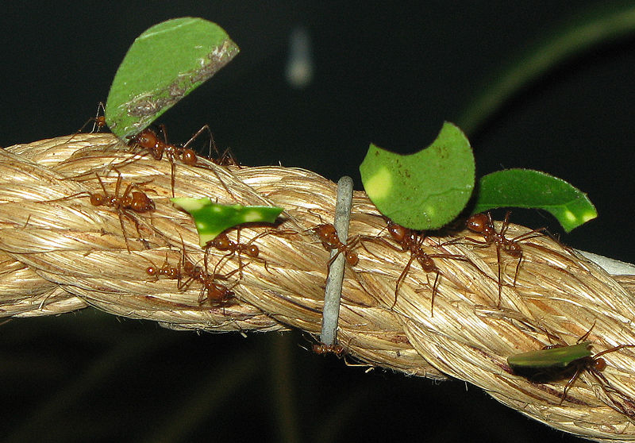
What Is Ant?
Notes:
Written by James Duncan Davidson on an airplane
Open source, Java-based Build tool from Apache
Files are written in XML
‘make’ on Unix systems
Platform independent
Ant engine translates to OS specific commands
Extensible

Slide 4
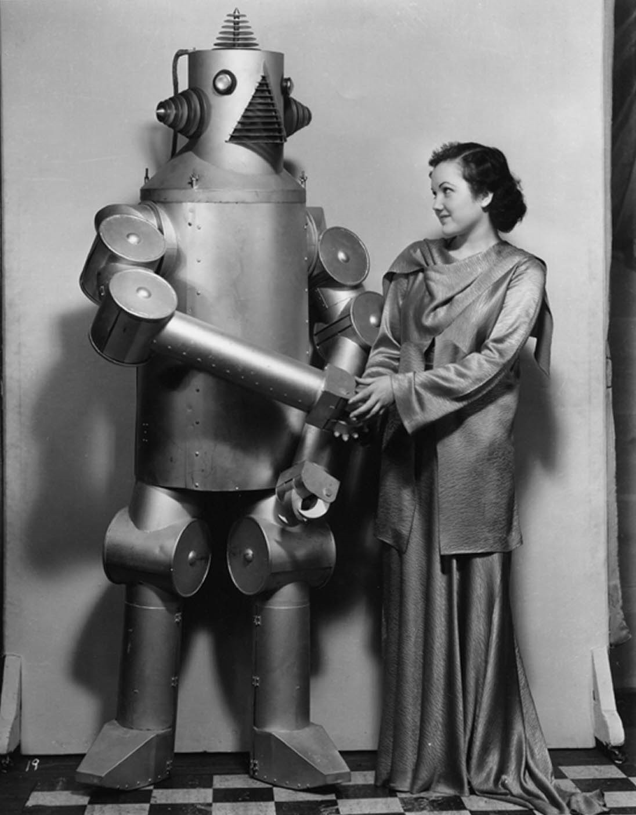
Why Use Ant?
Notes:
FTP and forget files, etc.
Repeat the SAME task over and over… deploy app to server, rebuild db, etc.

Slide 5
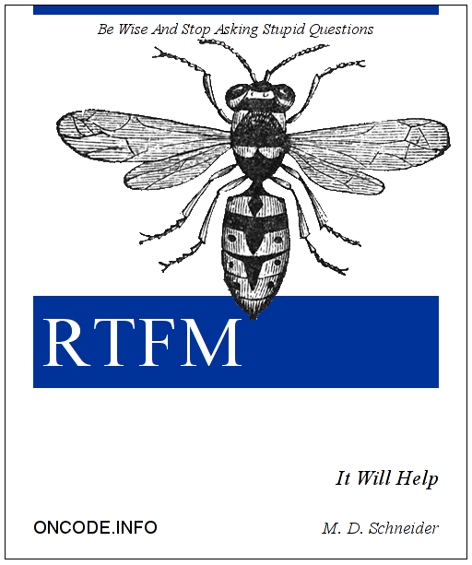
Installing Ant
Notes:
Read the docs – they are good!
And in Anger summary…

Slide 6

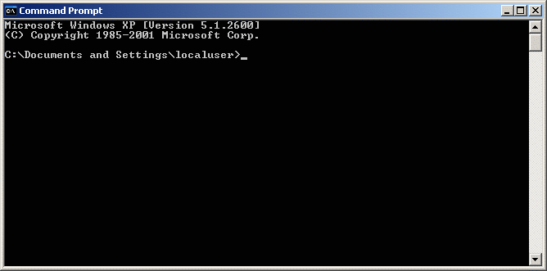
Running Ant
Notes:
Running CLI ant… quick flags for help, etc.

Slide 7
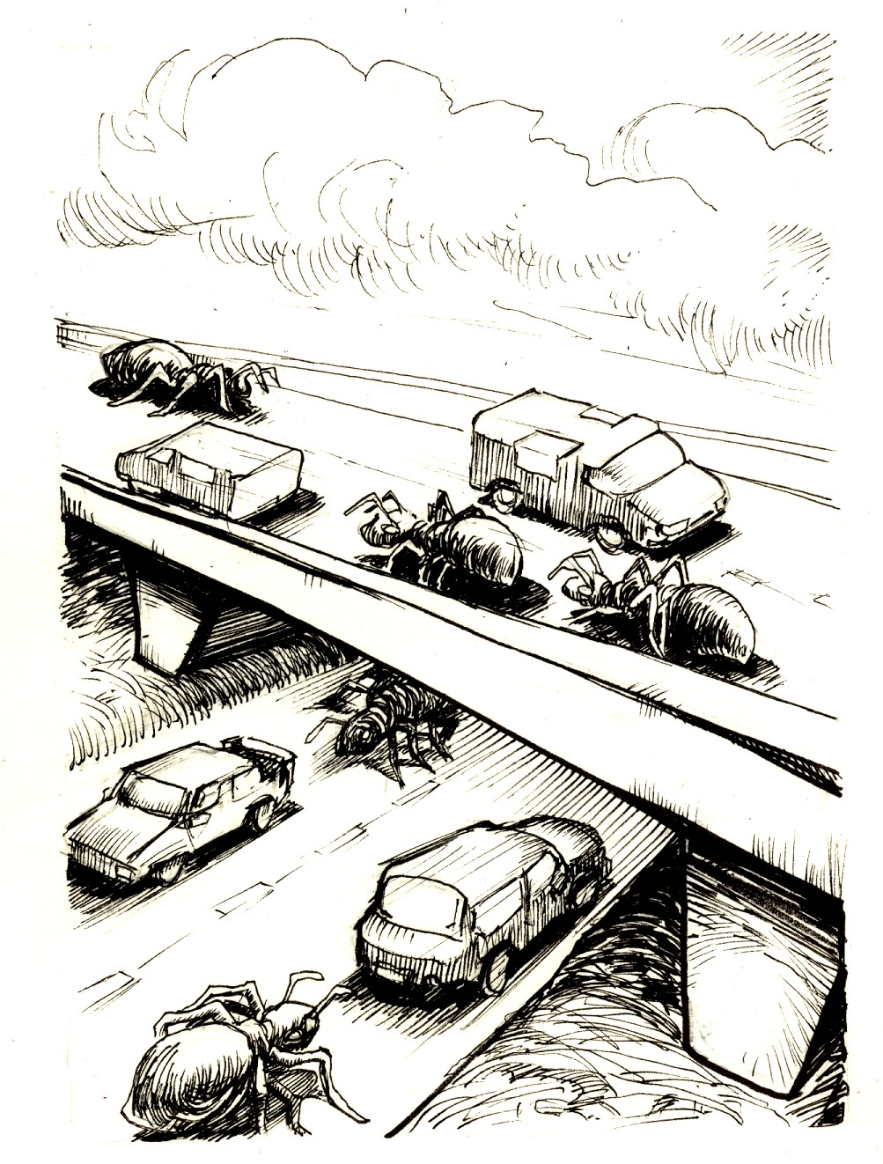
Under The Hood
PROJECTS
TARGETS
TASKS

Slide 8
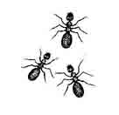

Examples
Hello World!
Modify, write data to files
Moving files / sync
Zip
SVN
Email
Database
MacroDef

Slide 9
Resources
My resources
  wiki: http://www.thecrumb.com/wiki/Ant
Apache Ant Online
  Manual: http://ant.apache.org/manual/index.html
  FAQ: http://ant.apache.org/faq.html

Slide 10

The End

