Slide 1

Selenium: Application Testing
Jim Priest
Triangle Area ColdFusion User Group
November 6th, 2007

Slide 2
About Me
Jim Priest
Application Developer at Lockheed Martin
http://www.thecrumb.com
  Blog
  Wiki

Slide 3


Introduction
What Is Selenium?
Selenium is a test tool for web applications. Selenium tests run directly in a browser, just as real users do. And they run in Internet Explorer, Mozilla and Firefox on Windows, Linux, and Macintosh.
Browser compatibility testing. Test your application to see if it works correctly on different browsers and operating systems.
System functional testing. Create regression tests to verify application functionality and user acceptance.

Slide 4
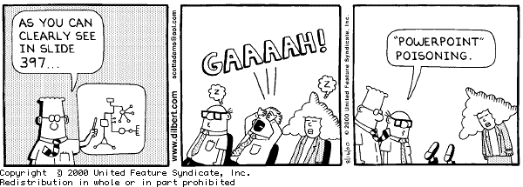
Examples
Powerpoint sucks
Let’s look at some examples!!!!

Slide 5
Resources
My resources
  wiki: http://www.thecrumb.com/wiki/Selenium
  del.icio.us: http://del.icio.us/thecrumb/selenium
OpenQA: Selenium
  http://www.openqa.org/selenium

Slide 6
The End
Questions?

